Slide 1
New drugs for individuals with multi-resistant virus
6 APRIL 2020
Faculty
  Pedro Cahn, Buenos-Aires, Argentina
  Anton Pozniak, London, UK
  François Raffi, Nantes, France

Slide 2
Faculty Disclosures
Pedro Cahn has received research support for research grants: ViiV-Merck-Abbvie and for ad boards: ViiV - Merck
Anton Pozniak has received research support and/or honoraria for consulting and/or advisory boards from ViiV, Merck, Gilead, Janssen, Theratechnologies
François Raffi has received research support and/or honoraria for consulting and/or advisory boards from Correvio, Gilead Sciences, Janssen, Merck, MSD, Pfizer, Theratechnologies and ViiV Healthcare

Slide 3
New Drugs for individuals with multi-resistant virus
Epidemiological data
News drug for multi-resistant HIV
Practical management
  Patient’s assessment
  Constructing a new active ART
  Follow-up

Slide 4
New Drugs for individuals with multi-resistant virus
Epidemiological data
News drug for multi-resistant HIV
Practical management
  Patient’s assessment
  Constructing a new active ART
  Follow-up

Slide 5
History of MDR HIV
Before the advent of HAART, MDR HIV was frequent and resulted from sequential, partially suppressive ARV regimens ^{1,2}
  Combination ART permitted to achieve complete and prolonged viral suppression in most HIV-infected subjects, but in those exposed to prior sub-optimal therapy, accumulation of HIV resistance and MDR HIV still occurred ^{2,3}
  Low-potency ARVs
  Adherence challenges due to toxicity ³
  Extensive cross-resistance within drug classes^{3,4}
With availability of drugs with high genetic barrier (second-generation boosted PIs) and/or of new class (INSTI), less resistance is now being seen
  Virologic suppression can be achieved in most subjects with MDR HIV via wise use of combination regimens ⁴
1. Lima VD, et al. Am J Epidemiol. 2010;172:460-8. 2. Richman DD. Clin Infect Dis. 2016;62:1318-19. 3. Harris M, et al. AIDS Res Treat. 2012:595762. 4. Tang MW, et al. Drugs. 2012;72:e1-e25.

Slide 6
Decrease in Prevalence of MDR HIV in the US in Recent Era of HIV Treatment
Assessment of phenotypic drug resistance patterns in US samples submitted to Monogram Biosciences for HIV resistance testing from 2003-2012 (N = 62 397)
Resistant Samples (%)
1-Class Resistance
2-Class Resistance
3-Class Resistance
60
60
60
PI
NRTI
NNRTI
PI and NRTI
PI and NNRTI
NRTI and NNRTI
50
50
50
40
X
40
40
X
X
X
X
30
X
30
X
X
X
X
X
30
X
X
X
X
X
X
X
X
X
20
20
X
X
X
X
20
X
X
X
X
X
X
X
X
X
X
X
X
X
X
X
X
X
10
X
X
10
X
X
10
X
X
X
X
X
X
X
X
X
X
X
X
X
X
X
X
X
X
X
X
X
X
X
X
X
0
0
0
2003
2011
2004
2005
2006
2007
2008
2009
2003
2011
2010
2012
2003
2004
2005
2006
2007
2008
2009
2010
2011
2012
2004
2005
2006
2007
2008
2009
2010
2012
Paquet AC. Antivir Ther. 2014;19:435-41

Slide 7
Reduction in Virological Failure on 1st line ART in France
Proportion of HIV patients experiencing virological failure fell to only 9.7% during a 15 year period
(1997 and 2009-2011)
The decrease in virological failure can be attributed to:
  Better ARV drugs
  National guidelines recommending rapid management of VF after mid-2000
Proportion of patients experiencing at least 1 VF among patients having received ARV therapy for at least 6 months
Risk of virologic failure according
to 1st line ART (OR, 95 % CI)
70
6.0
5.0
60
4.0
50
3.0
40
2.0
30
1.0
20
10
0.5
0
Mono or dual
NRTI therapy
3 NRTI
2 NRTI + PI
2 NRTI + PI/r
2 NRTI
+ INSTI
2 NRTI
+ NNRTI (ref)
Other
1997-98
1999-00
2001-02
2003-04
2005-06
2007-08
2009-10
VF defined as 2 consecutive HIV-RNA values > 500 c/mL at least 6 months after treatment initiation
Delaugerre C. Clin Infect Dis 2015;60:463-72
Notes:
interquartile range
pVL = plasma viral load

Slide 8
Prevalence of Drug Resistance in Switzerland: 15 year Cohort Analysis
Estimated prevalence of drug resistance
11,084 ART-experienced patients (Swisss HIV cohort)
The prevalence of emergent drug resistance decreased from 57%
in 1999 to 37.1% in 2013
The prevalence of triple drug resistance decreased from 9.0% in 1999 to 4.4% in 2013, and was < 0.4% in patients who initiated ART after 1999
15 -
15 -
15 -
15 -
10 -
10 -
10 -
10 -
Prevalence of 3-class
resistance %
5 -
5 -
5 -
5 -
0
0
0
0
2009
2013
2013
2013
2013
2011
2009
2011
2009
2005
2011
2009
2011
2007
2005
2007
2005
2003
2003
2003
2007
2007
2001
2001
2001
1999
1999
1999
All individuals
Years of ART initiation
8000 -
8000 -
Before 1999
8000 -
1999-2006
8000 -
2007-2013
6000 -
6000 -
6000 -
6000 -
individuals, No
4000 -
4000 -
4000 -
4000 -
All patients
Ever VF or exposure to single or dual-NRTI
Ever GRT after ART initiation
Ever drug resistance detected
Ever 3-class resistance detected
2000 -
2000 -
2000 -
2000 -
0 -
0 -
0 -
0 -
2009
2013
2013
2013
2013
2011
2009
2011
2009
2005
2011
2009
2011
2007
2005
2007
2005
2003
2003
2003
2007
2007
2001
2001
2001
1999
1999
1999
Scherrer AU. Clin Infect Dis 2016;62:1310-7

Slide 9
Prevalence of multiresistance and limited therapeutic option in patients with HIV RNA > 50 c/mL on ART
Multicentric study, France, 5422 patients on ART > 6 months on Oct 1st 2018
HIV RNA > 50 c/mL
  Cumulative resistance genotype
  N active ARV (TDF or ABC, XTC, ≥ 1 NNRTI, ≥ 1 PI/r, ≥ 1 INSTI
  GSS of current ART
  Prevalence of patients with limited therapeutic option (R to ≥ 3/4 classes AND ≤ 2 active ARV
HIV RNA > 50 c/mL, n = 208 (3.8%)
R to ≥ 3/4 classes, n = 17
(8.2% of pts with VL > 50 c/mL)
N of active ARV ≥ 3/5: 85.6 %
GSS of current ART ≥ 3: 68 % ; 2: 24 %
Limited therapeutic option (R to ≥ 3/4 classes
AND ≤ 2 active ARV), n = 9
  4.33 % of patients with VL > 50 c/mL
  0.17 % (95%IC: 0.06 à 0.27) of total population on ART
Extrapolation to all patients on ART in France (112 877 in 2016)
Estimation of population with limited therapeutic option in France = 192 (95% CI: 68-305)
Robineau O, CROI 2020, Abs. 522

Slide 10
Multiresistance on ART in Europe – 2019 data
EuResist data base, 2008-2019
6 European countries (Belgium, Germany, Italy, Luxembourg, Portugal, Sweden)
4594 genotypes in 3414 patients: cumulative genotype
Prevalence of 4-class resistance
% 4-class R
N genotypes
16
3 000
X²: p < 0.001
12
2 000
8
5.6%
2.4%
(1.8-3.1)
1 000
4
0
0
2008
2009
2010
2011
2012
2013
2014
2015
2016
2017
2018
2019
Zazzi M, CROI 2020, Abs. 523

Slide 11
Multiresistance on ART in Europe – 2019 data
4-Class Resistance
Multivariate Analysis of Factors Associated With 4-class resistance
Variable* | 4CR (N = 85) | No 4CR (N = 3329) | Multivariate OR | p
Median nadir CD4+ cell count | 49 | 150 | 0.99 (0.99-1.00) | 0.005
Prior mono-dual NRTI therapy, % | 69.4 | 32.1 | 2.23 (0.94-5.58) | 0.075
Mean no. prior virologic failures (pVL > 50 c/mL), N (± SD) | 4.1 (3.3) | 1.3 (1.7) | 1.29 (1.13-1.47) | < .001
Zazzi M, CROI 2020, Abs. 523

Slide 12
MDR Still a Significant Concern in HIV
Despite modern ARV combination regimens changing the face of the HIV infection, MDR HIV remains relevant
Contributions to MDR HIV in today’s patients include
  Nonadherence
  Inadequate past treatment in pre- and early-HAART eras
  Transmission of harbored MDR HIV variants
  Pharmacokinetic factors
Due to cross-resistance within a drug class, fully active ARV options diminish with each successive viral failure
Patients harboring MDR HIV pose increased risk
  of drug-resistant virus transmission
  of HIV disease progression (AIDS)

Slide 13
New Drugs for individuals with multi-resistant virus
Epidemiological data
News drug for multi-resistant HIV
Practical management
  Patient’s assessment
  Constructing a new active ART
  Follow-up

Slide 14
New Agents for Patients With MDR HIV
Agent | Status | Mechanism of Action | Mode of administration
Ibalizumab | Approved | Humanized anti-CD4 receptor mAb | IV Q2W
Fostemsavir | Phase III (under review FDA/EMA) | Prodrug of temsavir; binds gp120 to prevent CD4+ cell attachment and HIV entry | po bid
Islatravir | Phase III | NRTTI (nucleoside reverse transcriptase translocation inhibitor) | po qd / po once weekly ?
PRO 140 (leronlimab) | Phase IIb/III | Humanized anti-CCR5 mAb | SC once weekly
GS-6207 | Phase II | Capsid inhibitor | po 3/week then SC Q6M
Anti-CD4 adnectin (GSK3732394) | Phase I | Multi-specific inhibitor of HIV entry | Long acting ?

Slide 15
Ibalizumab in Pretreated Patients Infected With Multidrug-Resistant HIV
146
Inclusion criteria
  On stable ARV > 6 months, pVL > 1 000 c/mL (mean baseline CD4: 150/mm³)
  Documented resistance ≥ 3 classes of ARV, with susceptibility to ≥ 1 ARV
Continuation on ongoing ART
Optimised ARV therapy
IBA 2000 mg iv
IBA 800 mg iv every 2 weeks
D0
D7
D14
D21
W25
Primary endpoint: % of patients with  pVL ≥0.5 log₁₀ c/mL at D7 of IBA add-on
→ 33/40 (83%) achieved response (median pVL : 1.1 log₁₀ c/mL) (Emu B et al., NEJM, 2018)
W96 results (N = 22)
  Median CD4 increase: + 45/mm³
  % with pVL < 50 c/mL at W25 maintained up to W96: 56%
   pVL from IBA + OT D0 : - 2.5 log₁₀ c/mL at W25 ; - 2.8 log₁₀ c/mL at W96
  Good safety profile
Emu B, CROI 2019, Abs. 485

Slide 16
Ibalizumab in Pretreated Patients Infected With Multidrug-Resistant HIV
147
Virologic response at W25 according to OT component
  Patients with genotypic susceptibility to DTG (N = 22)
    DTG in OT: pVL < 50 c/ml at W25: 11/16 (69%)
    No DTG in OT: pVL < 50 c/ml at W25: 2/6 (33%)
  Patients with genotypic susceptibility to DRV/r (N = 13)
    DRV/r in OT: pVL < 50 c/ml at W25: 3/8 (38%)
    No DRV/r in OT: pVL < 50 c/ml at W25: 2/5 (40%)
Emu B, CROI 2019, Abs. 485

Slide 17
Ibalizumab in Pretreated Patients Infected With Multidrug-Resistant HIV
% HIV RNA at W25, according
to CD4 subgroup at baseline
Adverse Event at W25 | N patients (%)
Any adverse event | 32 (80)
Assessed as related to ibalizumab | 7 (18)
Leading to discontinuation of ibalizumab | 5 (13)
Occurring in patients who died | 4 (10)
Serious adverse event | 9 (23)
%
100
< 50 c/mL
< 200 c/mL
70
60
50
40
30
20
10
0
ITT Patients
(N = 40)
Baseline CD4 count
< 50 cells/mm³
(N = 17)
Baseline CD4 count
> 50 cells/mm³
(N = 23)
Emu B. NEJM 2018; 379:645-54

Slide 18
Ibalizumab (Trogarzo®)
March 2018: FDA approved as IV injection for heavily treatment–experienced adults with multidrug-resistant HIV infection and virologic failure ¹
Recommendations from guidelines
  DHHS: “Patients with ongoing detectable viremia who lack sufficient treatment options to construct a fully suppressive regimen may be candidates for the recently approved CD4 postattachment inhibitor ibalizumab” ²
  IAS-USA: “Ibalizumab… may be useful as a fully active agent for patients with multiclass-resistant virus” ³
  EACS Guidelines (Nov 2019) ; “If limited options, consider experimental and new drugs (avoid functional monotherapy). New drugs with promising results include humanised CD4+-binding antibody ibalizumab and attachment inhibitor fostemsavir (currently not licensed by the EMA)”
Needs to be combined with other active agents to achieve viral suppression
Take advantage of the IV infusion every 2 weeks to intensify adherence to other components of the salvage regimen
1. Ibalizumab PI. 2. DHHS guidelines. October 2018. 3. Saag. JAMA. 2018;320:379-96.

Slide 19
BRIGHTE: Fostemsavir in Heavily Pretreated Patients Infected With Multidrug-Resistant HIV
149
Baseline characteristics
  Median CD4: 80/mm³ (IQR: 11-202)
  Median pVL: 4.6 log₁₀ c/mL (IQR : 3.9-5.0)
Prior exposure to different classes
Classes with no ARV fully active
Fully active ARV in Optimize ARV Treatment
Randomized cohort
Non randomized cohort
%
%
%
100
0
1
2
100
99
98
98
100
100
99
100
99
100
98
94
94
95
81
91
88
80
80
80
81
85
75
74
78
68
60
52
60
60
42
40
40
40
39
40
19†
29
20
20
26
20
6
0
0
0
Randomized cohort
(N = 272)
Non randomized cohort
(N = 99)
NRTI
NNRTI
PI
INSTI
MVC
ENF
0
NRTI
NNRTI
PI
INSTI
MVC
ENF
† 15/19 combination with Ibalizumab
† 15/19 : combination to ibalizumab
Kozal M. NEJM 2020: 382: 1232-43 ; Lataillade M. IAS 2019, Abs. MOAB0102

Slide 20
BRIGHTE: Fostemsavir in Heavily Pretreated Patients Infected With Multidrug-Resistant HIV
151
pVL < 40 c/mL at W96, ITT-E snapshot
Change in OT for lack of efficacy = failure
Change in OT for lack of efficacy permitted
%
Randomized cohort (N = 272)
%
Randomized cohort
100
100
85
86
90
88
80
53
54
53
60
80
79
60
60
62
67
40
40
57
20
20
pVL < 400 c/mL
0
0
D0
W24
W48
W72
W96
D0
W24
W48
W72
W96
%
%
Non randomized cohort
100
Non randomized cohort (N = 99)
100
80
80
61
68
60
53
55
60
37
38
35
37
59
40
40
42
48
49
20
20
pVL < 400 c/mL
0
0
D0
W24
W48
W72
W96
D0
W24
W48
W72
W96
Lataillade M. IAS 2019, Abs. MOAB0102

Slide 21
BRIGHTE: Fostemsavir in Heavily Pretreated Patients Infected With Multidrug-Resistant HIV
Among the 71 participants randomized with CD4 < 50/mm³,
56% achieved CD4 > 200/mm³ at W96
Safety at W96
 | Randomized cohort (N = 272) | Non randomized cohort (N = 99)
Grade 2-4 adverse event treatment-related, % | 21 | 22
Discontinuation for adverse event, % | 5 | 12
Death *, % | 4 | 17
* 18/29 deaths due to AIDS event of acute sepsis
No cases of anti-ibalizumab antibodies
Lataillade M. IAS 2019, Abs. MOAB0102

Slide 22
MK-8591 is more potent against most resistant mutants than approved NRTIs
Sauvage
M184I
M184V
L74V
L74V + M184V
Q151M
Q151M + M184I/V
69ins
69ins + M184I/V
K65R
K65R + M184I/V
K65R + L74I + M184V
K65R + L74V + Y115F + M184V
K65R + 69Ins + Q151M
K65R + 69ins + Q151M + M184V
K70E + M184I/V
2 TAMs + L74I
2 TAMs + M184I
2 TAMs + L74I + M184V
3 TAMs
3 TAMs + L74V
3 TAMs + M184I/V
4 TAMs
4 TAMs + M184I
4 TAMs + M184V
5 TAMs + L74V
6 TAMs
6 TAMS + M184I/V
MK-8591
AZT
TAF
3TC
0,01
0,1
1,0
10
100
1 000
Calculated hPBMC IC₅₀ (nM)

Slide 23
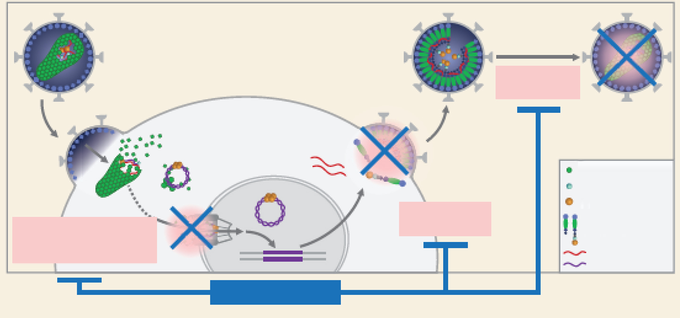
GS-6207, capside inhibitor
GS-6207, 1st capsid inhibitor
EC₅₀ = 50 pM
Capsid
assembly
Capsid
Reverse transcriptase
Intgrase
Virus
production
Gag/Gag-Pol
(capsid precursors)
Capsid Dissasembly
and
Nuclear Transport
HIV RNA
HIV DNA
GS-6207
Inhibition of multiple steps of viral replication
Mulato A, CROI 2019, Abs. 480 ; Daar ES, IAS 2019, Abs. LBPEB13

Slide 24
GS-6207, capsid inhibitor
PK/PD
Phase 1b study, SC GS-6207 (double-blind)
  Single-dose (20 mg, 50 mg, 150 mg, 450 mg, 750 mg)
Mean change in HIV RNA, log₁₀ c/mL (95% CI)
Dose-response curve
(Maximal reduction HIV RNA (log₁₀ c/mL)
SC GS-6207 single dose
Start B/F/TAF
3.0
0.0
2.5
-0.5
2.2
2.3
Placebo (N = 10)
2.0
-1.0
GS-6207 20 mg (N = 6)
1.8
-1.3
GS-6207 50 mg (N = 6)
1.5
1.8
-1.5
-1.8
GS-6207 150 mg (N = 6)
GS-6207 450 mg (N = 6)
1.4
-2.0
-2.1
GS-6207 750 mg (N = 5)
1.0
-2.3
-2.5
0.5
-3.0
0.0
-3.5
20
50
150
450
750
Dose (mg)
1
2
3
4
5
6
7
8
9
10
Mean D10 concentration
ng/mL (CV %)
Jours
2.6
(41.5)
4.4
(89.9)
13
(39.3)
38
(35.1)
79
(27.7)
Daar E, CROI 2020, Abs. 469

Slide 25
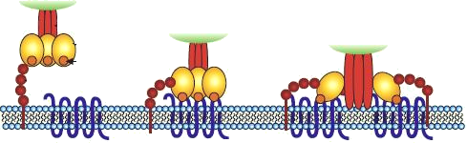
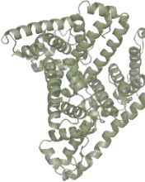

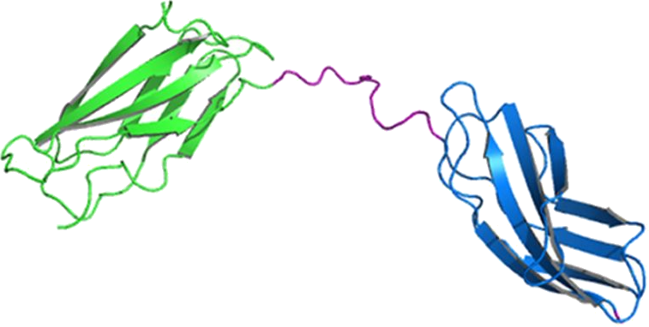
Bound anti-CD4 adnectin inhibitor of HIV-1
Anti-CD4 Adnectin
GSK3732394: multi-specific biologic inhibitor of HIV entry
  Key component = adnectin that binds to CD4 and inhibits downstream actions of gp160
Mechanism of inhibition
  Adnectin binding leads to significant conformational change of CD4, bringing the D1 domain of CD4 in proximity to the host cell membrane surface
  Following gp120-CD4 interaction, conformational changes needed for virus entry are inhibited
  gp120 interaction domains are redirected towards cell membrane, masking CD4 sites that cannot interact anymore with gp160 trimers
  CI₅₀ = 8.5 nM
CD4 liaison
Receptor
liaison
Fusion
virus-cell
gp41
gp120
CD4
Cell membrane
Albumine
Anti-CD4
NH₂
Anti-gp41
Anti-gp41
COOH
Adnectins
Wensel D, CROI 2020, Abs. 20

Slide 26
New Drugs for individuals with multi-resistant virus
Epidemiological data
News drug for multi-resistant HIV
Practical management
  Patient’s assessment
  Constructing a new active ART
  Follow-up

Slide 27
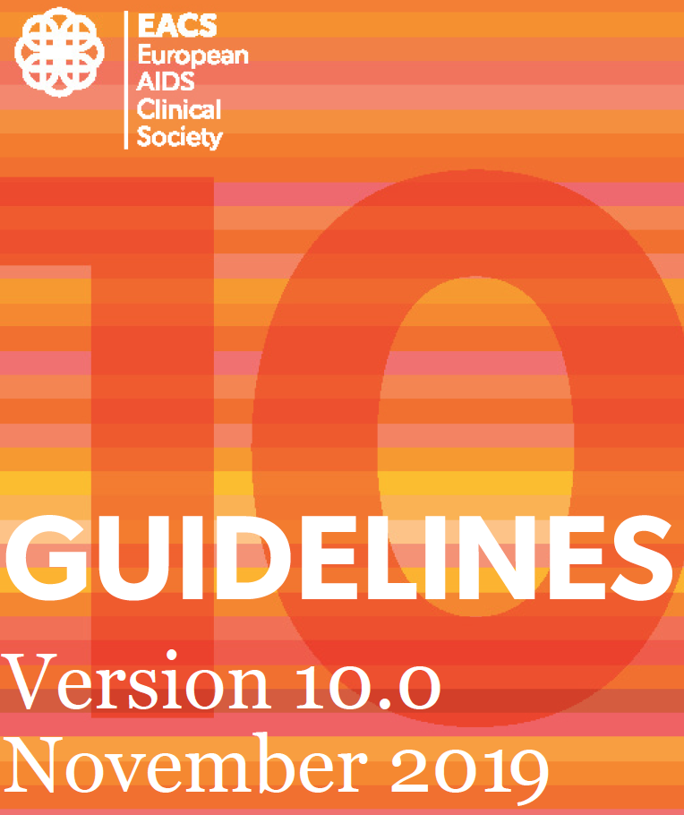
EACS Guidelines 2019
Management of a Patient with MDR HIV
  Review full ARV history
  HIV-1 RNA and CD4+ cell counts over time
    Current CD4 < 100/mm³: urgent need of finding an active ART
  Evaluate adherence, tolerability, drug-drug interactions, drug-food interactions, psychological issues
    Set-up behavioral and adherence interventions
  Perform resistance testing on failing therapy and obtain historical resistance (cumulative genotype) for archived mutations
  Identify treatment options, active and potentially active drugs/combinations
    Review expected potency of the regimen

Slide 28
Selection of New Regimen
New regimen should include 2 (and preferably 3) fully active agents based on cumulative genotype
Definition of fully active
  No predicted resistance based on treatment history or resistance testing
  Novel mechanism of action
  Any regimen should include at least 1 fully active PI/r (e.g. DRV/r 800/100 or 600/100 mg bid)
  if active + ≥ 1 drug from a class not previously used, as assessed by genotype testing
    INSTI (DTG 50 mg qd or 50 mg bid)
    Fusion inhibitor
    CCR5 antagonist (if CCR5 tropism)
    ETV
    New dugs with new mechanism of action: Ibalizumab, Fostemsavir
Adding a single ARV to a failing regimen is not recommended
DHHS ART Guidelines. December 2019 ; EACS Guidelines Nov 2019, v10

Slide 29
BENCHMRK: Efficacy of RAL + OBR Through W156
Randomized, double-blind, placebo-controlled, multicenter phase III trial (N = 703)
HIV-infected patients ≥ 16 y, HIV RNA > 1000 c/mL, no prior INSTI, and multiclass resistance
(> 1 drug from 3 classes)
HIV RNA< 50 copies/mL (%)
100
RAL + OBR
Placebo + OBR
80
75
69
67
59
60
59
45
45
40
38
37
24
20
34/
92
40/68
233/
396
51/
209
68/
152
8
156/
226
43/
112
50/112
3
111/
166
119/
158
n/N =
7/93
0
Overall
0
≥ 1
0
1
≥ 2
Active PIs in OBR
GSS of the Optimized Background
Eron JJ. Lancet Infect Dis. 2013;13:587-96

Slide 30
Unresolved questions
Increasing doses of PI/r: GIQ?
Treatment drug interruption?
Recycling of drugs with previous resistance?
  Specificity of 3TC/FTC-associated mutation M184V (fitness, decreased replicative capacity)
Foscarnet induction?
When salvage regimen should be considered ineffective
  Reoptimization?
  Dose adaptation (increase?)

Slide 31
DRV GIQ score for the prediction of
48W virological response to DRV-based salvage regimens
56 patients with MDR-HIV
DRV/r 600/100 mg bid + 2 NRTI + enfuvirtide in 32%
HIV RNA < 50 c/mL at W48: 62.5%
Multivariate analysis, antiviral response (HIV RNA <50 c/mL) at W48 associated with:
  DRV weighted GIQ (ratio of trough DRV concentration to number of baseline DRV mutation score: V11I, I54L/M, G73S and L89V, score 1; V32I, L33F and I47V, score 3; L76V and I84V, score 4; and I50V, score 5), p < 0.0001
  Baseline HIV RNA, p < 0.008
  But not DRV Ctrough, p = 0.09
  Nor mutation score
Gonzalez de Requena D. JAC 2011. 66:192-200

Slide 32
PI/r for salvage regimen in MDR HIV
Key points
DRV/r as PI of choice
Dose adjustment based
  On number of DRV mutations on cumulative genotype
  On drug-drug-interactions
TDM
  Check GIQ ≥ 2-3
  Tolerance

Slide 33
Benefit of treatment interruption in HIV-infected patients with multiple therapeutic failures: a randomized controlled trial (ANRS-GIGHAART)
68 HIV-infected patients with multiple previous treatment failures and CD4 < 200/mm³ and HIV RNA ≥ 50 000 c/mL
  GigHAART salvage regimen (6-9 ARVs) for 24 weeks: randomization
    Either immediately (immediate treatment group)
    Or after 8 weeks after the discontinuation of all previous ARV treatment (deferred treatment group)
   HIV RNA >1 log₁₀ c/mL at W12 (ITT): 26% immediate vs 62% deferred (p =0.007)
  Median  of HIV RNA (log₁₀ c/mL ) at W2: - 0.37 vs - 1.91 (p = 0.008)
  Treatment interruption led to an increase in the number of sensitive drugs of the multidrug regimen (71% versus 35% of regimen with ≥ 2 sensitive drugs; p = 0.004)
Virological success associated with treatment interruption, the reversion of ≥ 1 mutation
Katlama C. AIDS 2004; 18: 217-26

Slide 34
Foscarnet salvage therapy for patients with late-stage HIV disease and MDR
Open-label pilot study
11 three drugs-experienced patients with HIV RNA > 50 000 c/mL and CD4 < 100/mm³
(median : 10/mm³)
  Median n of R mutations :
    NRTI = 9
    NNRTI = 2
    PI = 12
Foscarnet 5 g iv bid x 6 weeks, no change in current ART
Median decrease in HIV RNA (log₁₀ c/mL)
  - 1.99 at W2
  - 1.79 at W6
Conclusion : could this be a strategy in some patients, as induction before/with salvage ?
Canestri A. Antiviral Therapy 2006; 11:561-6

Slide 35
Treatment interruption vs 3TC monotherapy
(E-184V Study)
Probability of immunological/clinical failure
in 58 HIV-1 infected subjects receiving lamivudine
monotherapy or discontinuing treatment
(Kaplan-meier curves)
Pilot study in patients failing ART (n=58)
HBV-negative subjects on 3TC-containing ART with CD4 >500/mm³ and HIV RNA >1000 c/mL randomized 1:1 to treatment interruption (TI) arm or continue 3TC alone (3TC arm)
Replication capacity increased in interruption group and remained low in 3TC monotherapy group
1,00
0,75
P = 0,018
TI
CD4/mm³
0,50
0
P = 0,1220
3TC
-50
-100
Mean CD4+ T-cell
change/cells/µl
3TC
-150
0,25
-200
TI
-250
-300
0
4
8
12
16
20
24
36
48
Weeks
0
2
HIV RNA, log₁₀ c/mL
0
10
20
30
40
50
1,75
P = 0,0015
Weeks
1,5
Number at risk
1,25
TI
1
3TC
TI
29
29
27
28
26
25
25
22
25
20
23
14
22
12
19
11
17
9
Mean HIV-RNA change
(log₁₀ copies per ml)
0,75
3TC
0,5
0,25
0
Treatment interruption (TI)
Lamivudine (3TC)
0
4
8
12
16
20
24
36
48
Weeks
Castagna A. AIDS 2006; 20:795-803

Slide 36
Treatment of MDR HIV
Key Points
For patients with virologic failure and MDR HIV, genotypic resistance testing results and treatment history should inform the construction of new ART regimens
  When considering CCR5 antagonist, tropism assay should be performed
No magic solution, “one size does not fit all”, careful selection of components of new regimen
For patients with confirmed MDR, the goal of a new regimen is a minimum of 2 (preferably 3) active drugs if possible
  For patients with resistance to currently available agents, consider enrolling patient in clinical study (GS-6207) or expanded access program
New agents with novel mechanism of action may provide options for patients with MDR HIV
  Ibalizumab
  Fostemsavir
  Islatravir

Slide 37
Follow-up of salvage regimen in patients with MDR HIV
Suboptimal regimen and/or functional monotherapy will have a very high likelihood of rapid virologic failure and further accumulation of resistance, including to new drugs
Need to reinforce adherence
Closer follow-up
  Tolerance of new, often complex regimen
  Early control of viral load: if reduction < 1 log₁₀ c/mL at D15-M1, low probability of long-term success
  TDM as appropriate (DRV +++ ; DTG)
If no evidence of rapid viral load decrease
  Reassess and reinforce adherence
  Drug-drug interactions (TDM)
  Discuss benefit of continuation, re-optimization of ARV regimen (taking into count CD4 counts) vs risks (tolerance, pill burden, resistance accumulation, loss of options)

Slide 38
New drugs for individuals with multi-resistant virus
6 APRIL 2020
Faculty
  Pedro Cahn, Buenos-Aires, Argentina
  Anton Pozniak, London, UK
  François Raffi, Nantes, France

