Slide 1


Slide 2
DTG/3TC 1st line
(GEMINI)
Test and Treat
D/C/F/TAF
(DIAMOND)
DOR > DRV/r 1st line
(DRIVE-FORWARD W96)
ARV
strategies
Switch RPV+DTG
(SWORD)
Switch PI/r-DTG (NEAT22)
DTG
monotherapy

Slide 3
GEMINI-1 and -2 Phase III Study Design
  Identically designed, randomized, double-blind, parallel-group,
  multicenter, noninferiority studies
Double-blind
phase
Open-label
phase
Continuation
phase
ART-naive adults
VL 1000-500,000 c/mL
No evidence of pre-existing
viral resistance
No HBV infection or
need for HCV therapy
DTG + 3TC (N=716)
DTG + 3TC
DTG + TDF/FTC (N=717)
Day
1
Week
24
Week
48
Week
96
Week
144
Baseline stratification factors:
HIV-1 RNA (vs >100,000 c/mL)
CD4 (≤200 vs >200 cells/mm³).
Primary endpoint
HIV-1 RNA <50 c/mL
(ITT-E snapshot)
−10% noninferiority margin for individual studies.
Cahn et al. AIDS 2018, TUAB0106LB.

Slide 4
GEMINI
Pooled Snapshot Outcomes at W48: ITT-E and Per Protocol Populations
  Virologic outcome
  Adjusted treatment difference (95% CI)ª
ITT-E |  | DTG + 3TC (N=716) |  | DTG + TDF/FTC (N=717)
PP^{b} |  | DTG + 3TC (N=694) |  | DTG + TDF/FTC (N=693)
DTG + TDF/FTC
DTG + 3TC
93
94
-1.7
ITT-E
-4.4
1.1
-1.3
PP
-3.9
1.2
Percentage-point difference
DTG + 3TC is non-inferior to DTG + TDF/FTC
Cahn et al. AIDS 2018, TUAB0106LB.

Slide 5
GEMINI
Snapshot Analysis W48, Stratified by baseline HIV RNA and CD4
Confirmed Virologic Withdrawals
Through W48: ITT-E Population
 | Pooled
Variable, n (%) | DTG + 3TC (N=716) | DTG + TDF/FTC (N=717)
CVW | 6 (<1) | 4 (<1)
Treatment-emergent resistance | 0 | 0
526
576
531
564
129
140
138
153
605
653
618
662
50
63
51
55
≤100,000
>100,000
>200
≤200
Baseline HIV-1
RNA, c/mL
Baseline CD4+
cell count, cell/mm³
Overall safety and tolerability at W48 : comparable between the 2 regimens
- Fewer drug-related AEs with DTG + 3TC
- Change in renal and bone biomarkers significantly favors DTG + 3TC
 | DTG + 3TC |  | DTG + TDF/FTC
2% of participants in each arm had baseline HIV-1 RNA >500,000 c/mL
Cahn et al. AIDS 2018, TUAB0106LB.

Slide 6
DTG Monotherapy studies
2 small RCT : DTG monotherapy vs continuation of triple therapy
  EARLY SIMPLIFIED TRIAL (Zurich, monocentric) : 99 patients with documented primary infection and with cART initiation within 180 days after estimated day of infection + suppressed viremia for at least 48 weeks
  Results : DTG monotherapy non-inferior compared to cART (98,5% vs 100%) at W48
  MONCAY (France, multicentric) : 158 patients with HIV RNA < 50 c/mL > 12 months, on DTG/ABC/3TC
  Results : DTG monotherapy non-inferior at W24 (94% vs 96%), however by W48 : 7 virologic failures on DTG monotherapy with resistance emergence to INSTI in 2/7 vs 0 VF on DTG/ABC/3TC. DSMB recommended to stop immediately the study
Conclusion : DTG monotherapy should not be offered as an option for maintenance in virologically suppressed patients
Braun DL, IAC 2018, Abs. TUAC0102 ; Hocqueloux L, IAC 2018, TUAB0103

Slide 7
DRIVE-FORWARD Study: DOR + 2 NRTI vs DRV/r + 2 NRTI
Design
Randomisation*
1 : 1
Double-blind
W48
W96
> 18 years
ARV-naïve
HIV RNA > 1 000 c/mL
Any CD4 cell count
eGFR (CG) ≥ 50 mL/min
No primary resistance
to DOR, DRV/r, NRTI
N = 340
DOR 100 mg QD + DRV/r placebo + 2 NRTI**
DRV/r 800/100 mg QD + DOR placebo + 2 NRTI**
N = 340
* Randomisation (DOR vs DRV/r) was stratified by HIV RNA (< or > 100 000 c/mL) at screening and NRTI backbone
** NRTI backbone (TDF/FTC or ABC/3TC if exclusion of the HLA-B*5701 allele) was selected by investigator
Objective
  Non inferiority of DOR at W48: % HIV RNA < 50 c/mL by intention to treat,
  non completer = failure, snapshot analysis (lower margin of the 95% CI
  for the difference = - 10%, 90% power)
Molina JM, Lancet HIV 2018, March 25 (Epub ahead of print)
Notes:
ARV-trial.com

Slide 8
DRIVE-FORWARD W96 results
HIV-1 RNA < 50 c/ml (95% CI)
Time to discontinuation due to AE
(weeks 0-96)
%
DOR
DRV + r
%
100
83.3
86.2
83.8
10
75.7
80.7
77.2
77.0
73.1
80
DOR
DRV/r
80.7
80.7
80.2
76.8
74.7
60
70.5
71.2
41.8
66.0
5
40
21.7
38.1
20
Difference (95% CI) : 7.1 % (0.5 - 13.7)
Log rank p = 0,063
15.1
0
0
4
8
16
24
36
48
60
72
84
96
0
0
8
16
24
36
48
60
72
84
96
Weeks
Weeks
Emergence of resistance at failure :
DOR : 2/15 to DOR + 2/15 to NRTI
DRV/r : 0/20 to PI + 1/20 to NRTI
Number of participants at risk
DOR
DRV/r
383
383
367
357
357
350
354
339
340
328
331
318
320
305
312
296
303
286
149
150
Molina JM, IAC 2018, Abs. LBPEB017

Slide 9
DOR - resistance profile
In the phase 3 trials, the rate of resistance to DOR (0.9%) was lower than EFV (3.3%) in DRIVE- AHEAD
DOR : specific resistance pathway (V106 or F227 substitutions)
    Among the 7 DOR-resistant clinical mutants, 5 were susceptible to etravirine
    Among the 12 EFV-resistant clinical mutants, 9 were susceptible to DOR
Mutants containing the F227C substitution were hypersusceptible to ZDV, TFV, 3TC, and MK-8591
IAC 2018, Abs. THBDB0101

Slide 10
NEAT 022 Study: Switch to DTG vs continuation of PI/r in patients with high cardiovascular risk
Design
Randomisation
stratified by country
1 : 1
Open label
W48
W96
6 European countries
HIV+ ≥ 50 years or
≥ 18 years with Framingham
risk score > 10% at 10 years
On PI/r + 2 NRTIs > 6 months
HIV RNA < 50 c/mL ≥ 6 months
No documented primary
resistance mutations
N = 205
Switch to DTG + 2 NRTIs (unchanged)
N = 210
Continuation PI/r + 2 NRTIs (unchanged)
Switch DTG + 2 NRTIs
Primary endpoints
  Proportion of patients with virological success at W48 (no consecutive HIV-1
  RNA > 50 c/mL and no treatment discontinuation): non-inferiority of DTG, by ITT,
  Kaplan-Meier analysis; lower limit of the 95% CI for the difference = - 10%, power 90%
    Mean percentage changes in fasting lipid total cholesterol at W48 (between treatment difference of 12%, 99% power)
Gatell JM. AIDS 2017; 31:2503-14

Slide 11
NEAT 022 Study: Switch to DTG vs continuation
of PI/r in patients with high cardiovascular risk
Outcome at W96, ITT
%
92.2
87,0
DTG-immediate witch
DTG-deferred switch (W48)
80
60
40
20
0
2,4
2,4
3,9
6,7
0,5
2,0
1,0
0
Treatment success
Virologic
non-response
Discontinuation
for AE
Lost to
follow-up
Other
No virological data
Confirmed virological failure (HIV RNA > 50 c/mL): DTG-immediate, N = 5 vs DTG-defferred, N = 5 ; genotype successful in 2/5 and 1/5patients: no emergence of resistance mutations
Gatell JM. IAC2018

Slide 12
NEAT 022 Study:
Results (VI): Lipids endpoint
No changes in the utilization of lipid lowering agents . Around 30% in each arm and both at baseline and weeks 48 and 96.

Slide 13
SWORD-1 & 2 Studies: Switch to DTG + RPV
Design
Randomisation
1:1
Open-label
W48
W148
HIV+ ≥ 18 years
On stable cART ≥ 6 months
(2 NRTI + INSTI or PI/r or NNRTI)
1st or 2nd cART with no prior
change for virologic failure
HIV RNA < 50 c/mL ≥ 12 months
HBs Ag negative
N = 513
DTG 50 mg QD + RPV 25 mg QD
DTG 50 mg QD + RPV 25 mg QD
Continuation of cART
N = 511
Endpoint
  Primary: proportion of patients maintaining HIV RNA < 50 c/mL at W48 (ITT-exposed, snapshot) ; non-inferiority if lower margin of a two-sided 95% CI for the difference = - 8% for pooled studies (- 10% for each individual study)
Study population: Mean age: 43 ans, women: 23 %, median CD4 : 625/mm³
  At screening, 3rd agent = NNRTI : 54 %, PI : 26 %, INSTI : 20 %
  Median duration ARV treatment at D0 : 52 months(on TDF : 72 %)
Aboud M, IAC 2018, Abs. THPEB047
Notes:
ARV-trial.com

Slide 14
SWORD-1 & 2 Studies: Switch to DTG + RPV
HIV RNA < 50 c/ml (ITT-E, snapshot)
Confirmed virologic failure : HIV RNA > 50 c/mL, and > 200 c/mL on confirmatory sample
  10/990 (1 %) patients on DTG + RPV between D0 and W100
  No emergence of resistance mutation to INSTI
  Emergence of resistance mutation to NNRTI : 3/10
Adverse events:
  Leading to discontinuation of DTG + RPV, n = 49/990 (5 %) at W100 ; psychiatric events = 17/49
Biomarkers bone, inflammation, atherogenesis : no change between W48 and W100
Renal tubular proteinuria (RBP/créatininuria and β2M/créatininuriat) : further improvement between W48 and W100
DTG + RPV
Continuation cART
%
100
94.7
94.9
89
93
80
60
40
20
0
W100
DTG +RPV
Since W52
( n = 477)
W48
W100
DTG +RPV
Since D0
SWORD
Aboud M, IAC 2018, Abs. THPEB047
Notes:
ARV-trial.com

Slide 15
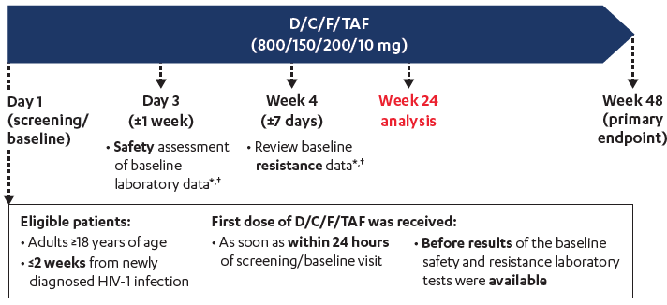
DIAMOND : D/C/F/TAF for Test and Treat strategy
N = 109 (2% female, 32% black, 23% VL > 5 log, 21% CD4 < 200)
Median time from HIV diagnosis to screening/baseline : 5 days (0 to 14)
Only 29% were enrolled within 48hours after HIV diagnosis
At W24
  Continuing study : 91%, discontinued for safety reasons : 1%
  HIV RNA < 50 c/ml : 81%, < 200 c/ml : 87%
Huhn GD, IAC 2018, Abs. WEPEC200

Slide 16
DTG and
Tuberculosis
(INSPIRING)
Other aspects
on ARV
DTG
and pregnancy
MI and
ATV or DRV

Slide 17
INSPIRING phase 3b
DTG dose switch
2 weeks post-completion of TB treatment
TB
therapy
HRZE (2 months)
HR (4 months)ª
HIV/TB co-infected
ART-naive adults
DTG (50 mg BID) + 2 NRTIs (n=69)
DTG (50 mg QD) + 2 NRTIs
EFV (600 mg QD) + 2 NRTIs (n=44)
Screenins
D1
W24
W52
2 confirmed virologic failure on DTG with no treatment-emergent resistance mutations
DTG C_{tau} with DTG 50 mg bid +RIF was similar to that of DTG 50 mg qd without RIF
DTG was well tolerated;
- no AEs leading to withdrawal
- Low rates of TB- and non–TB-associated IRIS in both groups;
- No AEs meeting the stopping criteria for drug-induced liver injury in either group
82 (95% CI: 70, 93)
75 (95% CI: 65, 86)

Slide 18
1st MI and exposure to ATV or DRV : retrospective case-control study (French Hospital Database)
109 cases (27%) et 288 control (23 %) exposed to ATV
41 cases (10 %) et 107 controls (9 %) exposed to DRV
Odds ratio (95 % CI)
for 5 years of exposure
MI risk
DRV
ATV
Univariate analysis
Multivriate analysis adjusted on exposure to other ARVs
Multivriate analysis adjusted on exposure to other ARVs + other confounders*
Multivriate analysis adjusted on exposure to LPV, IDV and ABC
Multivriate analysis adjusted on exposure to LPV, IDV and ABC + other confounders*
1.32 (0.84 - 2.08)
1.14 (0.36 - 3.59)
1.39 (0.84 - 2.29)
0.61 (0.16 - 2.36)
1.54 (0.87 - 2.73)
0.51 (0.11 - 2.32)
1.27 (0.80 - 2.03)
0.86 (0.27 - 2.75)
1.29 (0.76 - 2.20)
0.79 (0.21- 2.98)
* Transmission group, sub-saharian Africa origin, familial history of premature coronary disease, hypertension, smoking, cocaine or IV drug use, BMI, viral load, nadir CD4, more recent CD4:CD8 ratio
0.15
0.25
0.5
1
2
4
6
Conclusion : no increased risk of MI with ATV or DRV exposure
Costagliola D, IAC 2018, Abs. TUPEB087

Slide 19
DTG pregnancy
→When started during pregnancy, EFV and DTG appear equivalent in terms of pregnancy outcomes (including birth defects)
→But adverse outcomes with EFV or DTG ART are still higher than in HIV-uninfected women

Slide 20
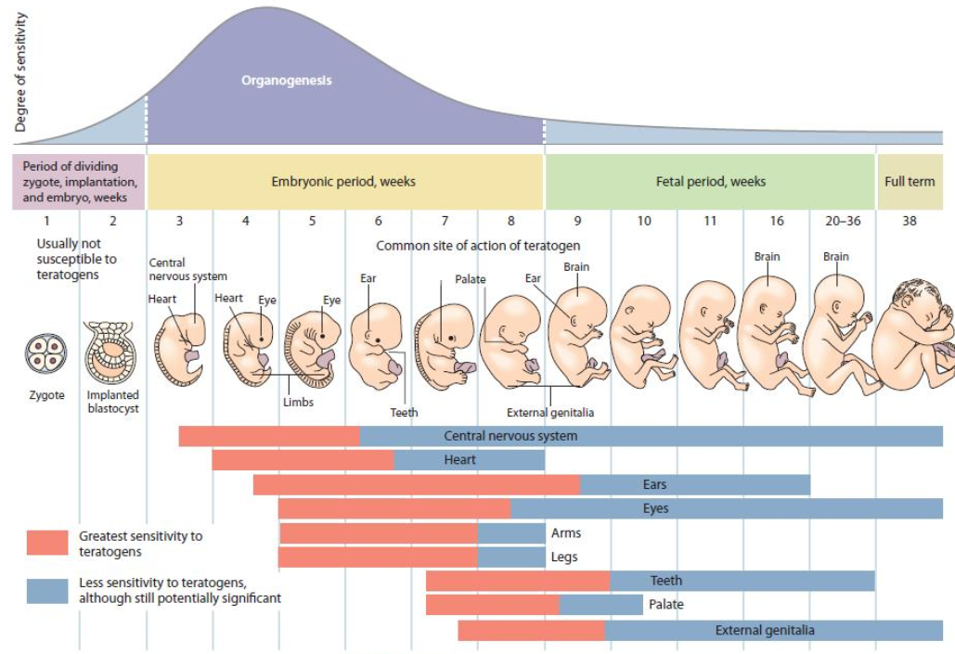
Timing of In Utero ARV Exposure and Fetal Risk
Weeks 3 to 8-12 Post Fertilization
Embryogenesis: Active Organogenesis
most sensitive period to teratogens
Neural Tube Closure by Day 28 (e.g. myelomeningocele)
Oral Structure Formation by Day 36 (e.g. cleft palate)

Slide 21
Tsepamo Study (May 1, 2018 with update to July 15, 2018)
NTD Prevalence Difference by Exposure
July 15, 2018 : Updated prevalence of DTG exposure at conception is 4/596 (0.67%, 95% CI 0.26%, 1.7%)
-- 95% CI still does not overlap with any other exposure group
May 1,
2018
NTDs/Exposures | 4/426 | 14/11,300 | 3/5,787 | 0/2.812 | 61/66,057
% with NTD (95% CI) | 0.94% (0.37%, 2.4%) | 0.12% (0.07%, 0.21%) | 0.05% (0.02%, 0.15%) | 0.00% (0.00%, 0.13%) | 0.09% (0.07%, 0.12%)
Prevalence Difference (95% CI) | ref | -0.82% (-0.24%, -2.3%) | -0.89% (-0.31%,- 2.3%) | -0.94% (-0.35%, -2.4%) | -0.85% (-0.27%, -2.3%)

Slide 22
Tsepamo Updated Analysis Plan
Next formal analysis will occur after 31 March 2019
  Will include women already exposed to DTG from conception prior to recent guideline change
  Plans in place to expand from 8 to 18 sites, increasing from 45% to 72% of births in the country
Final analysis in 2019 to include:
  NTDs
  All major malformations
  Other adverse birth outcomes (stillbirth, preterm, SGA, NND)

Slide 23
WHO 2018 recommendations for first-line
Population | Preferred | Alternatives | Special situations
Adult men and adolescent boys | TLDª | TLE600 TLE400 | AZT+3TC+ EFV600^{b} TDF+3TC (or FTC)+PI/r^{c}
Pregnant (from eight weeks after conception) and breastfeeding women and adolescent girls
Women and adolescent girls with effective contraception or not of childbearing potential
Women and adolescent girls of childbearing potential who want to become pregnant and have no effective contraception | TLE600 | TLE400 TDF+3TC (or FTC)+PI/r^{c} | AZT+3TC+ EFV600^{b} TDF+3TC (or FTC)+ RAL
In PLHIV with TB using rifampicin, the dose of DTG needs to be increased to 50 mg twice daily.
NVP may be used in special circumstances where alternative options are not available.
If national prevalence of EFV pretreatment drug resistance exceeds 10% or if no other alternatives are available.
TLD = TDF + 3TC + DTG TLE = TDF + 3TC (or FTC) + EFV
➔ A woman-centered approach : promoting human rights + promoting
gender equality – enable women to make informed choices

Slide 24
Important Considerations for
Improving Contraceptive Options
60% of HIV positive women of child bearing age are <26 years old
80% of women are single at time of delivery (ANC Survey 2010)
50% of HIV positive women who became pregnant did not desire pregnancy
80-90% of women use condoms as their primary contraceptive method.
Complications secondary to abortion are now the number one cause of maternal mortality. in Botswana (DHAPC, 2018)
Transitioning women off older and more toxic regimens will continue – including DTG for all women based on informed choices (decisions).
Concepts of “Family Planning” do not necessarily translate culturally. It is much better to speak of contraception.
Reproductive choice and safe guarding HIV positive women pregnancy outcomes - across all ART regimens – is the goal.
DHAPC 2018

Slide 25
Vulnerable
populations
Cascade Europe
2016
Cascade
UTT
Prevention
PREVENIR
Universal
Treatment
& Test and Treat
PARTNER2

Slide 26
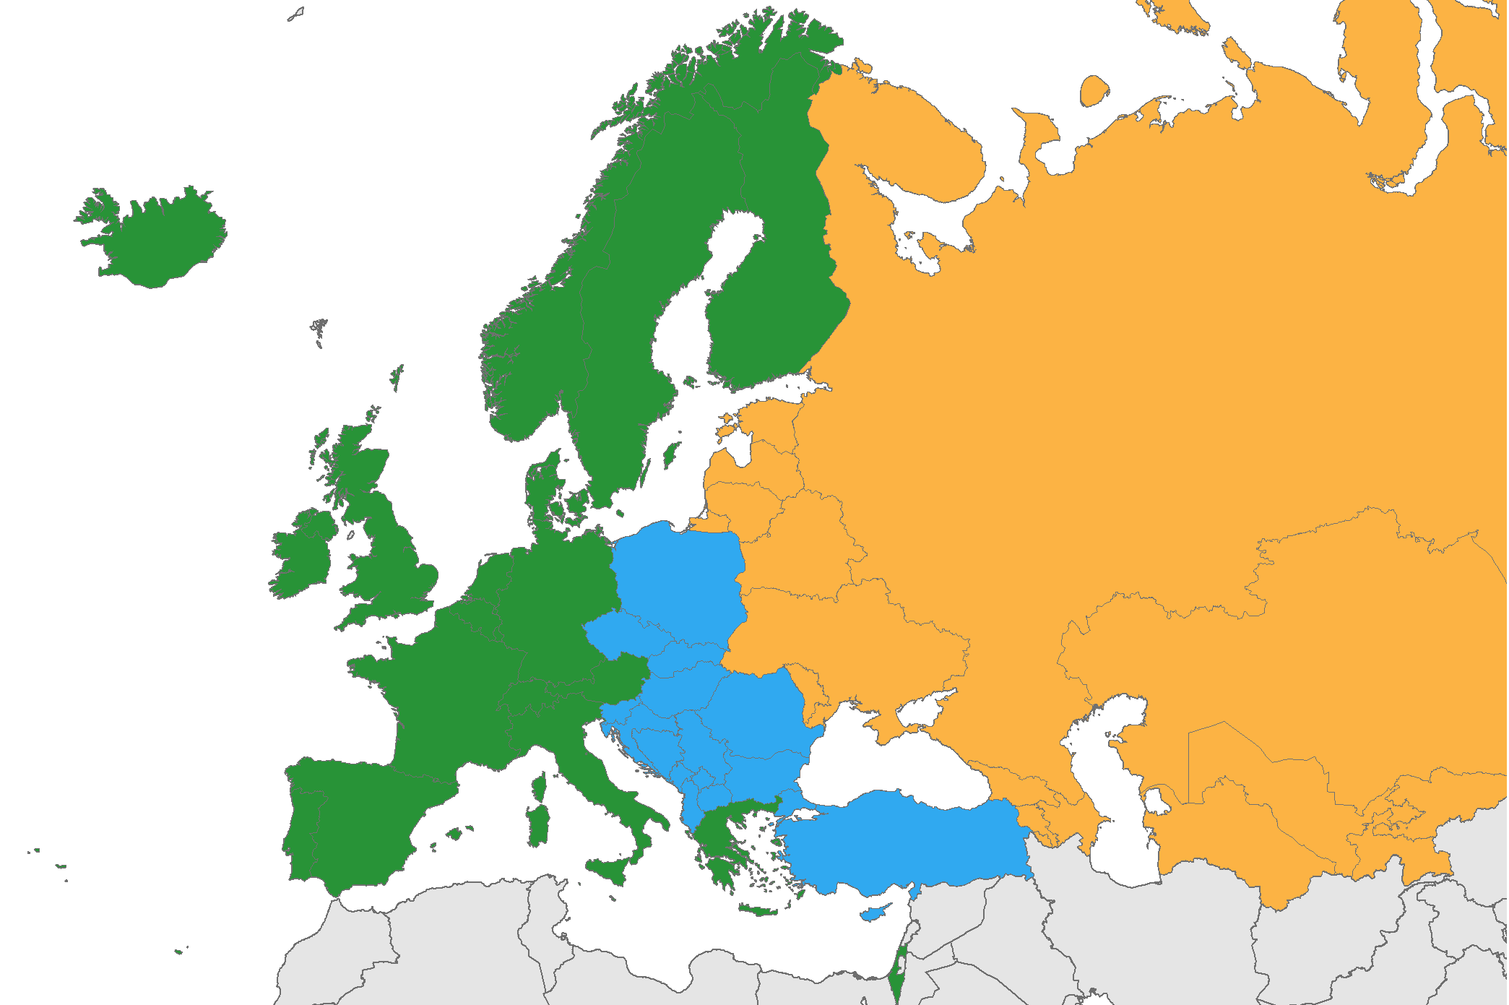
90:90:90 Cascade – Europe 2016
EAST
WEST
CENTRE
PLWHIV diagnosed
86 %
83 %
76 %
Diagnosed on ARV
90 %
73 %
46 %
On ARV with undetectable VL
92 %
78 %
74 %
PLWHIV with undetectbale VL
72 %
45 %
26 %
Source: ECDC. Dublin Declaration monitoring 2018
Teymur N, IAC 2018, Abs. MOAS3502

Slide 27
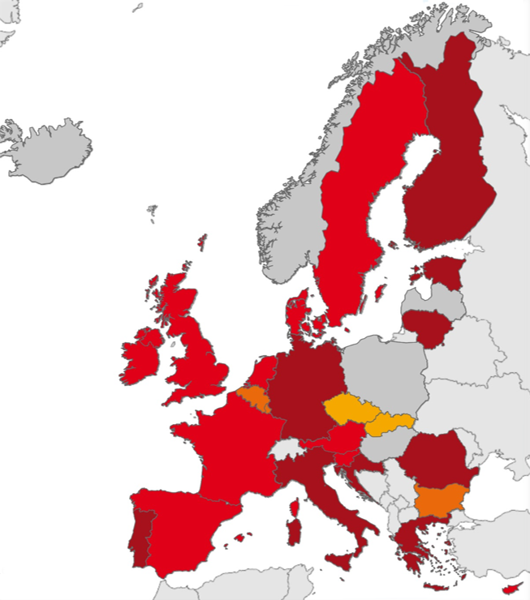
New HIV diagnosis – Europe 2016
High frequency of late diagnosis
% with CD4 < 350/mm³
at HIV diagnosis
< 30 %
30 à < 40 %
40 à < 50 %
> 50 %
Not reported
EU/EEA average : 48%
Luxembourg
Malta
Source: ECDC/WHO (2017). HIV/AIDS Surveillance in Europe 2017– 2016 data
Simoes D, IAC 2018, Abs. MOAS3503

Slide 28
3 large community-based randomised trials investigating the impact of multi-faceted, enhanced HIV treatment and prevention strategies (complex intervention package)
BCPP/Ya Tsie : community-randomized trial (Botswana) : patient-centered package of interventions (that also included on other diseases such as hypertension) including community-based HIV testing, linkage-to-care, and expanded ART criteria (with universal ART from June 2016).
  The intervention resulted in a 31% reduction in community HIV incidence.
  Will the full package now roll-out?

Slide 29
SEARCH trial (East Africa-Uganda/Kenya) : HIV “test and treat” strategy with universal ART, randomizing 32 communities. T
  The intervention did not result in reduced HIV incidence,
  but significant increases in ART initiation and virologic suppression
  and reductions in HIV-mortality (21% reduction) and HIV-TB incidence (59% reduction).
MaxART, stepped-wedge randomized-controlled health systems trial (Swaziland) : intervention offering ART regardless of CD4 count + clinical mentoring and community mobilization support. 3405 patients were enrolled across 14 clinics (40% during the intervention).
  86% retention was observed under the intervention (universal test and treat) compared with 80% under standard of care at 12 months, a significant difference

Slide 30

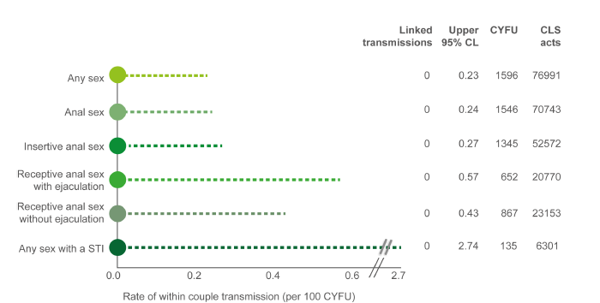
PARTNER2, study investigating HIV transmission among gay male serodifferent couples
Robust sample size (783 couples), median 1.6 years of F-U and a high degree of risk of HIV transmission.
Among serodifferent gay couples who had sex ~77,000 times without condoms with undetectable viral load (<200 copies), there were ZERO phylogenetically-linked transmissions during ~1600 couple-years of F-U.
Undetectable = Untransmissable
Rodger A, IAC 2018, Abs WEAX0104LB

Slide 31
PREVENIR
ANRS PREVENIR, interim results : prospective cohort study, 1594 high-risk individuals (98.9% MSM), daily (45%) or on-demand (55%) PrEP :
  HIV incidence in both groups has been zero after mean F-U of 7 months
  High incidence of STI and new HCV infection (1.2/100 pt-year)
  No participant discontinued PrEP due to drug-related adverse events.
  Study planned to enrol 3,000 participants and F-U of 3years
    Objective : reduction of HIV incidence of 15% in Paris MSM
Molina JM, IAC 2018, Abs WEAE0406LB

Slide 32
PrEP uptake, HIV diagnoses trend (USA)

Slide 33
Emerging issues in PrEP
Risk compensation and higher STI rates,
Elevated risk of new HVC infections among MSM
Feminizing hormones have no meaningful impact on TFV exposure in transgender women
Vulnerabilities of marginalised populations (overcome stigma and inequality toward MSM, TG women, homeless, PWID (including MSM-PWID) adolescents and younger age (25-29), migrants and indigenous populations). Programming must take account of these vulnerabilities.
Prevention programmes : importance of comprehensive sexuality education + address the psychosocial conditions
Risk perception may be low. Offer PrEP through health system friendliness
We are still short of the UNAIDS goals of linking 3 million persons to PrEP by 2020.

Slide 34
Viral
reservoir
Cure
Remission
Vaccine

Slide 35
Cure research
Strategies to modulate HIV expression in ART-treated people to either reactivate it in “Kick and Kill” strategies or to stop transcription in “Block and Lock” strategies
Anti-α4β7 administration could induce virological control after ART in non-human primates, the same results were not seen when the study was repeated or in an open-label human trial of vedolizumab.
New molecules able to enhance HIV transcription :
  a histone deacetylase inhibitor Chidamide,
  the CCR5-inhibitor MVC
  a modified proteinase K agonist GSK445A, that showed promising activity in reactivating HIV when tested in vivo in human or non-human primates with no toxicity.

Slide 36
Vaccine approaches to prevent HIV transmission
Novel concepts, based on advanced technology such as nanoparticles able to elicit higher neutralizing antibody titers and B cell activation
Novel vaccine mucosal delivery and out-of-the-box concepts such as small molecules blocking CD4 binding of gp120
Combination of broadly neutralizing antibodies : provide protection up to 6 months in SHIV model
APPROACH trial in human (Phase 2a) : immune responses elicited by the Ad26/Ad26mosaic and gp140 regimen remained durable 48 weeks after the final boost. Even better antibody titer persistence compared to antibodies in monkeys receiving the same regimen and showing protection after SIV challenge

