Slide 1
CONFERENCE ON RETROVIRUSES AND OPPORTUNISTIC INFECTIONS CROI 2024
Denver, United-States| 3-6 MARCH 2024
This webinar is proposed to you with the support of our institutional partner
Pedro Cahn (Argentina)
Anton Pozniak (UK)
François Raffi (France)

Slide 2
Faculty Disclosures
Pedro Cahn has received research support for research grants: ViiV Healthcare, Merck, CanSino and for ad boards: ViiV Healthcare, Merck and Gilead
Anton Pozniak has received research support and/or honoraria for consulting and/or advisory boards from ViiV Healthcare, Merck, Gilead, Janssen and Theratechnologies
François Raffi has received research support and/or honoraria for consulting and/or advisory boards from Gilead Sciences, Janssen, MSD, Theratechnologies and ViiV Healthcare

Slide 3
This presentation is made in complete editorial freedom
Thanks to ViiV Healthcare for their institutional support

Slide 4
MK-8527
NRTTI
GS-5894
NNRTI
GS-1720
INSTI
bNAbs
New ARVs
VH-937
Maturation inhibitor
CAB-ULA
ULA-DTG
ULA INSTI
GS-9770
Unboosted PI
TAF implant

Slide 5
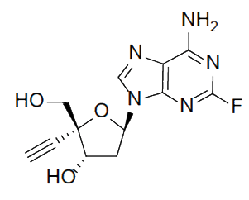
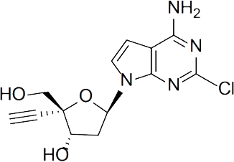
MK-8527: New NRTTI
Benchmark
Islatravir IC₅₀ = 0.8 nM
MK-8527
Structurally novel, potent HIV-1 inhibitor with a favorable off-target profile and PK properties suitable for long-acting oral dosing
Carstens RP et al. 31th CROI 2024 ; 115

Slide 6
MK-8527: Favorable safety and PK in healthy volunteers
MK-8527 plasma concentration
micromol/L
MK-8527-TP concentration, pmoL/10⁶ PBMCs
after single doses
MK-8527-TP concentration, pmoL/10⁶ PBMCs
after multiple doses
10
0.5 mg
100
100
1.0 mg
2.5 mg
5.0 mg
1
10 mg
10
10
25 mg (fasted)
25 mg (fed)
50 mg
0.1
100 mg
1
150 mg
1
200 mg
PK threshold
(preclinical translation)
0.01
0.1
0.1
5 mg (3 x QW)
PK threshold
(preclinical translation)
10 mg (3 x QW)
20 mg (3 x QW)
40 mg (3 x QW)
0001
0.01
0.01
0
24
48
72
96
120
144
168
0
84
168
252
336
420
504
588
672
0
48
96
144
192
240
288
336
384
432
480
528
576
624
672
Time, hr
Time, hr
Time, hr
Single doses (0.5 to 200 mg) and multiple (3 x QW) doses (5-40 mg)
in HIV negative volunteers: good safety profile
After single doses from 5 to 200 mg, mean MK85-27-TP concentration at 7 days were above the threshold for antiviral activity against wild-type HIV-1
Terminal half-life: 9- 12 days
PK profiles support QW and longer dosing
Gillespie G et al. 31th CROI 2024 ; 129

Slide 7
MK-8527: New NRTTI
2 phase 1, single dose, monotherapy studies
Adults, HIV-1 RNA ≥ 5000 c/ml, CD4 ≥ 200/mm³
ART-naïve, No resistance to NRTIs, HBs Ag negative
Mean change in HIV-1 RNA from baseline , log₁₀ c/mL (SD)
0.0
0.0
-0.5
2/5: no virologic response
-0.5
-1.0
-1.0
-1.5
-1.5
1.0 mg (N=5)
0.25 mg (N=6)
-2.0
3.0 mg (N=6)
-2.0
0.5 mg (N=6)
10.0 mg (N=6)
1.0 mg (N=8)
0
2
4
6
8
10
0
2
4
6
8
10
Time, days
Time, days
Carstens RP et al. 31th CROI 2024 ; 115

Slide 8
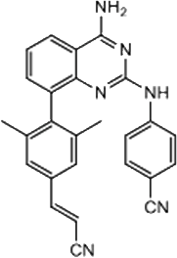
GS-5894: New NNRTI
GS-5894
GS-5894 Activity Against Clinical Isolates Carrying NNRTI-Resistance Mutations (EC50 Fold change)
100
GS-5894
RPV
EFV
75
50
25
0
L100I
K101E
K103N
V106M
E138A
E138K V179E
V108I Y181C
K103R V179D Y181C
Y181C
Y181V
Y188C
Y188H
Y188L
G190A
K103R V179D G190A
G190S
L100I K103N
L100I K103N V108I
K103N V108I
K103N V108I Y181C
K103N Y181C
K103N P255H
K103N Y188L
K101E G190A
K103N G190A
K103N V108I G190A
Y181C G190A
K103N V108I Y181C
K101E Y181C G190A
K103N Y181C G190A
V106A G190A F227L
K101E Y181C G190S
Improved resistance profile from NNRTI-experienced patients (vs EFV and RPV)
Slow selection of resistant mutants in vitro
Low predicted metabolic clearance
Human dose prediction < 600 mg QW to achieve an IQ > 5 at steady-state
Lansdon E et al. 31th CROI 2024 ; 636

Slide 9
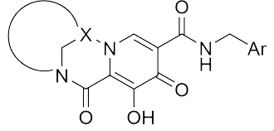
GS-1720: New INSTI
GS-1720
Phase 1, single dose study, HIV patients,
HIV RNA 5000 to ≤ 400 000 c/mL, CD4 > 200/mm³
ART-naïve or off ART > 12 weeks and INSTI-naïve
Mean (95% CI) change in HIV-1 RNA, log₁₀ c/mL
Phase 1, single dose study in healthy volunteers
Historical placebo
0
GS-1720 concentration-time profile following a single 450 mg dose (ng/mL)
Mean (95% CI) change from day 1 to day 11
100000
-1
30 mg
-1.74 (-2.45, -1.03)
10000
-2
150 mg
-2.18 (-2.37, -2.00)
450 mg
-2.44 (-2.83, -2.04)
1000
900 mg
-2.37 (-2.84, -1.90)
-3
All p < 0.0001 vs placebo
100
1
2
3
4
5
6
7
8
9
10
11
Median t_{1/2} = 9.4 days
Time (days)
10
GS-1720 administered
0
1
2
3
4
5
6
7
8
9
10
Study-drug related AE: 14.3%, none of grade 3-4, no SAE
2 patients with decreased CrCl (Day 3, Day 25)
Time (weeks)
Conclusion: new INSTI with weekly oral potential
Fichtenbaum CJ et al. 31th CROI 2024 ; 116

Slide 10
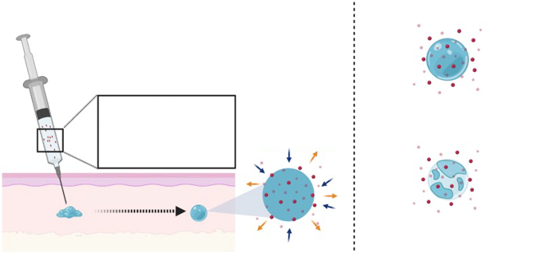
Ultra-Long Acting INSTI
New ultra-long acting CAB formulation (CAB-ULA) ¹
Cabotegravir plasma concentration (median and range), microg/mL
20
CAB200 IM median & 90% PI
Ultra-long acting DTG in situ forming implant ²
CAB-ULA SC 800 mg (2mL)
CAB-ULA IM 800 mg (2mL)
Mechanisms of drug release
CAB-ULA SC 1200 mg (3 mL)
CAB-ULA IM 1200 mg (3 mL)
2
Biodegradable polymer water miscible organic solvent APIs
Water influx Solvent influx
Diffusion-mediated
0.2
Phase inversion
Polymar degradation-mediated
0.025
After a single SC injection in mice : good safety and sustained plasma concentration above 4x PA-IC90 for more than 300 days
BQL
0
4
8
12
16
20
24
28
32
36
40
44
48
52
Time after LA injection, weeks
CAB-ULA t_{1/2}: > 6x for SC and > 2x for IM of CAB200 IM.
ISR: erythema, nodule and pain for SC, pain for IM
PK simulations ≥ Q4M dosing with IM. SC evaluation ongoing
Conclusion : ULA DTG ISFI is the first SC injectable for HIV PrEP that is biodegradable and removeable
1. Han K et al. 31th CROI 2024 ; 130. 2. Le T et al. 31th CROI 2024 ; 1137

Slide 11
TAF implant for PrEP
TAF silicone implant: 40 mm (length), 2.5 mm (OD), 2 delivery channels, with ± 110 mg TAF free-based micro-tablets, target release ± 0.25 mg/day
Phase 1, South Africa, women with low HIV risk profile
6 with biceps insertion 28 days in situ
30 randomized to 1 or 2 implants for up to 48 weeks in situ
Mild implant site reactions common (90%)
Poor tolerability: 31% of implants removed early (these were more difficult to remove)
Lower than planned drug release: even with 2 implants , median TFV-DP were below the target level
Conclusion: need to improve tolerability and drug delivery
Gengiah TN et al. 31th CROI 2024 ; 123

Slide 12
GS-9770 New Unboosted PI
Fold Change in EC₅₀ on PI resistant clinical isolates
GS-9770
60
DRV
40
ATV
20
0
1
2
3
4
5
6
7
8
9
10
11
12
13
14
15
16
17
18
19
20
21
22
23
24
25
26
27
28
29
30
31
32
33
34
35
36
37
38
39
40
41
42
43
44
45
46
47
48
49
I84V/L90M
PI resistant clinical isolates
Fold change in EC₅₀ | GS-9770 | DRV | ATV
Mean (SD) | 3.8 (3.8) | 52.8 (154.9) | 16.4 (23.2)
Range | 0.4 - 2.1 | 0.3 – 615 | 0.6 - > 132
Viruses with > 10-fold change in EC₅₀, n/N (%) | 3/49 (6) | 17/49 (35) | 23/49 (47)
QD 400 mg dose predicted to reach efficacity
Han X et al. 31th CROI 2024 ; 637

Slide 13
VH3739937: Maturation inhibitor
VH-937 is the back-up of 254 with prolonged oral half-life (3 days): potential for QW
Low nanomolar potency against
HIV-1 laboratoray strains
Clinical isolates
And viruses with a broad range of Gag polymorphisms associated with resistance to prior Mis, including A364V
Favorable pharmacokinetic and metabolism data in various animal species
Further development planned
Mac Auliffe B et al. 31th CROI 2024 ; 633

Slide 14
bNAbs: hope and hurdles – the saga continues
bNAB type
Strategy
VH381019 (N6LS): CD4-binding site of gp120 Phase I of monotherapy in ART-naïves
VRC07-523LS: CD4-binding site of gp120 Phase II of CAB + bNAb for maintenance
SAR441236: Trispecific bNAb Phase I of monotherapy in viremic and aviremic patients
Teropavimab (TAB): CD4-binding site of gp120
Zinlirvimab (ZAB): epitope on the V3 glycan of HIV-1 env
Phase I of lenacapavir + TAB + ZAB for maintenance
PGT121: epitope on the V3 glycan of HIV-1 env
PGDM1400: epitope on the V2 glycan of HIV-1 env
Phase I of 3 bNAbs (different targets) + ATI in ART-suppressed patients

Slide 15
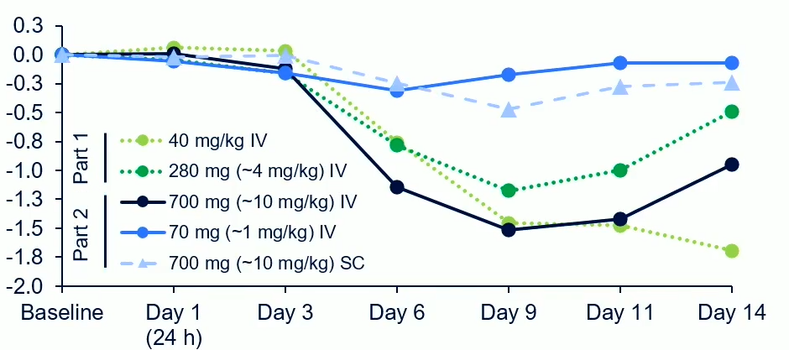
VH3810109 (N6LS): Banner Study
Randomized open-label study in ART-naïve adults
Part 1 (N = 12): N6LS 40 mg/kg vs 280 mg IV
Part 2 (N = 48): N6LS 700 mg IV vs 70 mg IV vs 700 mg SC
Endpoint criteria:
VL decline < 0.5 log₁₀ c/mL by Day 11
VL rebound ≥ 1 log₁₀ c/mL from nadir or to < 0.5 log₁₀ c/mL from baseline between Day 11 and Day 84
Reached Day 84
INSTI-based ART started after achieving endpoint
Median change in HIV-1 RNA, log₁₀ c/mL
Lower exposures with SC vs IV (lymphatic elimination)
Losos J et al. 31th CROI 2024 ; 117

Slide 16
VH3810109 (N6LS): Banner Study
Maximum change from baseline in VL, log₁₀ c/mL ¹
0
Participants with higher N6LS baseline in vitro IC₉₀ require higher N6LS concentrations
-1
IC₉₀ = 10 µg/mL
IC₉₀ = 2 µg/mL
-2
Median
IC₉₀ = 0,1 µg/mL
40 mg/kg IV
280 mg/kg (~ 4 mg/kg) IV
700 mg/kg (~ 10 mg/kg) IV
70 mg/kg (~ 10 mg/kg) IV
700 mg/kg (~ 10 mg/kg) SC
IC₉₀ = 0,1 µg/mL
Participants with lower N6LS baseline in vitro IC₉₀ require lower N6LS concentrations
Conclusion: baseline viral sensitivity to N6LS was an important predictor of N6LS concentrations required to achieve antiviral effect
-3
0
100
200
300
400
500
N6LS average concentration based on AUC₀₋₁₄, ug/mL 95% PI based on 1 000 samplings from variance-covariance matric
SPAN study ²: good safety of higher doses of N6LS, including SC with recombinant human hyaluronidase PH20, in HIV negative adults
Dose selection for phase 2b (EMBRACE) : 60 mg/kg IV and 3000 mg + rHuPH20 SC
1. Losos J et al. 31th CROI 2024 ; 117. 2. Win B et al. CROI 2024 ; 639

Slide 17
VRC07-523S + CAB LA for maintenance
VRC07-523S: CD4-binding site bNAb
ACTG A5357: 71 PWH, HIV-1 RNA <50 c/mL ≥ 2 years, triple ART, Susceptibility to VRC07-523S (Phenosense Assay)
Open-label study: 4 weeks of oral CAB + 2 NRTI, then CAB LA IM Q4W + VRC07-523S IV 40 mg/kg Q8W for 44 weeks
Screening: 25% of participants assessed had VRC07-523S IC₅₀ above susceptible threshold
Results
AE possibly related to treatment: 16.9%
AE leading to discontinuation = 1 (1.4%)
Grade 3 events, N=11, 16 events (14 events possibly related to VRC07-523S). No grade 4 events
Virologic failure (confirmed HIV-1 RNA ≥ 200 c/mL) at W44: N=5 (7.3%)
CAB trough levels within the therapeutic range
VRC07-523S concentrations > 100-fold higher than IC₈₀
2/5 resuppressed without change in therapy
Emergence of R263K INSTI mutation in one participant with high baseline VRC07-523S IC₅₀ (functional CAB monotherapy ?)
Taiwo B et al. 31th CROI 2024 ; 119

Slide 18
SAR441236, trispecific bNAb
Single bNAb with 3 specificities
Broad and potent neutralizing activity
Protection against mixed SHIV challenge
A5377 study: phase I of IV and SC administration
ART suppressed adults (N = 44): single IV doses or multiple IV dose (every 12 weeks), single SC doses
ART viremic adults, on ART or not, with HIV-1 RNA 5,000-200,000 c/mL (N = 7): single IV doses
No adverse events
PK similar to monospecific bNAbs
Treatment induced anti-drug antibodies transient and not affecting PK
Modest antiviral effect: no change of intact provirus over 72 weeks
Conclusion: feasibility, but what future ?
Tsibris A et al. 31th CROI 2024 ; 118

Slide 19
LEN + Teropavimab + Zinlirvimab
Previous Phase 1b study: a single dose of LEN + TAB + ZAB maintained virologic suppression after 6 months in 18/20 patients with HIV-1 highly susceptible to both bNAbs
New Study: 11 HIV+ adults, virologically suppressed ≥ 18 months, highly susceptible to EITHER TAB or ZAB
Randomization 1:1 LEN + TAB 30 mg/kg IV x 1 + ZAB IV x 1 (10 vs 30 mg/kg)
Endpoint at W26: safety, tolerability, HIV-1 RNA
Susceptibility at screening
To TAB = 5/11
To ZAB = 6/11
To both = 0
Results
Good tolerability
LEN + TAB + ZAB 30 mg/kg: 6/6 with VL < 50 c/mL at W26
LEN + TAB + ZAB 10 mg/kg: 2/4 with VL > 50 c/mL at W26
2 Participants with virologic rebound
2µg/mL
> 50
10
Participant 1
TAB IC₉₀ microg/mL
2µg/mL
1
Participant 2
ZAB IC₉₀: 0.12
TAB IC₉₀: 0.43
0.1
0.01
0.01
0.1
1
10
> 50
ZAB IC₉₀ microg/mL
Pt 1: virologic rebound 72 c/mL at W26, no R emergence
Pt 2: virologic rebound 112 c/ml at W20, confirmed < 100 c/ml, no R emergence
No other risk factors than low ZAB dose in 2 failures
Eron J et al. 31th CROI 2024 ; 120

Slide 20
bNAbs tritherapy for ART treatment interruption (ATI)
PGDM1400 (V2-glycan) + PGT121 (V3-glycan) + VRC07-523 (CD4-binding site): cover 99% of cross clade strains, 82% covered by ≥ 2 of the 3 bNAbs
12 patients on ART with VL < 50 c/mL, each bNAb at the dose of 20 mg/kg IV at D0, D28, D56, D84, D112 and D140, ART interrupted at Day 1
Endpoint : viral rebound at D300
Results
Good tolerability
Early virologic rebound, N = 2 (before D100)
Baseline R to PFT121 and PGDM1400 in 2/2
Late virologic rebound, N = 5 (after D200)
Declining serum concentrations of bNAbs, emergence of R to bNAbs in 1/3 patients tested
4/11 patients who completed follow-up had no virologic rebound by W44
Early rebound
Late rebound
bNAb infusions
End of Study
5
4
HIV-1 RNA log₁₀ c/mL
3
No Rebound
2
0
100
200
300
Days following first infusion
Conclusion: potential of a triple bNAb cocktail to provide long-term virologic control in the absence of ART
Juelg BD et al. 31th CROI 2024 ; 121

Slide 21
DTG for children
ODYSSEY
CAB + RPV LA Africa
CARES
CAB + RPV LA poor adherence
LATITUDE
2nd gen INSTI-R
Limited-resources
countries
ART studies
BIC + LEN qd
ARTISTRY-1
B/F/TAF + RIF
in Tuberculosis
ISL + LEN qW

Slide 22
DTG for children on 1st or 2nd line ART: ODYSSEY
3 months to < 18 years old, Starting 1st line or switching to 2nd line
N = 792
Difference in % with virological or clinical failure (ITT)
W48
Total
ODYSSEY A
ODYSSEY B
W96
Total
ODYSSEY A
ODYSSEY B
ODYSSEY A: First-line ART
N = 383
ODYSSEY B: Second-line ART
N = 409
Total
ODYSSEY A
ODYSSEY B
W144
Total
ODYSSEY A
ODYSSEY B
W192
DTG
N = 189
SOC
N = 194
NNRTI = 81%
DTG
N = 203
SOC
N = 206
bPI = 96%
-28
-24
-20
-16
-12
-8
-4
0
4
DTG better
SOC better
13% of SOC had switched to DTG before W192 without treatment failure
At the end of FU (median 5.5 years), 99% of SOC switched to DTG and 90% virologically suppressed < 400 c/mL
Primary endpoint: virological or clinical failure
Mujuru HA et al. 31th CROI 2024 ; 186LB

Slide 23
CARES Study: CAB + RPV LA IM as switch strategy in Africa
Randomized, open-label, active-controlled, multi-centre, non-inferior study
Kenya, South Africa, Uganda
Oral ART (SOC)
TDF + 3TC/FTC + DTG/NVP/EFV
N = 256
> 18 years of age
On stable oral therapy: TDF + 3TC/FTC + DTG/NVP/EFV
HIV-1 RNA <50 c/mL at > 4-12m prior to and at screening
No history of treatment failure
No HBV infection
Optional
Oral
CAB + RPV
CAB (600 mg) + RPV (900 mg) LA IM Q8W
N = 256
D-28
D-1
D1
W4
W24
W48
W72
W96
Confirm HIV-1 RNA <50 c/mL
Randomization (1:1)
Viral load every 24 weeks
Kityo CM et al. 31th CROI 2024 ; 122

Slide 24
CARES Study: CAB + RPV LA IM as switch strategy in Africa
Baseline characteristics
 | CAB + RPV LA N = 256 | Oral ART (SOC) N = 257
Female | 57 % | 58 %
BMI ≥ 30 kg/m2 | 22.4 % | 19.8 %
Time on ART, years | 8 | 7
Prior exposure to NNRTI | 73.7 % | 74.3 %
INSTI at screening | 90.6 % | 93.4 %
NNRTI at screening | 9.4 % | 6.6 %
Archived DNA analysis (baseline stored PBMC)
Viral sub-type A1 | 55.9 % | 57.2 %
RPV resistance mutations | 12.5 % | 14.7 %
CAB resistance mutations | 15.8 % | 16.5 %
Kityo CM et al. 31th CROI 2024 ; 122

Slide 25
CARES Study: CAB + RPV LA IM as switch strategy in Africa
Virologic outcome at W48
Adjusted Treatment Difference (IC 95%)
%
Proportion with plasma HIV-1 RNA < 50 copies/mL
CAB + RPV LA
Oral SOC
-10% NI margin
-0.5
-3.4
2.4
CAB + RPV LA Q2M (N = 255)
Oral SOC (N = 257)
Difference (%)
Proportion with plasma HIV-1 RNA > 50 copies/mL
Oral SOC
CAB + RPV LA
6
5
247
250
2
2
-2.2
0.3
Virologic non-response (≥ 50 copies/mL)
Virologic success < 50 copies/mL
No virologic data
4% NI margin
2.8
Difference (%)
2 virologic failures in the CAB + RPV LA arm, 0 in SOC
1 confirmed HIV-1 RNA ≥ 200 c/mL (W48), no delayed injections, subtype A1, BMI 26 kg/m², no baseline R, emergence of R to RPV and CAB
1 unconfirmed (died before retest) (W48), no delayed injections, subtype D, BMI 22 kg/m², baseline R to RPV, R to RPV and CAB at failure
Kityo CM et al. 31th CROI 2024 ; 122

Slide 26
LATITUDE (ACTG A5359): CAB + RPV LA in PWH with adherence challenges
Phase 3, randomized, open-label trial
PWH with barriers to adherence (poor viral response after oral ART ≥ 6 months or loss to clinical FU with ART non-adherence ≥ 6 months, no Hep B co-infection, no INSTI or NNRTI RAMs
Step 1 (max 24 weeks)
SOC ART (≥ 2 active ARVs)
+
Conditional economic incentives
1:1
Step 2 (52 weeks)
Arm A: CAB/RPV-LA (Q4W)
Arm B: SOC ART
Step 3 (52 weeks)
CAB/RPV-LA (Q4W)
R
Step 4
(max 52 weeks)
Baseline characteristics
Median age 40 years
30% Female, 64% Black/African American
Time since HIV diagnosis: 13 years
VL > 100 000 c/mL: 14%, < 200 c/mL : 32%
CD4: 270/mm³
Outcome: regimen failure (confirmed virologic failure
or treatment discontinuation in Step 2)
Rana AI et al. 31th CROI 2024 ; 212LB

Slide 27
LATITUDE (ACTG A5359): CAB + RPV LA in PWH with adherence challenges
Primary Outcome
Regimen failure
Treatment-related
failure
Permanent-treatment
discontinuation
Virologic failure
%
%
%
%
100
100
100
100
80
80
80
80
60
60
60
60
38.5
40
24.1
40
25.4
40
26.2
40
24.9
20.9
20
20
7.2
20
9.6
20
0
0
0
0
CAB/RPV-LA
SOC
CAB/RPV-LA
SOC
CAB/RPV-LA
SOC
CAB/RPV-LA
SOC
VF
TRT-DISC
5 23
28 19
6
28
6 3
28 1
25
30
Rana AI et al. 31th CROI 2024 ; 212LB

Slide 28
ARTISTRY-1: simplification to BIC + LEN qd
W0
Primary endpoint W24
128 adults on a complex ART regimen
bPI or NNRTI + ≥ 1 third agent other than NRTI
Or regimen of ≥ 2 pills/day or requiring ≥ 2 dosing/day
Or regimen with parenteral agents (excluding CAB/RPV) + oral agents
HIV-1 RNA < 50 c/mL for ≥ 6 months
No prior exposure to LEN, no R to BIC, no HBV infection, eGFR ≥ 15 mL/min
BIC 75 mg + LEN 25 mg QD *, N = 51
Phase 2 extension
Randomization
2:2:1
BIC 75 mg + LEN 50 mg QD *, N = 52
BIC/LEN FDC QD 75 mg/50 mg
Continue Baseline ART, N = 25
* LEN loading dose D1 and D2
Mounzer K et al. 31th CROI 2024 ; 642

Slide 29
ARTISTRY-1: simplification to BIC + LEN qd
Participants characteristics
Median age 60 years
27 years of HIV infection
81% on a complex regimen because history of resistance
Median number of pills = 3 (63% on DRV/b + DTG ± TAF/FTC or NNRTI)
HIV-1 RNA< 50 c/mL at W24
Treatment-emergent AEs up to W24
%
100
 | BIC 75 mg + LEN 25 mg N = 51 | BIC 75 mg + LEN 50 mg N = 52 | SBR N = 25
AE related to treatment | 9 (18 %) | 3 (6 %) | 0
Serious AE | 2 (3.9 %) | 1 (1.9 %) | 2 (8 %)
AE leading to treatment discontinuation | 1 (2 %) Nausea | 1 (1.9 %) Vomiting | 0
Mounzer K et al. 31th CROI 2024 ; 642

Slide 30
ISL + LEN QW as maintenance therapy: Phase 2
Adults > 18 years
VL < 50 c/ml on B/F/TAF
No history of virologic failure
CD4 count > 350 cells/µl
﻿Lymphocytes ≥ 900 cells/µl
﻿No HBV infection
Extension phase
N=106 1:1
ISL 2 mg + LEN 300 mg oral QW
ISL 2 mg + LEN 300 mg oral QW
B/F/TAF QD
D1
W12
W24
W48
Visits every 12 weeks
Virologic outcome at W24
Safety at W24
100
94.2
94.2
ISL + LEN (N = 52)
B/F/TAF (N = 52)
80
 | ISL + LEN N = 52 | B/F/TAF N = 52
Treatment-related AEs (all grade 1 and 2) | 9 (17.3 %) Dry mouth 3.8 % Nausea 3.8 % | 3 (5.8%)
Grade 3-4 laboratory abnormalities | 6 (11.5 %) | 4 (7.8 %)
Mean change in lymphocytes | - 0.04 | - 0.01
Mean change in CD4 | - 4 | - 57
60
40
20
5.8
1.9
3.8
0
HIV-1 RNA
> 50 c/ml
HIV-1 RNA
< 50 c/ml
No data in window
n
1
0
49
49
2
3
1 patient with VL at 64 c/mL at W24, ≤ 50 c/mL at W30 (without change in regimen, adequate levels of ISL and LEN)
Colson A et al. 31th CROI 2024 ; 208LB

Slide 31
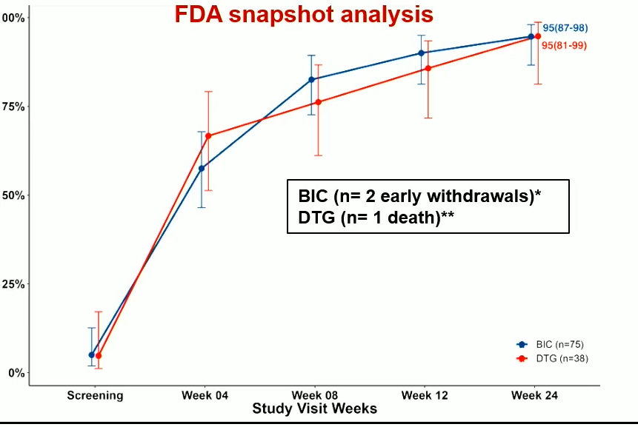
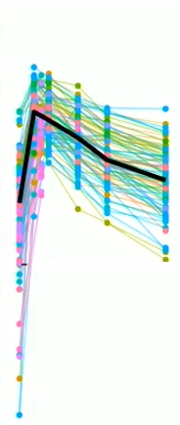
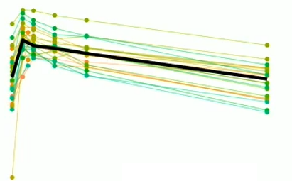
B/F/TAF in tuberculosis treated with rifampicin
Open-label, non-comparative, randomized clinical trial
TB treatment
HRZE (2 months)
HR (4 months)
ART-naïve and non-naive adults with
HIV and Tuberculosis (Rx with rifampicin < 8 weeks)
BIC/FTC/TAF (BID) , N = 80
BIC/FTC/TAF (QD)
2 weeks post RIF stop
DTG/TDF/3TC (QD) + DTG (50mg Nocte) N = 42
DTG/TDF/3TC (QD)
2 weeks post RIF stop
HIV treatment
D1
W24
W48
Viral suppression at W24 (FDA snapshot)
BIC plasma concentration (mg/L)
BIC 50 mg BID + RIF
BIC 50 mg QD
10,00
3,00
1,00
0,30
PA-EC95/IQ1 = 0,162 mg/l
PA-EC95/IQ1 = 0,162 mg/l
0,10
0,03
Ctau : 0.397 mg/L
AUC₀₋₂₄ : 30.0 mg*h/L
Ctau : 2.29 mg/L
AUC₀₋₂₄ : 94.9 mg*h/L
No treatment faiure (VL > 400 c/mL) at W48
Good tolerability
0,01
0
6
12
18
24
0
6
12
18
24
Time (h)
Naidoo A et al. 31th CROI 2024 ; 211LB

Slide 32
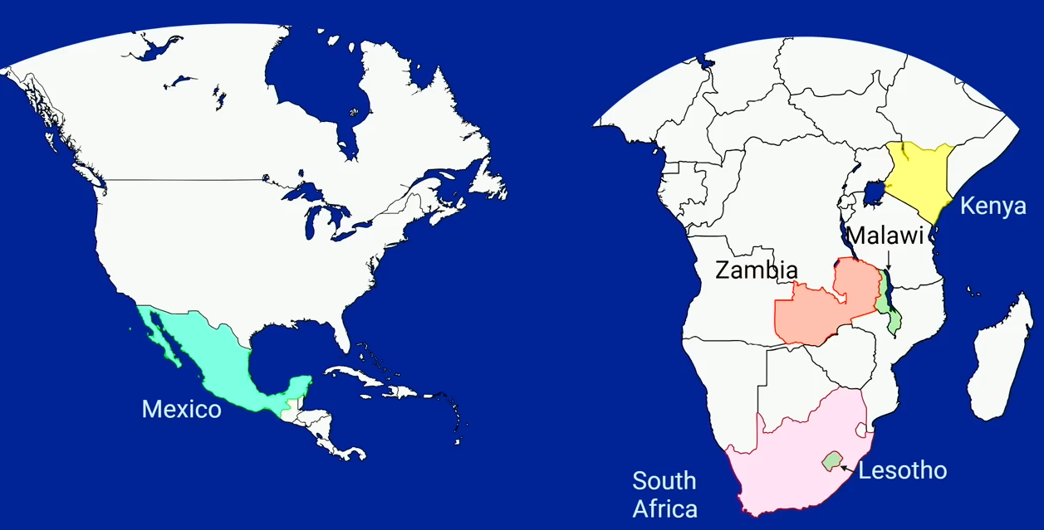
DTG and BIC Resistance in Resource Limited Settings
1. Observational cohort Malawi + Zambia: 2852 adults switched from NNRTI to DTG-based ART
95 % VL < 400 c/mL at switch. VL ≥ 400 c/mL at 2 years = 3.3 % (mainly in patients not suppressed at switch)
Major DTG RAMs in only 2/45 samples with VL > 1000 c/mL (4.4 %)
3
2. Malawi Sept 2023: 99.9% of 35,352 children on ART were on DTG
Cross-sectional survey of 302 children: confirmed VL > 1000 c/mL = 44 %. Major INSTI RAM = 16.3 % (DTG 13.5 %)
2
1
5
3. Kenya : Treatment-experienced and naïve patients from national DTG regimen rollout
- 41 ART-naïve. After median 1.5 y, VL > 200 c/mL=32 %, DTG RAM=1/12 (8.3 %)
- 190 ART-experienced (NNRTI and/or PI). After 2.1 years, VL > 200 c/mL = 28 % DTG RAM = 7/31 (22.6 %)
4
5. Reference laboratory data
87,000 patients on 2nd generation INSTI, mainly BIC
Oct 2021-Sept 2023:
- 100 R tests (25 1st line failure, 75 ≥ 2nd line failure)
- Primary INSTI RAM : 5/25 and 15/75 (20 % )
- no M184V mutation
4. Lesotho : Patients who switched form NNRTI and on DTG for ≥ 18 months with 1 VL ≥ 500 c/mL or 2 VL ≥ 50 c/mL 15,299 patients, 151 eligible for R testing: R in 8/78 (10.3 %)
1. Whitesell Skrivankova V et al. 31th CROI 2024 ; 676. 2. Bello G et al. 31th CROI 2024 ; 187LB. 3. Kingwara L. et al. 31th CROI 2024 ; 677. 34 Tschumi N et al. 31th CROI 2024 ; 678.
5. Soto Ramirez LE et al. 31th CROI 2024 ; 679

Slide 33
WHO NEWS RELEASE, March 5th 2024
New report documents increase in HIV drug resistance to dolutegravir
The World Health Organization’s (WHO) latest HIV Drug Resistance (HIVDR) Report tells us where drug resistance is growing and offers recommendations for countries to monitor and respond to the potential challenges
The report shares some good news and some concerning news. It highlights high levels of HIV viral load suppression (> 90%) in populations receiving dolutegravir (DTG)-containing antiretroviral therapy (ART). However, observational and country-generated survey data indicate that levels of HIVDR to DTG are exceeding levels observed in clinical trials
Since 2018, WHO has recommended use of dolutegravir as the preferred first- and second-line HIV treatment for all population groups. It is more effective, easier to take, and has fewer side effects than other drugs currently in use. It also has a high genetic barrier to developing drug resistance
However, among the four surveys reported, levels of resistance to dolutegravir ranged from 3.9% to 8.6%, and reached 19.6% among people experienced with treatment and transitioned to a DTG-containing ART while having high HIV viral loads. To date, only a few countries have reported survey data to WHO

Slide 34
DOXYPEP
DOXYVAC
Prevention
Complications
BIC during
pregnancy
Diabetes
and INSTI
Semaglutide
- weight
- lipohypertrophy
- MASLD

Slide 35
Doxycycline as PEP
DoxyPEP: doxycycline 200 mg as PEP reduced overall by 65% bacterial STIs each quarter during 1 year (randomization doxy vs no doxy) (Luetkemeyer A. NEJM 2023; 388:1296-1306)
May 2022: all participants offered open-label doxy PEP (207 initially randomized to doxy + 82 initially randomized to no doxy) : DoxyPEP Open-Label Extension (OLE)
Results: sustained reduction in STIs during OLE
Sexual partners and condomless sex: increased during OLE in both groups (doubled in SOC➜ doxy)
% of quarters with > 1 STI
As randomized quarters
Open label extension quarters
Gonorrhea
31 %
Chlamydia
30
Syphilis
14 %
> 2 STIs
20
17 %
12 %
13 %
8 %
12 %
10
9 %
10 %
3 %
2 %
5 %
2 %
3 %
0
1 %
Doxy-PEP
SOC
Doxy-PEP
SOC → Doxy-PEP
Conclusion: results support doxy-PEP CDC draft guidelines (A1 recommendation)
Warning : long-term evaluation of sustained sexual behavior changes and impact on antimicrobial resistance needed
Luetkemeyer A et al. 31th CROI 2024 ; 125

Slide 36
DOXYVAC: prevention of STI in MSM on PrEP
4CMenB Vaccine 2 injections (M0 and M2)
Doxy PEP 200mg 24-72h post sex
N = 362
1:1
MSM on PrEP > 6 months
Bacterial STI in prior 12 months
No STI symptoms
(N = 270)
No Vaccine
2:1
4CMenB Vaccine 2 injections (M0 and M2)
No PEP
N = 183
1:1
No Vaccine
Molina JM et al. 31th CROI 2024 ; 124

Slide 37
DOXYVAC: prevention of STI in MSM on PrEP
DOXY PEP RESULTS
Time to first CT or syphilis infection : primary endpoint
CT
Syphilis
Time to first Gono
1.00
1.00
1.00
No PEP (N = 183, events = 68)
No PEP (N = 183, events = 27)
No PEP (N = 183, events = 94)
0.75
DoxyPEP (N = 362, events = 24)
0.75
DoxyPEP (N = 362, events = 12)
0.75
DoxyPEP (N = 362, events = 144)
0.50
0.50
0.50
Cumulative Probability of 1st STI Diagnosis
Adjsuted HR: 0.21 (IC 95%: 0.11-0.41, p < 0.001)
0.25
Adjsuted HR: 0.14 (IC 95%: 0.09-0.23, p < 0.0001)
0.25
0.25
Adjsuted HR: 0.67 (IC 95%: 0.52-0.87, p = 0.003)
0.00
0.00
0.00
0
3
6
9
12
15
18
21
24
0
3
6
9
12
15
18
21
24
0
3
6
9
12
15
18
21
24
Months until 1st STI
Months until 1st STI
Months until 1st STI
92 subjects infected 68 in No PEP arm (incidence: 42.1/100 PY), 24 in Doxy PEP arm (incidence: 5.9/100 PY)
39 subjects infected 27 in No PEP arm (incidence: 14.5/100 PY), 12 in Doxy PEP arm (incidence: 2.9/100 PY)
238 subjects infected 94 in No PEP arm (incidence: 68.4/100 PY), 144 in Doxy PEP arm (incidence: 45.5/100 PY)
No interaction between Doxy PEP and 4CmenB vaccine
Increased rates of high level R to tetracyclines
Molina JM et al. 31th CROI 2024 ; 124

Slide 38
DOXYVAC: prevention of STI in MSM on PrEP
4C Men B vaccine
Time to first GC infection
1,00
No Vaccine (N = 270, events = 122)
0,75
4CMenB vaccine (N = 274, events = 103)
0,50
0,25
Adjsuted HR: 0.78 (IC 95%: 0.60-1.01, p = 0.061)
0,00
0
3
6
9
12
15
18
21
24
Cumulative incidence of GC infections
not reduced by vaccine
(adjusted IRR 0.84 (0.67-1.07))
N at risk
Months until 1st STI
No Vaccine
270
234
194
131
94
58
30
4
0
4CMenB vaccine
274
251
212
159
105
68
37
6
0
225 subjects infected 122 in No Vaccine arm (incidence: 77.1/100 PY) 103 in Vaccine arm (incidence: 58.3/100 PY)
No interaction between Doxy PEP and 4CmenB vaccine
Molina JM et al. 31th CROI 2024 ; 124

Slide 39
Semaglutide in PWH: impact on weight
Monocentric retrospective study
PWH who initiated oral or sc semaglutide between 2018 and 2022
222 patients (mean age: 53 years, 75% male, 77% diabetic), mean follow-up 1.1 years
0
Mean percent body weight change (%)
Weight loss at 2 years by baseline BMI
BMI class (kg/m²) | Weight loss, kg (95% CI)
Normal (18.5-24.9) | - 4.1 (- 0.2 to -7.9)
Overweight (25-29.9) | - 4.6 (- 2.3 to - 6.9)
Obesity class I (30-34.9) | -5.4 (- 3.4 to -7.3)
Obesity class II (35-39.9) | - 7.6 (-5.7 to -9.5)
Obesity class III (≥ 40) | - 8.8 (-6.7 to -10.9)
-5
At 2 years :
Mean % loss of body weight : 5.7% (95% CI: 4.5-6.9)
Mean loss of weight : 6.5 kg (5.2-7.7)
Weight loss greater
- with higher semaglutide dose
- in patients without diabetes
-10
0
0.5
1
1.5
2
Time on semaglutide (years)
Ruderman SA et al. 31th CROI 2024 ; 797

Slide 40
Semaglutide in HIV-associated “lipohypertrophy”
Randomized, double-blind, placebo-controlled trial
108 adults HIV, VL < 400 c/mL > 6 months
BMI > 25 kg/m² and recent increase in waist girth
Semaglutide 0.25 mg sc weekly x 4 weeks, then 0.5 mg sc weekly x 4 weeks, then 1 mg sc weekly x 24 weeks
Outcomes at w32
Weight, kg
Abdominal VAT, cm²
140
Placebo
300
Sémaglutide
250
120
200
100
150
80
100
60
50
Entry
Week 32
Entry
Week 32
Entry
Week 32
Entry
Week 32
Body weight: -10.4%
Lean body mass (DXA) =: - 5.7%
Visceral adipose tissue: -30.6%
Cutaneous adipose tissue: -11.2%
Ross Eckard A et al. 31th CROI 2024 ; 798

Slide 41
Semaglutide in HIV-associated lipohypertrophy
Placebo
Sémaglutide
hsCRP, µg/mL
IL-6, pg/mL
sCD163, ng/mL
p = 0.006
p = 0.046
p = 0.074
4
3
8
2
2
7
1
0
0
0
0.2
- 39.9 %
-1
- 18.8 %
0.5
- 12.3 %
Entry
Week 32
Entry
Week 32
Entry
Week 32
Entry
Week 32
Entry
Week 32
Entry
Week 32
Anti-inflammatory effects of semaglutide not fully explained by decreases in weight or VAT
No correlation between changes in hsCRP and changes in weight/VAT
Ross Eckard A et al. 31th CROI 2024 ; 798

Slide 42
SLIM LIVER study (ACTG A5371): Semaglutide in PWH with MASLD
MASLD = Metabolic Dysfunction-Associated Steatotic Liver Disease (ex NAFLD)
Phase 2b, single-arm, open-label study
51 PWH
on suppressive ART
waist circumference ≥ 95 cm in males, ≥ 94 cm in females
insulin resistance or pre-diabetes
≥ 5% intrahepatic triglyceride (IHT) content on MRI-PDFF (magnetic resonance imaging-proton density fat fraction)
Semaglutide SC for 24 weeks (titrated dosing)
At baseline: median BMI 35 kg/m², median WC 114 cm
Primary outcome: percent changes in IHTG at W24
All participants
Gender
Cis or Trans Female
Cis Male
Race/Ethnicity
Black of African American
White Hispanic
White non-Hispanic and Other
Age (years)
< 40
40-60
> 60
N
Est. (95% CI)
P-value
48
21
27
16
16
16
8
33
7
-31.3 (-39.0 ; -23.6)
-35.8 (-47.5 ; -24.2) -27.8 (-38.1 ; -17.6)
-26.8 (-40.3 ; -13.3) -36.0 (-49.5 ; -22.5) -31.2 (-44.7 ; -17.7)
-30.4 (-49.6 ; -11.2)
-29.9 (-39.3 ; -20.4)
-39.2 (-14.4 ; -18.7)
< 0.001
0.31
0.63
0.70
-60
-40
-20
0
58% of participants had ≥ 30% reduction in IHTG
29% of participants had complete MASLD resolution (absolute IHTG < 5%)
Lake JE et al. 31th CROI 2024 ; 159

Slide 43
SLIM LIVER study (ACTG A5371): Semaglutide in PWH with MASLD
Waist circumference (cm) changes at W24
N
Est. (95% CI)
P-value
Mean weight loss at W24: - 7.8 kg
Greater weight loss in
Women
Hispanic and non-hispanic white participants
Persons ≥ 40 years of age
Significant improvement in metabolic parameters: glucose, HOMA-IR, HbA1c, HDL-cholesterol, triglycerides
Semaglutide was well tolerated, but participants had lean mass loss: significant loss of psoas muscle volume with preserved physical function ²
All participants
Gender
Cis or Trans Female
Cis Male
Race/Ethnicity
Black of African American
White Hispanic
White non-Hispanic and Other
Age (years)
< 40
40-60
> 60
48
21
27
16
16
16
8
33
7
-6.7 (-8.5 ; -4.8)
-6.4 (-9.3 ; -3.5) -6.9 (-9.4 ; -4.3)
-4.4 (-7.6 ; -1.2) -7.7 (-10.9 ; -4.5) -7.8 (-11.1 ; -4.6)
-6.9 (-11.6 ; -2.2)
-6.5 (-8.9 ; -4.2)
-7.0 (-12.0 ; -1.9)
< 0.001
0.82
0.24
0.98
-12
-10
-8
-6
-4
-2
0
Lake JE et al. 31th CROI 2024 ; 159. 2. Ditzenberger GL et al. 31th CROI 2024 ; 799

Slide 44
GLP1-receptor agonists
Possible long-term benefits
Diabetes prevention
Reduction of CVD risk (decrease by 20% of major CV events)
Reduction of liver fat
Decrease of systemic and adipose inflammation
Decrease of ectopic fat
Renal function preservation
Improved physical function (SF-36)
Possible adverse effets
Nausea/diarrhea
Pancreatitis
Gastroparesis
Bowel obstruction
Decreased muscular mass
Facial lipoatrophy (« Ozempic Face »)
? Medullar thyroid cancer
Brown TT. CROI 2024, Themed Discussion - 02

Slide 45
Birth outcomes following BIC use during pregnancy
Retrospective US cohort of women receiving ≥ 7 days of BIC during pregnancy
Birth outcomes of infants exposed to > 7 days of BIC during gestation
Infant outcome | Pre-conception BIC initiation N = 76 | Post-conception BIC initiation N = 68
Gestational age, weeks | 37.9 | 38.4
Preterm birth | 19.7 % | 7.5 %
Small for gestational age | 3.9 % | 18.2 %
Congenital abnormalities * | 5.3 % | 4.3 % of the 23 with 1st trimester exposure
* Abnormalities included ventricular septal defect, Turner syndrome, Dandy-Walker malformation, polydactyly, and Jacob’s syndrome
Conclusion: no early safety signals for adverse birth outcomes with BIC use in pregnancy
Olivero R et al. 31th CROI 2024 ; 933

