Slide 1
10TH IAS CONFERENCE ON HIV SCIENCE (IAS 2019)
MEXICO CITY| 21-24 JULY 2019
Faculty
Pedro Cahn, Buenos-Aires, Argentina
Anton Pozniak, London, UK
François Raffi, Nantes, France

Slide 2
2DR
LA CAB + RPV IM
Patient views
ATLAS & FLAIR
TAF/FT/DTG
TDF/FTC/DTG
TDF/FTC/EFV
ADVANCE
4/7 days
QUATUOR
TDF/FTC +
EFV or RAL
TB-HIV
REFLATE-TB2
ARV
strategies
Switch
DTG/F/TXF
To B/F/TAF
380-430
D/C/F/TAF
R at W96
AMBER/ EMERALD
2DR
3TC/DTG
GEMINI
2DR
TANGO

Slide 3
ADVANCE TRIAL
Randomized, open-label, single-site Study (Johannesburg)
Treatment-naïve
HIV-1 RNA > 500 c/mL
no TB or pregnancy
no baseline genotyping
TAF/FTC + DTG
(N = 351)
TDF/FTC + DTG
(N = 351)
non-inferiority margin = -10%
TDF/FTC/EFV
(N = 351)
96 weeks
60% female, median age: 32
100% black
HIV RNA < 100 000 c/mL: 78%
Mean CD4: 330/mm³
% HIV-1 RNA level <50 c/mL by time point (ITT)
NON INFERIORITY
Strongest correlation in ITT: age/employment
➔significant lower virological success if < 32 years, or unemployed
Venter F, IAS 2019, Abs. WEAB0405LB ; Venter F. NEJM 2019 ; July 24 (ePub ahead of print)

Slide 4
ADVANCE TRIAL
Follow-up, resistance and toxicity
 | TAF/FTC + DTG (N = 351) | TDF/FTC + DTG (N = 351) | TDF/FTC/EFV (N = 351)
HIV RNA > 50 c/mL at W48 HIV RNA < 50 c/mL post W48 following counselling on adherence | 18 15/17 | 19 14/17 | 16 7/14
Number w/VF, tested for resistance with paired baseline genotype | 1 (0.3%) | 1 (0.3%) | 6 (2%)
Emergent NRTI mutation | 0 (0%) | 1 (0.3%) | 4 (1%)
Emergent NNRTI mutation | 0 (0%) | 0 (0%) | 3 (1%)
Emergent InSTI mutation | 0 (0%) | 0 (0%) | 0 (0%)
Toxicity was low except for weight gain:
Renal, bone, lipid measures showed similar differences as per other studies (TDF > TAF)
No neuropsychiatric impact
Weight gain significant - > women, > DTG, > TAF
Venter F, IAS 2019, Abs. WEAB0405LB ; Venter F. NEJM 2019 ; July 24 (ePub ahead of print)

Slide 5
REFLATE-TB2 : TDF/FTC + EFV vs TDF/FTC + RAL as 1st line in 455 patients on TB Rx
Primary endpoint ITT:
HIV RNA<50 c/mL at W48 (FDA snapshot)
Treatment Difference (95% CI): RAL - EFV
EFV arm
RAL arm
%
100
-12% NI margin
90
EFV 600 mg QD
RAL 400 mg BID
Non-inferiority
criteria not met
80
-13.9
-5.1
3.7
70
66
61
60
%
-12
-8
-4
0
4
8
12
80
50
40
70
63.9
65.2
60
57.9
62.3
30
29
56.1
60.5
22
57.9
20
50
12
10
40
10
39.2
0
30
HIV RNA < 50
Virologic non
No virologic data
20
21.1
EFV Arm
RAL Arm
Advanced HIV infection
Median CD4: 100/mm³
HIV RNA > 5 log: 74%
10
7.0
0
0.0
0
4
12
Weeks
24
32
40
48

Slide 6
D/C/F/TAF (AMBER-EMERALD studies) Emergence of resistance at W96
Post-baseline resistance through week 96 evaluated in patients with PDVF in the AMBER and EMERALD Phase III Clinical Studies
Study | ART | Patients, N | Patients with PDVF, N (%) | PDVF patients evaluated for resistance, N (%) | Patients with > 1 RAM post-baseline, N (%)
 |  |  |  |  | Reverse transcriptase FTC/TFV | Protease Primary PI/ darunavir
AMBER | D/C/F/TAF Control | 362 363 | 15 (4) 19 (5) | 9 (2) 8 (2) | M184I/Vª; N=1 M184V^{b}; N=1 | 0 0
AMBER | D/C/F/TAF Control | 763 352 | 24 (3) 8 (2) | 4 (1) 2 (1) | 0 0 | 0 0
Total | D/C/F/TAF | 1,125 | 39 (3) | 13 (1) | 1 (<0,1) | 0
Lathouwers E, IAS 2019, Abs. MOPEB225

Slide 7
GEMINI-1 AND GEMINI-2 PHASE III STUDY
Screening
(28 days)
1:1
Double-blind phase
Open-label phase
Continuation
phase
ART-naive adults
DTG + 3TC (N = 716)
DTG + 3TC
DTG + TDF/FTC (N = 717)
D1
W48
W96
Cahn P, IAS 2019, Abs. WEAB0404LB

Slide 8
GEMINI-1 AND GEMINI-2 PHASE III STUDY
Treatment | Responders, n (%) | Adjusted difference, % (95% CI)ª
DTG + 3TC | 616/716 (86.0) | −3.4 (−6.7, 0.0)
DTG + TDF/FTC | 642/717 (89.5)
Snapshot
Non-inferiority
0
4
8
12
16
24
36
48
60
72
84
96
Cahn P, IAS 2019, Abs. WEAB0404LB

Slide 9
GEMINI - HIV RNA < 50 c/mL according to baseline HIV RNA and CD4
Snapshot DTG + 3TC DTG + TDF/FTC
TRDFª DTG + 3TC DTG + TDF/FTC
HIV-1 RNA <50 c/mL or without TRDF, %
499/
576
510/
564
560/
576
545/
564
117/
140
132/
153
132/
140
146/
153
573/
653
594/
662
633/
653
638/
662
43/
63
48/
55
59/
63
53/ 55
n/N
≤100,000
>100,000
>200
≤200
Baseline HIV-1 RNA, c/mL
Baseline CD4+ cell count, cells/mm³
No emergence of resistance at CVW: 11 in DTG/3TC vs 7 in DTG + FTC/TDF
AEs leading to withdrawal from the study: 3 in each group
Lower risk of drug-related AEs with DTG + 3TC
Change in renal and bone biomarkers significantly favors DTG + 3TC
Improvement in TC:HDL ratio in both arms
Cahn P, IAS 2019, Abs. WEAB0404LB

Slide 10
TANGO – PHASE III
Randomized, open-label, multicenter, parallel-group, non-inferiority study
Adults, virologically suppressed (HIV-1 RNA <50 c/mL) for >6 months
Stable TAF-based regimen
Late-switch phase
Continuation
phase
Screening
Randomization 1:1
Early-switch phase
DTG/3TC (N = 369)
DTG/3TC
TAF-based regimen (N = 372)
DTG/3TC
DTG/3TC
D1
W24
W48
W96
W144
W148
W196
Primary endpoint: virologic failure
per FDA Snapshot (ITT-E)
BL 3rd agent:
EVG/c: 66%
RPV: 12%
bDRV: 7%
Van Wyk J, IAS 2019, Abs. WEAB0403LB

Slide 11
TANGO – PHASE III
Virologic Outcome
Adjusted treatment difference (95% CI)
93.2
93
DTG/3TC
TAF-based regimen
Primary endpoint:
DTG/3TC non-inferior to TAF-based regimen (≥50 c/mL) at W48
4% non-inferiority margin
TAF-based regimen
DTG/3TC
Key secondary endpoint: DTG/3TC non-inferior to TAF-based regimen (<50 c/mL) at W48
6.5
6.5
-8% non-inferiority margin
0.3
0.5
Van Wyk J, IAS 2019, Abs. WEAB0403LB

Slide 12
Study 380-4030 : Switch DTG + F/TXF to B/F/TAF
W0
W48
Adults with HIV on DTG + F/TAF or DTG + F/TDF
HIV-1 RNA <50 c/mL for ≥3 or 6 mo*
eGFR_{CG} ≥30 mL/min
No known INSTI resistance
No prior virologic failure on INSTI
N = 284
B/F/TAF QD
DTG + F/TAF placebo QD
1:1
DTG + F/TAF qd
N = 281
B/F/TAF placebo QD
Randomization stratified by known or suspected NRTI resistance category at baseline (historical genotype or investigator assessment): 1) K65R or ≥3 TAMS; 2) other NRTI mutations; 3) no known NRTI resistance
Virologic Outcome by FDA Snapshot
Treatment Difference in % Participants With HIV-1 RNA ≥50 c/mL (95.001% CI)
B/F/TAF (N = 284)
DTG + F/TAF (N = 281)
Favors
B/F/TAF
Favors
DTG + F/TAF
Participants, %
HIV-1 RNA ≥50 c/mL
HIV-1 RNA <50 c/mL
No Virologic
Data
1
284
3
281
265
284
256
281
18
284
22
281
No participant with pre-existing NRTI resistance had HIV-1 RNA ≥50 c/mL at Week 48
No emergence of resistance
Discontinuation for AE: 2.1 % each arm
Sax PE, IAS 2019, Abs. MOAB0105

Slide 13
Study 380-4030 : Switch DTG + F/TXF to B/F/TAF
HIV-1 RNA <20 c/mL by FDA Snapshot
B/F/TAF (N = 284)
%
DTG + F/TAF (N = 281)
Overall
K65R or ≥3 TAMs*
Other NRTI resistance
No NRTI resistance
No M184V/I
M184V/I ± other resistance
257
284
241
281
15
16
13
14
48
55
46
53
194
213
182
214
216
237
212
247
41
47
29
34
Undetectable HIV-1 RNA (target not detected): B/F/TAF 64.1% vs DTG + F/TAF 60.5%
*Includes K65R/E/N, or ≥3 TAMs that include M41L or L210W, or T69 insertions.
Sax PE, IAS 2019, Abs. MOAB0105

Slide 14
QUATUOR – Study design Randomized, multicenter, national, open-label, non-inferiority study in adults with HIV-1 virological suppression
Screening Phase
Controlled Phase
Long-term follow-up
- VL < 50 c/mL for ≥ 12 months
- No genotype resistance
- CD4 > 250 cells/mm³
- PI, INNTI or INI based regimen with a 2 NRTI backbone
4 D/ 7
(N = 320)
4 D/ 7
4D/7 n= 324
4D/7 n= ?????
R
1:1
7 D/ 7
(N = 320)
W0
W48
Primary endpoint
W96
Final endpoint
Stratified according to the third agent
Landman R, IAS 2019, Abs. WEAB0406LB

Slide 15
QUATUOR – Primary endpoint at W48 KM estimation (ITT)
HIV RNA < 50 c/mL without strategy interruption
Therapeutic success
7D/7
4D/7
%
4D/7
7D/7
Non-inferiority margin
-1,6
ITT – KM
PP – KM
ITT – Snapshot
-1,6
-1,3
-5
-4
-3
-2
-1
0
1
2
3
4
5
7D/7
Virological failure
4D/7
FDA non-inferiority margin
Therapeutic success
No virological data
Virological failure
+0,6
ITT – KM
PP – KM
N = 318 318 318 318 318 318
+0,6
-5
-4
-3
-2
-1
0
1
2
3
4
5
Difference (95% CI) of proportion
Landman R, IAS 2019, Abs. WEAB0406LB

Slide 16
QUATUOR –Treatment failure
 | 4 D /7 (N = 318) | 7 D /7 (N = 318)
Virological non-response
Confirmed VL > 50 c/mL INI group (N = 304) R emergence NNRTI group (N = 296) R emergence | 6 3 1 (on RAL) 3 2 (on RPV) | 4 1 0 3 1 (on RPV)
No virological failure
Death | 2 (sudden death, cancer) | 0
Discontinuation because of AE | 1 (depression) | 0
Lost to follow-up | 0 | 1
Patient decision | 5 | 4
Of note: no difference in AE incidence between both groups
Landman R, IAS 2019, Abs. WEAB0406LB

Slide 17
CAB + RPV LA IM as switch ATLAS Participant Reported Outcomes: Summary
Baseline ACCEPT score higher than other chronic conditions
ACCEPT score significantly better after switch to CAB/RPV (all time points)
Acceptability of ISR’s and pain scored “totally/very acceptable” by 90% and 86%
Frequency of pain decreased over time
Withdrawals due to ISR’s: 4 (1%)
HIVTSQ score improvements from baseline were significant at week 24 and 44 and met the threshold for the minimally clinically important difference (MCID)
Preference question: 97% (266/273) of responding participants preferred CAB/RPV LA
Orkin C, IAS 2019, Abs. TUSY0404
Murray M, IAS 2019, Abs. MOAB013

Slide 18
CAB + RPV LA IM as induction/maintenance - FLAIR Study Patient-reported Outcomes and views (W48)
General treatment acceptance (ACCEPT) scores by visit
CAB + RPV LA
DTG/ABC/3TC
100 -
80 -
60 -
Mean (+ SD) score
86,0
83,4
88,5
85,6
89,1
85,4
87,9
83,8
40 -
20 -
0 -
Maintenance
baseline
Week 8
Week 24
Week 48
N=
258
207
272
269
280
278
280
280
Murray M, IAS 2019, Abs. MOPEB258

Slide 19
Islatravir
(MK8591)
NRTTI
bnAb
VRC01LS
VRCO7-523LS
GS6207
Capside inhibitor
New ARVs
Vetasolimod
GS-9620
Fostemsavir
BRIGHTE W96

Slide 20
Islatravir (MK-8591)
Phase 2a, ART-naive patients, double-blind, randomization in 4 groups :
3 groups ISL + DOR + 3TC vs DOR/3TC/TDF for 24 weeks (PART 1), then 24 weeks open label ISL (3 initial groups continuing) + DOR vs DOR/3TC/TDF (PART 2)
Virologic outcome at week 24 (FDA Snapshot Approach), Part 1
100 -
100%
89,7%
87,1%
87,1%
ISL (0,25 mg) + DOR + 3TC QD
ISL (0,75 mg) + DOR + 3TC QD
ISL (2,25 mg) + DOR + 3TC QD
DOR/3TC/TDF QD
80 -
60 -
Percent of participants (%)
40 -
20 -
6,9%
9,7%
9,7%
0%
3,4%
0%
3,2%
3,2%
100 -
HIV-1 RNA
< 50 copies/ml
HIV-1 RNA
> 50 copies/ml
No virologic data in
Week 24 Window
No virologic failure, no discontinuation for AE, no dose-related AE or lab abnormalities
Molina JM, IAS 2019, Abs. LBPED46

Slide 21
Islatravir Phase 2 (switch to 2DR ISL + DOR)
HIV RNA < 50 c/ml at W48, ITT-snapshot, Part 2
ISL (0,25 mg) + DOR + 3TC QD
ISL (0,75 mg) + DOR + 3TC QD
ISL (2,25 mg) + DOR + 3TC QD
DOR/3TC/TDF QD
Percent (%) of Participants
26 29
27 30
24 31
26 31
2
29
2 30
4 31
2 31
HIV-1 RNA <50 copies/mL
HIV-1 RNA ≥50 copies/mL
No Virologic Data in Window
No participant in any treatment group met criteria for resistance testing (All confirmed HIV-1 RNA for PDVF was < 80 copies/mL)
ISL + DOR was generally well- tolerated
Few drug-related AEs
2 out of 90 participants in the combined ISL arms discontinued due to AEs
Molina JM, IAS 2019, Abs. WEAB0402LB

Slide 22
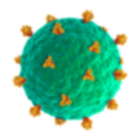
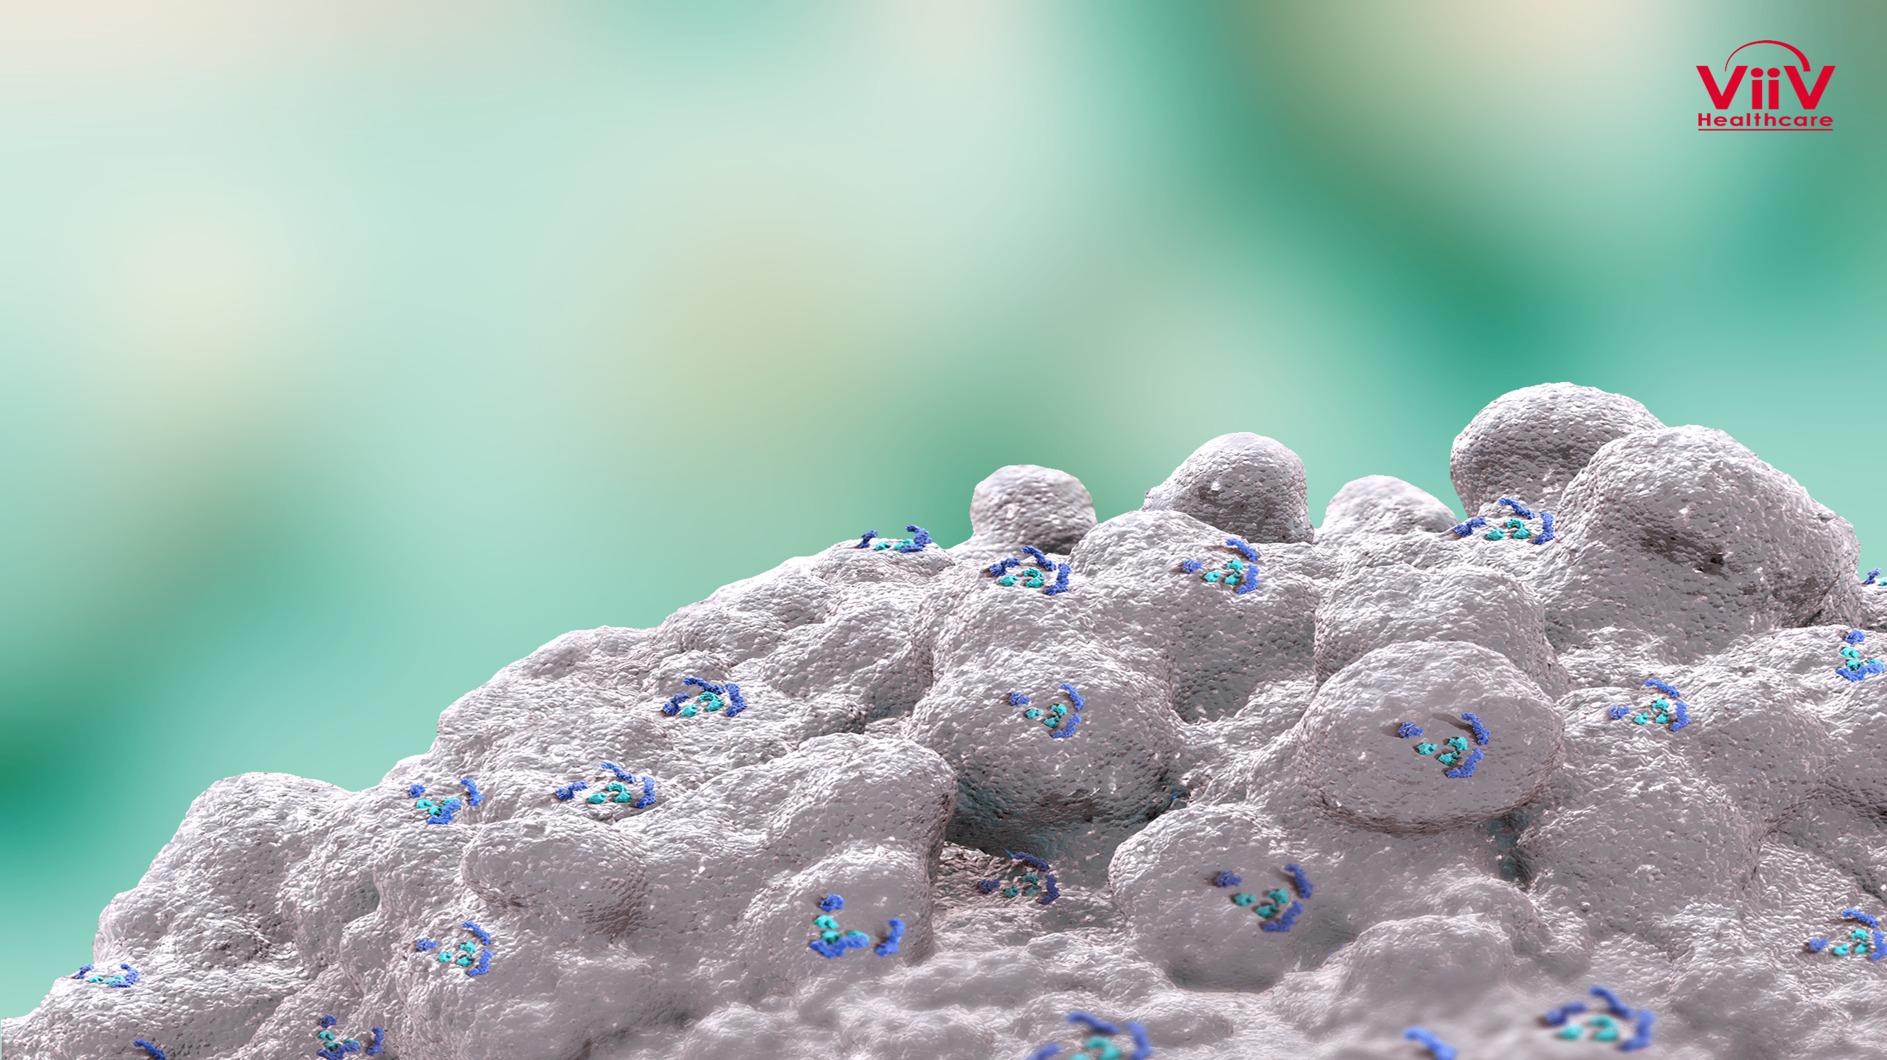
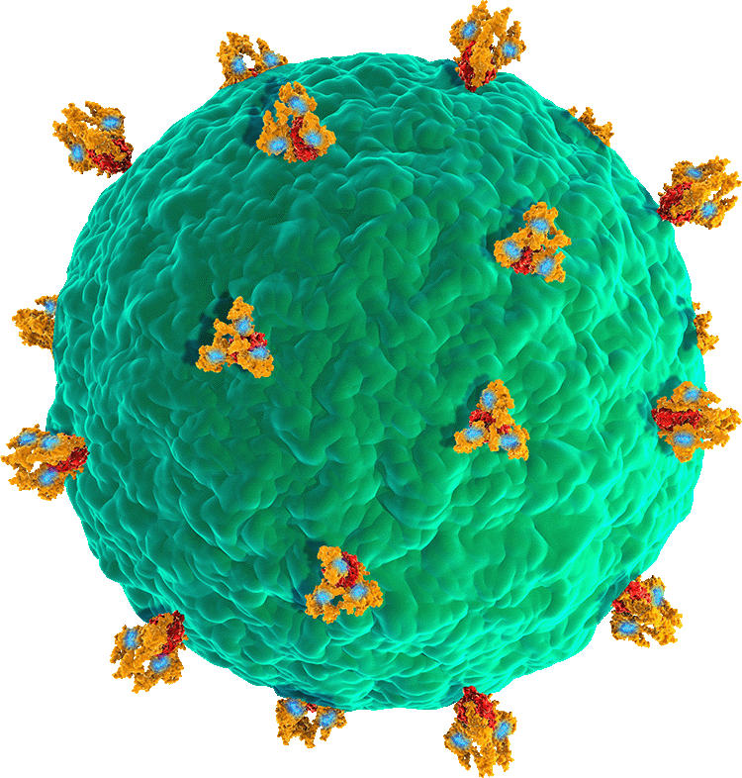
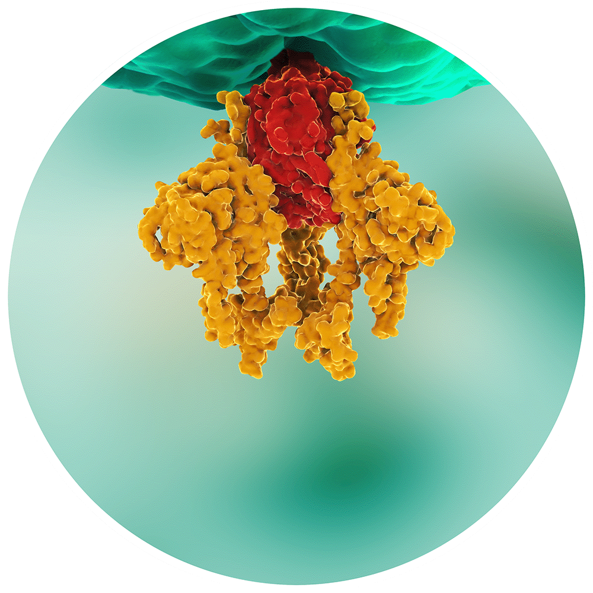
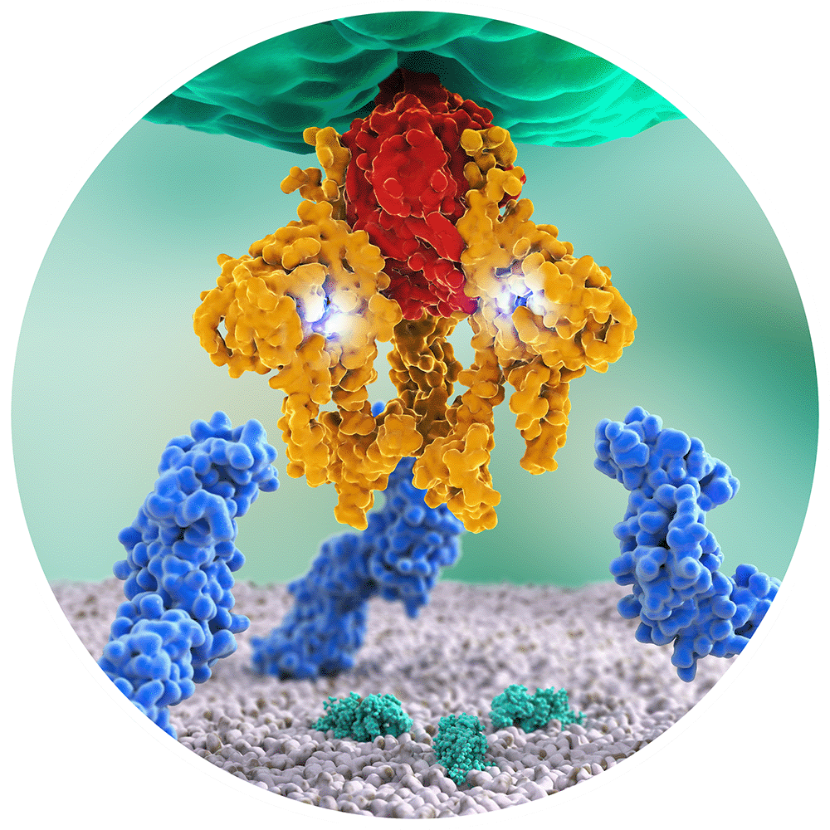
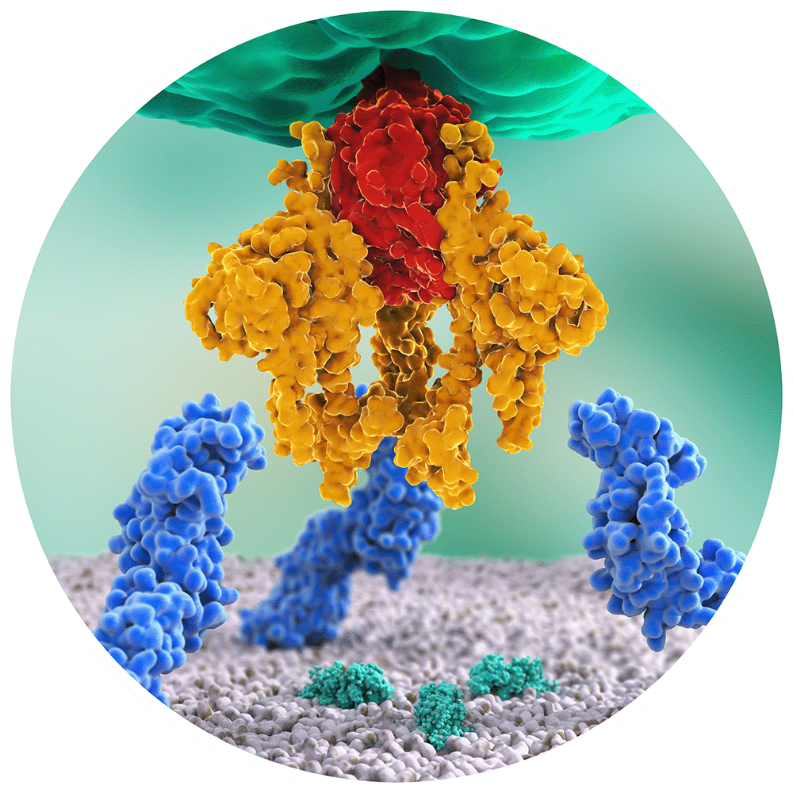
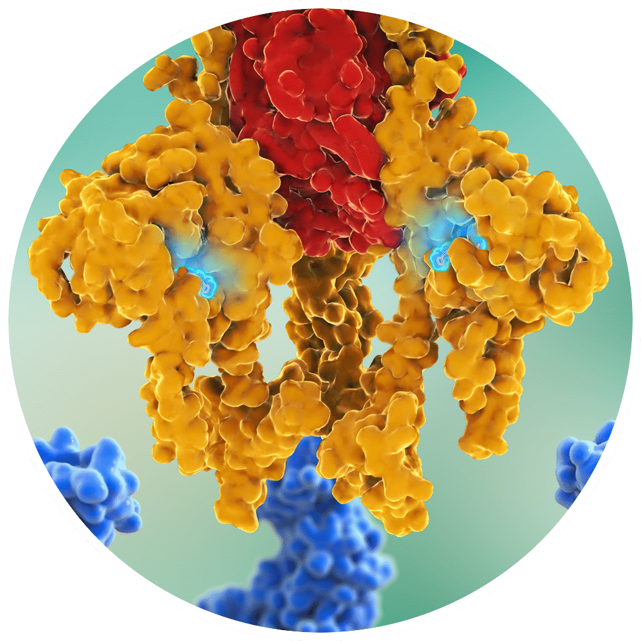
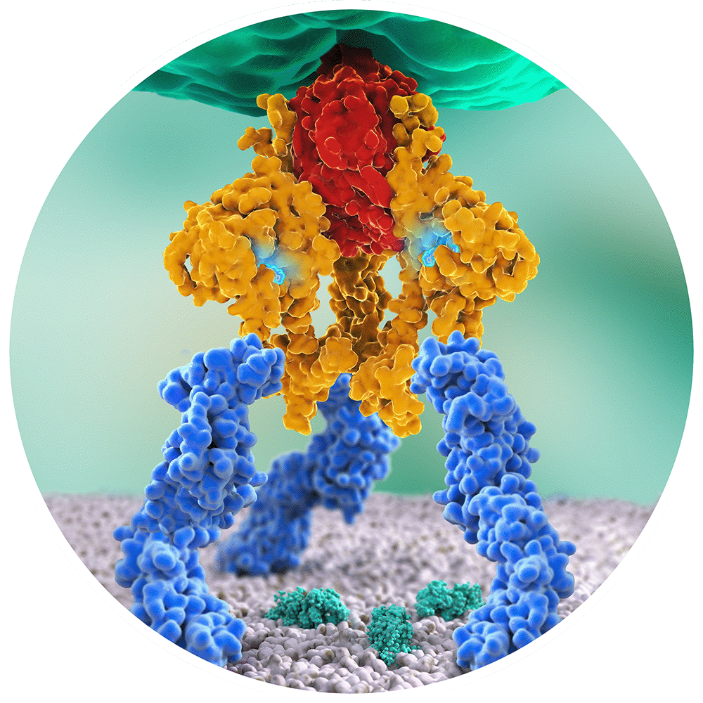
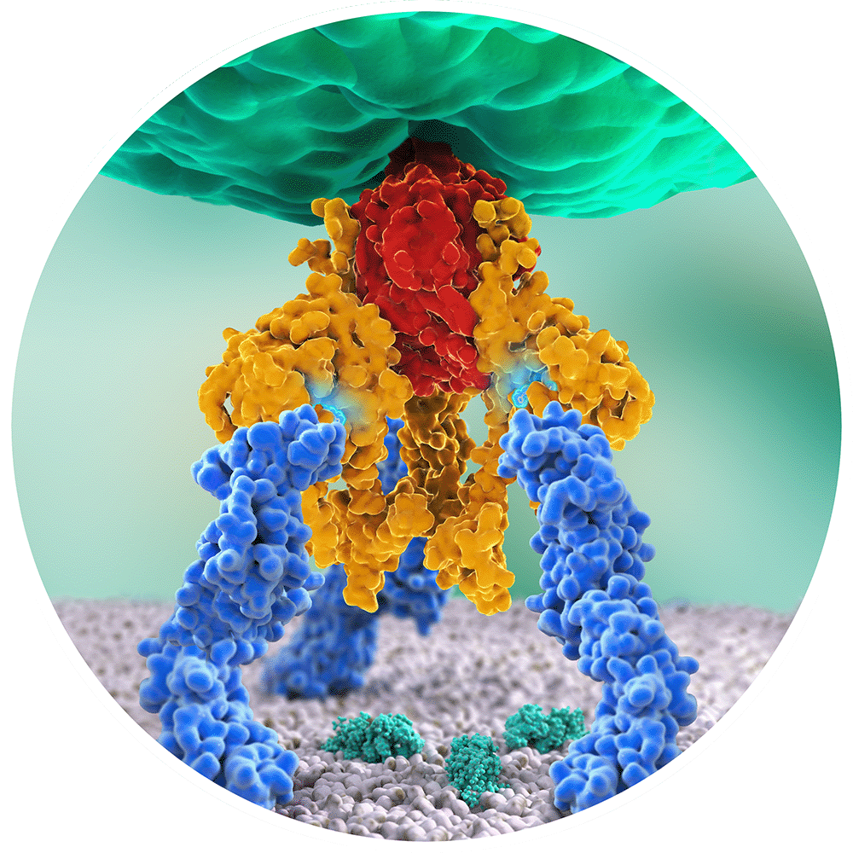
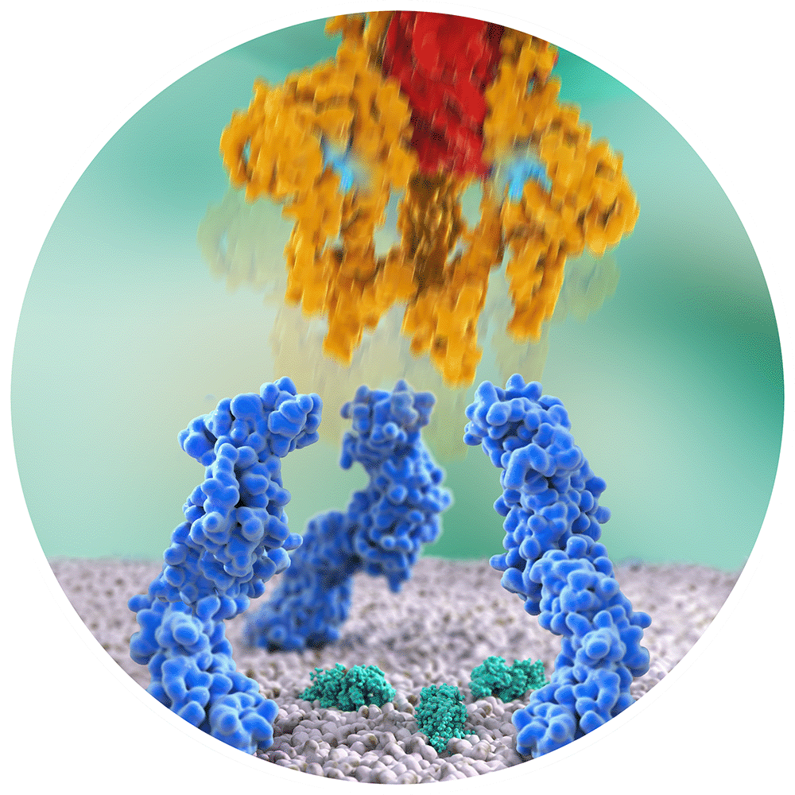
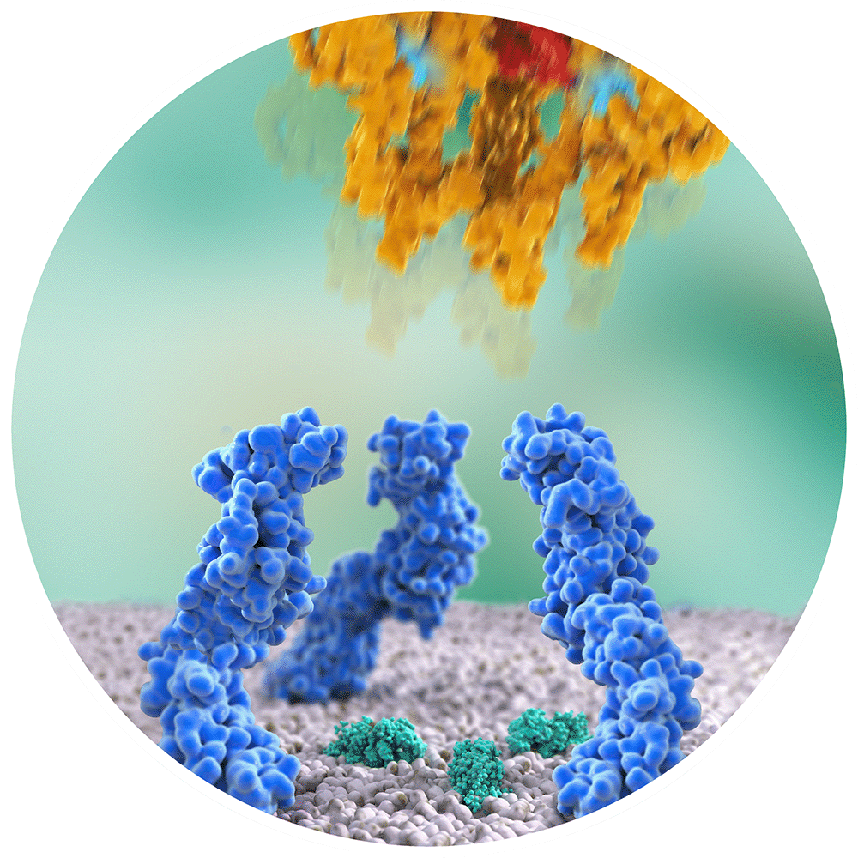
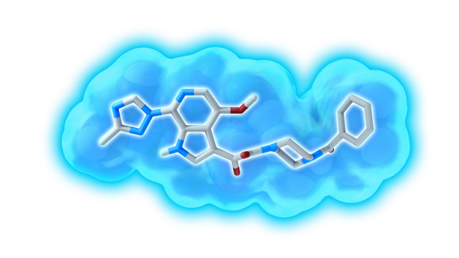
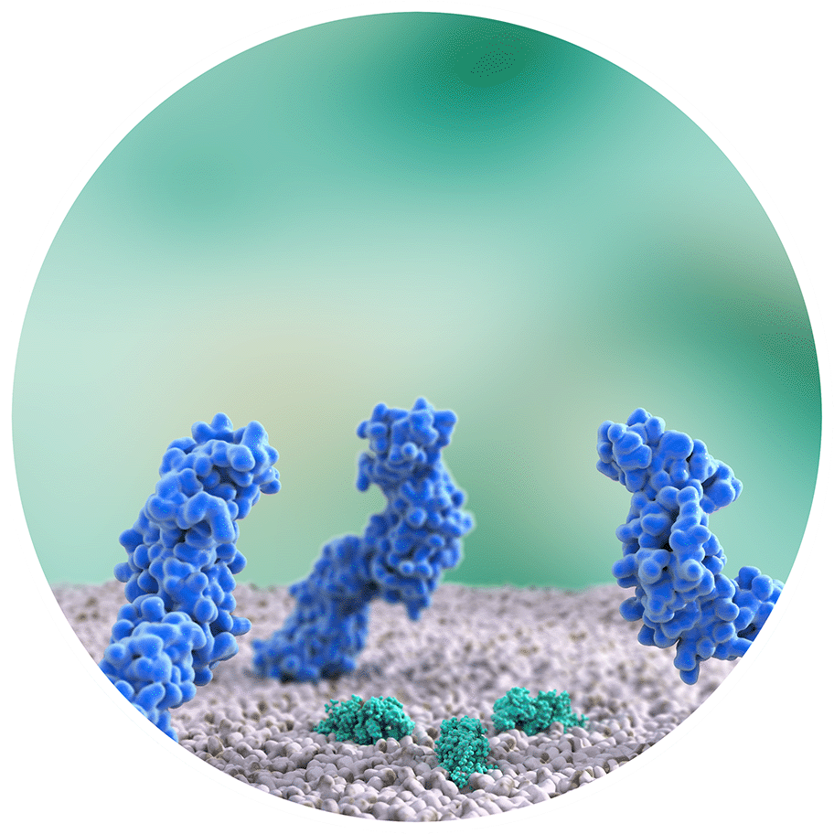
Fostemsavir, prodrug metabolized to temsavir, a first in-class attachment inhibitor that binds to gp120, preventing HIV attachment and entry into the CD4+ T cell
Temsavir mode of action
Temsavir prevents gp120
conformational
change,
inhibiting
HIV-1
attachment
CD4 binding
site
Attachment inhibited
Temsavir
Temsavir binds near the CD4 binding site
gp120 trimer
gp41 trimer
gp160
CD4 receptor
CCR5/CXCR4
Lataillade M, IAS 2019, Abs. MOAB0102

Slide 23
BRIGHTE STUDY W96: fostemsavir in heavily treatment experienced patients with MDR
Patients with virologic failure (HIV RNA > 400 c/ml) and
1 or 2 ARV classes remaining with ≥ 1 fully active agent, unable to construct viable regimen: randomize 8 days add-on FTR 600 mg bid vs placebo, then FTR + OBT
0 ARV classes remaining and no fully active approved agents : non-randomized = FTR + OBT
Most common ARV agents in initial OBT
Randomized Cohort (N = 272)
Non-randomized Cohort (N = 99)
84
Not fully active
Not fully active
Fully active
75
75
Fully active
72
49
43
20
19
21
15
10
8
11
DTG (92% BID)
DRV (89% BID)
TFV (96% TDF)
Most common ARVs
Most common ARVs
Lataillade M, IAS 2019, Abs. MOAB0102

Slide 24
BRIGHTE STUDY W96
Virologic response through week 96 – Observed analysis
Randomized Cohort (N = 272)
Non-randomized Cohort (N = 99)
HIV-1 RNA copies/mL
HIV-1 RNA copies/mL
†
Lataillade M, IAS 2019, Abs. MOAB0102

Slide 25
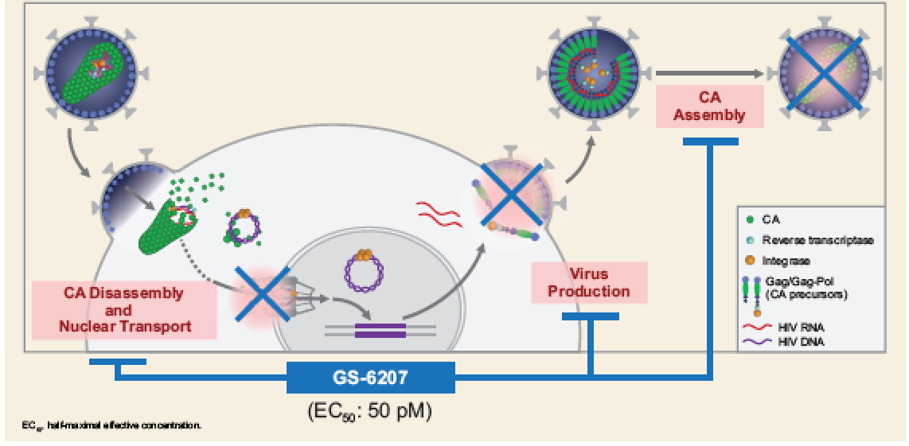
GS-6207: First-in-Class HIV Capsid Inhibitor
Phase 1 Objectives
Primary: to assess the efficacy of GS-6207 in reducing plasma HIV-1 RNA over 10 days after a single dose
Secondary: to assess the safety and tolerability of GS-6207
Daar ES, IAS 2019, Abs. LEPEB13

Slide 26
Subcutaneous GS-6207: Antiviral Activity
Single SC GS-6207 Dose
Start of B/F/TAF
0 -
- 0,.2
0 -
-1 -
Mean change in HIV-1 RNA
log10 c/ml (95% CI)
-1,5 -
- 1.8
- 1.8
-2 -
Placebo (N = 6)
GS-6207 50 mg (N = 6)
GS-6207 150 mg (N = 6)
GS-6207 450 mg (N = 6)
- 2.2
-2,5 -
-3 -
1
2
3
4
5
6
7
8
9
10
Time day
No treatment-emergent resistance was detected
ISR (63%), with rapid resolution
1 grade 3-4 lipase and 1 grade 3-4 CK elevation (group 150 mg)
Daar ES, IAS 2019, Abs. LEPEB13

Slide 27
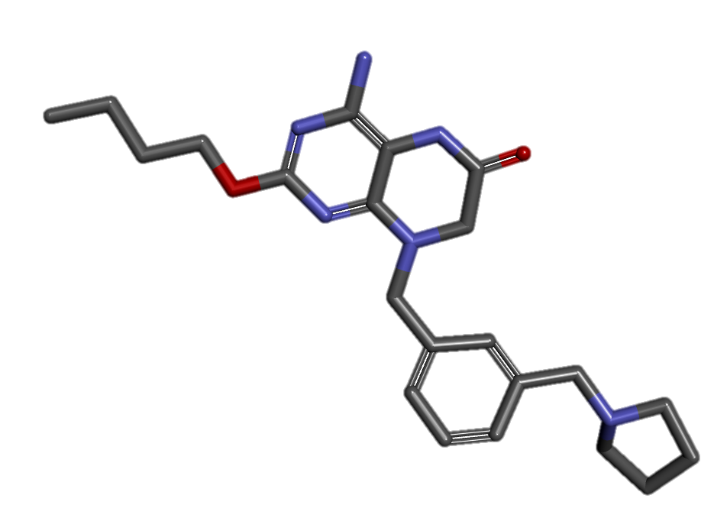
Immune-Based Strategies to Eliminate HIV Reservoirs Vesatolimod (GS-9620)
Protect
Vesatolimod
(TLR7 agonist)
ART
Activate
Eliminate
Infected CD4 T cells
bNAb
Vaccines
Vesatolimod
(TLR7 agonist)
Recruit
immune
cells
NK cells
MΦs
T cells
Goal
Combine TLR7 agonist, bNAbs, therapeutic vaccine
Riddler S, IAS 2019, Abs. WEAA0304

Slide 28
Vesatolimod Dose Escalation Study in PLWH
1 mg x 6
PLWH on ART
HIV RNA < 50 c/mL CD4 > 400
N = 48
2 mg x 6
Randomized 6:2
4 mg x 6
VES:PBO PO, fasted
Every other week
6 mg x 10
8 mg x 10
10 mg x 3→12 mg x 7 doses
Multiple doses of VES 1-12 mg were well tolerated
Plasma exposure of VES was generally dose proportional
Immune stimulation was evident at ≥ 6 mg doses
Cellular activation markers, plasma cytokine increases and Interferon-Stimulated Gene mRNA induction
No obvious changes in virologic markers (except single blips)
Riddler S, IAS 2019, Abs. WEAA0304

Slide 29
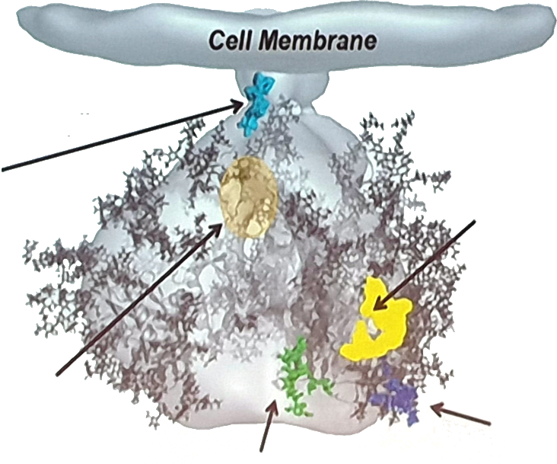
HIV-1 neutralizing antibodies
Background
HIV-1 viral spike
Gp41 MPER: 2F5, 4E10, 10E8, 10E8v4 V2
CD4 Binding Site: VRC01, VRC01 LS, PG04, CH31, 3BNC117, 12A12, CH103, VRC07-523LS, N6
Trimer (gp120/41): 8ANC195 PGT151 35022
V3/N332 Glycan Supersite: PGT121, PG128 10-1074
V1V2 Glycan: PG6, PG9 (GS-9277), GSPG16, CH01-04, PGT 141-145, PGMD1400, CAP259-VRC26.25
Chen G, IAS 2019, Abs. WEAA0305LB

Slide 30
HIV-1 broadly neutralizing antibodies, VRC01LS or VRC07-523LS (Phase 1)
Single IV infusion of 40 mg/kg IV, 16 HIV-infected adults not on ART
(7: VRC01LS ; 9: VRC07-523LS)
Reduction in viral load after VRC01LS or VRC07-523LS infusion
2
2
Subject 8
1
Subject 1
1
Subject 9
Subject 2
Subject 10
0
Subject 3
0
Subject 11
Δlog₁₀ virus load (copies/ml)
Subject 4
Subject 12
-1
Subject 5
-1
Subject 13
Subject 6
Subject 14
-2
Subject 7
-2
Subject 15
-3
-3
Subject 16
0
2
4
6
8
10
12
14
0
2
4
6
8
10
12
14
Days post infusion
Days post infusion
VRC01LS
Day 7: 2/7  ≥ 0.9 log₁₀
Day 14: 2/7  ≥ 1.6 log₁₀ (all subjects off ARVs)
No AE
VRC07-523LS
Day 7: 8/9  ≥ 1.2 log₁₀; 2/9 ≥ 2 log₁₀
Day 14: 6/9  ≥ 1.6 log₁₀; 7/9  0.6 log₁₀ (all subjects off ARVs)
1 infusion site reaction, 1 grade 3 neutropenia short duration
Chen G, IAS 2019, Abs. WEAA0305LB

Slide 31
INSTI and NTD
Definitive data !
WHO new
recommendations
ART
Toxicity
Rosuvastatin
Atherosclerosis
Weight gain
on INSTI
TDF-TAF switch
Kidney

Slide 32
Retrospective study (Brazil) NTD with ARV at conception
Of the total 1 452 birth outcomes, there were no NTD observed
DTG-exposed women incidence = 0 [95% CI: 0, 0.0099]
DTG-unexposed women incidence = 0 [95% CI: 0, 0.003]
 | No DTG (N = 1 068) | Any DTG (N = 384) | P value
NTD | 0 (0) | 0 (0) | -
Live birth Stillbirth Abortion | 1 025 (96.0) 15 (1.4) 28 (2.6) | 359 (93.5) 2 (0.5) 23 (6.0) | < 0.01
Pereira G, IAS 2019, Abs. MOAX0104LB

Slide 33
Prospective APR, Periconception: CNS and NTD by Drug Class
Periconception ARV | Births | Any Defect | CNS Defects | Neural Tube Defect | Encephalocele
Any ART | 8546 | 241 | 23 | 3 (0.03%) | 0
Any NRTI/NtRTI ABC FTC 3TC TDF | 8013 1027 2742 4129 3366 | 230 32 68 129 80 | 22 4 8 13 8 | 3 (0.04%) 1 (0.10%) 2 (0.07%) 1 (0.02%) 2 (0.06%) | 0 0 0 0 0
Any PI ATV DRV LPV/r | 3830 1067 436 949 | 112 25 16 22 | 9 3 1 5 | 1 (0.03%) 1 (0.09%) 0 0 | 0 0 0 0
Any NNRTI EFV NVP RPV | 2304 1037 943 329 | 57 25 28 4 | 5 3 2 0 | 1 (0.04%) 1 (0.10%) 0 0 | 0 0 0 0
InSTI DTG EVG RAL | 725 248 217 268 | 21 9 6 8 | 3 2 1 0 | 1 (0.14%) 1 (0.40%) 0 0 | 0 0 0 0
Mofenson L IAS 2019, Abs. TUAB0101

Slide 34
Tsepamo (Botswana): NTD Prevalence by Exposure at Conception
NTDs/Exposures | 5/1683 | 15/14792 | 3/7959 | 1/3840 | 70/89372
% with NTD (95% CI) | 0.30% (0.13, 0.69) | 0.10% (0.06, 0.17) | 0.04% (0.01, 0.11) | 0.03% (0.0, 0.15) | 0.08% (0.06, 0.10)
Prevalence Difference (95% CI) | ref | 0.20% (0.01, 0.59) | 0.26% (0.07, 0.66) | 0.27% (0.06, 0.67) | 0.22% (0.05, 0.62)
Zash R, IAS 2019, Abs. MOAX0105LB

Slide 35
Tsepamo-DTG at conception - Conclusions
Clinical and policy recommendations based on these findings should consider
Small potential risk of NTDs vs large projected benefits of DTG
No folic acid supplementation in Botswana
Lack of similar data for most other modern ARVs (except EFV) that would be acceptable alternatives to DTG
Many other unknown risks of in-utero exposure to ARVs
Long-term neurologic outcomes
Abnormalities not measured in Tsepamo
Modified from Zash R, IAS 2019, Abs. MOAX0105LB

Slide 36
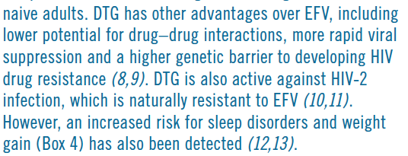

Slide 37
Preferred and alternative first-line ART regimens
Population | Preferred first-line regimen | Alternative first-line regimen | Special circumstances
Adults and adolescents | TDF + 3TC (or FTC) + DTG | TDF + 3TC + EFV 400 mg | TDF + 3TC (or FTC) + EFV 600 mg AZT + 3TC + EFV 600 mg TDF + 3TC (or FTC) + Pl/r TDF + 3TC (or FTC) + RAL TAF' + 3TC (or FTC) + DTG ABC + 3TC + DTG
Children | ABC + 3TC + DTG | ABC + 3TC + LPV/r ABC + 3TC + RAL TAF + 3TC (or FTC) + DTG | ABC + 3TC + EFV (or NVP) AZT + 3TC + EFV (or NVP) AZT + 3TC + LPV/r (or RAL)
Neonates | AZT + 3TC + RAL | AZT + 3TC + NVP | AZT + 3TC + LPV/r

Slide 38
ADVANCE study: 1st line open-label randomized ART in Johannesburg
TAF/FTC + DTG (N = 351) vs TDF/3TC + DTG (N = 351) vs TDF/3TC/EFV600 (N = 351)
Percentage weight change (%) to w96 (incomplete data W48-W96)
MEN
WOMEN
22
TDF/FTC+DTG
22
TDF/FTC+DTG
20
TAF/FTC+DTG
TDF/FTC/EFV
20
TAF/FTC+DTG
TDF/FTC/EFV
18
18
16
16
+16%
14
14
***
12
12
Mean weight change (% from baseline)
Mean weight change (% from baseline)
10
10
***
8
+7%
8
+8%
6
+6%
6
*
4
4
+4%
2
+2%
2
0
0
0
4
12
24
36
48
60
72
84
96
0
Weeks
4
12
24
36
48
60
72
84
96
* P <0,05 ; ** p < 0,01 ; *** p < 0,001
Weeks
Percentage weight change over time
MEN
WOMEN
TAF/FTC+DTG
TDF/FTC+DTG
TDF/FTC/EFV
TAF/FTC+DTG
TDF/FTC+DTG
TDF/FTC/EFV
100
100
100
100
100
100
80
80
80
80
80
80
60
60
60
60
60
60
40
40
40
40
40
40
20
20
20
20
20
20
0
0
0
0
0
0
0
12
24
36
48
60
72
84
96
0
12
24
36
48
60
72
84
96
0
12
24
36
48
60
72
84
96
0
12
24
36
48
60
72
84
96
0
12
24
36
48
60
72
84
96
0
12
24
36
48
60
72
84
96
≥20% loss
≥10% loss
+/-10%
≥20% gain
Hill A, IAS 2019, Abs. MOABX0102LB

Slide 39
NAMSAL study: 1st line open-label randomized ART in AFRICA (Cameroon)
TDF/3TC + DTG (N = 310) vs TDF/3TC + EFV400 (N = 303)
Changes in body weight/BMI by arm at week 48
Week 48 | TDF/3TC+DTG (N = 293) | TDF/3TC+EFV400 (N = 278) | P-value for difference
Mean change from baseline : Weight (kg) BMI (kg/m²) | +5 + 1,7 | +3 +1,2 | < 0,001 < 0,001
Treatment-emergent overweight (BMI 25 - 29,9), n (%) | 16% | 17% | n.s.
Treatment-emergent obesity (BMI ≥ 30), n (%) | 12% | 5% | < 0,01
Hill A, IAS 2019, Abs. MOABX0102LB

Slide 40
PrEP
Implementation
TAF/FTC vs TDF/FTC
DISCOVER
Vaccines
APPROACH ASCENT DNA/MVA
Prevention
Dapivirine
Vaginal ring
MTN-025/HOPE
Islatravir
implant

Slide 41
DISCOVER: Randomized, Double Blind, Non inferiority PrEP Trial
F/TAF 200/25 mg QD
N = 2 694
MSM or TGW
Adults ≥ 18 y
Randomized
1:1
Double-blinded
Active controlled
Primary analysis:
HIV incidence/100 PY when 100% complete Week 48 & 50% complete Week 96
F/TDF 200/300 mg QD
N = 2 693
HIV Incidence/100 PY (95% CI)
Incidence Rate Ratio (95% CI)
PBMC TFV-DP Levels
Favors F/TAF
Favors F/TDF
NI margin
0.47
98% >EC₉₀
68%
>EC₉₀
0.19
1.15
404
61
1.62
EC₉₀
N = 2 694
N = 2 693
7 infections
4370 PY
15 infections
4386 PY
IRR : 0.47 (0.16/0.34)
Spinner CD, IAS 2019, Abs. TUAC0403LB

Slide 42
MTN-025 HOPE
Phase 3b, dapivirine vaginal ring (25 mg/month)
1 342 HIV negative women (Malawi, South Africa, Uganda, Zimbabwe)
31 years, 57% no condoms, 16% STI
At 12 months
No safety issue
HIV incidence: 2.7/100 person-years (95% CI: 1.9-3.8), corresponding to a reduction of 39% vs expected rate
Baeten J. IAS 2019, Abs. TUAC0203

Slide 43
Islatravir Implant Phase 1
ISL implant based on Implanon®/Nexplanon®
Uses same polymer, Removable (not bioerodible), Able to use Nexplanon® applicator
Double-blind, placebo-controlled trial in healthy individuals
Objectives: safety, tolerability, PK
Panel A: 54 mg ; Panel B: 62 mg ; 8 (6 + 2 placebo) per panel
Implant placed subdermally in upper arm of non dominant hand, in place 12 weeks, followed by 4 weeks post-removal
PK (plasma and PBMC), safety
No discontinuations due to an AE and no severe implant-related AEs
No laboratory or other signs of systemic reactions
Local tolerability (erythema, induration, pruritus, tenderness) generally mild and possibly dose dependent
Matthews R. IAS 2019, Abs. TUAC0401LB

Slide 44
Islatravir Implant Phase 1
Intracellular ISL-TP PK Threshold of 0.05 pmol/10⁶ Cells Maintained Throughout Placement for Both Doses
54 mg Implant
62 mg Implant
10¹
Mean
10¹
Mean
Min & Max of range
Removal of
implant
Min & Max of range
Removal of
implant
Removal of implant
Removal of implant
10⁰
10⁰
10⁻¹
10⁻¹
ISL-TP (pmol/10⁶ cells)
ISL-TP (pmol/10⁶ cells)
PK Threshold : 0,05 pmol/10⁶ cells
10⁻²
PK Threshold : 0,05 pmol/10⁶ cells
10⁻²
10⁻³
10⁻³
0
5
10
15
0
5
10
15
Relative Nominal Time (weeks)
Relative Nominal Time (weeks)
62 mg implant projected to lead to concentrations above threshold for at least 12 months
Matthews R. IAS 2019, Abs. TUAC0401LB

Slide 45
ImPrEP
Objective: assess uptake, acceptability and feasibility of same day PrEP (TDF/FTC) for MSM and TGW in the context of HIV combination prevention
Design: multi-site prospective, open-label demonstration study (Brazil, Peru and Mexico), at Public Health services and NGOs
Population: 7500 MSM/TGW (Brazil: 3 000 ; Mexico: 3 000 ; Peru: 1 500)
High rate of STI at First visit: 11.5% GC ; 7.5% Chlamydia ; 10% syphilis ;
Acute HIV infection: 0.3% at this initial visit
 | N | Early continuation | HIV Incidence per 100 person years (CI 95%)
Brazil | 3 466 | 85.4% | 0.2 (0.1-0.6)
Mexico | 739 | 84.0% | 0.6 (0.2-2.3)
Peru | 1 149 | 52.7% | 2.4 (1.2-5.1)
Overall Overall TGW Overall 18-24 | 5 354 335 1 382 | 79.6% 55% 70.4% | 0.6 (0.3-1.0)
Veloso VG. IAS 2019, Abs. TUAC0404LB

Slide 46
Expanded PrEP implementation is effective
EPIC-NSW (New South Wales, Australia)
March 2016-April 2018: 9 708 PrEP initiations (98.5% MSM)
16 HIV incident diagnoses, all with evidence of non adherence
Global HIV incidence: 0.9/1000 PY (higher if methamphetamine use and history of rectal STI)
During follow-up, 13% stopped PrEP > 3 months (26% restarted)
May be associated with changes in risk profile
But intentional discontinuation associated with high risk behavior in some
Decrease of new HIV diagnoses of 44% in 2 years
PREVENIR (Paris, France)
May 2017-May 2019: 3057 PrEP initiations (98.7% MSM)
Daily TDF/FTC = 50.8% ; On demand = 49.2%
2 incident HIV infections (on demand PrEP, not adherent)
HIV incidence 0.9/1000 PY
Grulich A. IAS 2019, Abs. TUAC0201 ; Molina JM, IAS 2019, Abs. TUAC0202

Slide 47
Next ARV-trials.com webinars
EACS, Basel
9th November 2019

