Slide 1



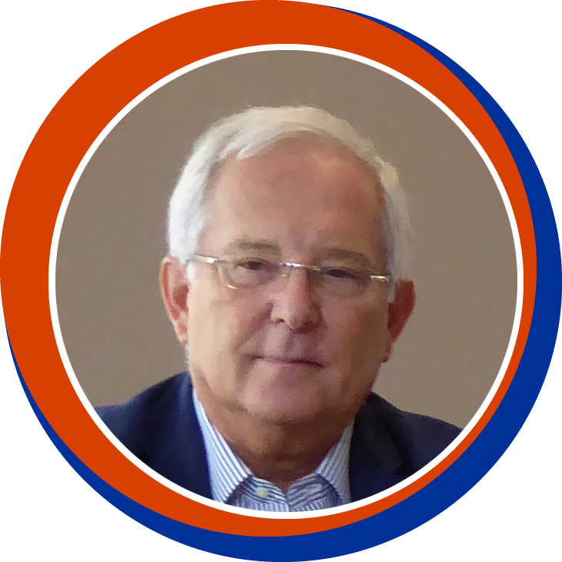
Does 2 equal 3 ?
September, 20th 2022
  Pedro Cahn
  (Argentina)
  Anton Pozniak
  (UK)
  François Raffi
  (France)

Slide 2
Disclosure
Pedro Cahn has received research support and/or honoraria for consulting
and/or advisory boards from Janssen ; MSD ; Richmond ; ViiV Healthcare
Anton Pozniak has received research support and/or honoraria for consulting
and/or advisory boards from Gilead ; Janssen ; MSD ; ViiV Healthcare
François Raffi has received research support and/or honoraria for consulting and/or advisory boards from Gilead ; Janssen ; MSD ; Theratechnologies ; ViiV Healthcare

Slide 3
Does 2 equal 3 ?
Classic combined ART = Triple therapy = 3 drugs from 2 classes (2 NRTI + X)
Today there has been much progress
  In triple cART
  2DR have demonstrated non-inferiority to triple ART in many situations
Then, the question is « Does 2DR equal 3DR ? »
  Are there specific situations to consider ?
  Are there limitations to 2DR ?
Objectives of this webinar are to review
  How treatment has evolved to 2DR,
  Available data with 2DR,
  Comparison of 2DR and 3DR for all aspects to consider for all important decisions
  when opting on a strategy,
  Potential limitations of 2DR

Slide 4
A look in the rearview mirror
History of HAART
  1 NRTI No good
  2 NRTIs Not enough
  2 NRTIs + PI (PI/r) or NNRTI Standard of care since 1996
Problems with Initial Triple ART
  Pill burden
  Low genetic barrier
  Poor tolerance
  Toxicity
  Drug interactions

Slide 5
1996-2006: cART = Triple ART
Since 2006: Alternative strategies have been studied
Attempts at alternative strategies
  Structured treatment interruptions (STI)
  Later initiation vs Today Universal Treatment/TasP/U = U
  Dual combinations
    EFV + boosted PI ACTG5142, Riddler SA. NEJM 2008;395:2095-2106
    RAL + boosted PI (NEAT001) NEAT001/ANRS143, Raffi F. Lancet 2014;384:1942-51
  Monotherapy
    Boosted PI Almost as good as triple 2008-2010
    In meta-analysis: a few more failures
    DTG monotherapy Virologic failures with resistance emergence 2016-2019

Slide 6
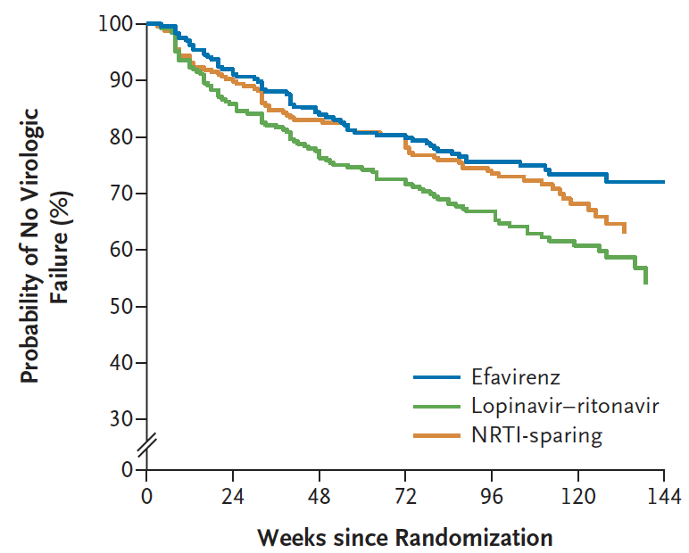
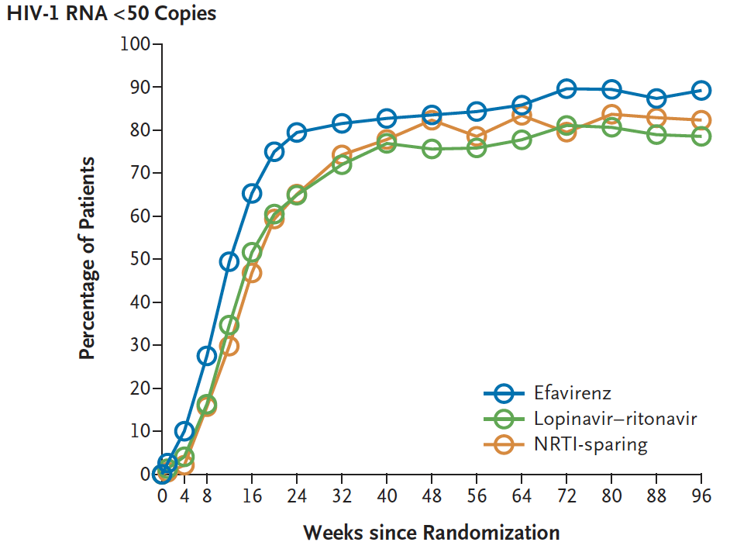
Class-Sparing Regimens for Initial Treatment of HIV-1 Infection
EFV = EFV + 3TC + NRTI *
LPV/r = LPV/r + 3TC + NRTI*
NRTI-sparing = EFV + LPV/r
* NRTI = ZDV 42%, TDF 34% d4T 24%
89
83
77
NRTI-sparing:
  High pill burden
  More Grade 3-4 laboratory abnormalities (lipids)
  High incidence of resistance at virological failure
Regimen | Time to virologic failure
Efavirenz vs lopinavir-ritonavir | 0,63 (0.45-0.87)
Efavirenz vs NRTI-sparing therapy | 0,86 (0.61-1.21)
Lopinavir-ritonavir vs NRTI sparing therapy | 1,30 (0.95-1.77)
Riddler SA. NEJM 2008; 395: 2095-2106

Slide 7
DRV/r + RAL vs DRV/r + TDF/FTC in antiretroviral-naive adults infected with HIV-1: 96 week results from the NEAT001/ANRS143 randomised non-inferiority trial
HIV RNA < 50 c/mL
100
80
60
NO benefit of DRV/r + RAL
Frequency of serious or treatment-modifying AEs
Similar marginal difference in eGFR changes
BID regimen
High incidence of RAL resistance at failure
Percentage of participants (95% CI)
40
20
RAL + DRV/r, 89.4% (95% CI : 85.7-92.4)
TDF-FTC + DRV/r, 93.3% (95% CI : 90.3-95.6)
0
0
4
8
12
18
24
32
48
64
80
96
 | Baseline CD4 cell count <200 cells per pL and HIV RNA concentration <100000 copies per mL (N=46) |  | Baseline CD4 cell count a200 cells per pL and HIV RNA concentration <100 000 copies per mL (N=484) |  | Baseline CD4 cell count <200 cells per pL and HIV RNA concentration 2100 000 copies per mL (N=77) |  | Baseline CD4 cell count 2200 cells per pL and HIV RNA concentration 2100000 copies per mL (N=198)
 | RAL + DRV/r | TDF-FTC + DRV/r | RAL + DRV/r | TDF-FTC + DRV/r | RAL + DRV/r | TDF-FTC + DRV/r | RAL + DRV/r | TDF-FTC + DRV/r
Number meeting endpoint | 3/23 | 3/23 | 19/232 | 21/252 | 23/37 | 12/40 | 32/109 | 25/89
Proportion meeting primary endpoint | 9.4% | 9.0% | 7.1% | 7.1% | 60.1% | 29.9% | 26.5% | 28.4%
Difference (95% CI) | 0.4% (13.7 to 14.6) | - | 0% (-3.9 to 3.9) | - | 30.3% (13.8 to 46.8) | - | 1.9% --13.9 to 10.0) | -
Raffi F. Lancet 2014; 384 : 1942-51

Slide 8
PI/r monotherapy – meta-analysis in virologically suppressed patients
Rates of HIV RNA suppression
PI/r monotherapy
Triple therapy
Risk difference
Risk difference
IV, random, 95% CI
Study or subgroup
OK pilot
KalMo
KRETA
Monarch
MODAT
MOST
DREAM
MONOI
OK-04
MONET
KALESOLO
PROTEA
Total (95% CI)
Total events
Heterogeneity: tau² = 0.00; χ=7.19 ; df =11 (p = 0.78) ; ІІ=0%
Tets for overall effect: Z = 4.62 (p < 0.0001)
Events
17
24
29
14
37
23
63
66
77
88
73
118
629
Total
21
30
44
15
51
29
98
112
100
127
87
137
851
Events
20
26
37
15
44
31
69
79
76
97
87
129
710
Total
21
30
44
15
52
31
97
113
98
129
99
136
865
Weight
3.4%
3.6%
4.0%
4.5%
5.1%
5.3%
7.3%
8.1%
9.2%
10.5%
12.4%
26.5%
100%
IV. random. 95% CI
-0.14 (-0.33 ; 0.05)
-0.07 (-0.25 ; 0.12)
-0.18 (-0.36 ; -0.00)
-0.07 (-0.23 ; 0.10)
-0.12 (-0.28 ; 0.04)
-0.21 (-0.36 ; -0.05)
-0.07 (-0.20 ; 0.06)
-0.11 (-0.23 ; 0.01)
-0.01 (-0.12 ; 0.11)
-0.06 (-0.17 ; 0.05)
-0.04 (-0.14 ; 0.06)
-0.09 (-0.16 ; -0.02)
-0.08 (-0.12 ; -0.05)
-0.5
-0.25
0
0.25
0.5
Favours triple therapy
Favours PI monotherapy
Arribas JR. HIV Medicine 2016; 17:358-67

Slide 9
2006-2020 = Improvement in Triple ART
At the same time
  Many old ARVs dropped for inconvenience, toxicity, inferiority to or poorer tolerance than new drugs in the class
  Improvement of pill burden with STR, with NNRTI (EFV/FTC/TDF, RPV/FTC/TDF-TAF, DOR/3TC/TDF), PI/r (DRV/c/FTC/TAF), INSTI (DTG/ABC/3TC, DTG/TDF/3TC, EVG/c/FTC/TDF-TAF, BIC/FTC/TAF)
  3TC remaining in the game for > 35 years (« me too » FTC)
    Companion of all triple cART
    Specific unique resistance profile (M184V/I mutation)
    Absence of long-term toxicity, the safest ARV

Slide 10
20 years of ARV research (1996-2016)
The quest for NRTI-sparing regimen
  EFV based-regimens
  MVC-based regimens
  RAL-based regimens
Overcoming problems with triple therapies
  Potency
  Resistance
  Forgiveness
  Toxicity (ZDV,d4T, ddI, TDF)
  Metabolic issues (PI/r)
  d-d-i
  Complexity
Overall, failure of the strategy
Many STR available

Slide 11
The road to modern 2DR
If potent ARV with high genetic barrier to resistance is not enough as monotherapy, could it be optimal as 2DR
  New way of thinking: rather than 2 NRTI + X, building with X + 3TC (as the « gold standard » NRTI)
Dual combination = A potent « 3rd drug » with high genetic barrier to resistance + 3TC
  PI/r + 3TC
  DTG + 3TC

Slide 12
PI/r + 3TC, the first 2DR
Naive patients
  GARDEL study: LPV/r + 3TC vs LPV/r + 2 NRTI. Cahn P. Lancet Infect Dis 2014;14:572-80
    Non-inferiority of 2DR, also in patients with baseline HIV RNA ≥ 100 000 c/mL
    No resistance mutations to PI at virologic failure in either group (2 patients with M184V in 2DR group)
    Incidence of AEs higher in 3DR group (discontinuation because of AEs mainly related to NRTI)
Switch to ATV/r + 3TC
  SALT study: Perez-Molina JA. Lancet Infect Dis 2015;15:775-84 & Journal Antimicrob Chemother 2017;72:246-53
  ATLAS-M study: De Giambenedetto S. Journal Antimicrob Chemother 2017;72:1163-71
Switch to LPV/r + 3TC
  OLE study: Arribas JR. Lancet Infect Dis 2015;15:785-92
Switch to DRV/r + 3TC
  DUAL GESIDA: Pulido F. Clin Infect Dis 2017;65:2112-8

Slide 13
2DR vs 3DR: Equal or Different ?
Potency?
Advanced infection/late presenters?
Durability?
Genetic barrier to resistance?
Forgiveness for missing doses?
Frequency of viral load monitoring?
Tolerance?
Long term toxicity?
Penetration in sanctuaries?
Residual viremia, Inflammation?
Effect on lipids?
Use in HBV coinfection (3TC-based)?

Slide 14
2DR vs 3DR in Naive: the DTG question
Is it possible to initiate treatment with 2DR (DTG/3TC) ?
Are there specific situations to consider ?
Is test and immediate start feasible with DTG/3TC ?

Slide 15
GEMINI 1 & 2 Studies:
DTG + 3TC vs DTG + TDF/FTC in first-line (1)
Randomisation *
1 : 1
Double-blind
W96
Design
HIV+ ≥ 18 years
ARV-naïve
HIV RNA 1 000-500 000 c/mL
No HBV co-infection
No major HIV resistance mutations
N = 716
DTG + 3TC
DTG + TDF/FTC
N = 717
* Randomisation stratified by HIV RNA (≤ or > 100 000 c/mL) and CD4 (≤ or > 200/mm³)
Primary endpoint
  2 parallel studies (GEMINI-1 and GEMINI-2), each with a combined number of 710-720 patients and similar endpoint
  Proportion of patients with HIV RNA < 50 c/mL at W48, ITT-E analysis, snapshot algorithm ; non-inferiority if lower margin of a one-sided 97.5% CI for the difference = - 10%, 90% power
GEMINI
Cahn P. Lancet. 2019;393(10167):143-155 ; Cahn P, J AIDS 2020;83:310-8 ; Cahn P. AIDS 2022;36:39-48

Slide 16
GEMINI 1 & 2 Studies:
DTG + 3TC vs DTG + TDF/FTC in first-line (2)
Baseline characteristics
 | DTG + 3TC N = 716 | DTG + TDF/FTC N = 717
Median age, years | 32 | 33
Female, % | 16 | 14
HIV RNA, log₁₀ c/mL, mean ≤ 100 000 c/mL, % > 100 000 c/mL, % | 4.42 80 20 | 4.45 79 21
CD4/mm³, mean < 200, % ≥ 200, % | 462 9 91 | 461 8 92
HCV co-infection, % | 5 | 7
GEMINI
Cahn P. Lancet. 2019; 393(10167):143-155

Slide 17
GEMINI 1 & 2 Studies: W144 results (3)
% of Participants With HIV-1 RNA <50 c/mL in the Pooled ITT-E Population
100
93
93
89
90
87
86
84
80
72
93
91
87
84
86
84
82
60
70
40
DTG + 3TC (N = 716)
20
DTG + TDF/FTC (N = 717)
0
0
4
8
12
16
24
36
48
60
72
84
96
108
120
132
144
Study visit
DTG + 3TC was non inferior to DTG + TDF/FTC in Snapshot HIV-1 RNA < 50 c/mL for GEMINI-1, GEMINI-2, and the pooled population at week 144
Cahn P. AIDS 2022; 36:39-48

Slide 18
GEMINI 1 & 2 Studies: W144 results (4)
HIV RNA < 50 c/mL (ITT-E snapshot) by subgroup at week 144
N
DTG + TDF/FTC
DTG + 3TC
Overall
716
717
-1,8
Baseline HIV-1
RNA, copies/ml
> 100 000
140
153
-1,5
< 100 000
576
564
-2,1
Baseline CD4+ cell
count, cells/µl
> 200
653
662
-1,1
< 200
63
55
-9,7
Positive
39
49
-5,8
HCV serostatus
Negative
676
668
-1,7
> 50
65
80
0,6
Age
35 to 50
231
229
-0,7
< 35
420
408
-0,6
Female
113
98
Sex
Male
603
619
-9,3
-0,6
-35
-30
-25
-20
-15
-10
-5
0
5
10
15
20
25
30
Difference in proportion, % (95% CI)
Cahn P. AIDS 2022; 36:39-48

Slide 19
GEMINI 1 & 2 Studies:
DTG + 3TC vs DTG + TDF/FTC in first-line (5)
Time to viral suppression, HIV RNA < 50 c/ml
(cumulative incidence): pooled ITT-E population
  Participants with baseline
  HIV-1 RNA > 100 000 c/mL
  All participants
DTG + 3TC (N = 716)
DTG + 3TC (N = 140)
DTG + TDF/FTC (N = 717)
DTG + TDF/FTC (N = 153)
1,0
1,0
0,8
0,8
0,6
0,6
0,4
0,4
0,2
0,2
0
0
0
4
8
12
16
24
36
48
60
0
4
8
12
16
24
36
48
60
Weeks
Weeks
Median time to viral suppression:
DTG + 3TC vs DTG + TDF/FTC = 29.0 vs 29.0 days
Median time to viral suppression:
DTG + 3TC vs DTG + TDF/FTC = 57.0 vs 57.0 days
Eron J. HIV DART and Emerging Viruses 2018; Miami, FL. Oral Presentation #7

Slide 20
GEMINI 1 & 2 Studies:
HIV RNA < 40 c/mL with target not detected (6)
85
Weeks to HIV RNA < 40 c/mL with target not detected (observed data)
Baseline HIV RNA < 100 000 c/mL
CD4 > 200/mm³
1.0
1.0
0.8
0.8
0.6
0.6
N | Group | Median, Weeks (95 % CI)
573 | DTG + 3TC | 8 (NE - NE)
594 | DTG + TDF/FTC | 8 (NE - NE)
N | Group | Median, Weeks (95 % CI)
499 | DTG + 3TC | 8 (8 - 8)
510 | DTG + TDF/FTC | 8 (8 - 8)
0.4
0.4
0.2
0.2
0
0.0
0
4
8
12
16
24
36
48
60
72
84
96
108
0
4
8
12
16
24
36
48
60
72
84
96
108
HIV RNA > 100 000 c/mL
CD4 < 200/mm³
1.0
1.0
0.8
0.8
0.6
N | Groupe | Median, Weeks (95 % CI)
117 | DTG + 3TC | 16 (16 - 24)
132 | DTG + TDF/FTC | 24 (24 - 36)
0.6
N | Group | Median, Weeks (95 % CI)
43 | DTG + 3TC | 16 (12 - 24)
48 | DTG + TDF/FTC | 12 (8 - 24)
0.4
0.4
0.2
0.2
0.0
0.0
0
4
8
12
16
24
36
48
60
72
84
96
108
0
4
8
12
16
24
36
48
60
72
84
96
108
Underwood M, EACS 2019, Abs. PS8/2

Slide 21
GEMINI 1 & 2 Studies:
HIV replication at < 50 c/ml through 144 weeks (7)
Proportions with TND or TD by visit, ITT-E population
DTG + 3TC TD
DTG + TDF/FTC TD
DTG + 3TC TND
DTG + TDF/FTC TND
100
80
60
Proportion of participants (%)
40
20
0
S4
S8
S12
S16
S24
S36
S48
S60
S72
S84
S96
S108
S120
S132
S144
Study visit
Underwood M, IAS 2021, Abs. PEB163

Slide 22
GEMINI 1 & 2 Studies:
Blips through 144 weeks (8)
Proportions with ≥ 1 blip through W144, by sub-groups, ITT-E population
50 %
DTG + 3TC « blips »
DTG + TDF/FTC « blips »
40 %
153
30 %
55
Proportion of participants, %
140
20 %
717
63
662
716
564
653
10 %
576
0 %
Overall
BL VL
≤ 100 000
BL VL
> 100 000
BL CD4
≤ 200
BL CD4
> 200
Underwood M, IAS 2021, Abs. PEB163

Slide 23
GEMINI 1 & 2 Studies:
Resistance emergence (9)
Confirmed virologic withdrawal (CVW)
  Decrease from baseline in HIV RNA < 1 log₁₀ c/mL, unless HIV RNA < 200 c/mL, by W12
  Confirmed HIV RNA ≥ 200 c/mL at or after W24
  Confirmed rebound (HIV RNA ≥ 200 c/mL) after confirmed HIV RNA < 200 c/mL
  Genotypic and phenotypic resistance tests on initial suspected plasma sample
CVW up to W144
  All were virologic rebounds
 | DTG + 3TC N = 716 | DTG + TDF/FTC N = 717
CVW at W48, N (%) | 6 (0.8) | 4 (0.6)
CVW at W96, N (%) | 11 (1.5) | 7 (1.0)
CVW at W144, N (%) | 12 (1.7) | 9 (1.3)
Emergence of INSTI or NRTI resistance mutations | 1 (M184V + R263R/K) | 0
Cahn P. AIDS 2022; 36:39-48

Slide 24
GEMINI 1 & 2 Studies:
Adverse events through week 144 (10)
 | DTG + 3TC (N = 716) | DTG + TDF/FTC (N = 717)
Drug-related AEs | 146 (20) | 192 (27)
Grade 2-5 drug-related AEs | 58 (8) | 69 (10)
Grade 2-5 drug-related AEs occurring in >1% of participants
Headache | 8 (1) | 8 (1)
Serious AEs | 76 (11) | 85 (12)
AEs leading to withdrawal from study | 31 (4) | 33 (5)
AEs of interest leading to withdrawal from study
Psychiatric | 11 (2) | 8 (1)
Renal-related | 2 (<1) | 12 (2)
Osteoporosis | 0 | 2 (<1)
Significantly lower risk of drug-related AEs with DTG + 3TC vs DTG + FTC/TDF
  20% vs 27%; relative risk: 0.76
  (95% CI: 0.63-0.92)
Cahn P. AIDS 2022; 36:39-48

Slide 25
GEMINI 1 & 2 Studies:
Renal biomarkers (11)
Mean change from baseline in serum/plasma
renal biomarkers at W144
Mean change from baseline in ratios of urine
renal biomarkers at W144, %
DTG + 3TC (N = 716)
DTG + TDF/FTC (N = 717)
**
**
*
**
**
**
GFR from
cystatin C,
CKD-EPI
(ml/min per 1,73 m²)
Creatinine
(µmol/l)
GFR from
creatinine,
adjusted for BSA
(ml/min per 1,73 m²)
Protein/
Creatinine
(g/mol)
Retinol-binding
protein/
creatinine
(µg/mol)
Beta-2
microglobulin/
creatinine
(mg/mmol)
Cahn P. AIDS 2022; 36:39-48

Slide 26
GEMINI 1 & 2 Studies:
Bone turnover biomarkers (12)
Mean change from baseline in serum bone turnover biomarkers at Week 144, μg/L
DTG + 3TC (N = 716)
DTG + TDF/FTC (N = 717)
**
**
**
**
Bone specific alkaline
phosphatase
Osteocalcin
Procollagen 1
N-terminal
Type 1 collagen
C-telopeptide
Cahn P. AIDS 2022; 36:39-48

Slide 27
GEMINI 1 & 2 Studies:
Lipids (13)
Mean change from baseline in fasting lipids at Week 144
DTG + 3TC (N = 716)
DTG + TDF/FTC (N = 717)
**
**
**
*
*
Total
cholesterol
(mmol/l)
HDL
cholesterol
(mmol/l)
LDLcholesterol
(mmol/l)
Triglycerides
(mmol/l)
Total cholesterol/
HDL cholesterol ratio
Cahn P. AIDS 2022; 36:39-48

Slide 28
GEMINI 1 & 2 Studies:
Week 144 Weight Gain (14)
Mean Change in Weight From Baseline at W144 (kg)
4 -
3.7
3.8
3 -
2.7
2.5
2.4
2 -
1.8
1 -
0 -
All patients
Women
Men
DTG + 3TC
(N = 716)
DTG + TDF/FTC
(N = 717)
DTG + 3TC
(Women, n = 113;
Men, N = 603)
DTG + TDF/FTC
(Women, n = 98;
Men, N = 619)
Cahn. HIV Glasgow 2020. Abstr P018
Notes:
3TC, lamivudine; AE, adverse event; DTG, dolutegravir; FTC, emtricitabine; TDF, tenofovir disoproxil fumarate.

Slide 29
The STAT Study: DTG/3TC as 1st line regimen in a TEST-AND-TREAT Setting for newly diagnosed PLWHiV (1)
Phase IIIb, multicentre, open-label, single-arm study in the United States
131 Treatment-naïve adults aged ≥18 years
  diagnosed with HIV within 14 days of study entry for whom laboratory results were not available at baseline, willing to initiate ART immediately
Exclusion criteria: HIV-1 drug resistance genotype test results known prior to Day 1, Known/suspected HBV
Treatment adjusted if BL resistance, HBV co-infection, CrCL < 30 mL/min, or as required
Population:
  Median age 31, female 15%
  Time to enrolment since diagnosis, median (range): 5 days (0-15)
  Enrolled on day of diagnosis: 26%
  Median HIV RNA: 63,000 c/mL (> 100,000 c/mL: 40 % ; > 500,000 c/mL 15 %)
  HBV co-infection, N = 7 (5%)
  M184V mutation, N = 1 (0.8%)
Rolle CP, IAS 2021, Abs. PEB182

Slide 30
The STAT Study: DTG/3TC as 1st line regimen in a TEST-AND-TREAT Setting for newly diagnosed PLWHiV (2)
HIV-1 RNA < 50 copies/mL at W48
HIV-1 RNA < 50 copies/mL at W48 by
baseline HIV RNA and CD4 (ITT-E M = F)
Observed (N = 110, on any ART regimen)
Observed (N = 103, on DTG/3TC)
ITT-E missing = failure (N = 131)
%
97
97
100
N = 79
< 100 000
107/
110
100/
103
82
80
N = 51
> 100 000
107/
131
BL HIV-1
RNA srtata
c/mL
N = 32
100 000 to < 500 000
60
N = 19
> 500 000
40
N = 10
> 1 000 000
BL CD4+ cell
count strata,
cells/mm³
N = 94
> 200
20
N = 37
< 200
0
* HIV RNA ≥ 50 c/mL, N = 19
  data in window and HIV RNA ≥ 50 c/mL, N = 3
  discontinued for other reason and HIV RNA ≥ 50 c/mL, N = 6
  change in ART, N = 10
HIV-1 RNA < 50 c/mL
HIV-1 RNA > 50 c/mL, data in window
HIV-1 RNA > 50 c/mL, data missing or study withdrawal
Rolle CP, IAS 2021, Abs. PEB182

Slide 31
The STAT Study: DTG/3TC as 1st line regimen in a TEST-AND-TREAT Setting for newly diagnosed PLWHiV (3)
Participants who switched from DTG/3TC
Reason for switch | Visit window | Modified ART | Plasma HIV-1 RNA at Week 48, c/mL
BL HBV | Week 1 | DTG/3TC + TAF | < 40
BL HBV | Week 1 | BIC/FTC/TAF | < 40
BL HBV | Week 4 | DTG + TAF/FTC | < 40
BL HBV | Week 4 | BIC/FTC/TAF or DTG + TDF/FTC | NA
Decision by participant or proxy | Week 4 | BIC/FTC/TAF | NA
BL HBV | Week 8 | DTG/3TC + TAF | < 40
BL M184V | Week 8 | DTG/RPV | NA
AE (rash) | Week12; Week12 | DRV/COBI/FTC/TAF; BIC/FTC/TAF | < 40
Decision by participant or proxy | Week 24 | BIC/FTC/TAF | < 40
Pregnancy | Week 24 | DTG/ABC/3TC | 327; < 40
Participants who switched after Week 48 HIV-1 RNA assessment
Lack of efficacy | Week 48 | DTG + 3TC | 223; 182; 831
Non-adherence | Post Week 48 | Off treatment | NA
10 by W48
*
Rolle CP, IAS 2021, Abs. PEB182

Slide 32
Genital HIV-1 Shedding With DTG + 3TC
Genital shedding detected in 2% to 20% of patients who have viral suppression in plasma
Genital shedding was assessed in 3 groups of participants receiving 2 vs 3-drug regimens
Study | N | Treatment Experience | ART Regimen | Genital HIV RNA Detected, n/N (%)
ASPIRE | 20 | Virologically suppressed on three-drug regimen | Continued suppressive three-drug regimen | 1/20 (5)
ASPIRE | 18 | Virologically suppressed on three-drug regimen | Switched to DTG + 3TC | 1/18 (5.6)
A5353 | 13 | Naive | Initiated DTG + 3TC | 1/13 (7.7)
Gianella. J Acquir Immune Defic Syndr. 2018;79:e112

Slide 33
DTG/3TC is as good as 3DR for 1st line ART
Potency? YES
Advanced infection/late presenters? YES (high VL)
Durability? YES
Genetic barrier to resistance? YES
Forgiveness for missing doses? YES
Frequency of viral load monitoring? YES
Tolerance? YES
Long term toxicity? YES
Penetration in sanctuaries? YES
Residual viremia, Inflammation? YES
Effect on lipids? YES (better than TAF-based)
Use in HBV coinfection? NO (3TC-based)

Slide 34
DHHS, IAS-USA Guidelines, EACS Guidelines:
Recommended First-line ART
DHHS¹ | IAS-USA² | EACS ³
Recommended (rating AI, unless otherwise specified) initial regimens for most PWH: BIC/FTC/TAF DTG/3TC/ABC if HLA-B*5701 negative and without chronic HBV coinfection DTG + (FTC or 3TC) + (TAF or TDF) DTG/3TC † | Recommended (rating A1a) initial regimens for most PWH: BIC/FTC/TAF DTG + FTC/(TAF or TDF) DTG + 3TC/TDF DTG/3TC †‡ | Recommended regimens DTG/3TC/ABC if HLA-B*5701 and HBs Ag negative DTG + FTC/TAF + XTC/TDF BIC/FTC/TAF RAL + FTC/TAF or XTC/TDF DTG/3TC * DOR/3TC/TDF
†Except for persons with baseline HIV-1 RNA >500,000 copies/mL, with HBV, or for whom results of HIV genotypic resistance testing or HBV testing are not yet available.
‡Possibly not suitable for individuals with baseline CD4+ cell count <200 cells/mm³.
* If baseline HIV-1 RNA < 500,000 copies/mL, HBsAg negative, excluding PrEP failure
1. DHHS. clinicalinfo.hiv.gov/en/guidelines/adult-and-adolescent-arv/whats-new-guidelines. September 2022. 2. Saag MS. JAMA 2020; 324:1651-69. 3. EACS Guidelines, Version 11.0. October 2021

Slide 35
2DR vs 3DR in virologically suppressed patients
DTG/RPV (SWORD)
DTG/3TC (TANGO ; SALSA)
CAB + RPV LA (ATLAS 2M)
New investigational 2DRs
  ISL + DOR
  BIC po + LEN sc

Slide 36
SWORD-1 & 2 Studies: Switch to DTG + RPV (1)
Design
Randomisation
1:1
Open-label
W48
W148
HIV+ ≥ 18 years
On stable cART ≥ 6 months
(2 NRTI + INSTI or PI/r or NNRTI)
1st or 2nd cART with no prior
change for virologic failure
HIV RNA < 50 c/mL ≥ 12 months
HBs Ag negative
N = 513
DTG 50 mg QD + RPV 25 mg QD
DTG 50 mg QD + RPV 25 mg QD
Continuation of cART
N = 511
Endpoint
  Primary: proportion of patients maintaining HIV RNA < 50 c/mL at W48 (ITT-exposed, snapshot) ; non-inferiority if lower margin of a two-sided 95% CI for the difference = - 8% for pooled studies
  (- 10% for each individual study)
Llibre JM. Lancet. 2018;391:839-49
Notes:
ARV-trial.com

Slide 37
SWORD-1 & 2 Studies: Switch to DTG + RPV (2)
90
HIV RNA < 50 c/mL at W100, ITT snapshot
%
100
95
95
89
93
80
DTG + RPV
(N=513)
60
Continuation cART
(N=511)
40
20
0
DO-W48
D0-W100
Deferred Switch
DTG + RPV W52-W100
(N=477)
Confirmed virologic failure: 2 consecutive HIV RNA ≥ 50 c/mL, with HIV RNA ≥ 200 c/mL on confirmation sample
  10/990 (1 %) patients on DTG + RPV between D0 and W100
  No emergence of resistance mutation to INSTI
  Emergence of resistance mutation to NNRTI: 3/10
Aboud M, Lancet HIV. 2019 Sep;6(9):e576-87

Slide 38
SWORD-1 & 2 Studies: Switch to DTG + RPV (3)
91
Virologic failure on DTG + RPV between D0 and W100, N=10 *
Failure | Previous ARV regimen | HIV RNA, c/mL | Resistance mutations |  |  |  | Fold Change
 |  |  | DNA genotype at baseline |  | Plasma genotype at failure
 |  |  | NNRTI | INSTI | INNTI | INSTI
W24 | EFV/TDF/FTC | 88 ; 466 | 0 | G193E | 0 | G193E | DTG : 1.02
W36 | EFV/TDF/FTC | 1059 ; 771 | 0 | 0 | K101K/E | 0 | RPV : 1.21
W64 | DTG/ABC/3TC | 833 | 0 | N155N/H, G163G/R | ? | Amplification failure | ND
W76 | ATV/ABC/3TC | 79 | ND | ND | ND | ND | -
W88 | DTG/ABC/3TC | 278 | 0 | 0 | E138E/A | 0 | RPV : 1.61 DTG : 0.72
W88 | RPV/TDF/FTC | 147 | ND | ND | NR | NR | -
W100 | EFV/TDF/FTC | 651 | K101E, E138A | G193E | K101E, E138A, M230M/L | Amplification failure | RPV : 31 DTG : ND
W100 | ATV/r/TDF/FTC | 280 | 0 | 0 | 0 | 0 | -
* Results available for 8/10 patients
In red: emerging mutations
Aboud M, Lancet HIV. 2019 Sep;6(9):e576-87

Slide 39
SWORD-1 & 2 Studies: Switch to DTG + RPV (4)
90
Cumulative adverse events through W100, %
 | DTG + RPV N=513 D0-W100 | Deferred DTG + RPV N=477 W52-W100
Adverse events related to study drug | 20 | 12
Drug-related adverse events in ≥ 2% Headache Nausea | 2 2 | 2 1
Serious adverse event | 11 | 6
Adverse event leading to discontinuation Psychiatric disorders | 7 (N=34 *) 2.3 | 3 (N=15 *) 1.0
Adverse events leading to DTG + RPV discontinuation: 49/990 (5%) at W100 including 17 for psychiatric disorders: suicidal ideation (N=5), suicide (N=1), anxiety (N=4), depression (N=5), depressed mood (N=1), insomnia (N=5), nightmare (N=1), affective disorder
(N=1), abulia (N=1), confusional state (N=1), loss of libido (N=1)
Bone, atherogenesis and inflammation biomarkers: no change on DTG + RPV between W48 and W100
Renal tubular proteinuria (RBP/creatininuria and b2M/creatininuria): improvement maintained in immediate switch group at W100
Aboud M, Lancet HIV. 2019 Sep;6(9):e576-87

Slide 40
TANGO/SALSA Pooled Analyses (1)
48-week data from the phase 3 TANGO and SALSA trials ¹⁻³
In these trials, switching to DTG/3TC demonstrated high rates of virologic suppression and good safety
and tolerability vs continuing different ART regimens (PI, INSTI, or NNRTI + TAF/FTC in TANGO or + 2 NRTIs in SALSA) in virologically suppressed adults ^{4,5}
Phase 3, randomized, open-label, non-inferiority studies
Virologically suppressed adults
(HIV-1 RNA <50 c/mL
for >6 months)
Eligibility criteria
≥2 documented HIV-1 RNA measurements <50 c/mL
No HBV infection or need for HCV therapy
No prior VF and no documented NRTI or INSTI resistance
TANGO
Switch to DTG/3TC, N=369
Continue CAR (TAF/FTC + PI, INSTI, or NNRTIª), N=372
Week 48
pooled analyses
DTG/3TC N=615
CAR N=619
SALSA
Switch to DTG/3TC, N=246
Continue CAR (2 NRTIs + PI, INSTI, or NNRTI^{b}), N=247
1. Scholten et al. AIDS 2022, abstr. EPB169
2. Walmsley et al. AIDS 2022 , abstr. PESUB21
3. Llibre et al. AIDS 2022 , abstr. EPB165
4. Osiyemi et al. Clin Infect Dis. 2022 [Epub ahead of print]
5. Llibre et al. Clin Infect Dis. 2022 [Epub ahead of print]

Slide 41
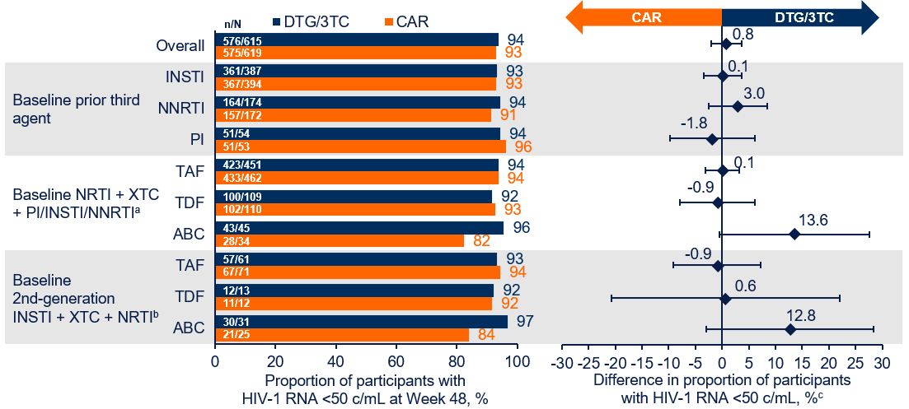
TANGO/SALSA Pooled Analysis: Baseline ARV (2)
N=1234 participants; most common BL third agent was INSTIs (63%) and most common NRTI backbone was TAF/FTC (74%)
Efficacy: At Week 48, few participants had HIV-1 RNA ≥50 c/mL (adjusted difference, −0.5; 95% CI, −1.3, 0.4)
  High proportions of participants maintained HIV-1 RNA <50 c/mL in the DTG/3TC and CAR groups
  Results were consistent across BL ART regimens
Safety: AEs were similar between groups ; drug-related AEs were higher with DTG/3TC
    % HIV-1 RNA < 50 c/mL at W48 overall and by baseline regimen: pooled ITT-E population
Conclusion: Regardless of baseline ARV regimen, DTG/3TC maintained high proportions of virologic suppression, had a high barrier to resistance, and demonstrated a good safety and tolerability profile 1 year after switch from 3- or 4-drug regimens
Scholten et al. AIDS 2022, abstr. EPB169

Slide 42
TANGO Study: switch to DTG/3TC (1)
  Post-hoc analysis on baseline proviral DNA genotyping
    Pre-existing archived M184V/I: 4/322 DTG/3TC and 3/321 TAF-based ART
    HIV RNA < 50 c/mL at W48 in 7/7
Van Wyk J. Clin Infect Dis 2020 71(8):1920-1929

Slide 43
TANGO Study: switch to DTG/3TC - W144 results (2)
Median change in weight: DTG/3TC = + 2.2 kg vs TAF-based regimen: + 1.3 kg
Change in Fasting Lipids From Baseline to Week 144
DTG/3TC (N = 243)ª
TAF-based regimen (N = 230)ª
-7.2 (-9.6, -4.8)
-6.1 (-9.1, -2.9)
-7.2 (-10.8, -3.6)
-11.7 (-18.1, -4.7)
10
4.2
3.9
4.6
2.2
-1.2 (-4.7, 2.4)
5
0.3
0
Adjusted change from
baseline (95% CI), %
-0.9
-5
-2.4
-3.3
-3.0
-10
-15
-9.7
-20
BL
5.0
4.9
1.3
1.3
2.9
2.8
1.3
1.2
3.7
3.6
Total cholesterol
(mmol/L)
HDL cholesterol
(mmol/L)
LDL cholesterol
(mmol/L)
Triglycerides
(mmol/L)
Total cholesterol/
HDL cholesterol ratio
Osiyemi O. Clin Infect Dis. 2022 Jan 25:ciac036. doi: 10.1093/cid/ciac036

Slide 44
SALSA Study: Switch to DTG/3TC - Weight change (3)
Baseline and adjusted mean change
from baseline in weight at Week 48
Adjusted mean change from baseline in weight at W48 by baseline TDF use
Kg
1.5 (0.7-2.3)
2.1 kg
0.6 kg
78.1 kg
75.9 kg
DTG + 3TC
(N = 342)
CAR
(N = 247)
BL
TDF
No BL
TDF
BL
TDF
No BL
TDF
Llibre JM. Clin Infec Dis2022 Mar 2;ciac130. doi: 10.1093/cid/ciac130

Slide 45
SALSA Study: Switch to DTG/3TC - Lipid changes (4)
Adjusted mean change from baseline, fasting lipids, μg/L
DTG + 3TC (n/N = 185/246)
CAR (n/N = 159/247)
-0,2 (-3,9 ; 3,6)
-1,0 (-3,7 ; 1,7)
-2,2 (-5,6 ; 1,3)
1,5 (-2,1 ; 5,2)
0,0 (-7,4 ; 8,1)
Total
cholesterol
(mmol/l)
HDL
cholesterol
(mmol/l)
LDLcholesterol
(mmol/l)
Triglycerides
(mmol/l)
Total cholesterol/
HDL cholesterol ratio
Llibre JM. Clin Infec Dis2022 Mar 2;ciac130. doi: 10.1093/cid/ciac130

Slide 46
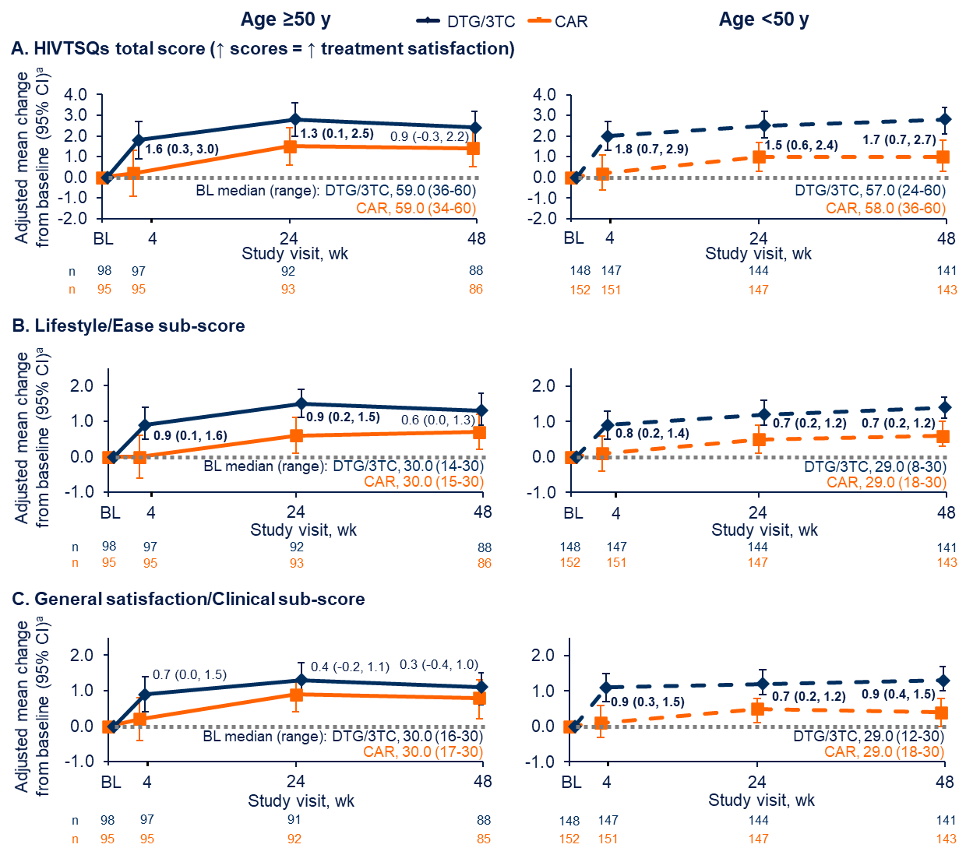
SALSA PROs
  Adjusted mean change from baseline (95% CI) in HIVTSQs through W48 by age
  (A) total score, (B) lifestyle/ ease sub-score, and (C) general satisfaction/clinical sub-score
Patient-reported health outcomes in participants aged ≥50 years were evaluated 48 weeks after switching to DTG/3TC
Results
  Greater treatment satisfaction early after switch compared with those continuing a 3- or 4-drug ARV regimen and remained high through 48 weeks
  In the DTG/3TC group : numerical improvements in symptom bother score vs CAR at W4 and W24, which remained stable through W48
Conclusion : Switching to DTG/3TC results in improved aspects of HRQOL
in older adults compared with remaining on 3- or 4-drug regimens
Priest, AIDS 2022, Abs. EPB140

Slide 47
TANGO and SALSA studies (switch for DTG/3TC): change in inflammatory biomarkers at W48
Pooled analysis of TANGO and SALSA (virologically suppressed PLWHIV = randomisation continuation triple cART vs switch for DTG/3TC)
Baseline demographics, characteristics and biomarkers similar between both groups (DTG/3TC = 615, cART = 619)
At W48
  CD14s and CRPus lower in DTG/3TC group
  No difference for CD163s, IL-6 and CD4/CD8 ratio
  W48 biomarker level highly associated to baseline value
  Age associated with higher levels of CD14s, CD63s and IL-6
  at W48
Conclusion: DTG/3TC switch is not associated with increase inflammation
Baseline and W48 geometric means (95 % CI)
for inflammatory biomarkers and CD4/CD8 ratio
 |  | DTG/3TC (N = 615) | Continuation cART (N = 619)
CD14s, x 10⁶ ng/mL | D0 W48 | 1.58 (1.56-1.61) 1.27 (1.19-1.35) | 1.53 (1.51-1.56) 1.35 (1.27-1.43)
CD163s, ng/mL | D0 W48 | 611.1 (590-633) 570.5 (540-603) | 602.1 (582.5-622.3) 561 (530.9-592.9)
IL-6, ng/L | D0 W48 | 1.67 (1.58-1.78) 1.63 (1.4-1.9) | 1.67 (1.57-1.78) 1.51 (1.29-1.76)
CRPus, mg/L | D0 W48 | 1.36 (1.25-1.49) 1.13 (0.90-1.42) | 1.29 (1.18-1.41) 1.30 (1.03-1.63)
CD4/CD8, % | D0 W48 | 0.94 (0,90-0,98) 1.00 (0.96-1.03) | 0.95 (0.91-0.99) 1.01 (0.97-1.05)
Llibre JM, AIDS 2022, Abs. EPB165

Slide 48
Switching to DTG/3TC 2DR vs BIC/FTC/TAF : Real life experience
Retrospective single-center study of virologically suppressed (<50 c/mL) PWH who switched to either DTG/3TC or BIC/FTC/TAF between April 2019 and November 2021
358 switched to DTG/3TC; 332 switched to BIC/FTC/TAF
Baseline: PWH who switched to DTG/3TC vs BIC/FTC/TAF were older
(48 vs 45 years), had shorter time of follow-up (293 vs 440 days),
and had fewer previous regimens (13 vs 22)
Efficacy (end of follow-up): No differences in virologic suppression
(98% vs 97% had HIV-1 RNA <50 c/mL with DTG/3TC vs BIC/FTC/TAF; p = NS)
Discontinuations: 8.7% vs 15% with DTG/3TC vs BIC/FTC/TAF (p=0.02)
  DTG/3TC: AEs 1.1% (anxiety/insomnia=3, abdominal pain=1) , LTFU 5.9%, death 1.4%, DDIs 0.3%
  BIC/FTC/TAF: AEs 0.3% (arthromyalgia=1), LTFU 10.5%, death 1.5%, HCP decision 2.4% (weight gain=3, dyslipidemia=2), DDIs 0.3%
Remain on treatment
1.0 -
0.9 -
0.8 -
D/L
B/T/F
0.7 -
aHR of discontinuation of
BIC/FTC/TAF: 1.37 (95% CI, 0.85-2.20)
0.6 -
I
0
I
200
I
400
I
600
I
800
I
1000
Days of follw-up
In this largest Real World Experience of switching to DTG/3TC vs BIC/FTC/TAF to date, switching to both regimens was effective and well tolerated and questions the benefit of the 3rd ARV
Knobel, AIDS 2022, Abs. EPB168

Slide 49
Virologic Failure and Resistance in Treatment-experienced Patients Who Switched to DTG + 3TC in Real-world Studies
%
Patients with documented treatment-emergent resistance
†
Timepoint | 2,014.7 PYFU, up to Week 240¹ | Median FU 1.2 years² | 2 years³ | 1 year⁴ | 1 year⁵ | Week 48⁶ | Week 48⁷ | 96 weeks⁸ | 5 years⁹
Emergent mutations Comments | – | 0 M184V. No other information given | 0 INI/NRTI resistance in 4 patients with genotypic testing | 0 resistance in 7 patients with resistance testing | n=1 M41ML mutation n=1 E138K mutation n=1 resistance at VF but no BL data | No VFs reported | n=1 with resistance at VF but no BL data | No VFs reported | No VFs reported
Data only for ‘lead’ studies with ≥100 patients treated with DTG + 3TC that reported VFs; potential overlap between cohorts cannot be ruled out
* Patients viraemic at BL: URBAN N=7; DOLAM(A) N=8; Bravo N=16; †10 patients were excluded from the URBAN analysis due to missing data
1. Ciccullo A, JAIDS 2021;88:234–7; 2. Hocqueloux L. EACS 2021. Abstract OS1/2; 3. Santoro MM, CROI 2021. Poster P429; 4. Scholten Sl. EACS 2021. Poster PE2/52 ; 5. Galizzi N. Int J Antimicrob Agents 2020;55:105893; 6. Bravo O, GeSIDA 2019. Abstract P-145 ; 7. Liano P, EACS 2021. Poster PE2/38;
8. Mussini C. EACS 2021. Poster PE2/48; 9. Maggiolo F. IAS 2021. Poster PEB179

Slide 50
Discontinuation Due to AEs in Treatment-experienced Patients Who Switched to DTG + 3TC in Real-world Studies
%
Patients discontinuing
treatment due to AEs*
†
Timepoint | 2,014.7 PYFU, up to Week 240¹ | Up to Week 96*² | 1 year³ | Up to Week 48*⁴ | 5 years⁵ | Week 48⁶ | Week 96⁷
Study type | Retrospective, multicentre | Retrospective, single centre | Prospective, multicentre | Retrospective, multicentre | Prospective, multicentre | Retrospective, multicentre | Prospective, multicentre
Data only included for ‘lead’ studies with ≥100 patients treated with DTG + 3TC that reported discontinuation for safety/tolerability reasons; potential overlap between patient cohorts cannot be ruled out. *Not all patients had reached this timepoint (Bravo N=66 at Week 48; Palmier N=82 at Week 96)
Discontinuation due to AEs appears to be low with DTG + 3TC in real-world studies, mirroring the rates seen in the TANGO and SALSA trials ^{8–11}
1. Ciccullo A, et al. JAIDS 2021;88:234–7; 2; 3. Scholten S, et al. EACS 2021. Poster PE2/52 ; 4. Bravo O, et al. GeSIDA 2019. Abstract P-145 ; 5. Maggiolo F, et al. IAS 2021. Poster PEB179. 6. Liano P. EACS 2021. Poster PE2/38; 7. Mussini C, et al. EACS 2021. Poster PE2/48; 8. van Wyk J, et al. Clin Infect Dis 2020;71:1920–9.
9. van Wyk J, et al. HIV Glasgow 2020. Oral O441; 10. van Wyk J, et al. IAS 2021. Poster PEB164; 11. Llibre J, et al. IAS 2021. Oral OALB0303

Slide 51
Conclusions
RWE confirm data on efficacy, safety and durability of 2DR based on DTG/3TC
The question is no longer why should I prescribe 2-drug regimens, but why should I prescribe 3 chemical products if I can achieve similar results with two

Slide 52
What do the guidelines say for regimen optimization in the setting of viral suppression ?
2 options
3-drugs regimens switch (within-class or between-class)
2-drugs regimens
Recommended 2DR as switch options
DHHS¹ | IAS-USA² | EACS ³
Recommended (Rating AI, unless otherwise specified) DTG/RPV * DTG/3TC or DTG + FTC * DRV/r + 3TC (BI) ** CAB + RPV LA IM Q4W *, § | Recommended (rating A1a, unless otherwise specified) $: DTG/RPV DTG/3TC PI/r + 3TC CAB LA RPV LA IM Q4W or Q8W (B1b) | Recommended regimens £: DTG/RPV DTG/3TC or DTG + FTC PI/r + 3TC or FTC CAB LA RPV LA IM Q8W
* Only if no HBV coinfection (unless on HBV active regimen) and no resistance to either ARVs
** Only if no HBV coinfection (unless on HBV active regimen)
§ No prior virological failure, no preganncy or plan to become pregnant
$ No prior virological failure or evidence of drug resistance, no hepatitis B co-infection
£ Only if no historical resistance and HBs Ab positive
1. DHHS. clinicalinfo.hiv.gov/en/guidelines/adult-and-adolescent-arv/whats-new-guidelines. 1 Sept 2022.
2. Saag MS. JAMA 2020; 324:1651-69. 3. EACS Guidelines, Version 11.0. October 2021

Slide 53
Long Acting 2DR as maintenance

Slide 54
LA injectable CAB + RPV for HIV maintenance therapy: W48 pooled analysis of phase 3 ATLAS and FLAIR trials (1)
PI, NNRTI, or INSTI Current daily oral ART
(N = 308)
Screening phase
Maintenance phase
Extension phase
DTG/ABC/3TC
Oral daily (N = 283)
CAB LA 400 mg
+ RPV LA 600 mg IM monthly
(N = 303)
ART-experienced N=705
PI-, NNRTI-, or
INSTI-based regimen with 2 NRTI backbone
Extension phase or transition
to the ATLAS-2M study*
ATLAS
R
1:1
Oral CAB
+ RPV (N = 308)
N=618
CAB LA (400 mg) + RPV LA (600 mg)
IM monthly (N = 278)
D1
W4
W48
W52
W96
W100
Induction phase
ART-naive
N=809
HIV-1 RNA >1000
Any CD4 count
HBsAg-negative
NNRTI RAMs excluded
N=629 DTG/ABC/3TC single-tablet regimen for 20 weeks
FLAIR
R
1:1
Oral CAB
+ RPV (N = 283)
Extension
W-20
W-4
D1
W4
W48
W52
W96
W100
Confirm HIV-1 RNA < 50 c/ml
Primary endpoint
Rizzardini G. JAIDS 2020; 85:498-506

Slide 55
LA injectable CAB + RPV for HIV maintenance therapy: W48 pooled analysis of phase 3 ATLAS and FLAIR trials (2)
Outcome | LA, N = 591 N (%) | CAR, N = 591 N (%) | Difference % (95 % CI) | Adjusted difference % (95 % CI)
HIV-1 RNA > 50 copies/mL at W48 (primary endpoint) | 11 (1.9) | 10 (1.7) | 0.17 (-1.34 ; 1.68) | 0.16 (-1.35 ; 1.67)
HIV-1 RNA < 50 copies/mL at W48 (key secondary endpoint) | 550 (93.1) | 558 (94.4) | -1.35 (-4.11 ; 1.41) | -1.37 (-4.12 ; 1.39)
Rizzardini G. JAIDS 2020; 85:498-506

Slide 56
ATLAS-2M study: LA CAB + RPV every
2 Months – W152 Results (1)
Q8W CAB LA 600mg + RPV LA 900mg
(N = 522)
Phase 3b, randomized, multicenter, parallel-group, noninferiority, open-label study
Q4W CAB LA 400 mg + RPV LA 600 mg
(N = 523)
Screening phase
Maintenance phase
Extension phase
Eligible participants:
• ATLAS Phase 3 study
(CAB + RPV LA Q4W)
N = 391
• ATLAS Soc arm +
additional soc
participants
N = 654
Oral CAB
+ RPV
R
1:1
Oral CAB
+ RPV
D1
W4
W48
W96
W100
W152
Primary endpoint: % of participants with plasma HIV RNA >50 c/mL at Week 48 (Snapshot, ITT-E)
Secondary endpoints: % of participants with plasma HIV RNA >50 or <50 c/mL at W96 / W152 (Snapshot, ITT-E)
Other endpoints at W152: incidence of CVF (2 consecutive plasma HIV RNA >200 c/mL ), incidence of viral resistance
in participants with CVF, and safety and tolerability
Overton ET, CROI 2022, Abs. 479

Slide 57
ATLAS-2M study: LA CAB + RPV every
2 Months – W152 Results (2)
Baseline characteristics similar between Q4W and Q8W arms (N = 1 045)
Female: 27 %, median age: 42 years, BMI > 30 kg/m²: 20 %, prior exposure to CAB + RPV: 37 %
Virologic response at W152, %
Adjusted differences
Q8W
Q4W
Proportion HIV RNA > 50 c/mL at W152
Q8W CAB + RPV LA ITT-E
(N = 522)
Q4W CAB + RPV LA ITT-E
(N = 523)
1.7
ITT-E
0.1
3.3
1.4
4% non inferiority margin
Q8W CAB + RPV LA PP
(N = 510)
PP
-0.2
2.9
-10
-8
-6
-4
-2
0
2
4
6
8
10
Q4W CAB + RPV LA PP
(N = 513)
Q4W
Difference (%)
Q8W
Proportion HIV RNA < 50 c/mL at W152
1.5
-2.6
5.6
-10% non inferiority margin
1.3
-2.7
5.3
HIV RNA > 50 c/mL
HIV RNA < 50 c/mL
No virological data
-10
-8
-6
-4
-2
0
2
4
6
8
10
Difference (%)
Overton ET, CROI 2022, Abs. 479

Slide 58
ATLAS-2M study: LA CAB + RPV every
2 Months – W152 Results (3)
Discontinuation for adverse events related to treatment
 | Not related to injections n (including between W96-W152), % | Related to injections n (including between W96-W152), %
Q8W (N = 522) | 6 (0) ; 1.1 % | 8 (+1) ; 1.5 %
Q4W (N = 523) | 13 (+2) ; 2.5 % | 13 (+2) ; 2.5 %
%
Proportion of participants with injection site reactions
100
80
CAB + RPV LA Q8W grade 1 or 2
CAB + RPV LA Q4W grade 1 or 2
60
Grade 3
40
20
0
Participants
at visit
J1
194
196
S4
322
515
S8
514
515
S12
NA
513
S16
511
508
S20
NA
502
S24
502
503
S28
NA
502
S32
495
499
S36
NA
492
S40
495
491
S44
NA
490
S48
483
488
S52
NA
483
S56
487
480
S60
NA
480
S64
485
477
S68
NA
477
S72
481
476
S76
NA
478
S80
482
475
S84
NA
475
S88
480
475
S92
NA
470
S96
473
468
S100
NA
464
S104
452
459
S108
NA
450
S112
456
451
S116
NA
450
S120
456
449
S124
NA
453
S128
460
455
S132
NA
456
S136
459
454
S140
NA
449
S144
456
449
S148
NA
446
S152
456
448
Overton ET, CROI 2022, Abs. 479

Slide 59
ATLAS-2M study: LA CAB + RPV every
2 Months – W152 Results (4)
Confirmed virological failure (2 consecutive HIV RNA > 200 c/mL) on Q8W at W152
Sex, Country | Time of CVF | Subtype | BMI | NNRTI RAMs |  | INSTI RAMs |  | Baseline VF predictive factors
 |  |  |  | Archived | RAMs at CVF | Archived | RAMs at CVF
F, South Africa | W8 | C | ≥ 30 | Y181C, H221Y | None | None | None | 2
F, South Africa | W16 | C | ≥ 30 | Y188 | Y188L | L74I, G140R | L74I, Q148R, N155H | 2
F, Russia | W16 | A6 | ≥ 30 | None | K101E | L74I | L74I, Q148R | 2
M, Spain | W16 | B | < 30 | None | None | None | None | 0
F, Canada | W24 | A1 | ≥ 30 | Y188L | Y188L | L74I | L74I, N155H | 3
M, US | W24 | B | ≥ 30 | E138A | E138A | None | N155H | 2
F, Russia | W24 | A6 | ≥ 30 | E138A | E138A, K101E | L74I | L74I, N155H | 3
M, Spain | W48 | A1 | < 30 | None | E138K | None | None | 1
M, Russia | W48 | A6 | < 30 | None | E138K | L74I | L74I, Q148R, N155H | 1
M, US | W88 | B | < 30 | Y181C | Y181C | L74I | None | 1
M, Russia | W112 | A6 | < 30 | None | E138A, Y181C | L74I | L74I, Q148R | 1
M, Germany | W120 | B | < 30 | None | E138A, M230M/L | None | Q148R | 0
Among 12 CVF, 9 occurred during the first 48 weeks, 1 between W48 and W96 and 2 between W96 and W152
  10/12 had at least 1 baseline predictor of virological failure, No injections were outside the 7 days window
Overton ET, CROI 2022, Abs. 479

Slide 60
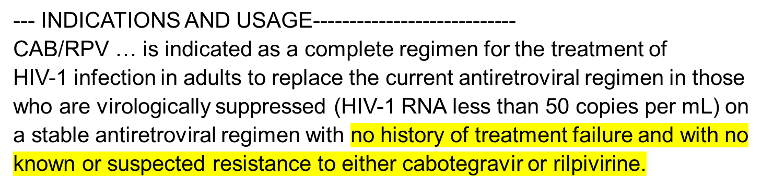
Predictors of virologic failure to CAB LA + RPV LA (1)
ATLAS, FLAIR, ATLAS-2M: 13/1039 (1.25 %) participants experienced CVF at W48 on CAB LA + RPV LA IM
Multivariable Analysis: 4 Factors Were Associated With an Increased Odds Ratio of CVF, 3 Are Baseline Factors
Parameter | Final Model - OR (95% CI), p-value
RPV RAM(s) at baseline | 37.24 (8.44– >99), p<0.001
Log₂ of post hoc Week 8 RPV trough concentration | 4.17 (1.59–11.11), p=0.004
Baseline HIV-1 subtype A6/A1 | 6.59 (1.82–25.26), p=0.005
BMI (kg/m²) at baseline | 1.13 (1.03–1.25), p=0.014
Pre-specified INSTI mutation (excluding L74I non-M mixture) at baseline | 0.11 (0.01–0.83), p=0.029
N baseline factors | CVF, N (%) | HIV-1 RNA <50 c/mL, N(%)
None | 3/732 (0.41) | 694/732 (95)
Any one | 1/272 (0.37) | 261/272 (96)
Two or more | 9/35 (26) | 25/35 (71)
²
Cutrell AG, AIDS 2021, 15;35(9):1333-42

Slide 61
Predictors of virologic failure to CAB LA + RPV LA (2)
ATLAS, FLAIR, ATLAS-2M: 13/1039 (1.25 %) participants experienced CVF at W48 on CAB LA + RPV LA IM
Multivariable Analysis: 4 Factors Were Associated With an Increased Odds Ratio of CVF, 3 Are Baseline Factors
Patients may have VF even if they have none of these factors
Why?
Parameter | Final Model - OR (95% CI), p-value
RPV RAM(s) at baseline | 37.24 (8.44– >99), p<0.001
Log₂ of post hoc Week 8 RPV trough concentration | 4.17 (1.59–11.11), p=0.004
Baseline HIV-1 subtype A6/A1 | 6.59 (1.82–25.26), p=0.005
BMI (kg/m²) at baseline | 1.13 (1.03–1.25), p=0.014
Pre-specified INSTI mutation (excluding L74I non-M mixture) at baseline | 0.11 (0.01–0.83), p=0.029
N baseline factors | CVF, N (%) | HIV-1 RNA <50 c/mL, N(%)
None | 3/732 (0.41) | 694/732 (95)
Any one | 1/272 (0.37) | 261/272 (96)
Two or more | 9/35 (26) | 25/35 (71)
²
Cutrell AG, AIDS 2021, 15;35(9):1333-42

Slide 62
2DR injectable – What is the risk of failure ?
Risk of virological failure and resistance
  approximately 1 in 70 at year 1 and 1 in 60 at year 2
LA-CAB/RPV has been investigated only in the context of viral suppression in a highly selected population
Need data in more complex populations, including those with a history of poor adherence, virological failure or treatment interruption

Slide 63
CAB + RPV LA: practical monitoring
Every-8 weeks Dosing: Monitoring and Missed Doses
  HIV-1 RNA: 4-8 weeks after switch to LA CAB + RPV and after unplanned missed visits/delayed dosing
  If viremia develops, test for resistance (including INSTI resistance)
  Oral-bridging therapy should be made available for planned missed doses
  If <3 months since last every-2-months injections, resume prior dosing schedule
  If >3 months since last every-2-months injections, initiate dose, followed by another dose
  1 month later, then resume every-2-months dosing
  When stopping, transition to suppressive oral regimen within 8 weeks of last IM doses
DHHS Guidelines. Guidelines for the Use of Antiretroviral Agents in Adults and Adolescents Living with HIV.

Slide 64
2DR in special situations
Archived M184V
Archived K103N
Patients with detectable viremia

Slide 65

ART-PRO: DTG + 3TC in patients w/wo historical M184V (1)
Inclusion
CD4 >350 cel/µL and VL < 50 c/mL for 12 months (1 blip allowed)
Stable ART for 3 months
FTC or 3TC in past/present treatment
INSTI naive
Group WITH historical M184V/I o K65R (N = 21)
Day 1
Switch to
DTG + 3TC
Group WITHOUT historical M184V/I o K65R (N = 20)
Week 4
Week 8
Week 12
Week 36
Week 64, 80, 96, 112, 128
Exclusion
M184V/I or K65R in baseline proviral DNA Sanger genotype
HBAgS +
Pregnant/women wishing to conceive
Screening
Peripheral blood proviral DNA Sanger genotype
Proviral DNA PBMC next-geneation
sequencing (NGS) {retrospective analysis]
Week 24
Week 48
Week 144
Primary endpoint at week 48:
Proportion of participants with HIV-1 RNA <50 c/mL (ITT-E FDA Snapshot)
De Miguel R, EBioMedicine. 2020 May;55:102779

Slide 66
ART-PRO: DTG + 3TC in patients w/wo historical M184V (2)
 | Historical M184V/I (N = 21) | No historical M184V/I (N = 20)
CD4/mm³ nadir/current, median | 160 / 705 | 259 / 647
Duration of suppressed HIV RNA, median years | 9.8 | 7.5
Baseline ART including 3TC or FTC, % | 42.9 (N = 9) | 95 (N = 19)
M184V in proviral DNA Sanger genotype, % | 9,5 (N = 2) | 0
M184V/I detected by NGS in proviral DNA, % > 1% > 5% > 20% | 95.2 66.7 33% | 35 15 5
De Miguel R, EBioMedicine. 2020 May;55:102779

Slide 67
ART-PRO: DTG + 3TC in patients w/without historical M184V (3)
HIV RNA < 50 c/mL at W96
(ITT-E, analyse Snapshot)
%
95
90.2
85.7
2 protocol violations
1 discontinuation for AE
1 consent withdrawal
37
41
18 *
21
19
20
Total population
Group with
historical R to 3TC
Group without
historical R to 3TC
NO VIROLOGIC FAILURE
12 participants with 14 blips
De Miguel R, EBioMedicine. 2020 May;55:102779

Slide 68
WISARD: switch to DTG/RPV in patients with HIV RNA < 50 c/mL and history of K103N (1)
Background: RPV susceptibility maintained in presence of K103N mutation
Randomised, open-label trial 2:1, immediate vs deferred (W48) to DTG/RPV qd
Population: adults on triple cART, HIV RNA < 50 c/mL, history of virologic failure on NNRTI with evidence of K103N
Baseline characteristics | DTG/RPV (N=95) | Continuation cART (N=45)
Median age | 52 | 53
Male | 82.1% | 77.8%
Median duration HIV infection. y | 17.1 | 22.4
Median duration ART. years | 15.8 | 17.7
Median CD4/mm³ | 510 | 617
ARV at screening, % TDF/FTC / TAF/FTC / ABC/3TC DRV / ATV DTG / BIC | 26 / 23 / 18 53 / 8 17 / 21 | 16 / 33 / 20 49 / 13 16 / 18
DTG/RPV FDC, N=100
Screening
Randomisation
Continuation cART, N=50
DTG/RPV FDC
D0
W48
W96
Moyle G, AIDS 2022, Abs. EPLBB04

Slide 69
WISARD: switch to DTG/RPV in patients with HIV RNA < 50 c/mL and history of K103N (2)
Proportion of participants with HIV-RNA < 50 copies/mL at week 48, with the ITT FDA Snapshot method
%
Difference (95% CI):
-0.5% (-11.7 to 10.7)
100
88.4
88.9
80
DTG/RPV
60
Current ART
40
20
8.9
3.2
2.2
3.2
4.2
1.1
0
0.0
0.0
HIV-RNA
<50 copies/mL
HIV-RNA
≥50 copies/mL
AEs
Other
On study but
with missing data
N at risk
95
45
Moyle G, AIDS 2022, Abs. EPLBB04

Slide 70
First Demonstration Project of LA Injectable ART for Persons With and Without Detectable HIV Viremia in an Urban HIV Clinic
Viral load (log₁₀ copies HIV RNA/mL)
15 patients started CAB/RPV LA with detectable viremia, (median CD4 cell count, 99 cells/mm³ ; mean log10 viral load, 4.67
12/15 achieved and maintained viral suppression
For the 3 patients who had not yet achieved viral suppression, all had a 2-log decline by a median of 22 days
6
4
2
0
0
28
56
84
112
140
168
196
Days from first injection
Christopoulos KA. Clin Infect Dis 2022 Aug 1;ciac631.doi: 10.1093/cid/ciac631

Slide 71
When NOT to use 2DR
Active HBV coinfection
Active TB treated with rifampin
Pregnancy?
Pediatric patients
Naive patients with pVL above 500 000 copies/mL
Acquired or transmitted resistance to XTC

Slide 72
Summary
2DR has shown non-inferiority to 3DR both in naive and stable suppressed patients
In some studies, renal and bone side effects are less frequent with 2DR
Evidence comes from RCTs and real-life experience
ART is for life, so if 2drugs can do the job, why should patients be exposed to three drugs?
A new treatment paradigm has been added to major international guidelines
  Caution: There are several situations where 2DR is not appropriate
2DR paved the way for long-acting regimens, not yet feasible with 3DR

