Slide 1





HIV Prevention and Treatment in vulnerable populations: No one left behind
LIVE SESSION
Wednesday, December 17th & Thursday, December 18th 2025
With the institutional support of :
Pedro Cahn (Argentina)
Anton Pozniak (UK)
François Raffi (France)

Slide 2
Faculty Disclosures
Pedro Cahn has received research support for research grants: ViiV Healthcare, Merck, CanSino and for ad. boards: ViiV Healthcare, Merck and Gilead
Anton Pozniak has received research support and/or honoraria for consulting and/or advisory boards from ViiV Healthcare, Merck, Gilead, Janssen
François Raffi has received research support and/or honoraria for consulting and/or advisory boards from Gilead Sciences, MSD, and ViiV Healthcare

Slide 3
This presentation is made in complete editorial freedom
Thanks to ViiV Healthcare for their institutional support

Slide 4



Anton Pozniak
François Raffi
Pedro Cahn

Slide 5

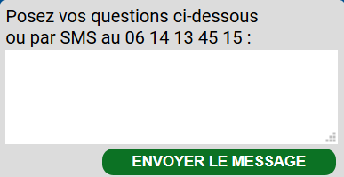
Use the chat to send your questions
Ask your questions here or text us: +33 625 357 402
SEND MESSAGE
Or send us a text message:
+33 625 357 402

Slide 6

Technical assistance
Use our chat
Call / Text us:
+33 625 357 402
Email us:
yannick@aei.fr

Slide 7

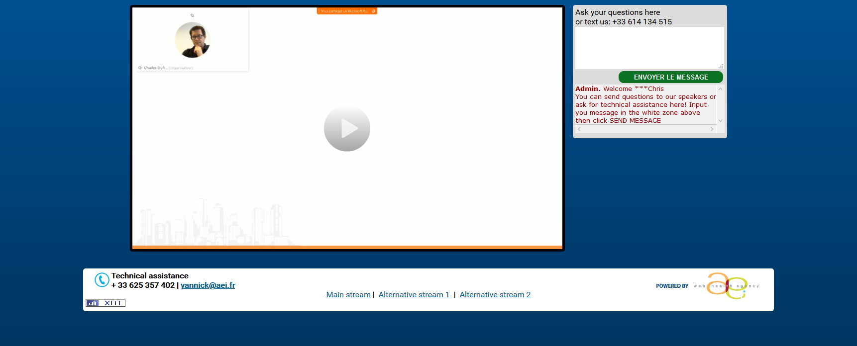

3 streaming options If you have trouble with one stream click and change for another one

Slide 8
HIV Prevention and Treatment in vulnerable populations: No one left behind
LIVE SESSION
Wednesday, December 17th & Thursday, December 18th 2025
This webinar is proposed to you with the support of our institutional partner
Pedro Cahn (Argentina)
Anton Pozniak (UK)
François Raffi (France)

Slide 9
HIV Prevention & Treatment in Vulnerable Populations “No One Left Behind”
OUTLINE
Vulnerable/Key populations
Stigma/discrimination
Criminalisation
Migration
Adherence
Treatment strategies
Prevention Strategies

Slide 10
Vulnerable Populations
LGBTQ + communities
Sex workers
People who inject drugs (PWID)
Homeless populations
Adolescents & young adults
Migrants & refugees
Incarcerated individuals
Major Mental Illness
Low socioeconomic status

Slide 11
Key populations continue to be more affected by HIV globally
HIV prevalence among people from key populations compared
with other adults (aged 15–49 years), global, 2020–2024
%
70
Sex workers (N = 78)
60
Gay men and other men who have sex with men (N = 80)
50
People who inject drugs (N = 54)
40
Transgender people (N = 40)
People in prisons and other closed settings (N = 69)
30
Adults (aged 15-49 years)
20
N = number of countries
10
7.6
7.1
8.5
2.7
1.4
0
0.7
Source: Global AIDS Monitoring 2021–2025 (https://aidsinfo.unaids.org/); UNAIDS epidemiological estimates 2025 (https://aidsinfo.unaids.org/).

Slide 12
Median HIV prevalence in Key populations
2.7% among sex workers
7.6% among gay men and other men who have sex with men
7.1% among people who inject drugs
8.5% among transgender people
1.4% among people in prisons and other closed settings
The estimated HIV prevalence among adults (aged 15-49 years) was 0.7% [0.6-0.8%)

Slide 13
Adolescent girls and young women are still at much higher risk of acquiring HIV in sub-Saharan Africa, but adolescent boys and young men are at higher risk elsewhere
Estimated numbers of new HIV infections among young people aged 15-24 years, by sex, global and regional, 2024
Caribbean
54 %
46 %
Middle East and North Africa
36 %
Female
64 %
Male
Western and central Europe and North America
20 %
80 %
Eastern Europe and Central Asia
42 %
58 %
Latin America
23 %
77 %
Western and central Africa
75 %
25 %
Asia and The Pacific
26 %
74 %
Eastern and Southern Africa
77 %
23 %
Global
43 %
57 %
0
50 000
100 000
150 000
200 000
250 000
Source: UNAIDS epidemiological estimates 2025 (https://aidsinfo.unaids.org/).

Slide 14
Many children are missed along the HIV treatment cascade
Disparities in treatment programs across regions, between men, women, age groups and key populations
620 000 children living with HIV not receiving treatment
Testing and treatment cascade, global 2024
%
92 (73-98)
83 (66-97)
79 (71-88)
84 (66-98)
73 (57-85)
69 (61-77)
63 (46-84)
55 (40-73)
47 (38-60)
Source: UNAIDS estimates 2025.

Slide 15
Progress in reducing new HIV infections is uneven-Global regions
40% fewer new infections in 2024 compared to 2010
Progress insufficient to reach the 2025 and 2030 goal
Varying rates of decline across regions
55% decline in new infections in sub-Saharan Africa
% change in annual new infections 2010-2024
Global
Eastern and Southern Africa
Western and central Africa
Caribbean
Asia and The Pacific
Western and central Europe and North America
Eastern Europe And Central Asia
Latin America
Middle East And North Africa
Source: UNAIDS epidemiological estimates 2025 (https://aidsinfo.unaids.org/).

Slide 16
Barriers to Prevention and Treatment
Stigma, discrimination,
Criminalization
Migrant populations
Lack of political will
Ultra far right policies confronting human rights
Funding shortages

Slide 17
HIV-related stigma and discrimination are still unacceptably high
% PLHIV (aged 15-49) who experienced discriminatory attitudes, 2020-2024
%
100
Samoa
Jordan
80
Mauritania
Nauru
Comoros
Uzbekistan
Ghana
Madagascar
tuvalu
Kyrgyzstan
Tunisia
Liberia
Vanuatu
Democratic Republic of the Congo
60
Philippines
Burkina Faso
Côte d’Ivoire
Vietnam
40
Guyana
Nepal
Mozambique
Gabon
India
United Republic of Tanzania
Thailand
Cambodia
20
Trininad and Tobago
Kenya
Lesotho
Argentina
Rwanda
2025 target
Eswatini
0
Asia and The Pacific
Caribbean
Eastern and Southern Africa
Eastern Europe and Central Asia
Latin America
Middle East And North Africa
Western and central Africa
Source: population-based surveys, 2020–2024.

Slide 18
People living with HIV routinely exposed to stigma, discrimination and violence (2020-2024)
Treatment coverage substantially lower among key populations
Barriers such as stigma and discrimination, harassment and violence can prevent access to HIV testing and treatment services
% PLHIV experienced stigma/discrimination over prior 12 months
when seeking HIV or other healthcare, 2020-2024
Iran
Zimbabwe
Sierra Leone
Vietnam
New Zealand
Indonesia
Zambia
Morocco
Belarus
Kyrgyszstan
Chad
Ukraine
Panama
Kazakhstan
Thailand
Somalia
Guinea
Central African Republic
South Sudan
Non-HIV related
Republic of Moldova
Senegal
HIV related
Bhutan
Lesotho
Ghana
Dominican Republic
0
10
20
Percent
30
40
50
Source:: People living with HIV Stigma Index 2.0, 2020–2024.

Slide 19
Vulnerable people living with HIV are routinely exposed to stigma and discrimination
Median % of key populations experiencing Stigma, discrimination, sexual/physical violence or avoidance of healthcare 2020-2024
%
100
Experience of stigma and discrmination in the past 6 months
80
Experience of physical and/or sexual violence in the past 12 months
Avoidance of health services because of stigma and discrmination in the past 12 months
60
40
35
35
28
23
23
20
2025 target
20
21
17
22
14
11
2025 target is < 10 %
8
0
Sex workers
Gay men and other men who have sex with men
People who inject drugs
Transgender people
N = 40
N = 36
N = 18
N = 21
N = number of countries
N = 27
N = 31
N = 16
N = 16
N = 35
N = 36
N = 23
N = 21
Source: Global AIDS Monitoring 2021–2025 (https://aidsinfo.unaids.org/).

Slide 20
Women living with HIV still experience abuse and mistreatment when using sexual and reproductive health services
Percentage of women experiencing coercion, mistreatment or abuse
when accessing sexual and reproductive health services, by country, 2020-2023
Bolivia
Peru
Kazakhstan
Ecuador
Belarus
Kyrgyzstan
Kenya
Togo
El Salvador
Benin
Nigeria
Angola
Republic of Moldova
Zimbabwe
Mauritania
Burkina Faso
Russian Federation
Sterilization
Paraguay
Pregnancy and infant feeding practices
Ukraine
Contraception and family planning services
Lesotho
Ghana
Côte d’Ivoire
%
0
10
20
30
40
50
Source: People Living with HIV Stigma Index 2.0 studies 2020–2023; Confronting coercion: a global scan of coercion, mistreatment and abuse experienced by women living with HIV in reproductive and sexual health services. International Community of Women Living with HIV; 2024.

Slide 21


Stigma and discrimination must be eliminated within all healthcare settings to provide inclusive health and social care policies that support access to services
Stigma within healthcare settings still exists
% respondents experiencing stigma and/or discrimination by a healthcare facility or healthcare worker in 2019 (N = 3206)
Stigma Index surveys (>50 countries)⁴
1 in 8 people living with HIV reported having been denied healthcare services
Individuals at high risk of HIV infection fear being stigmatised*5
1 in 5 people living with HIV (7 countries) reported having their HIV status disclosed by a healthcare worker without consent
adapted from The Fast-Track Cities Quality of Life Survey, IAPAC 2019 (20 fast-track cities).
Tackling stigma in healthcare settings will require improvements in education and training. Involving stigmatised individuals in this training could subsequently help reduce stigma among healthcare workers⁷
*In 7 out of 31 countries with available data (People Living with HIV Stigma Index, 2011–2016); IAPAC, International Association of Providers of AIDS Care.
1. DHHS Panel on Antiretroviral Guidelines for Adults and Adolescents. 2021. Available at: https://clinicalinfo.hiv.gov/sites/default/files/guidelines/archive/AdultandAdolescentGL_2021_08_16.pdf (Last Accessed: July 2022); 2. Safreed-Harmon K, et al. Lancet HIV. 2019;6(12):e869–77; 3. Lazarus JV, et al. Nat Commun. 2021;12(1):4450; 4. UNAIDS On the Fast-Track to end AIDS by 2030: Focus on location and population. Available at: http://www.unaids.org/sites/default/files/media_asset/WAD2015_report_en_part01.pdf (Last Accessed: July 2022); 5. UNAIDS Confronting discrimination 2017. Available at: https://www.unaids.org/en/resources/documents/2017/confronting-discrimination (Last Accessed: July 2022); 6. The Fast-Track Cities Quality of Life Survey. 2019. Available at: https://www.iapac.org/ftcqolsurvey/ (Last Accessed: July 2022); 7. Hedge B, et al. BMC Public Health. 2021;21(1):1–0.

Slide 22
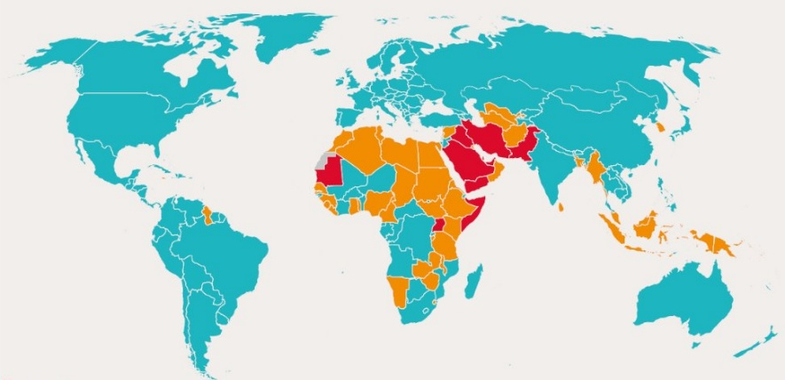
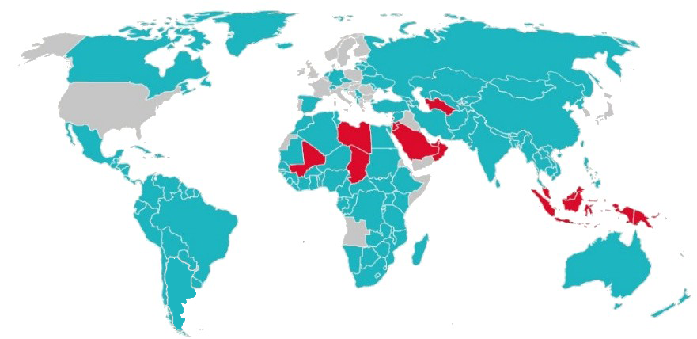
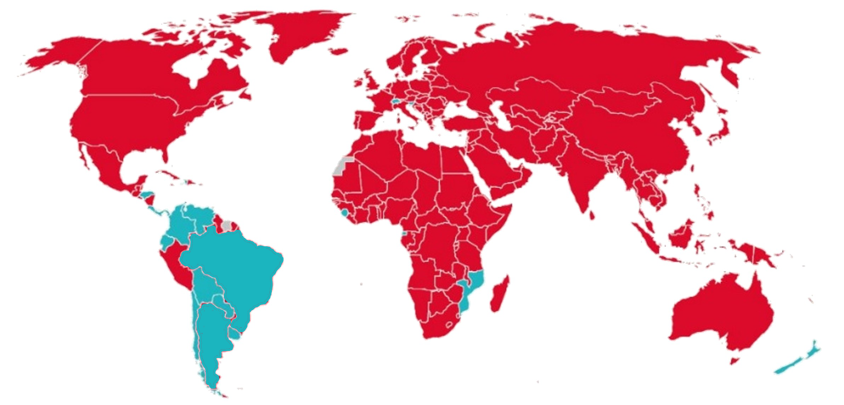
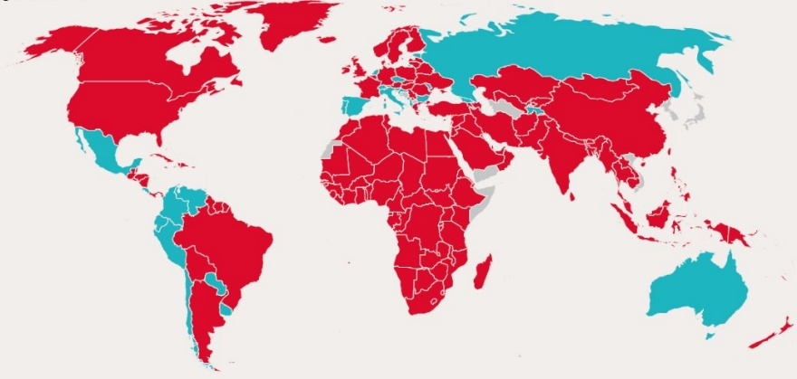
Almost all countries have punitive laws that criminalize at least one key population
Countries criminalizing same-sex sexual activity and gender expression have increased
Countries with laws criminalizing same-sex sexual acts in private global, 2025
Countries with laws criminalizing transgender people global, 2025
Death penalty
Imprisonment (14 years-life, up to 14 years) or no penalty specified)
Criminalizing
Laws penalizing same-sex sexual acts have been decriminalized or never existed, or no specific legislation
No criminalizing low
No data available
No data available
Countries with laws criminalizing any aspect of sex work, global, 2025
Countries with laws criminalizing the possession of small amounts of drugs for personal use, global, 2025
Any criminalizing or punitive regulation of sex work
Yes
Sex work is not subject to punitive regulations or is not criminalized
No
No data available
No data available
Source: National Commitments and Policy Instrument, 2017–2024 (http://lawsandpolicies.unaids.org/), supplemented by additional sources (see references in http://lawsandpolicies.unaids.org/).

Slide 23
Very few countries are on track to reach the main 2025 harm reduction targets
Coverage of needle-syringe programs and opioid agonist maintenance therapy among people who inject drugs, countries with available data, 2020-2024
100
Seychelles
Malaysia
80
2025 target
60
Percentage of people who inject drugs receiving opioid agonist maintenance therapy
40
Serbia
Morocco
Georgia
Vietnam
20
Kenya
Myanmar
Togo
Ukraine
Armenia
Republic of Moldova
Bangladesh
Togo
Iran
Kazakhstan
Indonesia
Thailand
Belarus
Azerbaijan
Nepal
Cambodia
0
South Africa
0
50
100
150
200
250
300
Needles and syringes distributed per year per person who injects drugs
Source: UNAIDS Global AIDS Monitoring 2021–2025 (https://aidsinfo.unaids.org/)

Slide 24
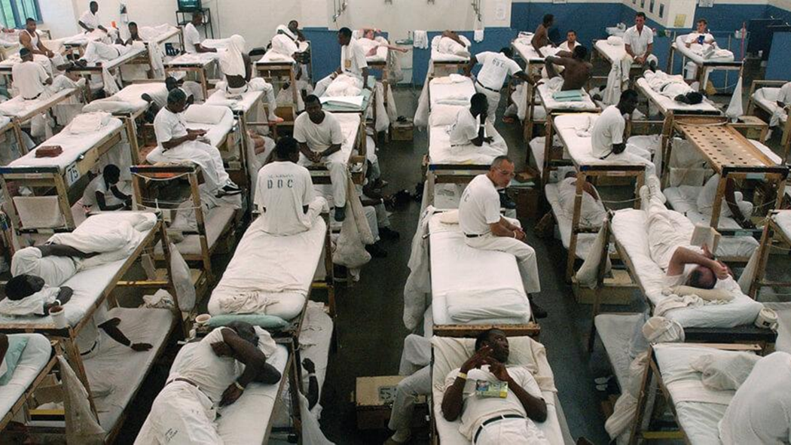
HIV IN US PRISONS
HIV continues to be a generalized epidemic in US prisons
Rates of infection overall are 1.5%, roughly three times that of the US population
Incarcerated populations are a stigmatized population whose health care needs are frequently ignored

Slide 25
US State annual Federal Prison population, 1925-2017
1 600 000
2017 : 1 439 808
1 400 000
1 200 000
1 000 000
Number of people
800 00
600 000
400 000
200 000
0
1925
1928
1932
1936
1940
1944
1948
1952
1956
1960
1964
1968
1972
1976
1980
1984
1988
1992
1996
2000
2004
2008
2010
2012
2014
2017

Slide 26

Migrants

Slide 27
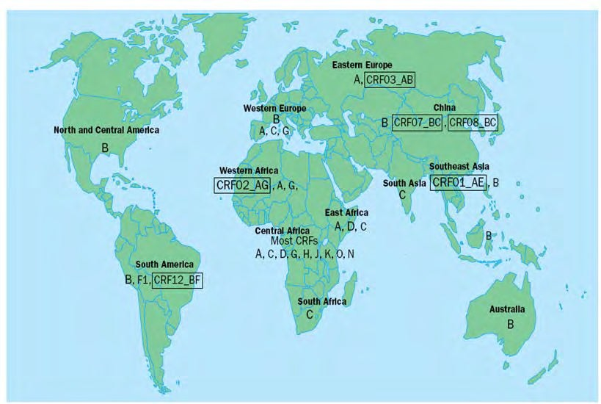
HIV/AIDS in immigrants
In Europe, overall prevalence among immigrants is 0.6-1%, accounting for 21-37% of all HIV cases
Greater proportion of heterosexual contact, greater proportion of females
Diagnosed at a later stage of HIV infection, with lower CD4 counts in some series
Different HIV subtypes (non-B subtypes >75%)
Epidemiological markers
Most immigrants have acquired HIV-1 infection before immigration
VFR´s resulting in newly acquired infections
HIV-1 diversity
Europe : HIV-1 M-B Africa : HIV M-non B

Slide 28
Migrants account for half of new HIV diagnosis in Europe in 2024
Percentage of HIV diagnoses among migrants out of all reported cases with known information on region of origin, by country of report, EU/EEA, 2024 (N = 19 595)
Iceland
Malta
11 401 cases (47.2% of total HIV diagnoses and 55.7% of those with known origin information) were reported among migrants
Migrants origin :
32.2% from Sub-Saharan Africa
26.4% from Central or Eastern Europe
24.4% from Latin America and the Caribbean
5.3% from South and South-East Asia
5.2% from Western Europe
6.5% from other regions
Norway
Sub-Saharan Africa
Ireland
Luxembourg
Central and Eastern Europe
Sweden
Denmark
Western Europe
Belgium
Netherland
Finland
Latin America and Caribbean
Cyprus
France
South and South-East Asia
Czechia
Germany
Other
Austria
EU/EEA
Portugal
Spain
Croatia
Slovenia
Greece
Italy
Lithuania
Hungary
Bulgaria
Romania
0
20
40
60
80
100
%
ECDC 2024

Slide 29
Treatment and Prevention Strategies that may be important in vulnerable populations
PC
Linkage to care
Importance of adherence
Rapid Start
Treat late presenters
Use Differentiated Service Delivery Models
Specific Therapy models
Long acting agents

Slide 30
Linkage to Care Is a Crucial Step in HIV Care Continuum
Improve Survival and Quality of Life
HIV Screening
HIV Diagnosis
Linkage to Care
Prevent Forward Transmission of HIV
CDC definition of linkage to care: ≥1 HIV-1 RNA test or CD4+ cell count within 30 days of diagnosis
CDC. HIV Surveillance Suppl Report 2017.

Slide 31
Factors That Predict Delayed Care Linkage and Inconsistent HIV Care and Treatment
Substance Use
Structural Barriers
Youth/ Adolescents
Mental Health Issues
Linkage
Adherence
Use of alternative treatments
Poverty
Belief that God or ART has cured HIV
(Fear of) Stigma
Race or Ethnicity
(Fear of) Medication Adverse Events
Treatment Fatigue
Camlin. AIDS. 2016;30:495. CDC. HIV Surveillance Suppl Report 201. Dombrowski. AIDS Patient Care STDS. 2015;29:279. Giordano. Top Antivir Med. 2011;19:12. Mayer. Clin Infect Dis. 2011;52(Suppl 2):S205.

Slide 32
Adherence is Crucial Social Enablers of adherence
Stigma and discrimination
Access to justice
Human rights
Decriminalization
Prevention of Gender
Based Violence
Community involvement

Slide 33

The Eﬀect of Interventions on Adherence
Odds ratio relative to SOC (95% CI)
Global network
Enhanced SOC
1.05 (0.72-1.55)
BST/MAT
1.32 (0.94-1.88)
SOC : Instructions by the healthcare provider at treatment initiation regarding how to take ART medication and the importance of adhering to it
BST/MAT plus CBT
1.39 (0.72-2.67)
BST/MAT plus device reminder
1.88 (0.86-4.30)
CBT
1.12 (0.87-1.47)
CBT plus device reminder
1.14 (0.70-1.87)
CBT plus incentives
2.42 (0.51-12.83)
CBT plus supporter
0.87 (0.44-1.79)
Device reminder
1.32 (0.84-2.11)
Multimedia BST/MAT
1.35 (0.73-2.46)
SMS
1.48 (1.00-2.16)
Supporter
1.25 (0.97-2.63)
Supporter plus device reminder
1.25 (0.57-2.84)
Supporter plus telephone
6.74 (2.87-16.55)
Telephone
1.12 (0.76-1.75)
SMS plus CBT
2.67 (0.97-7.51)
BST/MAT=behavioural skills training or medication adherence training. CBT=cognitive behavioural therapy. SMS=short message services
Kanters S. Lancet HIV 2017; 4: e31–40

Slide 34

There should be fair and barrier-free access to antiretroviral therapy that is recommended by internationally recognised guidelines
Although progress has been made, a large proportion of people who are in immediate need of treatment are not receiving ART
In 2024…
Access to ART must be:
38.4m people living with HIV
Equitable:
Differentiated and integrated models of care to address the unique needs of key populations
40.8 people living with HIV
=9.2m
31.6m
not receiving ART
Barrier-free:
Removal of structural and social barriers that persist across the continuum of care
accessing ART
1. DHHS Panel on Antiretroviral Guidelines for Adults and Adolescents. 2021. Available at: https://clinicalinfo.hiv.gov/sites/default/files/guidelines/archive/AdultandAdolescentGL_2021_08_16.pdf (Last Accessed: July 2022); 2. WHO guidelines 2017. Available at: https://www.who.int/publications/i/item/9789241550062 (Last Accessed: July 2022); 3. EACS guidelines. Version 11.0. 2021. Available at: https://www.eacsociety.org/media/final2021eacsguidelinesv11.0_oct2021.pdf (Last Accessed: July 2022); 4. https://www.hiv.gov/hiv-basics/overview/data-and-trends/global-statistics/; 5. Bunda B and Bassett I. Curr Opin. 2019;14:494–502.

Slide 35
International Guidelines-Preferred Combinations for Initiation of Antiretroviral Therapy
EACS
(NOV2024)
US DHHS (SEP 2024)
IAS-USA
(Dec 2022)
WHO
(Jul 2021)
BIC
TAF/FTC/BIC
TAF/FTC/BIC
TAF/FTC/BIC
DTG
DTG/3TC
DTG/3TC
DTG/3TC
DTG
TAF/FTC or TDF/FTC or TDF/3TC + DTG
TAF/FTC or TDF/FTC or TDF/3TC + DTG
TFV/XTC-DTG
TDF+ 3TC (or FTC) + DTG
DOR
DOR/XTC/TDF
or/TAF
Source: https://www.eacsociety.org/files/2024_guidelines-10.0_final.pd.f https://aidsinfo.nih.gov/contentfiles/lvguidelines/adultandadolescentgl.pd.f https://www.iasusa.org/wp-content/uploads/guidelines/arv/arv_2018.pdf https://apps.who.int/iris/bitstream/handle/10665/325892/WHO-CDS-HIV-19.15-eng.pdf?ua=1

Slide 36
Improved Clinical Outcomes With Rapid ART Initiation
Systematic review of rapid ART initiation (including 4 RCTs)[1]
Same-day ART associated with:
Characteristic
ART start within 90 days
Retained in care at 12 mos
Viral suppression at 12 mos
LTFU at 12 mos
Died by 12 mos
RR (95% CI)
1.35 (1.13-1.62)
1.11 (0.99-1.26)
1.17 (1.07-1.27)
0.66 (0.42-1.04)
0.53 (0.28-1.00)
Increased likelihood of ART initiation, retention in care, viral suppression
Decreased likelihood of loss to follow-up and death
.2
1
2
3
Standard Care
Same-Day ART
In addition, earlier ART initiation reduces the viral reservoir in the individual[2-5]
Ford N. AIDS. 2018;32:17.

Slide 37
Rapid Start-Time to virologic suppression and impact on reservoir may benefit late presenters
Time to VS with rapid ART versus universal ART
Time to HIV RNA < 200 c/mL Among Newly Diagnosed PWH by ART Initiation Strategy
%
Rapid ART (Rapid (2013–2014; n=39) :ART initiation as soon as possible, preferably on the day of diagnosis
100
ART initiated within ≤ 30 days of HIV acquisition led to faster and more sustained decay of HIV reservoir markers than ART initiated within 31–90 days or >24 weeks after acquisition^{4,¶}
75
Universal ART (2010–2013; n=69): ART offered
immediately to all PWH by primary care providers
CD4-guided ART 2006–2009; n=25): ART recommended if CD4 count <500 cells/mm³
50
25
p<0.0001 for rapid ART versus universal ART and CD4-guided ART
0
0
10
20
30
Time From Clinic Referral, months
¶Longitudinal analysis of data (Oct. 2014–Nov. 2018) from MERLIN study in Peru (N=56).
1. DHHS. https://clinicalinfo.hiv.gov/sites/default/files/guidelines/documents/adult-adolescent-arv/guidelines-adult-adolescent-arv.pdf (accessed July 19, 2024); 2. Pilcher CD, et al. J Acquir Immune Defic Syndr. 2017;74:44-51; 3. Girometti N, et al. HIV Med. 2020;21:613-5; 4. Massanella M, et al. Lancet Microbe. 2021;2:e198-209

Slide 38



Rapid Start in the guidelines
Start ART at diagnosis (when possible) to increase uptake, decrease time to linkage & virologic suppression, & to improve the rate of virologic suppression
Offer same day ART regimen:
Primary HIV infection
Patient wishes to do so
Lost to follow up more likely if not started
Soon as possible after diagnosis, ideally within 7 days, including on the same day as diagnosis or at the first clinic visit if the patient is ready and there is no suspicion for a concurrent opportunistic infection
2023
Source: https://www.eacsociety.org/files/2019_guidelines-10.0_final.pd.f https://aidsinfo.nih.gov/contentfiles/lvguidelines/adultandadolescentgl.pd.f https://www.iasusa.org/wp-content/uploads/guidelines/arv/arv_2018.pdf https://apps.who.int/iris/bitstream/handle/10665/325892/WHO-CDS-HIV-19.15-eng.pdf?ua=1

Slide 39
Paradox-PI/b not in naïve start but in some rapid start guidance
Bictegravir/TAF/FTC
Dolutegravir + TAF or TDF + XTC
Darunavir/b + TAF or TDF + XTC
AVOID NNRTI, DTG/3TC & ABC
Bictegravir/TAF/FTC
Dolutegravir+TDF or TAF + FTC
DRV/b + TAF or TDF + XTC
Bictegravir/TAF/FTC
Dolutegravir + TAF or TDF + XTC
2023
Source: https://www.eacsociety.org/files/2019_guidelines-10.0_final.pd.f https://aidsinfo.nih.gov/contentfiles/lvguidelines/adultandadolescentgl.pd.f https://www.iasusa.org/wp-content/uploads/guidelines/arv/arv_2018.pdf https://apps.who.int/iris/bitstream/handle/10665/325892/WHO-CDS-HIV-19.15-eng.pdf?ua=1

Slide 40
WHO European Region, 2023 Proportion of people diagnosed late (CD4 cell count < 350 per mm³) by gender, age and transmission mode
Total
Men
Gender
Women
Transgender
15-19
Age group (years)
20-24
25-29
30-39
40-49
50+
Heterosexual transmission (men)
Transmission mode
Heterosexual transmission (women)
Heterosexual transmission (transgender)
Injecting drug use
Sex between men
0
10
20
30
40
50
60
70
Percentage
Note : CD4 data from the Russian Federation was excluded as this was not provided with age, sex and transmission route breakdowns
ECDC 2024

Slide 41




In Europe, every second HIV diagnosis happens at a late stage of infection when the immune system has already started to fail. According to ECDC estimates, it takes on average three years from the time of HIV infection until diagnosis
50%
ECDC 2024

Slide 42
Common Reasons for Late Diagnosis
Access to HIV testing
Psychological and individual reasons
Denial , Fear, stigma, discrimination, mental health
Employment, Poor history of accessing healthcare, migration status
Too busy
Missed indicator infections that should always prompt HIV testing
HIV Med. 2022;23:1118–1126

Slide 43
The Impact of Late Diagnosis on Health Outcomes
Individual
17-fold higher risk of death over the first year
An extended period of uncontrolled viraemia
with immune inflammation and activation
Higher incidence rates
for AIDS Defining Events Serious Non-AIDS Events , including heart,liver, and kidney-related disease and some cancers and deaths
HIV Med. 2022;23:1118–1126

Slide 44
The Impact of Late Diagnosis on Health Outcomes
Population level
Late diagnosis, now estimated to be a median of 3–5 years after infection,
Increases the risk of further HIV transmission as viral load steadily increases
Increases costs
HIV Med. 2022;23:1118–1126

Slide 45
The high cost of medical care for patients who present late (CD4 < 200 cells/µl) with HIV infection
Mean cost per patient per month by category for the 12 months following HIV diagnosis (in Canadian dollars)
$ 20 000
$ 18 000
$ 16 000
< 200/µl
$ 14 000
> 200/µl
$ 12 000
$ 10 000
$ 8 000
$ 6 000
$ 4 000
$ 2 000
$ 0
Total costs
All drugs
HIV drugs
Out-patient care
All-patient care
HIV-related hospitalizations
Non-HIV related hospitalizations
Home care
$
18 448
8 455
8 539
3 839
7 918
3 780
3 015
2 284
6 162
2 308
5 431
365
736
1 943
817
35
HB Krentz, MC Auld and MJ Gill, HIV Med. 2024;5:93–98.

Slide 46
Therapeutic strategies

Slide 47
DOLCE: DTG/3TC vs DTG + TDF/XTC ART naive with CD4 < 200/mm³
Phase IV, exploratory, open-label , multicenter study including naïve PLWHIV (11 sites in Argentina and Brazil)
Dual Therapy
DTG + 3TC (STR) QD,
(N = 152)
ARV- naïve,
≥18 years old
CD4 ≤ 200/mm³
HIV-1 RNA > 1 000 c/mL, no upper limit
HBs Ag negative
Randomisation 2:1
W48 primary endpoint (HIV-1 RNA < 50 c/ml)
Triple Therapy
DTG QD + TDF/XTC, QD, FDC
(N = 77)
AT BASELINE
CD4/mm³, median (IQR): 116 (53 – 188)
HIV RNA > 100 000 c/ml: 61.3 % ; > 500 000 c/ml: 23 %
CDC stage C: 33%
Cahn P, HIV Drug Therapy Glasgow 2024, Abs. O24

Slide 48
Data on Dual therapy in High Viral Load and CD4 <200
AT BASELINE
CD4/mm³, median (IQR):116 (53 –188)
HIV RNA
> 100 000 c/ml: 61.3 %
> 500 000 c/ml: 23.0 %
CDC stage C: 33%
DOLCE study: virologic outcomes at week 48
HIV-1 RNA < 50 copies/ml (FDA-snapshot, ITT-E)
%
92 %
91 %
82 %
81 %
81 %
77 %
ITTe-population (N = 229)
Per protocol population (N = 204)
ITTe-population > 100 000 (N = 141)
Adjusted risk Difference (95% CI) : 2.0% (-8.6 ; 12.8)
Adjusted risk Difference (95% CI) : 1.8% (-6.3 ; 9.9)
Adjusted risk Difference (95% CI) : 5.1% (-10.1 ; 20.3)
Cahn P, HIV Drug Therapy Glasgow 2024, Abs. O24

Slide 49
LAPTOP: B/F/TAF vs D/c/F/TAF for first-line ART in PWH and advanced HIV
Phase 4, randomized, non-inferiority, multicentric (7 European countries), consortium Neat-ID
Design
Adults HIV +
ARV naïve
CV > 1000 c/mL
and
AIDS, all CD4
Or serious bacterial infection, CD4 < 200/mm³
Or symptomatic or not, CD4 < 100/mm³
Or severe OI on treatment
B/F/TAF qd (N = 220)
R 1:1
DRV/c/F/TAF qd (N = 222)
D1
W12
W24
W48
Composite primary endpoint: time to
Virologic failure (VL decrease < 1 log₁₀ c/mL at W12 or > 50 c/mL at W48)
Or clinical failure
Evaluation by Kaplan-Meier and Cox regression, non-inferiority margin = HR 1.606
Behrens GMN, Lancet Infectious Diseases 2025, published online 1 Dec 2025

Slide 50
Baseline Characteristics
 | Total (N = 442)
Age (years), median (IQR) | 43 (35-53)
Gender
Male | 358 (81.0)
Female | 84 (19.0)
Ethnicity
White | 276 (62.4)
Black | 83 (18.8)
Other | 83 (18.8)
CD4+ count<100 cells AL | 379 (85.8)
HIV RNA viral load >500,000 log₁₀ copies/mL | 197 (44.6)
Behrens GMN, Lancet Infectious Diseases 2025, published online 1 Dec 2025

Slide 51
LAPTOP-Kaplan Meier curves for primary outcome
Primary composite endpoint (mITT analysis)
0.40
Protease inhibitor (N = 222, events = 70)
Integrase inhibitor (N = 220, events = 49)
0.30
Adjusted hazard ration 0.70 (95% CI: 0.48 - 1.00 ; p=0.052
Probability of first clinical and/or virological events
0.20
0.10
0
0
12
24
36
48
Number at risk
Weeks until first Event
222
220
196
179
191
179
179
177
132
151
Behrens GMN, Lancet Infectious Diseases 2025, published online 1 Dec 2025

Slide 52
LAPTOP: B/F/TAF vs D/c/F/TAF for first-line ART in PWH and advanced HIV
VL < 50 c/mL (%)
Time to CD4 > 200/mm³ in participants with
Baseline CD4 ≤ 200/mm³ (Kaplan-Meier)
80
INI
1,0
PI
69%
Integrase inhibitor (N = 212)
60
61%
Protease inhibitor (N = 215)
0,75
40
0,5
20
0,25
0
0
4
8
12
24
36
48
0
12
24
36
48
Missing (discontinuation/ missing in window)
Weeks
N at risk
Weeks
18
11
30
21
31
20
36
27
43
33
45
38
215
212
132
117
119
101
100
86
52
43
Behrens GMN, Lancet Infectious Diseases 2025, published online 1 Dec 2025

Slide 53
Results
Primary composite outcome (VF&CE)
P = 0.052
0.70
Non-inferiority margin : 1.606
0.48
1.00
Virological Fialure (VF)
P = 0.013
0.54
0.33
0.88
Insufficient virological response
P = 0.014
0.53
0.32
0.88
Viral rebound
P = 0.687
0.69
0.12
4.15
Clinical Events (CE)
P = 0.974
0.99
0.57
1.72
New/recurrent AIDS defining event
P = 0.114
0.48
0.20
1.19
SAE due to non-AIDS defining event
P = 0.119
2.32
0.81
6.68
AE leading to discontinuation
P = 0.071
0.15
0.02
1.18
Death related to HIV, AIDS, OI/BI
P = 0.202
2.41
0.62
9.33
^{0.1}
1
¹
Adjusted Hazard ratio (95% CI)
Favors INI group
Favors PI group
Behrens GMN, Lancet Infectious Diseases 2025, published online 1 Dec 2025

Slide 54
Conclusions: In people with advanced HIV disease
The bictegravir-containing regimen was:
Non-inferior to the darunavir-containing regimen in terms of the composite outcome
Had a better virologic response at week 48 and fewer overall AE’s
Behrens GMN, Lancet Infectious Diseases 2025, published online 1 Dec 2025

Slide 55
Planning for Success: Tasks for Moving Ahead With Effective Implementation of LA Injectable ART and PrEP
FR
Providers Have Comprehensive Understanding of New Paradigm
Requires overcoming inertia to change/add to long-established successful paradigms so that patients can make the choice
GOAL: New Treatment Reaches Appropriate Patients and Improves Health/Quality Of Life Outcomes
Health Systems Provide Logistical Support and Resources for Effective Delivery of New Paradigm
Clinic staffing/scheduling
Injection training and drug storage
Patient transportation access
Appointment reminders
Oral bridging
Providers Identify and Counsel Appropriate Patients on New Paradigm
Patient interest and eligibility
Education on safety, efficacy
Education on clinic visits/ monitoring frequency
Contingency for missed doses

Slide 56

HIV guidelines New LA Treatment Recommendations
Treatment | Previous recommendations | New recommendations
Long-acting injectable regimens | --- | CAB + RPV as alternative ART switching option in adults and adolescents with undetectable HIV viral load*
*no active HBV infection
The Medicines Patent Pool (MPP) and ViiV Healthcare announced a licensing agreement to allow generic production of CAB-LA for HIV treatment for use in combination with rilpivirine in 133 countries

Slide 57
Long Acting Drugs to Improve Adherence to Treatment
In Viraemic Patients
In those with prior loss to linkage in care

Slide 58


LATITUDE: LA CAB/RPV IM in Patients with Barriers to Adherence ACTG 5359
Step 1
Step 2
Open-label, phase III RCT
Barriers to adherence
Poor viral response to oral ART (>6 mo)
Loss to f/u with ART nonadherence (>6 mo)
No RPV/INSTI resistance
No HBV
LA CAB/RPV IM q4 weeks (17% with baseline VL >200 copies/mL)
Oral ART + economic incentives (week 4- 24)
Eligible for randomization once VL <200 copies/mL
Continue oral ART (7% with baseline VL >200 copies/mL)
N = 434
Transgender 5%, IVDU current or past 14%
Primary outcome: Treatment failure (virologic failure or discontinuation)
Secondary outcomes: Virologic failure, treatment-related failure, treatment discontinuation
Rana A. CROI 2024. Abstr 212.

Slide 59


LATITUDE: LA CAB/RPV IM in Patients with Barriers to Adherence
Treatment failure -Primary outcome Virologic failure, discontinuation
24%
39%
98.75% CI
(-29.8% to 0.8%)
Virologic failure*
Treatment-related failure*
Treatment discontinuation
7%
25%
10%
26%
21%
25%
Study stopped early due to superior efficacy of LA CAB + RPV in secondary outcomes*
6 patients in CAB/RPV with virologic failure; 2 had resistance, 3 did not, 1 re-suppressed
Rana A. CROI 2024. Abstr 212.

Slide 60
LA CAB/RPV in highly vulnerable population
Ward 86 HIV Clinic San Francisco
Transgender women 4%
Major Mental illness 38%
Retrospective study, 370 PWH (241 virologically suppressed, 129 viremic)
LA CAB/RPV Jan 2021-Sept 2024
Virologic suppression (HIV RNA ≤ 200 c/mL) at W48
99.4% in patients with virologic suppression at D0
97.9% in patients with initial viremia
Conclusion : In a cohort of PWH with high rates of housing instability,(58%) substance use (38% )and low CD4 counts, LA CAB/RPV was highly effective even in those initiating injectables with viremia
HIV RNA ≤ 200 c/mL in patients with initial viremia
1.00
0.75
0.50
Median time to achieve virologic suppression :
32 days (95% CI : 30-45)
0.25
0
0
12
24
36
Weeks
At risk
Events
129
0
22
105
7
117
2
122
Gistand NL. CROI 2025, Abs. 689

Slide 61
CAB + RPV in individuals with HIV viremia
OPERA cohort
≥ 18 years old, ART-experienced, VL ≥ 50 c/mL at CAB + RPV LA initiation
Correspond to 368/3 304 (11%) individuals initiating CAB + RPV LA
57% black, 18% Hispanic, 30% women
Median HIV-1 RNA: 120 c/mL (IQR: 61 - 2535)
Virologic outcomes
Complete initiators, > 1 VL within 6 months (N = 306)
Complete initiators, > 1 VL during follow-up (N = 313)
Complete initiators, > 1 VL after suppression (N = 301)
85%
(N = 259)
82%
(N = 258)
88%
(N = 277)
Case 1: Missed 2 doses, At failure,
S to DOR, Resistance to all INSTI
Case 2: at failure, R to NNRTI, possible R to INSTI
Case 3: at failure, genotype not amplified
1%
(N = 3)
VL < 50 c/mL
within 6 months
VL < 50 c/mL
at last follow-up
VL < 50
c/mL*
Confirmed virologic failure
* 12% never achieved < 50 c/mL
Hsu RK, IAS 2025, Abs. OAB0104

Slide 62
CAB + RPV LA in individuals with suboptimal HIV control (1)
IMPALA trial
Phase 3b, open-label, non-inferiority RCT (Kenya, Uganda, South Africa)
HIV RNA > 1000 c/mL in prior 2 years despite being on ART
History of loss to follow-up
Unlinked to HIV care ≥ 3 months
Exclusion of participants with HBs Ag+ or HBc Ab+ AND HBs Ab < 10 IU/L
HIV RNA < 200 c/mL
2 NRTI + DTG N = 269
VL > 1000 c/ml (N = 261)
LFTU (N = 282)
Unlinked (N = 11)
2 NRTI + DTG
for ≥ 3 months
Randomised
N = 540
CAB + RPV LA Q8W N = 271
Population
Mean age 41 years
Female: 62%
No Trans or IVDU
BMI ≥ 30 kg/m²: 22%
Prior AIDS: 26%
Prior NNRTI exposure: 78%
Primary endpoint: HIV RNA < 50 c/mL (FDA snapshot), non-inferiority with 10% NI margin
Cresswell F, IAS 2025, Abs. OAS0105LB

Slide 63
CAB + RPV LA in individuals with suboptimal HIV control (2)
W48 virologic outcomes (HIV RNA < 50 c/mL)
CAB+RPV % (n/N)
Oral ART % (n/N)
CAB + RPV LA interpretation
Relative difference (95% CI)
Inferior
Non-inferior
Superior
Primary analysis (ITT-e)
91.2% (244/268)
89.2% (240/269)
+1.9 (-3.1 ; 6.9)
Per protocol analysis
93.9% (229/244)
89.9% (223/248)
+4.0 (-0.8 ; 8.8)
BMI <30
90.0% (180/200)
89.0% (194/218)
+1.1 (-4.8 ; 6.9)
BMI >30
94.1% (64/68)
90.2% (46/51)
+4.2 (-5.3 ; 13,.8)
-15
-10
-5
0
5
10
15
5 confirmed virologic failures (1.9%) on CAB + RPV LA, Genotype results in 4: low R to DTG/BIC = 2/4, intermediate R to DTG/BIC: 2/4;
High R to RPV: 3/4, S to RPV: 1/4, R to DOR: 1/4, S to DOR 3/4
Conclusion: non-inferiority of CAB + RPV LA
Cresswell F, IAS 2025, Abs. OAS0105LB

Slide 64
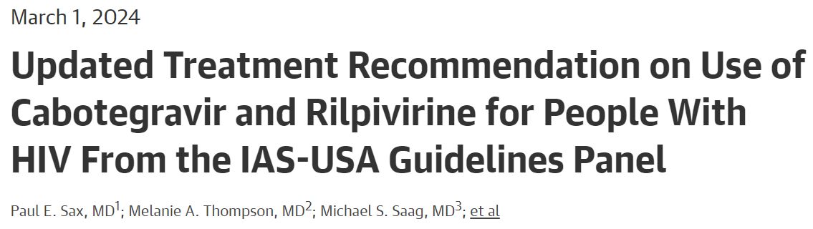
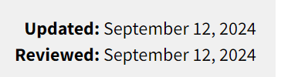

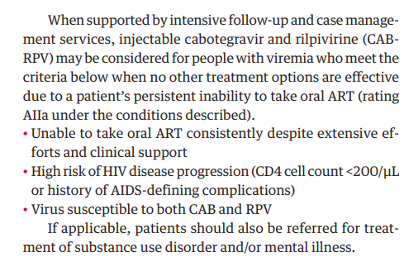
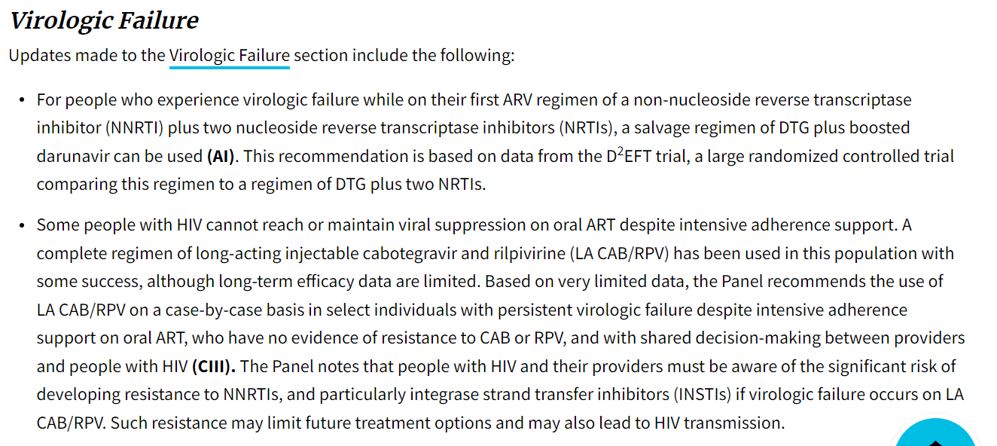

Both IAS-USA guidelines (March 1, 2024) and DHHS guidelines (September 1, 2024) updated to include the use of LA-ART in those with adherence challenges/viremia
Sax. JAMA. 2024; DHHS guidelines September 12, 2024

Slide 65
CVF definitions are not standard across real-world studies for CAB + RPV LA
Study | CVF definition
OPERA¹ | 2 consecutive VL ≥200 c/mL or 1 VL ≥200 c/mL followed by discontinuation
Dat’AIDS² | 2 consecutive VL >50 c/mL or 1 VL >200 c/mL
ATHENA³ | VL >200 c/mL
SHARE LAI-net⁴ | NR
SWISS HIV Cohort⁵ | 2 consecutive VL >50 c/mL
BEYOND⁶ | 2 consecutive VL ≥200 c/mL or 1 VL ≥200 c/mL and discontinuation within 3 months of VL ≥200 c/mL
Seang⁷ | 2 consecutive VL >200 c/mL
PSOMAS⁸ | NR
COMBINE-2⁹ | 2 consecutive VL ≥200 c/mL or 1 VL ≥200 c/mL followed by discontinuation
Fernández-Hinojal¹⁰ | NR
Bana¹¹ | NR
Ferre¹² | 2 consecutive VL >200 c/mL or 1 VL >50 c/mL and discontinuation
Nasser¹³ | >200 c/mL
1. Sension M, et al. IDWeek 2023. Poster 1608​ 2. Deschanvres A, et al. EACS 2023. Poster MeP.T2.01; 3. Jongen V, et al. EACS 2023. Oral PS8.O3 4. Ring K, et al. EACS 2023. Poster eP.A.056; 5. Ramirez JD, et al. EACS 2023. Oral and Abstract PS8.02 6. Sinclair G, et al. IDWeek 2023. Poster 1607; 7. Seang S, et al. EACS 2023. Poster eP.A.074 8. Psomas KC, et al. EACS 2023. Poster eP.A.016; 9. Pozniak A, et al. EACS 2023​. Poster eP.A.039 10. Fernández-Hinojal F, et al. EACS 2023. Poster eP.A.026; 11. Bana N, et al. EACS 2023. Poster eP.A.047 12. Ferré VM, et al. EACS 2023. Poster eP.A.042; 13. Nasser K, et al. EACS 2023. Poster MeP.T2.03
Studies from EACS and ID Week 2023, including over 100 patients reporting relevant efficacy and/or VF outcomes

Slide 66
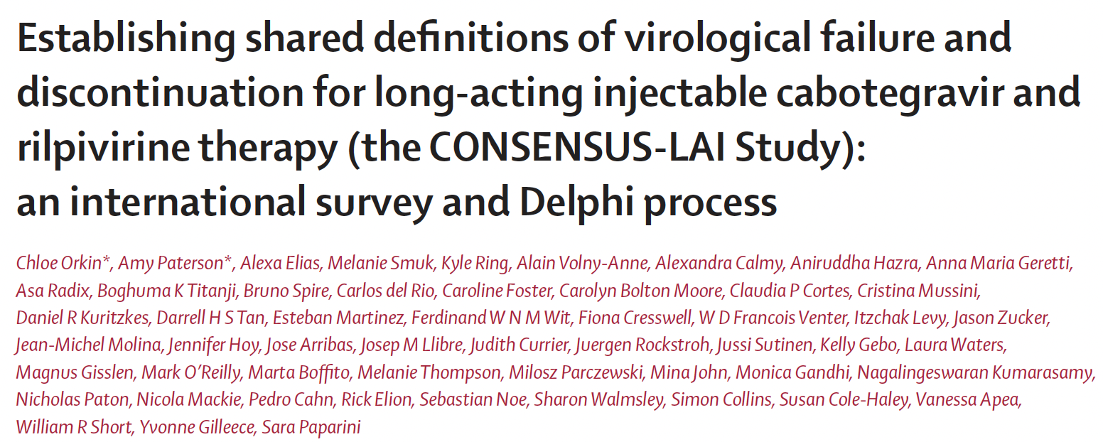
Lancet HIV 2025; 12: e649–59

Slide 67




Concerns with current LA integration
Re-medicalization as injectable product administration role will be task-shifted back from KP lay providers to nurses/doctors
De-medicalize Simplify
Differentiate

Slide 68

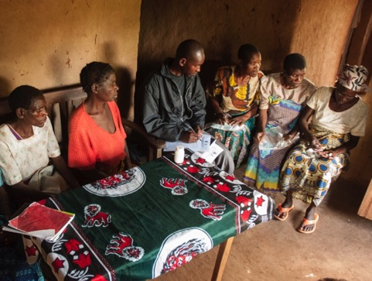
Use current Health care models for LA integration
Integrated models of care:
from HIV, to HIV + TB, to HIV + TB + HIV Co-morbidities
to HIV + TB + Co-Morbidities + Chronic Diseases (NCDs)
Differentiated Models of Care:
→ client-centered approach,.
→ this model can also be applied to NCD care
Health care worker-managed group
Client-managed group

Slide 69
Transgender people
Transgender people, especially transgender women (TW), are disproportionately affected by HIV
Historically underrepresented in ART clinical trials; many studies are observational or implementation-focused
Key concerns include adherence, retention, stigma, and ART–hormone interactions

Slide 70
Transgender Trials & Studies
Study / Registry | Population | Design | Intervention / Focus | Status / Key refs
GET IT RiGHT (A5403) / NCT06005610 | Transgender women with HIV | Open-label, non-randomized (Phase II) | Estradiol + Three ART regimens; PK, safety, VL | ACTG A5403 info; ClinicalTrials.gov NCT06005610
TRANSViiV / NCT03033836 | ART-naïve transgender women | Prospective, single-arm pilot | DTG + TDF/FTC (or 3TC); retention, suppression | Frola et al., PLoS ONE 2023; ClinicalTrials.gov NCT03033836
NCT05663892 (DDI study) | Virally suppressed TW on ART | Interventional DDI study | Assess cabotegravir PK with/without FHT and ART differences | ClinicalTrials.gov NCT05663892
HPTN 083 / related PK analyses | MSM & transgender women (PrEP) | Phase II/III (PrEP) | CAB LA for PrEP; PK and efficacy analyses included TW | NEJM 2022/2023; Lancet HIV analyses

Slide 71
Prevention
Coverage
Services for vulnerable populations
Long acting drugs

Slide 72
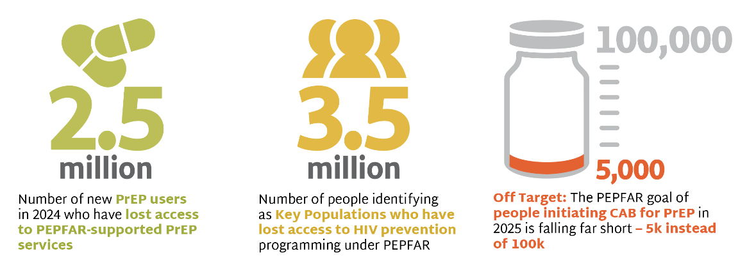
PrEP Initiations to 2024
https://www.prepwatch.org/pepfar-stop-work/

Slide 73
Combination prevention services are not reaching the most vulnerable people
Gap to achieve combination prevention targets among key populations, by intervention, global, 2020-2024
Condom use at last sex with a client (n = 66)
85
Sex workers
Sexually transmitted infections screening in past 3 months (n = 38)
30
PrEP use for HIV-negative people (n = 41)
32
HIV prevention programme coverage (n = 33)
47
2020-2024 status
Condom use at last anal sex with a male partner (n = 60)
67
Gap to 2025 target
Gay men and other men who sex with men
Sexually transmitted infections screening in past 3 months (n = 34)
25
PrEP use for HIV-negative people (n = 55)
8
HIV prevention programme coverage (n = 27)
38
Condom use at last sex (n = 38)
37
Sterile injecting equipment use at last injection (n = 35)
87
People who inject drugs
Opioid agonist maintenance therapy coverage (n = 25)
9
PrEP use for HIV-negative people (n = 23)
13
HIV prevention programme coverage (n = 22)
39
Condom use at last sex (n = 33)
65
Sexually transmitted infections screening in past 3 months (n = 21)
18
Transgender People
PrEP use for HIV-negative people (n = 37)
4
HIV prevention programme coverage (n = 15)
44
0
20
40
60
80
100
Percent
Source: Global AIDS Monitoring 2021–2025 (https://aidsinfo.unaids.org/); UNAIDS special analysis 2025.

Slide 74
PrEP cascade in migrant women : community survey in 11 European countries
115
(%)
PrEP cascade according to migrant status (N = 521)
Undocumented migrant
Asylum seeker
Réfugee
Naturalised citizen/document resident
Total
PrEP awareness
PrEP intention
PrEP uptake
PrEP discontinuation
(%)
PrEP cascade according to sex work status
Sex worker
Non-sex worker
Total
PrEP awareness
PrEP intention
PrEP uptake
PrEP discontinuation
Wang H, EACS 2025, Abs. MeP09.7LB

Slide 75
PrEP strategies that may be important in high risk/vulnerable populations
Long acting agents
Cabotegravir
Lenacapavir

Slide 76
First experiences of long-acting cabotegravir in Zambia
A qualitative study explored the first implementation of injectable PrEP in a real-world setting for adolescent girls and young women in the DREAMS programme in Zambia
Semi-structured interviews were conducted with 17 adolescents (16-24 years) who had started long-acting cabotegravir PrEP in the previous four weeks
Overall, participants described high levels of satisfaction and limited side effects
Participants contrasted injectable PrEP with oral PrEP and the burden of daily pill-taking
“When they inject you, it makes you freer... but the one for tablets you often forget... I chose injectable PrEP because I don't want to be forgetting”
IAS 2025 Mwango LB48

Slide 77
PURPOSE 1 Study: Long-Acting Lenacapavir for PrEP in Cisgender Women
Phase 3 study
Double-blind, placebo-controlled
Cisgender women without HIV
Sexually active with male partners
Not on PrEP
Lenacapavir sc q26 weeks
(N = 2134)
Daily Oral F/TAF
(N = 2136)
Daily Oral F/TDF
(N = 1068)
Week 0 52
June 18, 2024
External independent data monitoring committee reviewed the interim efficacy analysis and concluded that the pre-
specified efficacy criteria for stopping the trial had been met
Matching oral and SC placebos included.
PURPOSE 1 was conducted in South Africa (25 sites) and Uganda (3 sites).
Bekker LG, et al. AIDS 2024. Abstract SS0407.
Bekker LG, et al. N Engl J Med. 2024;July 24. Online ahead of print.

Slide 78
PURPOSE 2: Study Design
International, double-blind, randomized phase III trial (N = 3295)
Coprimary endpoints: background HIV incidence per 100-PY at screening, HIV incidence
Key secondary endpoints: HIV incidence while adherence to study therapy, safety
Interim analysis: LEN vs background HIV incidence, LEN vs FTC/TDF during blinding
Open-Label Extension Phase
Cisgender men,(78%) transgender women, transgender men, and gender nonbinary people with unknown HIV status;
(22%) aged ≥16 yr; sexually active with ≥1 partner who is assigned male sex at birth within last 12 mo and 1 risk factor†; no prior HIV testing or oral PrEP/PEP use in last 3 mo; no prior
LA PrEP use
Double-Blind Phase*
PK Tail Phase
LEN 600 mg PO on D1, D2 (N = 2179)
LEN‡ 927 mg SC Q26W
LEN 927 mg SC Q26W x2
FTC 200 mg + TDF 300 mg PO QD 26 wk after final LEN dose for 78 wk
FTC 200 mg + TDF 300 mg PO QD
(N = 1086)
LEN 927 mg SC on D1 and WK26; LEN 600 mg PO on D1, D2
NCT04925752. Kelley. HIVR4P 2024. Abstr OA0208.

Slide 79
PURPOSE 1 and PURPOSE 2 Results in Adolescents and Young Adults: HIV Infections
4
PURPOSE-1 (16-25 Yrs)
4
PURPOSE-2 (≥16 Yrs)
2.37
2.41
3
2.02
1.69
3
2
2
0.93
HIV Incidence Per 100 PY (95% CI)
HIV Incidence Per 100 PY (95% CI)
1
1
0.10
0
0
0
Background HIV Incidence
LEN 0 Infections 1939 PY
F/TAF 39 Infections 1932 PY
F/TDF 16 Infections 949 PY
Background HIV Incidence
LEN 2 Infections 1938 PY
F/TDF 9 Infections 967 PY
Injection-site reactions in youth were predominantly mild and aligned with those reported in the broader PURPOSE 1 and 2 study populations. In the PURPOSE 1 and PURPOSE 2 studies, LEN efficacy and safety in adolescents and young adults were similar to those seen in adults
Gill. IAS 2025. Abstr OAC0503

Slide 80
PrEP cascade and unmet PrEP needs in transgender women, transgender men and non-binary individuals
123
Cross-sectional survey (20 European countries), october 2023-april 2024, 432 TGW, TGM, NB
Oral PrEP cascade
Awareness and interest for LA injectable PrEP
(%)
(%)
no significant differences
Twice less individuals
on PrEP
Discontinuation rate
twice higher
Conclusions : inequalities in access to, coverage and retention in PrEP in trans communities in Europe. Despite this current PrEP suboptimal use, high interest in LA PrEP could mitigate current unmet HIV prevention needs in these vulnerable individuals
Wang H, EACS 2025, Abs. PS02.1

Slide 81
Purpose 5: LA LEN PreP in France and UK
Open-label randomised study LEN sc Q6M vs oral TDF/FTC for PrEP in high-risk individuals not receiving PrEP
268 individuals
Participants by gender identity
Repartition of participants by ethnicity
< 1 %
Race/ Ethnicity
Identité
de genre
21% of participants are trans or binary individuals
29% of participants from ethnic minority
High retention rate: 94% as of October 2025
Molina JM, EACS 2025, Abs. PS02.4

Slide 82
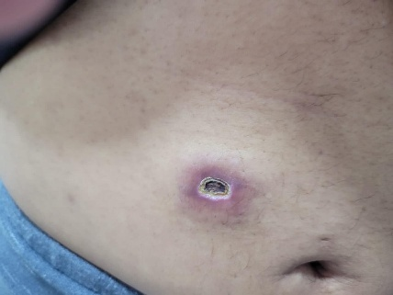
Some potential issues with LEN
Drug Interactions – steroids, antihistamines, clopidogrel, amiodorone, rifampicin cancer treatments etc
Health Care providers need to give injections
Ulcerative nodules

Slide 83
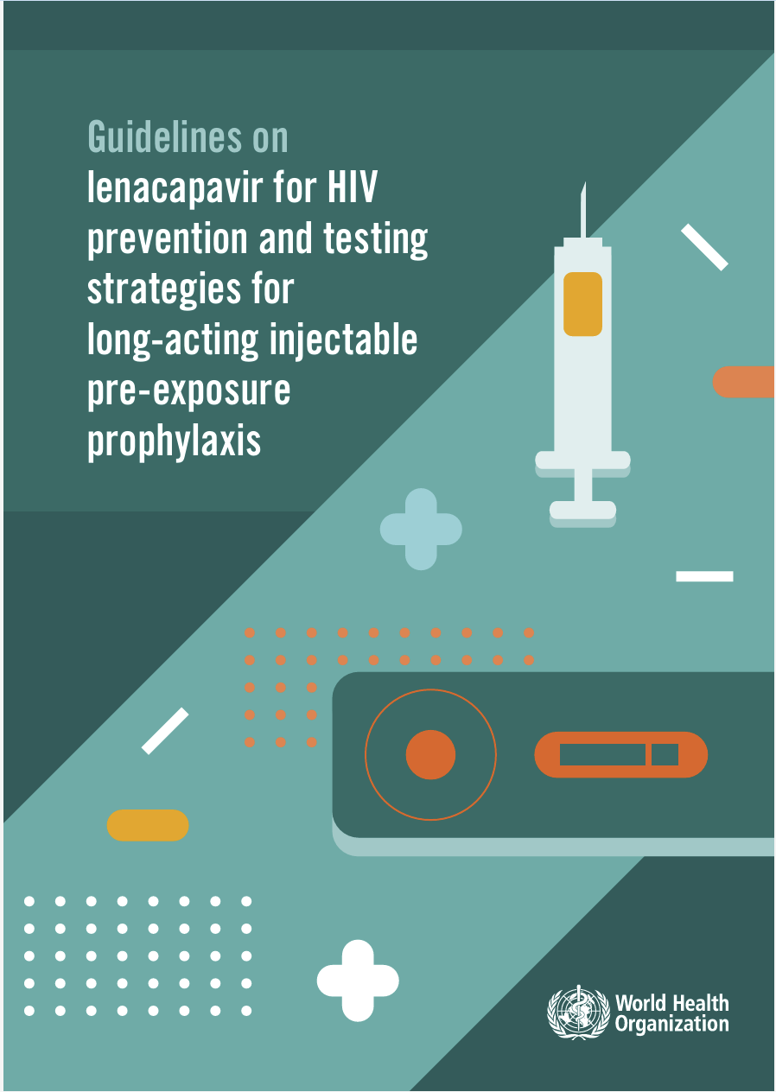

WHO guidelines on lenacapavir
WHO released guidelines recommending the use of six-monthly injectable lenacapavir as an additional HIV prevention
The guidelines were issued less than 13 months after the first press release announcing 100% efficacy in the PURPOSE 1 study
Other WHO-recommended prevention options include daily oral tenofovir/emtricitabine, injectable cabotegravir and the dapivirine vaginal ring
Rodolph SAT11

Slide 84









Differentiated service delivery in action –integrating different LA HIV medicines into population preferred service models?
D
ifferentiated
PrEP
Primary health care
Mobile & home-based
PrEP service delivery preferences
Pharmacies
Virtual/Telehealth
Public HIV clinics
KP-led clinics

Slide 85
“No One Left Behind”
HIV is preventable and treatable, but inequities continue to drive the epidemic
Ending HIV requires addressing structural barriers, not only medical ones
Community engagement is essential
Prevention and treatment must be tailored to the realities of vulnerable populations

Slide 86



present:
LIVE WEBINAR
François Raffi Nantes France
Pedro Cahn Buenos-Aires Argentina
Anton Pozniak London United-Kingdom
Next webinar
CROI
Tuesday, March 3rd 2026
This webinar is proposed to you with the support of our institutional partner

Slide 87
present:
LIVE SESSION
François Raffi Nantes France
Pedro Cahn Buenos-Aires Argentina
Anton Pozniak London United-Kingdom
The speakers at this webinar thank you for your participation
Please complete the satisfaction questionnaire (click on the questionnaire button in the chat)
If you missed part of this webinar, you can watch the replay on:
This webinar is proposed to you with the support of our institutional partner

