Slide 1
Long-Acting ARVs:
Current Status And Perspectives In Treatment
Monday, October 9th 2023
Faculty
  Pedro Cahn, Buenos-Aires, Argentina
  Anton Pozniak, London, UK
  François Raffi, Nantes, France
  Guest Editor : Monica Ghandi, San Francisco, USA

Slide 2
This presentation is made in complete editorial freedom
Thanks to ViiV Healthcare for their institutional support

Slide 3
Faculty Disclosures
Pedro Cahn has received research support for research grants: ViiV Healthcare, Merck, CanSino and for ad boards: ViiV Healthcare – Merck- Gilead
Monica Gandhi has no financial disclosures
Anton Pozniak has received research support and/or honoraria for consulting and/or advisory boards from ViiV Healthcare, Merck, Gilead, Janssen, Theratechnologies
François Raffi has received research support and/or honoraria for consulting and/or advisory boards from Gilead Sciences, Janssen, MSD, Theratechnologies and ViiV Healthcare

Slide 4
Long-Acting ARVs:
Current Status And Perspectives In Treatment
Monday, October 9th 2023
Faculty
  Pedro Cahn, Buenos-Aires, Argentina
  Anton Pozniak, London, UK
  François Raffi, Nantes, France
  Guest Editor : Monica Ghandi, San Francisco, USA

Slide 5


HAART: 25 years of constant progress
1996
2006
+
+
TDF/3TC/EFV

Slide 6
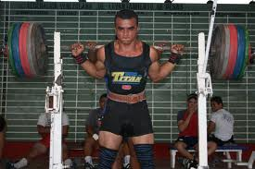
HAART: Is it about number of drugs or about potency and safety?

Slide 7
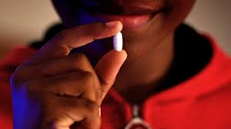
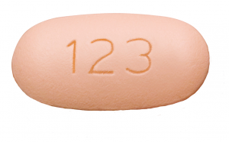

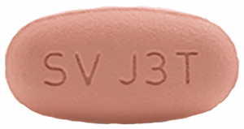

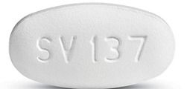

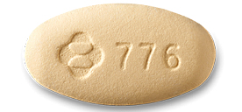

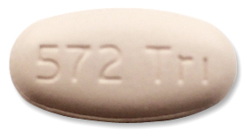

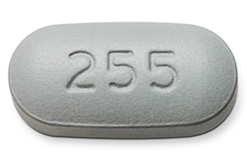
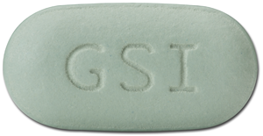
Oral Fixed-Dose Combinations in 2023
3 drugs
EFV/FTC/TDF
2 drugs
RPV/FTC/TDF
BIC/FTC/TAF
DTG/RPV
DOR/3TC/TDF
DTG/3TC
DRV/COBI/FTC/TAF
DTG/ABC/3TC
RPV/FTC/TAF
EVG/COBI/FTC/TAF
EVG/COBI/FTC/TDF

Slide 8
ART issues
Stigmatization associated with drugs intake
Psychological impact linking every day intake and having an incurable infection
Need for life-long treatment
Issues of pill size, of swallowing pills
Risk of non-adherence breakthroughs
Requirement of lifestyle organization (travel, week-ends), to maintain medications
Need for filling prescriptions
Problems in case of discontinuation for any reason (surgery, disruption of drug delivery…)

Slide 9
Challenges associated with daily dosing of HIV medications
Reasons for not sharing HIV status or missing ART in PLWHIV with and without privacy concerns
Never disguised HIV pills in past 6 months to avoid sharing HIV status (N=1006)
Ever disguised HIV pills in past 6 months to avoid sharing HIV status (N=1383)
Missed ART < 5 times in past month from privacy concerns (N=2287)
Missed ART ≥ 5 times in past month from privacy concerns (N=102)
I was worried
about criminal
prosecution
I was worried
about my
physical
safety/potential
violence
I was worried
about being
denied access
to financial
benefits/support
I was worried
about being
denied access
to health care
services
I was worried
I might lose
my job
I was worried
that I might be
excluded from
activities
I was worried
it might affect
my friendships
I was worried
it might affect
my romantic or
sexual relatioships
I was worried
that they would
see or treat me
differently
I was worried
that they might
then disclose
my HIV status
to others
De los Rios P, AIDS Behav 2021;25:961-762

Slide 10
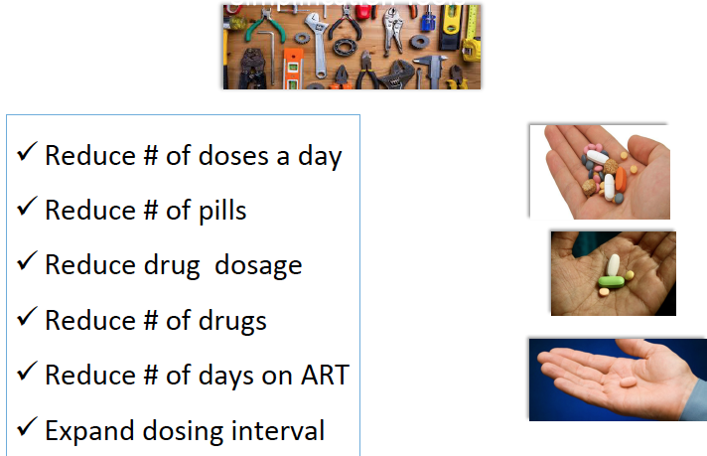
Tools aiming to reduce pill burden
Reduce # of doses a day
Reduce # of pills
Reduce drug dosage
Reduce # of drugs
Reduce # of days on ART
Expand dosing interval
Long-acting regimens
  Freedom from lifelong daily medications
  Low frequency of dosing
  Optimization of PK and decrease
  of inter-individual variability

Slide 11
Interest in Long-Acting HIV Regimen: PLWHIV and Physicians Perspectives (Western Europe)
BENEFITS
CONCERNS
HCPs’
perspectives
Q. For you as the treating physician, how important are each of the following benefits of Regimen Z?
Please select one response for each statement. (4-Point Scale [1-Not At All Important, 2-Not Very
Important, 3- Somewhat Important, 4- Very Important]), report for scores ≥3 on the 4 point scale.
Top five listed by HCP Total
Q. As the treating physician, how concerned are you about each of the following constraints of
Regimen Z? Please select one response for each statement. (4-Point Scale [1-Not At All Concerned,
2-Not Very Concerned, 3-Somewhat Concerned, 4- Very Concerned]), report for scores ≥3 on the 4
point scale. Top five by HCP Total.
More frequent
contact with
patients
Removes food
requirements
Route of drug
intake
Easier
management of
concomitant
diseases
Reduced GI side
effects related to
daily oral ART
Time/capacity to
receive patients 6
times/year for injections
Route of drug
intake
Injection site
reactions
Taking a patient
off long-acting
regimen and switching
back to oral ART
Patients missing
their appointments /
sending
reminders
PLWHIV’s
perspectives
Q. What characteristics do you like about Regimen Z? Please select all that apply below.
Top five listed by PLHIV Total
Q. What are the concerns you have with Regimen Z? Please select all that apply below.
Top five by PLHIV Total.
Easier to travel
because of not
having to take
pills along
2-month
uninterrupted
drug efficacy
Reduced
frequency of
drug intake
No risk of missing
a dose, which
minimizes the
risk of treatment
failure
Minimizes
transmission risk
and improves
sexual health
Scheduling travel to
meet the 2-week
injection window
Pain of the
injections
Missing the
2-week
injection window
Making the time
to go to the clinic
every 2 months
Having to travel to
the clinic every 2
months (cost)
Akinwunmi B, HIV Glasgow 2020, Abs P014

Slide 12
Long Acting 2DR as maintenance

Slide 13
CAB LA + RPV LA IM
Phase 3 programs for Treatment and Prevention
Indication
Phase 3
Phase 3b
Treatment
(Switch as
maintenance)
FLAIR (N=620)
ATLAS (N=570)
ATLAS 2M
(N=1020)
HPTN 083
(N=4500)
Prevention
MSM/TGW
HPTN 084
(N=3200)
Prevention
Women

Slide 14
FLAIR W96
Screening
Phase
Induction
Phase
Maintenance
Phase
Extension
Phase
N=809
ART naive
HIV-1 RNA ≥1000 c/mL
Any CD4 count
HBsAg-negative
NNRTI RAMs excluded
N=629
DTG/ABC/3TC
single-tablet regimen for
20 weeks
DTG/ABC/3TC
Oral daily N=283
Switch to LA N=232
Oral CAB+RPV N=283
CAB (400 mg)
+ RPV (600 mg)
LA IM monthly N=278
Extension
switch/continue CAB (400 mg)
+ RPV (600 mg)
LA IM monthly N=475
Study Week
−20
−4
Day 1
4
48
96
100
124
Confirm HIV-1 RNA
<50 c/mL
Randomisation (1:1)
Primary
Endpoint
Data
Cut-off
Oral
Lead-In
Analysis
Orkin C, Lancet HIV 2021 April; 8:e185-96

Slide 15
FLAIR W96
%
CAB + RPV LA
DTG/ABC/3TC
Adjusted treatment difference (95% CI)*
100
CAB + RPV LA (N=283)
86.6
89.4
DTG/ABC/3TC (N=283)
80
6%
non
inferiority
margin
LA is noninferior
to DTG/ABC/3TC
(≥50 c/mL) at
Week 96
- 2.9
0
2.9
60
-10
-8
-6
-4
-2
0
2
4
6
8
10
Difference (%)
DTG/ABC/3TC
CAB + RPV LA
40
20
LA is noninferior
to DTG/ABC/3TC
(<50 c/mL) at
Week 96
10.2
-10%
non
inferiority
margin
3.2
3.2
7.4
- 8.2
-2.8
2.5
0
Virologic non-response
HIV RNA ≥ 50 c/mL
Virologic success
HIV RNA < 50 c/mL
No virologic data
-10
-8
-6
-4
-2
0
2
4
6
8
10
Difference (%)
Orkin C, Lancet HIV 2021 April; 8:e185-96

Slide 16
ATLAS 2M – Design
CAB LA + RPV LA Q4W vs Q8W
391† ATLAS phase 3 study
(cabotegravir plus
rilpivirine LA every
4 weeks)
Screening Phase
Maintenance Phase*
Oral
cabotegravir
plus rilpivirine
Except
participants
from ATLAS
already on LA
therapy
522 every 8 weeks cabotegravir (600 mg)
plus rilpivirine (900 mg) LA
Randomly
assigned
1:1‡
Extension Phase
654 † ATLAS standard-of-care
group + additional
standard-of-care
Participants§: protease
inhibitor, NNRTI, or
INSTI-based regimen
with 2 NRTI backbone
523 every 4 weeks cabotegravir (400 mg)
plus rilpivirine (600 mg) LA
Primary endpoint
Day 1
W4
W48
W96
W100
Baseline characteristics similar between Q4W and Q8W arms (N=1045)
Female: 27 %, median age: 42 years, BMI > 30 kg/m²: 20 %, prior exposure to CAB + RPV: 37 %
Overton ET, Lancet 2020 Dec 19;396:1994-2005

Slide 17
ATLAS 2M – W96 results
%
Virologic outcomes at W96 – ITT-E snapshot
100
Q8W CAB + RPV LA
(N=522)
91.0
90.2
Q4W
Q8W
Q4W CAB + RPV LA
(N=523)
HIV RNA > 50 c/mL at W96
80
60
1.0
4%
non inferiority margin
- 0.6
2.5
40
-10
-8
-6
-4
-2
0
2
4
6
8
10
Difference (%)
Q4W
Q8W
20
HIV RNA < 50 c/mL at W96
6.0
8.6
2.1
1.1
0
0.8
- 2.8
4.3
Virologic non-response
HIV RNA ≥ 50 c/mL
Virologic success
HIV RNA < 50 c/mL
No virologic data
-10%
non inferiority
margin
-10
-8
-6
-4
-2
0
2
4
6
8
10
Difference (%)
Non-inferiority maintained at W152 (Overton ET, Clin Infect Dis 2023; 76(9):1646-54)
Jaeger H, Lancet HIV. 2021 Nov;8(11):e679-e689

Slide 18
ATLAS-2M study: LA CAB + RPV every
2 Months – W152 Results
Confirmed virological failure (2 consecutive HIV RNA > 200 c/mL) on Q8W at W152
Sex, Country | Time of CVF | Subtype | BMI | NNRTI RAMs |  | INSTI RAMs |  | Baseline VF predictive factors
 |  |  |  | Archived | RAMs at CVF | Archived | RAMs at CVF
F, South Africa | W8 | C | ≥ 30 | Y181C, H221Y | None | None | None | 2
F, South Africa | W16 | C | ≥ 30 | Y188 | Y188L | L74I, G140R | L74I, Q148R, N155H | 2
F, Russia | W16 | A6 | ≥ 30 | None | K101E | L74I | L74I, Q148R | 2
M, Spain | W16 | B | < 30 | None | None | None | None | 0
F, Canada | W24 | A1 | ≥ 30 | Y188L | Y188L | L74I | L74I, N155H | 3
M, US | W24 | B | ≥ 30 | E138A | E138A | None | N155H | 2
F, Russia | W24 | A6 | ≥ 30 | E138A | E138A, K101E | L74I | L74I, N155H | 3
M, Spain | W48 | A1 | < 30 | None | E138K | None | None | 1
M, Russia | W48 | A6 | < 30 | None | E138K | L74I | L74I, Q148R, N155H | 1
M, US | W88 | B | < 30 | Y181C | Y181C | L74I | None | 1
M, Russia | W112 | A6 | < 30 | None | E138A, Y181C | L74I | L74I, Q148R | 1
M, Germany | W120 | B | < 30 | None | E138A, M230M/L | None | Q148R | 0
Among 12 CVF, 9 occurred during the first 48 weeks, 1 between W48 and W96 and 2 between W96 and W152
  10/12 had at least 1 baseline predictor of virological failure, No injections were outside the 7 days window
Overton ET, Clin Infect Dis 2023; 76(9):1646-54

Slide 19
ATLAS-2M study: LA CAB + RPV every
2 Months – W152 Results
Discontinuation for adverse events related to treatment
 | Not related to injections n (including between W96-W152), % | Related to injections n (including between W96-W152), %
Q8W (N=522) | 6 (0) ; 1.1% | 8 (+1) ; 1.5%
Q4W (N=523) | 13 (+2) ; 2.5% | 14 (+2) ; 2.7%
Proportion of participants with injection site reactions
%
100
80
CAB + RPV LA Q8W grade 1 or 2
CAB + RPV LA Q4W grade 1 or 2
60
Grade 3
40
20
0
Participants
at visit
D1
194
196
W4
322
515
W8
514
515
W12
NA
513
W16
511
508
W20
NA
502
W24
502
503
W28
NA
502
W32
495
499
W36
NA
492
W40
495
491
W44
NA
490
W48
483
488
W52
NA
483
W56
487
480
W60
NA
480
W64
485
477
W68
NA
477
W72
481
476
W76
NA
478
W80
482
475
W84
NA
475
W88
480
475
W92
NA
470
W96
473
468
W100
NA
464
W104
452
459
W108
NA
450
W112
456
451
W116
NA
450
W120
456
449
W124
NA
453
W128
460
455
W132
NA
456
W136
459
454
W140
NA
449
W144
456
449
W148
NA
446
W152
456
448
Overton ET, Clin Infect Dis 2023; 76(9):1646-54

Slide 20
SOLAR: switch of CAB + RPV LA IM vs oral BIC/FTC/TAF
BIC/FTC/TAF
OD n=227
Randomised, open-label, multicentre, non-inferiority study
Inclusion criteria
  > 18 years
  On 1st or 2nd line BIC/FTC/TAF (1st line with triple INSTI-based ART allowed if no virologic failure)
  HIV-1 RNA ≤ 50 c/mL ≥ 6 months and at screening (between M-1 and Day 1)
CAB (600 mg) + RPV (900 mg) LA
IM Q2M n=166
Extension Switch to or continue
CAB (600 mg) + RPV (900 mg) LA
M12
M12
CAB (600 mg) + RPV (900 mg)
LA IM Q2M n=279
Oral
CAB+RPV
n=175
N=837
R
2:1
Patient’s
choice
Participants characteristics : median age = 37 years, female = 17%, median BMI = 26 kg/m²
Ramgopal MN, Lancet HIV 2023; 10:e566-77

Slide 21
SOLAR: switch of CAB + RPV LA IM vs oral BIC/FTC/TAF
Virologic outcomes at M12 (mITT-E population)
Adjusted treatment difference
100
100
90%
93%
Proportion with plasma HIV-1 RNA ≥50 c/mL
80
CAB + RPV LA Q2M (N=447)
CAB+RPV LA Q2M
BIC/FTC/TAF
80
-0.7
0.7
2.0
BIC/FTC/TAF (N=223)
60
60
4% NI margin
-12
-10
-8
-6
-4
-2
0
2
4
6
8
10
12
40
Difference (%)
40
Proportion with plasma HIV-1 RNA <50 c/mL
20
20
BIC/FTC/TAF
CAB+RPV LA Q2M
9%
7%
1%
<1%
-7.0
-2.7
1.7
0
Virologic non-response
(≥50 copies/ml)
Virologic success
(<50 copies/ml)
No virologic data
-12% NI margin
-12
-10
-8
-6
-4
-2
0
2
4
6
8
10
12
Difference (%)
Ramgopal MN, Lancet HIV 2023; 10:e566-77

Slide 22
SOLAR: switch of CAB + RPV LA IM vs oral BIC/FTC/TAF
Confirmed virologic failures : only in CAB + RPV LA arm
Sex at birth, BL BMI (kg/m²), country | HIV-1 subtype at BL | Viral load at SVF/CVF (c/mL) | RPV RAMs observed at BL (proviral DNA) | INI RAMs observed at BL (proviral DNA) | RPV RAMs observed at failure (viral RNA) | INI RAMs observed at failure (viral RNA) | Phenotypic resistance (fold-change) to RPV/CAB | SVF timepoint (month)
Participants with CVF in the mITT-E Population
Male, 21.5 Italy | B | 1327/1409 | None | None | M230L | Q148R | 3.2/3.1 | 6
Male, 22.0 Spain | AE | 6348/419 | None | G140G/R | K101E | G118R | 1.9/8.4 | 11
Participants with CVF in the ITT-E Population
Male, 30.5, United States | C | 3797/928 | Assay failed | Assay failed | E138E/K + Y181Y/C | None | 4.2/assay failed | 3
Ramgopal MN, Lancet HIV 2023; 10:e566-77

Slide 23
SOLAR: switch of CAB + RPV LA IM vs oral BIC/FTC/TAF
Weight changes (Kg)
Proportion of participants with an upward BMI shift resulting in overweight or obesity at month 12
1.0
%
CAB + RPV LA Q2M (N=454)
20
CAB + RPV LA Q2M
BIC/FTC/TAF
BIC/FTC/TAF (N=227)
0.5
15
13
+0.10
+0.05
10
9
0.0
-0.10
7
8
-0.20
-0.05
5
-0.40
-0.40
-0.30
N=13/175
N=12/94
N=14/174
N=7/78
-0.5
0
2
4
6
12
Normal to overweight
Overweight to obesity
Study visit (month)
Ramgopal MN, Lancet HIV 2023; 10:e566-77

Slide 24
SOLAR: Treatment Satisfaction
Mean HIVTSQ score at baseline: 58
Total HIVTSQs score at M6 and M12, mean (IC 95%)
Adjusted Difference (95% CI)
LA CAB + RPV
(Month 6, N=436;
Month 12, N=410)
M6
+3.86 (3.14, 4.57)
4.26 (3.02, 5.49); p < 0.001
-0.40 (-1.41, 0.61)
BIC/FTC/TAF
(Month 6, N=220;
Month 12, N=213)
M12
+3.36 (2.59, 4.13)
4.95 (3.59, 6.31); p < 0.001
-1.59 (-2.71, -0.47)
-4
-3
-2
-1
0
1
2
3
4
5
Worsening
Improvement
Of 425 participants in the CAB + RPV arm, 90% preferred LA CAB + RPV vs 5% preferred BIC/FTC/TAF
Ramgopal MN, Lancet HIV 2023; 10:e566-77

Slide 25
CAB LA + RPV LA IM
Indication and Practical questions

Slide 26
CAB LA + RPV LA IM
Indication and Practical questions
EMA approval (Rekambys® + Vocabria ®) / FDA approval (Cabenuva®)
  CAB LA (Vocabria®) IM + RPV LA (Rekambys®) IM indicated for the treatment of HIV-1 infection in adults (to replace current ART) who are virologically suppressed (HIV RNA <50 cp/mL) on a stable ART without present or past evidence of viral resistance to, and no prior virological failure with agents of the NNRTI and INI class (with no history of treatment failure and with no known or suspected resistance to CAB or RPV)
  Oral lead-in CAB 30 mg qd + RPV 25 mg qd x 28 days (optional / may be considered)
  CAB LA + RPV LA IM
      Monthly dosing: 600 mg CAB + 900 mg RPV (initial dose) then 400 mg CAB + 600 mg RPV every month (EMA / FDA)
      Every 2 months dosing: 600 mg CAB + 900 mg RPV at M1 and M2, then every 2 months (EMA/ FDA)
Questions for clinical use ?
  Patients’ satisfaction QM vs Q2M
  Predicting virologic failure
  Oral lead-in
  Missed doses
  Oral bridging
  Logistics

Slide 27
ATLAS-2M
CAB + RPV LA IM Q4W vs 8W: Patients satisfaction
Mean HIVTSQs Change From Baseline in Those Without Prior CAB + RPV Exposure
Mean HIVTSQ change from baseline item scores at S48
Satisfaction Items:
-0.5
0
0.5
1
1.5
Satisfaction with continuing present treatment?
0.8
0.7
Q8W
Q4W
Flexibility of recent treatment?
0.8
0.8
Convenience of recent treatment?
0.7
0.5
Satisfaction with impact of treatment on lifestyle?
0.5
0.5
Ease or difficulty of recent treatment?*
0.4
0,.3
Willingness to recommend present treatment to others?
0.4
0.3
Satisfaction with current regimen?
0.3
0.2
Satisfaction with current regimen demands?
0.2
0.2
Satisfaction with HIV understanding?
0.2
0.2
Satisfaction with the side effects of current treatment?
0
0
Perception of recent HIV control?
0
Satisfaction with amount or
discomfort/pain on present
treatment?*
0
-0.3
-0.5
Deterioration
Improvement
*HIVTSQ was adapted to include two additional questions relating to injectable treatment.
Chounta V, IAC 2020, Abs PEB0261

Slide 28
ATLAS-2M
Treatment preference
Treatment Preference at Week 48 in the Q8W Arm
Participants in Q8W arm with prior Q4W experience in ATLAS*
Participants in Q8W arm from SOC (no prior Q4W experience)†
Q8W CAB + RPV LA
Q8W CAB + RPV LA
Q4W CAB + RPV LA
No preference
No preference
Daily oral CAB + RPV
Daily oral CAB + RPV
†306 participants responded
to the preference question
*191 participants responded
to the preference question
94%
98%
Chounta V, IAC 2020, Abs PEB0261

Slide 29
Factors associated with virologic failure to CAB + RPV LA
Pooled data from FLAIR (through W124), ATLAS (through W96) and ATLAS-2M (through W152): 23/1363 (1.69 %) participants experienced confirmed virologic failure (2 consecutive HIV RNA ≥ 200 c/mL) on CAB LA + RPV LA IM
Risk of CVF
Multivariable analysis including only baseline factors
Relation with N of Factors and CVF / HIV RNA < 50 c/mL
 | BFA adjusted IRR (95% CI) [P value], N=1363
RPV RAMs: Yes/No | 21.7 (5.80-80.8) [< 0.0001]
HIV-1 subtype A6/A1: Yes/No | 12.9 (4.42–37.5 ) [< 0.0001]
Baseline BMI (kg/m²) | 1.09 (1.00-1.19) [0.0447]
 | Confirmed Virologic Failure, N (%) | HIV-1 RNA < 50 c/ml, N (%)
No Factor | 4/970 (0.4%) | 844/970 (87.0%)
Any one factor | 8/404 (2.0%) | 343/404 (84.9%)
≥ 2 Factors | 11/57 (19.3%) | 44/57 (77.2%)
Total | 23/1431 (1.6%) | 1231/1431 (86.0%)
Dosing regimen and integrase L74I were not predictive of CVF risk
Good sensitivity and specificity of ≥ 2 factors
 | PPV | NPV | Sensitivity | Specificity
≥ 2 Factors | 19.3% | 99.1% | 47.8% | 96.7%
Any one Factor | 2.0% | 98.5% | 34.8% | 71.9%
Orkin C. Clin Infect Dis 2023; Clin Infect Dis. 2023 Jun 21:ciad370. doi

Slide 30
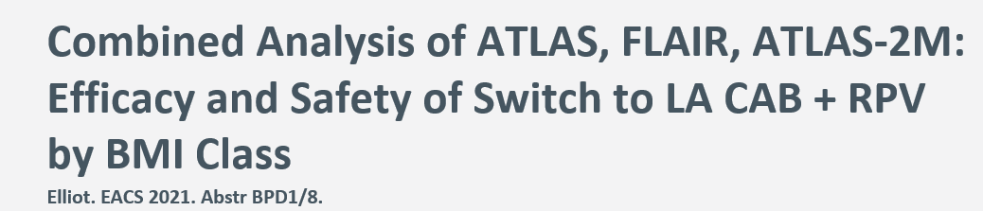
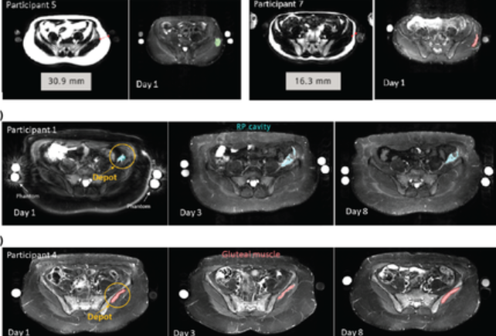
BMI and CAB
In this EACS study, use of longer 2-inch needles resulted in higher median CAB trough concentrations in all BMI
Pharmacology study showed deeper injections with more adipose tissue lead to more spread
Longer 2-inch needles recommended in participants with BMI ≥30 kg/m²
Jucker B. Br J of Pharm 2021

Slide 31
FLAIR OLI: Study Design
Phase III, Randomised, Multicentre, Parallel-Group, Noninferiority, Open-Label Study
Extension Phase
Screening
Phase
Induction
Phase
Maintenance Phase
Oral CAB+RPV N=121
Extension Switch
OLI arm (ORAL LEAD-IN)
N=809
ART naive
HIV-1 RNA ≥1000 c/mL
Any CD4 count
HBsAg-negative
NNRTI RAMs excluded
n=629
DTG/ABC/3TC
single-tablet regimen for
20 weeks
DTG/ABC/3TC
Oral daily N=283
CAB (400 mg) + RPV (600 mg) LA IM Q4W N=119
DTI arm (DIRECT TO INJECT)
CAB (400 mg) + RPV (600 mg) LA
IM Q4W N=111
Oral CAB+RPV N=283
CAB (400 mg) + RPV (600 mg) LA
IM Q4W N=278
CAB (400 mg) + RPV (600 mg) LA
IM Q4W N=243
Study Week
−20
−4
Day 1
4
48
96
100
104
124
Confirm HIV-1 RNA
<50 c/mL
Randomisation (1:1)
Primary Endpoint*
Participant/Physician Decision to Switch to
CAB + RPV LA^{ǁ}
Oral Lead-In Analysis
Orkin C. Lancet HIV 2021; 8: e668–78

Slide 32
FLAIR OLI
Snapshot Virologic Outcomes at Week 124
(Extension Switch)
99.1
100
DTI arm (N=111)
« Direct to Inject »
93.4
80
OLI arm (N=121)
« Oral Lead-in »
60
Participants (%)
40
20
5.8
0.9
0.8
0
0
Virologic non-response
HIV-1 RNA ≥ 50 c/mL
Virologic suppression
HIV-1 RNA < 50 c/mL
No virologic data
Only 1 participant (0.4%) met the CVF criterion in the Extension Switch population
  The participant was in the DTI arm and met the CVF criterion on the 12th week of LA therapy. No INSTI or NNRTI RAMs were detected at baseline and no INSTI RAMS were detected at the timepoint of suspected virologic failure (RT assay failed)
D’Amico, HIV Glasgow 2020, Abs 0414

Slide 33
CAB + RPV LA: practical monitoring
Every-8 weeks Dosing : Monitoring and Missed Doses
  HIV-1 RNA: 4-8 weeks after switch to LA CAB + RPV and after unplanned missed visits/delayed dosing
  If viremia develops, test for resistance (including INSTI resistance)
  Oral-bridging therapy should be made available for planned missed doses
  If <3 months since last every-2-months injections, resume prior dosing schedule
  If >3 months since last every-2-months injections, initiate dose, followed by another dose
  1 month later, then resume every-2-months dosing
  When stopping, transition to suppressive oral regimen within 8 weeks of last IM doses
DHHS Guidelines. Guidelines for the Use of Antiretroviral Agents in Adults and Adolescents Living with HIV.

Slide 34
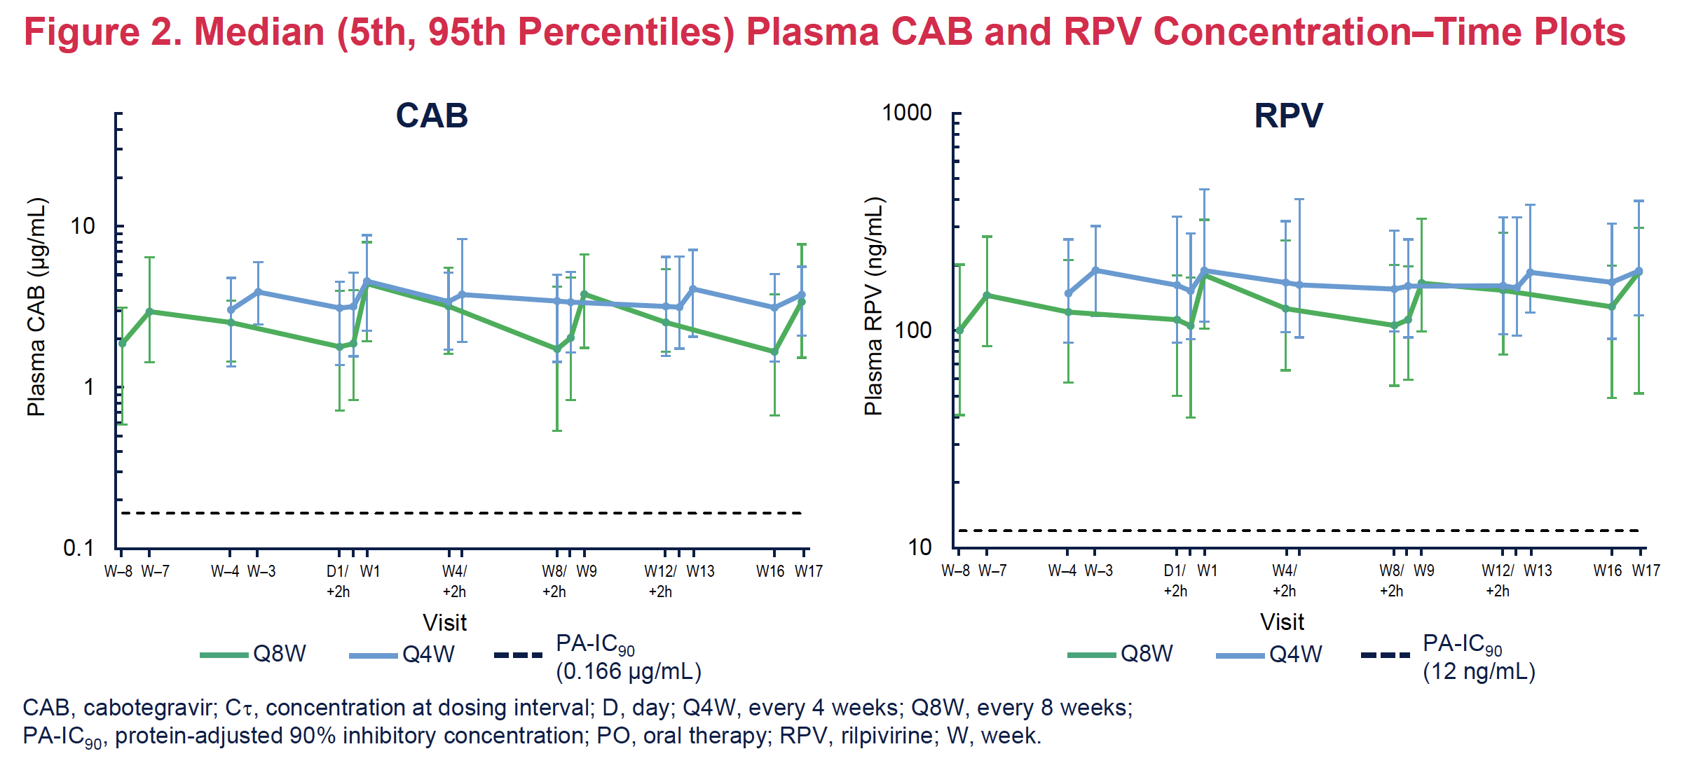

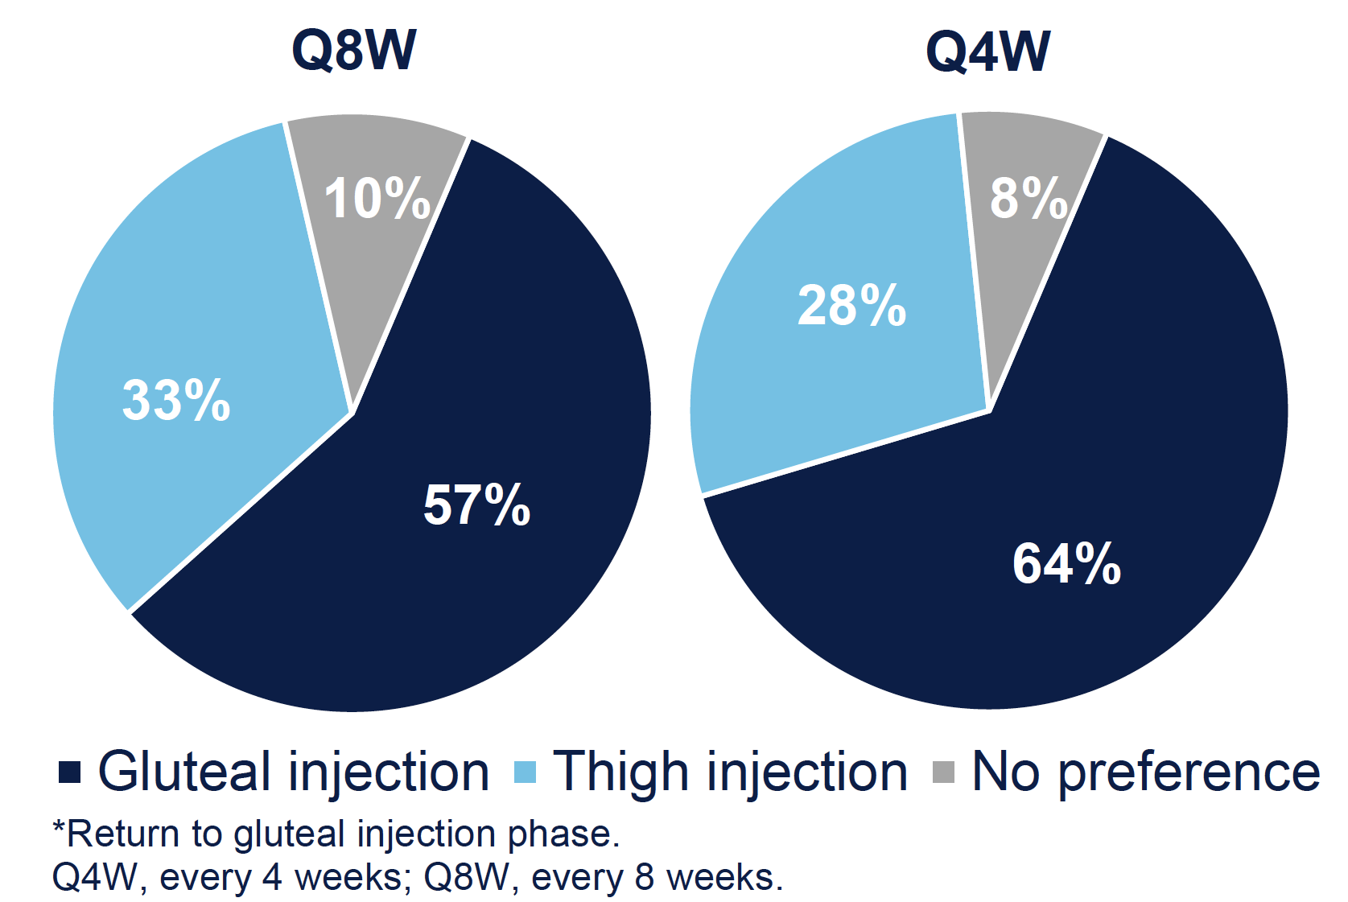
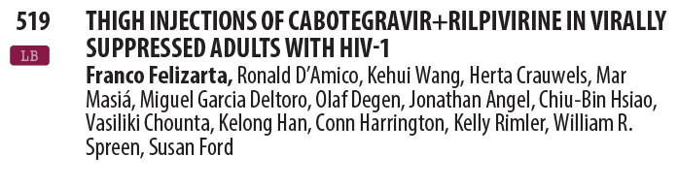
Median (5th, 95th Percentiles) Plasma CAB and RPV Concentration-Time Plots
Bottom line: Can use thigh injections for cabotegravir and rilpivirine (same PK) but hurt more

Slide 35
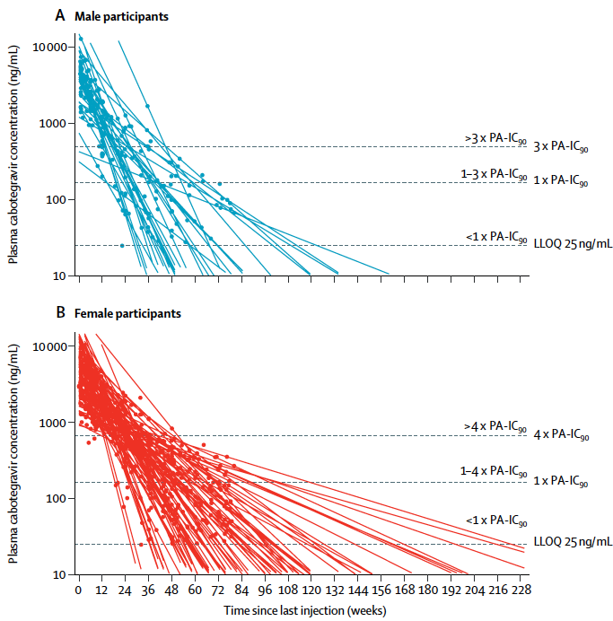
CAB LA PK tail
Phase 2a HPTN087
134 HIV uninfected adults
LA CAB IM 800 mg 3 times at 12 weeks intervals or 600 mg 5 times (at one 4 week interval, and every 8 weeks thereafter)
Median delay between last CAB IM and time to plasma C < LLOQ
  longer in female than male (67.3 vs 43.7 weeks)
  longer if BMI ≥ 25 kg/m²
Risk of resistance during PK tail ?
When should we oral bridge ? Risk of d-d-i ?
Safety in pregnancy ?
Landovitz RL, Lancet HIV 2020;7:e472-81

Slide 36
What do the guidelines say for regimen optimization in the setting of viral suppression ?
2 options
  3-drugs regimens switch (within-class or between-class)
  2-drugs regimens
Recommended 2DR as switch options
DHHS¹ | IAS-USA² | EACS ³
Recommended (Rating AI, unless otherwise specified) DTG/RPV * DTG/3TC or DTG + FTC * DRV/r + 3TC (BI) ** CAB + RPV LA IM Q4W or Q8W *, § | Recommended (rating A1a, unless otherwise specified) $: DTG/RPV DTG/3TC CAB LA RPV LA IM Q4W or Q8W (B1b) | Recommended regimens £: DTG/RPV DTG/3TC or DTG + FTC DRV/b+ 3TC or FTC CAB LA RPV LA IM Q8W
* Only if no HBV coinfection (unless on HBV active regimen) and no resistance to either ARVs
** Only if no HBV coinfection (unless on HBV active regimen)
§ No prior virological failure, no pregnancy or plan to become pregnant
$ No prior virological failure or evidence of drug resistance, no hepatitis B co-infection
£ Only if no historical resistance and HBs Ab positive
1. DHHS. clinicalinfo.hiv.gov/en/guidelines/adult-and-adolescent-arv/whats-new-guidelines. 23 March 2023. 2. JAMA. 2023 Jan 3;329(1):63-84.. 3. EACS Guidelines, Version 11.1. Oct 2022

Slide 37
2DR injectable – A validated option in maintenance
Risk of virological failure and resistance
  approximately 1 in 70 at year 1 and 1 in 60 at year 2
LA-CAB/RPV has been investigated only in the context of viral suppression in a highly selected population
Need data in more complex populations, including those with a history of poor adherence, virological failure or treatment interruption

Slide 38
Long Acting 2DR in patients with uncontrolled viremia on oral ART

Slide 39

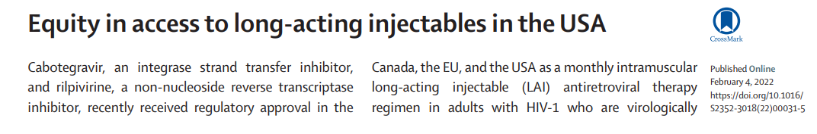

Why do we have to study this in “hardly reached” populations?
If wait until drug approved or not studied at outset, clinicians “flying blind” in how to use LA-ART in nonsuppressed
Critically important population for Ending the HIV epidemic
10% of people living with HIV holding 90% of the virus
Concomitant challenges in these patients

Slide 40
Outcomes of Demonstration Project of LA Injectable ART for Persons With Detectable HIV Viremia in an Urban HIV Clinic
Ward 86
96% on Medicaid or Medicare
4% on municipal health insurance program or uninsured
Vulnerable population:
Mental Illness (now up to 45%)
Poverty
Addiction (Alcohol, heroin, cocaine
methamphetamine): 35%
Marginal Housing (34%)
Inclusion criteria of Ward 86
Need not be virologically suppressed or take oral ART before injectables
No RPV or INSTI mutations (strengthened criteria later)
Express willingness to come to clinic q4 weeks, contact information, outreach from staff
Rigorous protocol, Biweekly review with Pharm D, pharm tech, clinic leadership, POP-UP program leadership to review each patient on injectables or being considered
57 patients started on CAB + RPV LA with viremia
Characteristic
Median age (range), y | 48.0 (25.0-68.0)
Gender, N (%) Cisgender man Cisgender woman Transgender woman | 51 (89.5) 5 (8.8) 1 (1.8)
Race/ethnicity, N (%) Black Latino/Latina White Multiracial/other | 13 (22.8) 18 (31.6) 23 (40.4) 3 (5.3)
Housing status, N (%)† Experiencing homelessness Unstable Stable | 6 (10.5) 24 (42.1) 27 (47.4)
Current stimulant use, N (%)† | 28 (49.1)
Mean log₁₀ viral load (SD) | 4.21 (1.30)
Median CD4 cell count (IQR), x 10⁹ cells/L‡ | 0.215 (0.075-0.402)
Gandhi M. Ann Intern Med 2023;176:969-974

Slide 41
RESULTS (continued)
Outcomes of Demonstration Project of LA Injectable ART for Persons With Detectable HIV Viremia
in an Urban HIV Clinic
Median follow-up 33 weeks
Kaplan-Meier curve of probability of achieving HIV RNA <30 copies/mL)
with long-acting anti-retroviral therapy (n = 57).
Among viremic PWH, at median of 33 days, 55 suppressed, 2 had early virologic failure
Current cohort virologic failure rate 1.5% similar to that across clinical trials (1.4%) by 48 weeks (68% by 24 weeks)¹
Two failures < 24 weeks, both had minor mutations at baseline (1 NNRTI, 1 INSTI), so protocol tightened; 3rd didn’t suppress <100 (182) so added LEN
100
75
97.5%
50
Proportion Achieving Viral Suppression, %
25
Updated data on our cohort (put into CROI 2024): Overall virologic success rate of 85% (we counted as going back to oral ART “failures) among N=256 (244 more on waiting list)
What is counterfactual? 33% VS rate among those who cannot take oral ART & have incentives, interventions to try to use oral ART
0
0
4
8
12
16
20
24
28
32
36
40
44
At risk, n
Weeks Since First Injection
57
49
22
12
8
7
3
1
1
1
1
0
Neither patient who didn’t have virologic suppression could take oral ART
¹Gandhi Ann Intern Med 2023 ; ²Chen W. OFID 2023518
Gandhi M. Ann Intern Med 2023;176:969-974 ; Chen W. OFID 2023

Slide 42
LA CAB + RPV in patients with virologic failure on ART
Adult Special Care Clinic, a Ryan White–funded HIV clinic at the University of Mississippi Medical Center in Jackson, Mississippi
CAB/RPV LA offered as a salvage option for patients with poor virologic outcomes
(viremic at multiple time points) despite ART optimization and intensive case management strategies
Number of patients: 12
Follow-up: 1 to 17 months
Despite historical poor adherence to oral therapy, adherence to injection visits was very good
with 5 of 82 injection visits occurring after the scheduled injection window period
HIV RNA < 50 c/mL: all patients, within 3 months
No discontinuations due to attrition, virologic failure, or adverse effects
Brock JB. Clin Infect Dis 2023 Sep 22;ciad511.doi

Slide 43
Projected Benefits of LA ART in Nonsuppressed People With HIV Experiencing Adherence Barriers
Projection of the long-term impact of CAB-RPV for nonsuppressed PWH experiencing adherence barriers
Cost-Effectiveness of Preventing AIDS Complications (CEPAC) model: comparison of 3 strategies:
  Standard of care oral INSTI–based ART (INSTI)
  INSTI-based ART with supportive social services (“wraparound services” [WS]) (INSTI/WS)
  CAB-RPV with WS (CAB-RPV/WS)
Outcomes: % viral suppression and % engagement in care at 3 years, and life expectancy
Base case cohort characteristics (derived from the demonstration project in San Francisco)
  Mean age: 47 years (± 10y)
  90% male at birth
  Baseline mean CD4 count 150/μL (± 75/μL)
  Viral suppression at 3 months: 13% (INSTI), 28% (INSTI/WS), and 60% (CAB-RPV/WS)
  Mean loss to follow-up: 28/100 person-years (PY) (± 2/100 PY) without WS and 16/100 PY (± 1/100 PY) with WS
Chen W. Open Forum Infect Dis 2023. https://doi.org/10.1093/ofid/ofad390

Slide 44
Projected Benefits of LA ART in Nonsuppressed People With HIV Experiencing Adherence Barriers
Projected Clinical Impact of LA CAB-RPV With Wraparound Services Compared With Oral INSTI—Based ART With or Without Wraparound Services
for Nonsuppressed People With HIV Experiencing Adherence Barriers
 | At 3 Years
Strategies | Viral Suppression, % | Engagement in Care, % | Survival, % | Life Expectancy, y
CD4 count = 150 (SD, 75) cells/µL (base case)
INSTI INSTI/WS CAB-RPV/WS | 16 38 44 | 45 57 58 | 73 77 79 | 7.4 9.0 9.4
One-way sensitivity analyses for cohorts of PWH with different baseline CD4 counts
CD4 count= 50 (SD, 25) cells/µL INSTI INSTI/WS CAB-RPV/WS CD4 count = 350 (SD, 75) cells/µL INSTI INSTI/WS CAB-RPV/WS CD4 count = 500 (SD, 75) cells/µL INSTI INSTI/WS CAB-RPV/WS | 16 37 43 16 38 44 16 38 44 | 40 54 56 46 59 59 46 59 59 | 62 71 74 81 83 83 83 84 84 | 6.3 8.3 8.7 9.0 10.2 10.4 9.7 10.7 10.8
Chen W. Open Forum Infect Dis 2023. https://doi.org/10.1093/ofid/ofad390

Slide 45
LA Injectable ART for Persons With Detectable HIV Viremia
Could LA-ART potentially be a game-changer for HIV treatment in patients experiencing barriers to oral ART adherence ? ¹
In populations who struggle with adherence to oral ART, the alternative outcome is not perfect adherence to oral ART but rather ongoing viremia and progression of HIV disease, which recalibrates the tipping point for use of LA CAB-RPV ¹
« The long-acting ARV combination of injectable cabotegravir (CAB) and RPV is not currently recommended for people with virologic failure » [DHHS]
Has time come to be « pragmatic » ?. CAB + RPV LA in patients fullfilling all following criteria:
  Uncontrolled viremia despite multiple oral ART regimen, with chronic non adherence
  High risk of HIV disease progression (CD4 < 200/mm³ or prior history of AIDS)
  Virus susceptible to both RPV and CAB
  Availability and acceptance of intensive case management services
1. Gandhi M. Ann Intern Med 2023;176:969-974

Slide 46
Concerns with current CAB + RPV LA integration
Re-medicalization as injectable product administration role will be task-shifted back from KP lay providers to nurses/doctors
De-medicalize Simplify
Differentiate
« We have much to learn to de-medicalize and deliver injectable and implantable drugs in the most remote of settings »

Slide 47
Long Acting ART in patients with virologic failure in the setting of HTE and multiresistance

Slide 48
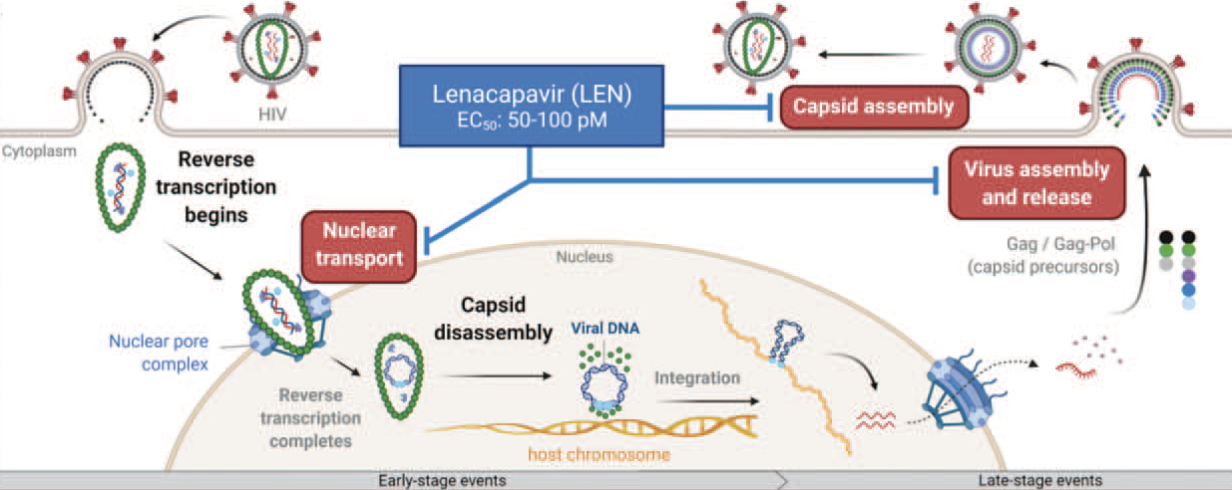
LEN Targets Multiple Stages of HIV Replication Cycle
Link JO. Nature 2020; 584:614-8 ; Bester SM. Science 2020; 370:360–4.

Slide 49
CAPELLA Study: lenacapavir in HTE patients
Key eligibility criteria:
HIV-1 RNA ≥400 c/mL
Resistance to ≥2 agents from
3 of 4 main ARV classes
≤ 2 fully active agents from
4 main ARV classes
Functional
monotherapy
(14d)
Optimisation
N=24
Oral LEN
SC LEN q6mo for 52 wk
Failing regimen
OBR
Randomised cohort
(double blind)
Resistance class at Screening |  |  |  | Number (%) of participants
NRTI | NNRTI | PI | INSTI | Cohort 1 (N=36) | Cohort 2 (N=36)
✅ | ✅ | ✅ | ✅ | 17 (47%) | 16 (44%)
✅ | ✅ | ✅ |  | 9 (25%) | 13 (36%)
✅ | ✅ |  | ✅ | 8 (22%) | 5 (14%)
✅ |  | ✅ | ✅ | 2 (6%) | 0
 | ✅ | ✅ | ✅ | 0 | 1 (3%)
 | ✅ |  | ✅ | 0 | 1 (3%)
NO
Screening period
Prerandomisation repeat HIV-1 RNA
Decline ≥ 0.5 log₁₀ c/mL
(vs screening) ; or <400 c/mL
Placebo
Oral LEN*
SC LEN q6mo for 52 wk
N=12
Failing regimen
OBR
YES
Non randomised cohort (open label)
N=36
Oral LEN
SC LEN q6mo for 52 wk
OBR
OBR
Segal-Maurer S, N Engl J Med 2022;386:1793-803 ; Ogbuagu O. Lancet HIV. 2023 Aug;10(8):e497-e505

Slide 50
CAPELLA Study: LEN in PLWHIV with multiresistant HIV-1- W52 Results
Week 52 efficacy: randomized cohort (n=36)
%
100
83
86
80
60
40
20
14
11
3
3
0
< 50 c/ml
< 200 c/ml
> 50 c/ml
> 200 c/ml
Virologic suppression
Virologic failure
No Virologic data
N=
30
31
5
4
1
1
Segal-Maurer S, N Engl J Med 2022;386:1793-803 ; Ogbuagu O. Lancet HIV. 2023 Aug;10(8):e497-e505

Slide 51
CAPELLA Study: LEN in PLWHIV with multiresistant HIV-1- W52 Results
HIV-1 RNA < 50 c/mL (%, 95% CI) at W52 by number of fully active agents in OBR
%
94
83
79
100
67
80
60
40
20
0
Randomized
cohort
0
1
>2
Number of fully active agents in OBR
N=
36
6
14
16
Ogbuagu O. Lancet HIV. 2023 Aug;10(8):e497-e505

Slide 52
CAPELLA Study: LEN in PLWHIV with multiresistant HIV-1- W52 Results
Mean change in CD4 cells per µL
Oral
lead-in
Subcutaneous maintenance
175
Randomly assigned cohort (mean baseline CD4 161/mm³)
Non-randomly assigned cohort (mean baseline CD4 258/mm³)
150
Total
125
113
100
97
75
82
50
25
0
1
8
D1
SC
4
10
16
22
26
36
52
Time (days)
Time (weeks)
N
Randomly assigned cohort
36
35
35
36
35
36
34
34
35
35
Non-randomly assigned cohort
36
33
35
35
31
30
33
33
32
31
Total
72
68
70
71
66
66
67
67
67
66
Ogbuagu O. Lancet HIV. 2023 Aug;10(8):e497-e505

Slide 53
CAPELLA Study: LEN in PLWHIV with multiresistant HIV-1- W52 Results
Injection site reaction
 | Cohort 1 (N=36) | Cohort 2 (N=36) | Total (N=72)
Related to lenacapavir Swelling Pain Erythema Subcutaneous nodule Induration Pruritus | 23 (64%) 13 (36%) 10 (28%) 9 (25%) 13 (36%) 2 (6%) 2 (6%) | 24 (67%) 13 (36%) 12 (33%) 13 (36%) 5 (14%) 9 (25%) 2 (2%) | 47 (65%) 26 (36%) 22 (31%) 22 (31%) 18 (25%) 11 (15%) 4 (6%)
Most ISRs were grade 1 or 2, one of grade 3
1 discontinuation at W52 (nodule ; grade 1)
Ogbuagu O. Lancet HIV. 2023 Aug;10(8):e497-e505

Slide 54
CAPELLA Study: LEN in PLWHIV with multiresistant HIV-1- W52 Results
Emergent LEN Resistance, n (%)
 | Randomized Cohort (N=36) | Nonrandomized Cohort (N=36)
Participants meeting criteria for resistance testing (confirmed HIV RNA ≥ 50 c/mL) | 11 (31) | 10 (28)
Emergent LEN resistance M661 Q67H/K/N K70H/N/R/S N74D/H/S A105S/T T107A/C/N | 4 (11) 4 1 1 3 3 1 | 4 (11) 2 2 3 0 1 3
All 8 participants with emergent LEN resistance were at high risk for resistance (0 active drugs in OBR, N=4; inadequate adherence to OBR, N=4)
Ogbuagu O. Lancet HIV. 2023 Aug;10(8):e497-e505

Slide 55
Future of LA ART ?
ART in 2023: 1 injectable ART
CAB-LA + RPV-LA

Slide 56
CALIBRATE: W80 results
Randomized, open-label phase II trial
Induction
W28
Maintenance
W54
W80
LEN SC Q6M +
If HIV-1 RNA
<50 c/mL at W16 and W22, switched to TAF or BIC ;
if ≥50 c/mL, discontinued study
LEN SC Q6M
Group 1* N=52
FTC/TAF‡ PO QD
TAF 25 mg PO QD
ARV-naive adults,
HIV-1 RNA ≥200 c/mL, CD4 ≥ 200 cells/mm³,
no active HCV or
HBV coinfection
(N=182)
Group 2* N=53
LEN SC Q6M +
LEN SC Q6M
FTC/TAF‡ PO QD
BIC 75 mg PO QD
Group 3† N=52
LEN 50 mg PO QD +
FTC/TAF ‡ PO QD
Group 4 N=25
BIC/FTC/TAF§ PO QD
*LEN oral lead-in 600 mg Days 1 and 2, 300 mg Day 8; LEN 927 mg SC Day 15 and then Q6M.
†LEN 600 mg Days 1 and 2, then 50 mg from Day 3. ‡FTC/TAF 200/25 mg. §BIC/FTC/TAF 50/200/25 mg.
Primary endpoint : HIV RNA <50 c/mL at W54 (Gupta SK. Lancet HIV 2023; 10: e15-23)
Virological suppression : 90% for group 1 (difference vs group 4: –2·6%, 95% CI –18·4 to 13·2), 85% for group 2 (–7·1%, –23·4 to 9·3), 85% for group 3 (–7·2%, –23·5 to 9·1), and 92% for group 4
Hagins D, CROI 2023, Abs. 522

Slide 57
CALIBRATE: W80 results
HIV RNA < 50 c/mL, FDA Snapshot
HIV RNA < 50 c/mL at W80 , FDA Snapshot
TG1: SC LEN + F/TAF to SC LEN + TAF
TG2: SC LEN + F/TAF to SC LEN + BIC
TG3: LEN QD + F/TAF
TG4: B/F/TAF
100
94
92
94
100
92
100
90
85
85
92
87
87
87
87
92
80
75
80
75
60
60
Participants, %
Participants, %
40
40
20
20
21
12
6
4
2
4
8
4
0
0
Week 28
Week 54
Week 80
HIV-1 RNA
<50 copies/mL
HIV-1 RNA
≥50 copies/mL
No HIV-1 RNA
Data
Hagins D, CROI 2023, Abs. 522

Slide 58
CALIBRATE: W80 results
Resistance analysis
Participants, N | TG1 N=52 | TG2 N=53 | TG3 N=52 | TG4 N=25
Met resistance testing criteria | 2 | 1 | 3 | 1
Emergent LEN resistance Q67H K70R | 1 1 1 | 1 1 1 | 1 1 1 | 0 0 0
Hagins D, CROI 2023, Abs. 522

Slide 59
CAB + RPV LA 1st line?

Slide 60
LA combo for salvage?
In MDR treatment experienced patients: optimal goal is at least 2
and preferably 3 active ARVs
Potential candidates
  ISL qw or monthly oral
  MK-8507 qw oral
  Lenacapavir Q6M sc (after oral lead-in)
  CAB LA IM? / Dolutegravir Ultra-long acting (preclinical)
  TAF implant (preclinical)
  Long acting monoclonal antibodies (IV)
  Ibalizumab (Q2W iv)
Selection based on treatment history, cumulative genotype, adherence and socio-psychological issues

Slide 61
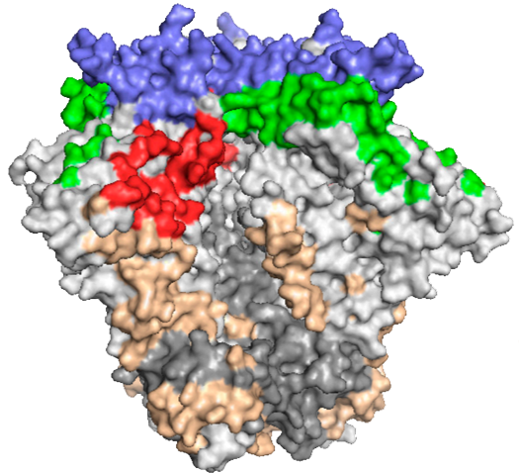
Broadly neutralizing monoclonal antibodies against HIV
V1/V2
CD4-binding site
b12, VRC01, VRC07, NIH45-46,
3BNC117, VRC-PG04
V3/Asn332 glycan
patch
CD4-binding site
V1/V2
PG9, PG16, CH01-04,
PGT141-145, PGDM1400
Phase 2 studies in HIV infected patients
Clear antiretroviral activity
Combinations will be necessary for treatment
Can be modified for longer half-life
Every 3 to 6 month infusions possible
Cellular targets (e.g. ibalizumab, UB-421)
V3/Asn332 glycan patch
PGT121-123, PGT125-131,
PGT135, 10-1074, 2G12
gp120/gp41
interface
gp120/gp41 interface
PGT151, 35O22, 8ANC195
MPER
MPER
2F5, 4E10, 10E8
Viral membrane
Tri-specific antibody

Slide 62
LEN + bNAbs Teropavimab and Zinlirvimab
GS-5423 = Teropavimab (TAB) = bNAb against the CD4-binding site of gp120
GS-2872 = Zinlirvimab (ZAB) = bNAb against the V3-glycan of HIV-1 Env
> 50% of clade B viruses are highly susceptible to both bNAbs and > 90% are highly susceptible to either bNAb
Phase 1b study of LEN + TAB + ZAB in virologically suppressed individuals
Eron J, CROI 2023, Abs. 193

Slide 63



LEN + bNAbs Teropavimab and Zinlirvimab
Dosing
Key inclusion criteria
Adults living with HIV-1
Virologically suppressed ≥18 months
Viral susceptibility to both TAB and ZAB
CD4 nadir ≥350
CD4 at entry ≥500
Week
0
26
..//..
52
Group 1: LEN + TAB 30 mg/kg + ZAB 10 mg/kg
Restart ART and continued follow-up
1:1
Group 1: LEN + TAB 30 mg/kg + ZAB 30 mg/kg
 | Day 1 | Day 2
LEN oral 600 mg
LEN SC 927 mg
TAB IV 30 mg/kg
ZAB IV 10 mg/kg or 30 mg/kg
Participants characteristics (N=21) : median time since HIV diagnosis = 8.2 years,
median duration of baseline ART=2.6 years, median CD4=909/mm³
Eron J, CROI 2023, Abs. 193

Slide 64
LEN + bNAbs Teropavimab and Zinlirvimab
Virologic Outcomes at W26, FDA snapshot
100
90%
90%
80
LEN + TAB + ZAB 10 mg/kg (N=10)
60
LEN + TAB + ZAB 30 mg/kg (N=10)
40
20
10%
10%
0%
0%
0
HIV-1 RNA <50 copies/mL
HIV-1 RNA ≥50 copies/mL
No virologic data:
Discontinued study treatment
and last available HIV-1 RNA <50 copies/mL
1 virological failure at W16, resuppressed on baseline oral ART ; resistance testing of rebound samples failed ; PK levels were adequate
Eron J, CROI 2023, Abs. 193

Slide 65
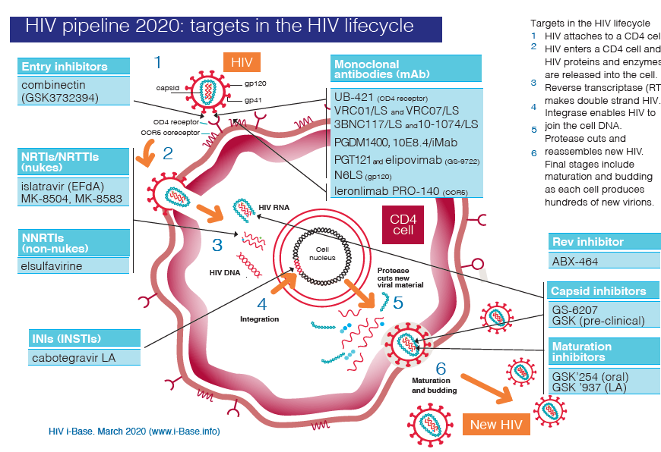
New ARVs in development: High focus on LA
HIV pipeline 2020: targets in the HIV lifecycle
QW
QW
Q6M
QW / QM
Q12M (PrEP)
QM
Q2W oral
Q6M SC
Q2M
Q6M (PrEP)

Slide 66
LA ARVs for treatment: Conclusion
Entering a new paradigm
CAB + RPV LA IM: the first cART for maintenance. Promises in patients with uncontrolled viremia
Increasing VS rates will take long-acting ART when can use CAB/RPV
More LA drugs already available: LEN sc Q6M, Ibalizumab iv Q 2 weeks
Given degree of NNRTI resistance worldwide, need another option for LA ART globally as well – LEN/CAB is closest option
Future: Dual LA regimens
  Oral QW, QM
  SC/IM Q3M, Q6M
  Implants

