Slide 1

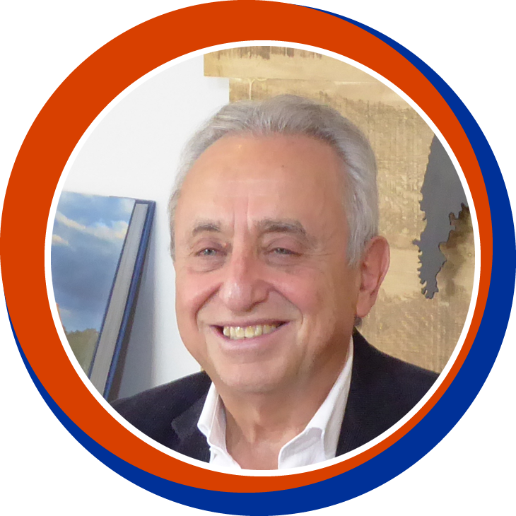

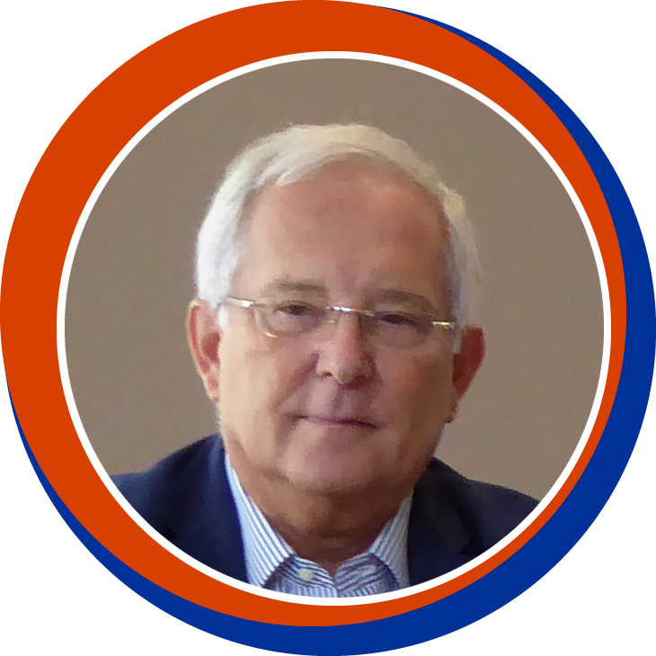

Long-acting therapies in 2025: prevention and treatment
LIVE SESSION
Monday, September 29th & Tuesday, September 30th 2025
This webinar is proposed to you with the support of our institutional partner
Pedro Cahn (Argentina)
Anton Pozniak (UK)
François Raffi (France)

Slide 2
Faculty Disclosures
Pedro Cahn has received research support for research grants: ViiV Healthcare, Merck, CanSino and for ad. boards: ViiV Healthcare, Merck and Gilead
Anton Pozniak has received research support and/or honoraria for consulting and/or advisory boards from ViiV Healthcare, Merck, Gilead, Janssen
François Raffi has received research support and/or honoraria for consulting and/or advisory boards from Gilead Sciences, MSD, and ViiV Healthcare

Slide 3
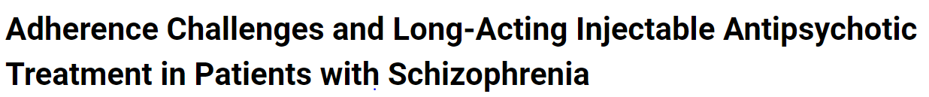
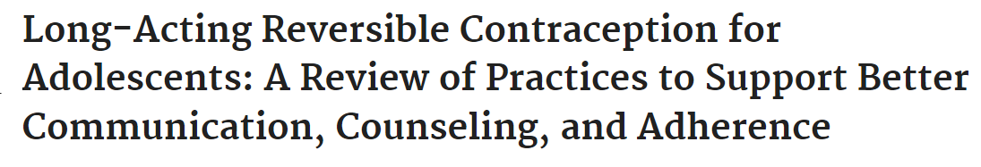
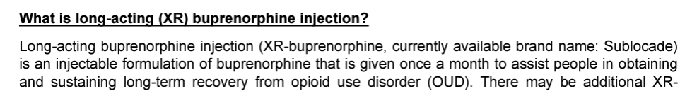
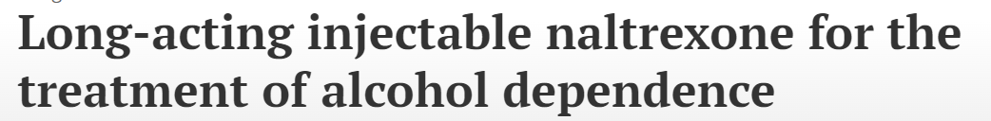
Long-acting medications help with adherence challenges in multiple fields
Treatment of psychiatric disorders
Contraception
Substance use disorder treatment
Courtesy Monica Gandhi

Slide 4
Long-acting therapies for HIV FDA/EU approved
Injectable ARVs
For Treatment
IM CAB + RPV
Maintenance in virologically suppressed individuals
In « difficult to treat » individuals with viremia (off label)
SC LEN
salvage in individuals with MDR virus
For Prevention (PrEP)
IM CAB Q2M
SC LEN Q6M

Slide 5
LA ARV in treatment

Slide 6






CAB + RPV LA Clinical development program
Suppressed switch
Implementation
EFFICACY
Non inferior to oral therapy at 48, 96, 124 weeks
ORAL LEAD IN
Can be used with and without oral lead in
ATLAS N=618
FLAIR N=566
ATLAS-2M N=1049
SOLAR N=654
CUSTOMIZE US clinics
CARISEL EU clinics
ADVERSE EVENTS
2% AE-related withdrawal rate
Mild/moderate in severity
Injection site reactions reduced over time
CAB+RPV LA IM Q1M vs CAR PO QD
Wk 48: 2% vs 1%
pVL > 50 c/ml
CAB+RPV LA IM Q1M vs DTG/ABC/3TC PO QD
Wk 48: 2% vs 2%
Wk 96: 3% vs 3%
pVL > 50 c/ml
CAB+RPV LA IM Q2M vs CAB+RPV LA IM Q1M
Wk 48: 2% vs 1%
Wk 96: 2% vs 1%
pVL > 50 c/ml
CAB+RPV LA IM Q2M vs BIC/FTC/TAF PO QD
M12: 1% vs 1%
Assess acceptability, appropriateness, feasibility, fidelity and sustainability of implementation of CAB+RPV LA IM Q1M
Assess acceptability, appropriateness, feasibility, fidelity and sustainability of implementation of CAB+RPV LA IM Q2M
VIROLOGICAL FAILURE RATE
1-1.5 %
RESISTANCE
Usually to 2 classes and mostly in first year
NON-INFERIOR
NON-INFERIOR
NON-INFERIOR
NON-INFERIOR
PREFERENCE
9 out of 10 patients preferred to oral therapies
1. Swindells S, et al. N Eng J Med 2020;382:1112-23; 2. Orkin C, et al. N Eng J Med 2020;382:1124-35; 3. Overton ET, et al. Lancet. 2021 Dec 19;396(10267):1994-2005; 4. Ramgopal MN et al. The Lancet HIV, 2023

Slide 7
SOLAR
Participant preference at M12
Multicenter, randomized (2:1), open-label, noninferiority phase III b study of switch from BIC/FTC/TAF to LA CAB + RPV in 687 adults with virologic suppression
LA CAB + RPV had noninferior virologic efficacy to BIC/FTC/TAF at 12 months
CVF : 2 participants on LA CAB + RPV vs none on BIC/FTC/TAF
2/2 LA CVF with RPV and INSTI RAM at failure
Most of the adverse events were ISRs
98% of ISRs were grade 1/2 and lasted for median of 3 days
5%
5%
90%
N = 425
Treatment satisfaction improved significantly among those who switched to LA regimen vs those continuing oral regimen
Ramgopal MN et al. The Lancet HIV, 2023

Slide 8
CARES Study: CAB + RPV LA IM as switch strategy in Africa (1)
Randomized, open-label, active-controlled, multi-centre, non-inferior study
Kenya, South Africa, Uganda
Oral ART (SOC)
TDF + 3TC/FTC + DTG/NVP/EFV
N = 256
> 18 years of age
On stable oral therapy: TDF + 3TC/FTC + DTG/NVP/EFV
HIV-1 RNA <50 c/mL at > 4-12m prior to and at screening
No history of treatment failure
No HBV infection
Optional
Oral
CAB + RPV
CAB (600 mg) + RPV (900 mg) LA IM Q8W
N = 256
D-28
D-1
D1
W4
W24
W48
W72
W96
Confirm HIV-1 RNA <50 c/mL
Randomization (1:1)
Viral load every 24 weeks
Stored PBMC: proviral DNA sequencing for resistance and subtype (retrospective determination
Kityo C, CROI 2025, Abs. 202

Slide 9
CARES Study: CAB + RPV LA IM as switch strategy in Africa (2)
Baseline characteristics
 | CAB + RPV LA (N = 255) | Oral ART (SOC) (N = 257)
Female | 57% | 58%
BMI ≥ 30 kg/m² | 22% | 20%
Time on ART, years | 8 | 7
Prior exposure to NNRTI | 74% | 74%
INSTI at screening | 91% | 93%
NNRTI at screening | 9% | 7%
Archived DNA analysis (baseline stored PBMC)
Viral sub-type A1 | 53% | 56%
RPV resistance mutations | 7% | 8%
CAB resistance mutations | 8% | 12%
APOBEC-related mutations were excluded
Kityo C, CROI 2025, Abs. 202

Slide 10
CARES Study: CAB + RPV LA IM as switch strategy in Africa (3)
Virologic outcome at W96
%
Confirmed virologic failures (VL ≥ 200 c/mL x 2): 4 (1.6%) in the CAB + RPV LA arm, 0 in SOC
2 at W48, 2 at W72
Genotype successful in 3/4: all 3 with resistance to RPV and to CAB
1/3 with baseline low resistance to RPV
1/3 with baseline low resistance to CAB
All 4 resuppressed after switch to TDF/3TC/DTG
CAB + RPV LA Q2M (N = 255)
Oral SOC (N = 257)
4
2
247
250
4
5
HIV RNA ≥ 50 c/mL
HIV RNA < 50 c/mL
No virologic data
Non-
inferiority
Non-
inferiority
Kityo C, CROI 2025, Abs. 202

Slide 11
Factors associated with virologic failure to CAB + RPV LA
Pooled data from FLAIR (through W124), ATLAS (through W96) and ATLAS-2M (through W152): 23/1363 (1.69 %) participants experienced confirmed virologic failure (2 consecutive HIV RNA ≥ 200 c/mL) on CAB LA + RPV LA IM
Risk of CVF
Multivariable analysis including only baseline factors
Relation with N of Factors and CVF / HIV RNA < 50 c/mL
 | BFA adjusted IRR (95% CI) [P value], N=1363
RPV RAMs: Yes/No | 21.7 (5.80-80.8) [< 0.0001]
HIV-1 subtype A6/A1: Yes/No | 12.9 (4.42–37.5 ) [< 0.0001]
Baseline BMI (kg/m²) | 1.09 (1.00-1.19) [0.0447]
 | Confirmed Virologic Failure, N (%) | HIV-1 RNA < 50 c/ml, N (%)
No Factor | 4/970 (0.4%) | 844/970 (87.0%)
Any one factor | 8/404 (2.0%) | 343/404 (84.9%)
≥ 2 Factors | 11/57 (19.3%) | 44/57 (77.2%)
Total | 23/1431 (1.6%) | 1231/1431 (86.0%)
Dosing regimen and integrase L74I were not predictive of CVF risk
Good sensitivity and specificity of ≥ 2 factors
 | PPV | NPV | Sensitivity | Specificity
≥ 2 Factors | 19.3% | 99.1% | 47.8% | 96.7%
Any one Factor | 2.0% | 98.5% | 34.8% | 71.9%
Orkin C. Clin Infect Dis 2023; Clin Infect Dis. 2023 Jun 21:ciad370. doi

Slide 12
CAB + RPV in virologically suppressed PWH
Lessons learned
Sustained efficacy
No need for oral lead-in
HIV-1 subtype A1 not anymore an exclusion criterion
Good tolerability (waning of ISRs over time)
Good acceptability
Patients’ satisfaction and QOL improvement
2-inch needles in obese or patients with « gynoid » morphology
Factors predictive of failure
Careful selection based on treatment history and/or DNA genotype
ABOPEC-related mutations (E138K in RT, E138K G140S, R263K in Integrase) not be considered as marker of resistance, especially if no prior VF with this class
Virological monitoring: every 6 months (as usual !)

Slide 13
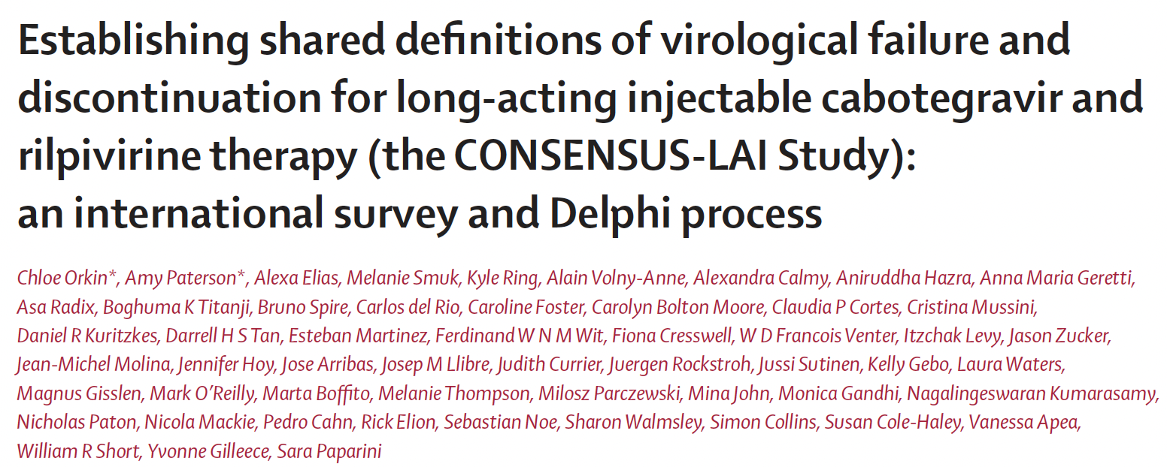
Lancet HIV 2025; 12: e649–59

Slide 14
Im CAB + RPV LA: other considerations
Risk of VF (2 x ≥ 200 c/mL): 1-2% across RCT and real-world studies
Options left ?
Should all failures be switched to triple oral combo with bPI ?
How often do NNRTI (DOR) or INSTI (BIC, DTG) remain fully active ?
Can it be offered in pretreated patients with uncontrolled viremia ?
Therapeutic monitoring ?
Patients with historical K103N ?

Slide 15
Long-acting injectable cabotegravir and rilpivirine in observational cohort studies: A systematic review on virological failure, resistance and re-suppression outcomes in virally suppressed individuals living with HIV
79 observational cohorts up to Nov 2024
Different definitions of VF
 | Individuals in the VF analysis 13 899
Number of virological failures (%) | 172 (1.24%)
Genotype at VF, n/N No RAMS identified Presence of RAMs NNRTI RAMs INSTI RAMs NNRTI + INSTI RAMs | 80/172 28/80 (35%) 52/80 (65%) 45/80 (56%) 40/80 (50%) 33 (41%)
 | VF with post-VF regimen data provided N = 92
Regimen type PI-based INSTI-based CAB + RPV LA Multi-tablet NNRTI-based | 31 (34%) 29 (32%) 25 (27%) 5 1
 | VF with known outcome N = 74
Resuppressed Continuation CAB + RPV | 65/74 (88%) 13/14
Ring K. HIV Med. 2025;26:1267–1288

Slide 16
CARES Study: CAB + RPV LA IM as switch strategy in Africa
Virologic outcome at W96
%
Confirmed virologic failures (VL ≥ 200 c/mL x 2): 4 (1.6%) in the CAB + RPV LA arm, 0 in SOC
2 at W48, 2 at W72
Genotype successful in 3/4: all 3 with resistance to RPV and to CAB
1/3 with baseline low resistance to RPV
1/3 with baseline low resistance to CAB
All 4 resuppressed after switch to TDF/3TC/DTG
CAB + RPV LA Q2M (N = 255)
Oral SOC (N = 257)
Loss of INSTI option (DTG/BIC) = 3/4 failures = 1.2% of individuals
Loss of DOR option = 1/4 failures = 0.4% of individuals
4
2
247
250
4
5
HIV RNA ≥ 50 c/mL
HIV RNA < 50 c/mL
No virologic data
Non-
inferiority
Non-
inferiority
Kityo C, CROI 2025, Abs. 202

Slide 17
Effectiveness of bi-monthly long-acting injectable cabotegravir and rilpivirine as maintenance treatment for HIV-1 in the Netherlands: results from the Dutch ATHENA national observational cohort
Observational national cohort
Individuals starting CAB + RPV 2017-2023 with VL < 200 c/mL and no prior virologic failure (VL ≥ 1000 c/mL)
Control group on standard oral ART, with VL < 200 c/ml and no prior VF, matched 1:2 (ART class of the anchor drug, age, sex, HIV acquisition category, time since ART initiation, nadir CD4, zenith VL
Median follow-up 1.3 years
Estimated cumulative risk of loss of virological control among patients using long-acting injectable
cabotegravir and rilpivirine and patients using a standard antiretroviral therapy
0.2
Standard antiretroviral therapy
Loss of virological control (VL ≥ 200 c/ml)
CAB + RPV: 2.4%
Control group: 2.5%
14 individuals with VL ≥ 200 c/mL on CAB + RPV
7 resuppressed without change on ART (median VL 331 c/mL [215-600]
7 switched ART ( confirmed VF in 6/7: INSTI-R in 5/6 and INNRTI-R in 6/6)
Cabotegravir and rilpivirine
Cumulative risk
0.1
Log-rank p = 0,671
0
0
0.5
1.0
1.5
2.0
N at risk
Years since the start of follow-up
1170
585
(110)
(68)
1052
513
(258)
(119)
785
390
(351)
(169)
431
218
(288)
(131)
137
85
Jongen VW, Lancet HIV 2025; 12:e40-50

Slide 18
Effectiveness of bi-monthly long-acting injectable cabotegravir and rilpivirine as maintenance treatment for HIV-1 in the Netherlands: results from the Dutch ATHENA national observational cohort
Observational national cohort
Individuals starting CAB + RPV 2017-2023 with VL < 200 c/mL and no prior virologic failure (VL ≥ 1000 c/mL)
Control group on standard oral ART, with VL < 200 c/ml and no prior VF, matched 1:2 (ART class of the anchor drug, age, sex, HIV acquisition category, time since ART initiation, nadir CD4, zenith VL
Median follow-up 1.3 years
Estimated cumulative risk of loss of virological control among patients using long-acting injectable
cabotegravir and rilpivirine and patients using a standard antiretroviral therapy
True VF rate : 1.2%
Loss of INSTI option (DTG/BIC) = 3/6 failures = 0.5% of individuals
Loss of DOR option = 4/6 failures (all with intermediate resistance) = 0.7% of individuals
0.2
Standard antiretroviral therapy
Loss of virological control (VL ≥ 200 c/ml)
CAB + RPV: 2.4%
Control group: 2.5%
14 individuals with VL ≥ 200 c/mL on CAB + RPV
7 resuppressed without change on ART (median VL 331 c/mL [215-600]
7 switched ART ( confirmed VF in 6/7: INSTI-R in 5/6 and INNRTI-R in 6/6)
Cabotegravir and rilpivirine
Cumulative risk
0.1
Log-rank p = 0,671
0
0
0.5
1.0
1.5
2.0
N at risk
Years since the start of follow-up
1170
585
(110)
(68)
1052
513
(258)
(119)
785
390
(351)
(169)
431
218
(288)
(131)
137
85
Jongen VW, Lancet HIV 2025; 12:e40-50

Slide 19
CAB + RPV LA Q2M: 24 months outcome in CARLOS cohort (1)
Real-world cohort in Germany, 351 individuals
Proportion of participants (%)
97.7% (N = 343)
Virologic suppression (<50 c/m/)
Virologic non-response (>50 c/m/)
PDVF
Discontinued
due to ISR
or other tolerability reason
Discontinued
for other non-virologic reasons
Missing data or LTFU
LOCF < 50 c/mL
LOCF > 50 c/mL
No data in window, LOCF < 50 c/mL
Wyen C, IAS 2025, Abs. TUPEB035

Slide 20
CAB + RPV LA Q2M: 24 months outcome in CARLOS cohort (2)
PDVF (2 VL ≥ 200 c/mL), N = 7 (2% at M24)
Emergence of NNRTI RAMs: 4/7
Emergence of INSTI RAMs: 3/7
1 without RAM at VF (421/446 cp/mL) resuppressed on CAB + RPV
True VF rate : 1.7%
Loss of INSTI option (DTG/BIC) = 2/6 failures = 0.3% of individuals
Loss of DOR option = 0/6 failures = 0% of individuals
Wyen C, IAS 2025, Abs. TUPEB035

Slide 21
COMBINE-2 cohort: Real world CAB + RPV LA in Europe (1)
N = 956 treatment experienced virologically suppressed (VL < 50 c/mL) PWH
Median ART duration: 9.4 years
Previous use of INSTI or NNRTI-based regimen: 96%
No history of VF or R to NNRTI or INSTI in those with history available (62%)
N = 882 (92%) on CAB+ RPV
at end of follow-up
Median f-u 10.2 months
N = 937 with ≥ 1 VL after 1st injection
Confirmed Virologic Failure (2 VL ≥ 200 c/mL or 1 VL ≥ 200 c/mL + discontinuation): N = 5/937 (0.5 %)
No subtype A6, no BMI > 30 kg/m²
No baseline R information
VL < 50 c/mL
100%
99
97
96
94
94
95%
50%
0%
Last VL
All VL
M6
N = 871
M12
N = 366
M24
N = 49
Pozniak A, IAS 2025, Abs. EP0171

Slide 22
COMBINE-2 cohort: Real world CAB + RPV LA in Europe (2)
N = 956 treatment experienced virologically suppressed (VL < 50 c/mL) PWH
Median ART duration: 9.4 years
Previous use of INSTI or NNRTI-based regimen: 96%
No history of VF or R to NNRTI or INSTI in those with history available (62%)
N = 882 (92%) on CAB+ RPV
at end of follow-up
Median f-u 10.2 months
N = 937 with ≥ 1 VL after 1st injection
Confirmed Virologic Failure (2 VL ≥ 200 c/mL or 1 VL ≥ 200 c/mL + discontinuation): N = 5/937 (0.5 %)
No subtype A6, no BMI > 30 kg/m²
No baseline R information
VL < 50 c/mL
100%
99
97
96
94
94
95%
50%
Loss of INSTI option (DTG/BIC) = 2/5 failures = 0.2% of individuals (S to DTG bid)
Loss of DOR option = 1/5 failures = 0.1% of individuals
0%
Last VL
All VL
M6
N = 871
M12
N = 366
M24
N = 49
Pozniak A, IAS 2025, Abs. EP0171

Slide 23
Im CAB + RPV LA: other considerations
Risk of VF (2 x ≥ 200 c/mL): 1-2% across RCT and real-world studies
Options left ?
Should all failures be switched to triple oral combo with bPI ?
How often do NNRTI (DOR) or INSTI (BIC, DTG) remain fully active ?
Can it be offered in pretreated patients with uncontrolled viremia ?
Therapeutic monitoring ?
Patients with historical K103N ?

Slide 24
CAB + RPV in individuals with HIV viremia
OPERA cohort
≥ 18 years old, ART-experienced, VL ≥ 50 c/mL at CAB + RPV LA initiation
Correspond to 368/3 304 (11%) individuals initiating CAB + RPV LA
Median HIV-1 RNA: 120 c/mL (IQR: 61 - 2535)
Virologic outcomes
Complete initiators, > 1 VL within 6 months (N = 306)
Complete initiators, > 1 VL during follow-up (N = 313)
Complete initiators, > 1 VL after suppression (N = 301)
85%
(N = 259)
82%
(N = 258)
88%
(N = 277)
Case 1: Missed 2 doses, At failure,
S to DOR, Resistance to all INSTI
Case 2: at failure, R to NNRTI, possible R to INSTI
Case 3: at failure, genotype not amplified
1%
(N = 3)
VL < 50 c/mL
within 6 months
VL < 50 c/mL
at last follow-up
VL < 50
c/mL*
Confirmed virologic failure
* 12% never achieved < 50 c/mL
Hsu RK, IAS 2025, Abs. OAB0104

Slide 25
CAB + RPV in individuals with HIV viremia
OPERA cohort
≥ 18 years old, ART-experienced, VL ≥ 50 c/mL at CAB + RPV LA initiation
Correspond to 368/3 304 (11%) individuals initiating CAB + RPV LA
Median HIV-1 RNA: 120 c/mL (IQR: 61 - 2535)
Virologic outcomes
Complete initiators, > 1 VL within 6 months (N = 306)
Complete initiators, > 1 VL during follow-up (N = 313)
Complete initiators, > 1 VL after suppression (N = 301)
88%
(N = 277)
Loss of INSTI option (DTG/BIC) = 2/3 failures = 0.7% of individuals (S to DTG bid)
Loss of DOR option = 1/3 failures = 0.3% of individuals
85%
(N = 259)
82%
(N = 258)
Case 1: Missed 2 doses, At failure,
S to DOR, Resistance to all INSTI
Case 2: at failure, R to NNRTI, possible R to INSTI
Case 3: at failure, genotype not amplified
1%
(N = 3)
VL < 50 c/mL
within 6 months
VL < 50 c/mL
at last follow-up
VL < 50
c/mL*
Confirmed virologic failure
* 12% never achieved < 50 c/mL
Hsu RK, IAS 2025, Abs. OAB0104

Slide 26
CAB + RPV LA in individuals with suboptimal HIV control (1)
2 NRTI + DTG HIV RNA < 200 c/mL
IMPALA trial
Phase 3b, open-label, non-inferiority RCT (Kenya, Uganda, South Africa)
HIV RNA > 1000 c/mL in prior 2 years despite being on ART
History of loss to follow-up
Unlinked to HIV care ≥ 3 months
Exclusion of participants with HBs Ag+ or HBc Ab+ AND HBs Ab < 10 IU/L
HIV RNA < 200 c/mL for ≥ 3 months on 2 NRTI + DTG
Primary endpoint: HIV RNA < 50 c/mL (FDA snapshot), non-inferority with 10% NI margin
2 NRTI + DTG N = 269
VL > 1000 c/ml (N = 261)
LFTU (N = 282)
Unlinked (N = 11)
Randomised
N = 540
CAB + RPV LA Q8W N = 271
Population
Female: 60%
BMI ≥ 30 kg/m²: 22%
Prior AIDS: 26%
Prior NNRTI exposure: 78%
Cresswell F, IAS 2025, Abs. OAS0105LB

Slide 27
CAB + RPV LA in individuals with suboptimal HIV control (2)
W48 virologic outcomes (HIV RNA < 50 c/mL)
CAB+RPV % (n/N)
Oral ART % (n/N)
CAB + RPV LA interpretation
Relative difference (95% CI)
Inferior
Non-inferior
Superior
Primary analysis (ITT-e)
91.2% (244/268)
89.2% (240/269)
+1.9 (-3.1 ; 6.9)
Per protocol analysis
93.9% (229/244)
89.9% (223/248)
+4.0 (-0.8 ; 8.8)
BMI <30
90.0% (180/200)
89.0% (194/218)
+1.1 (-4.8 ; 6.9)
BMI >30
94.1% (64/68)
90.2% (46/51)
+4.2 (-5.3 ; 13,.8)
-15
-10
-5
0
5
10
15
5 confirmed virologic failures (1.9%) on CAB + RPV LA, Genotype results in 4: low R to DTG/BIC = 2/4, intermediate R to DTG/BIC: 2/4;
High R to RPV: 3/4, S to RPV: 1/4, R to DOR: 1/4, S to DOR 3/4
Conclusion: non-inferiority of CAB + RPV LA
Cresswell F, IAS 2025, Abs. OAS0105LB

Slide 28
LA CAB/RPV in highly vulnerable population
Ward 86 HIV Clinic San Francisco
Retrospective study, 370 PWH (241 virologically suppressed, 129 viremic)
LA CAB/RPV Jan 2021-Sept 2024
Virologic suppression (HIV RNA ≤ 200 c/mL) at W48
99.4% in patients with virologic suppression at D0
97.9% in patients with initial viremia
Conclusion : In a cohort of PWH with high rates of housing instability, substance use and low CD4 counts, LA CAB/RPV was highly effective even in those initiating injectables with viremia
HIV RNA ≤ 200 c/mL in patients with initial viremia
1.00
0.75
0.50
Median time to achieve virologic suppression :
32 days (95% CI : 30-45)
0.25
0
0
12
24
36
Weeks
At risk
Events
129
0
22
105
7
117
2
122
Gistand NL. CROI 2025, Abs. 689

Slide 29
LA Injectable ART for Persons With Detectable HIV Viremia
Could LA-ART potential to be a game-changer for HIV treatment in patients experiencing barriers to oral ART adherence ? ¹
In populations who struggle with adherence to oral ART, the alternative outcome is not perfect adherence to oral ART but rather ongoing viremia and progression of HIV disease, which recalibrates the tipping point for use of LA CAB-RPV ¹
« The long-acting ARV combination of injectable CAB and RPV is not currently recommended for people with virologic failure » [DHHS]
Has time come to be « pragmatic » ?. CAB + RPV LA in patients fullfilling all following criteria:
Uncontrolled viremia despite multiple oral ART regimen, with chronic non adherence
High risk of HIV disease progression (CD4 < 200/mm³ or prior history of AIDS)
Virus susceptible to both RPV and CAB
Availability and acceptance of intensive case management services
1. Gandhi M. Ann Intern Med 2023;176:969-974

Slide 30
Im CAB + RPV LA: other considerations
Risk of VF (2 x ≥ 200 c/mL): 1-2% across RCT and real-world studies
Options left ?
Should all failures be switched to triple oral combo with bPI ?
How often do NNRTI (DOR) or INSTI (BIC, DTG) remain fully active ?
Can it be offered in pretreated patients with uncontrolled viremia ?
Therapeutic monitoring ?
Patients with historical K103N ?

Slide 31
Can we offer CAB + RPV LA in patients with historical K103N
RPV LA is contra-indicated only when there is archived or historical RPV-associated mutations
K103N is not a RPV mutation
ATLAS, ATLAS-2M and FLAIR studies allowed inclusion of patients with K103N mutation
EACS guidelines remains equivocal
« In persons with suppression of HIV-VL < 50 copies/mL for the past 6 months dual therapy strategies should only be given if there is a) no historical resistance…… »
« Long-acting intramuscular dual therapy CAB + RPV: The following baseline factors, when combined, are associated with risk of virologic failure and resistance:
Archived RPV-associated mutations … »

Slide 32
WISARD: switch to DTG/RPV in patients with HIV RNA < 50 c/mL and history of K103N
Proportion of participants with HIV-RNA < 50 copies/mL at W48 and W96, with the ITT FDA Snapshot method
Confirmed virologic failure (2 VL > 50 c/mL)
%
W48 DTG/RPV
 | DTG/RPV N = 95 | N = 45 | Genotype at VF on DTG/RPV
W0-W48 | 3/95 = 3.2% | Continuation cART 1/45 = 2.2% | 3/3 : no testing (VL < 200 c/mL)
W48-W96 | 2/87 = 2.3% | Deferred DTG/RPV 2/40 = 5% | N = 2/4 No DTG or RPV RAMs
100
88.4
88.9
W48 Continuation cART
84.2
80
W96 DTG/RPV
60
40
No safety issues
20
4.2
8.9
5.3
3.2
2.2
5.3
3.2
3.2
1.1
2.1
0
0.0
0.0
HIV-RNA <50 copies/ml
HIV-RNA ≥50 copies/ml
AEs
Other
On study but with missing data
Moyle G. Lancet HIV 2024;11:e156-66; Moyle G et al. AIDS 2024 ; # TUPEB106

Slide 33
Im CAB + RPV LA: other considerations
Risk of VF (2 x ≥ 200 c/mL): 1-2% across RCT and real-world studies
Options left ?
Should all failures be switched to triple oral combo with bPI ?
How often do NNRTI (DOR) or INSTI (BIC, DTG) remain fully active ?
Can it be offered in pretreated patients with uncontrolled viremia ?
Therapeutic monitoring ?
Patients with historical K103N ?

Slide 34
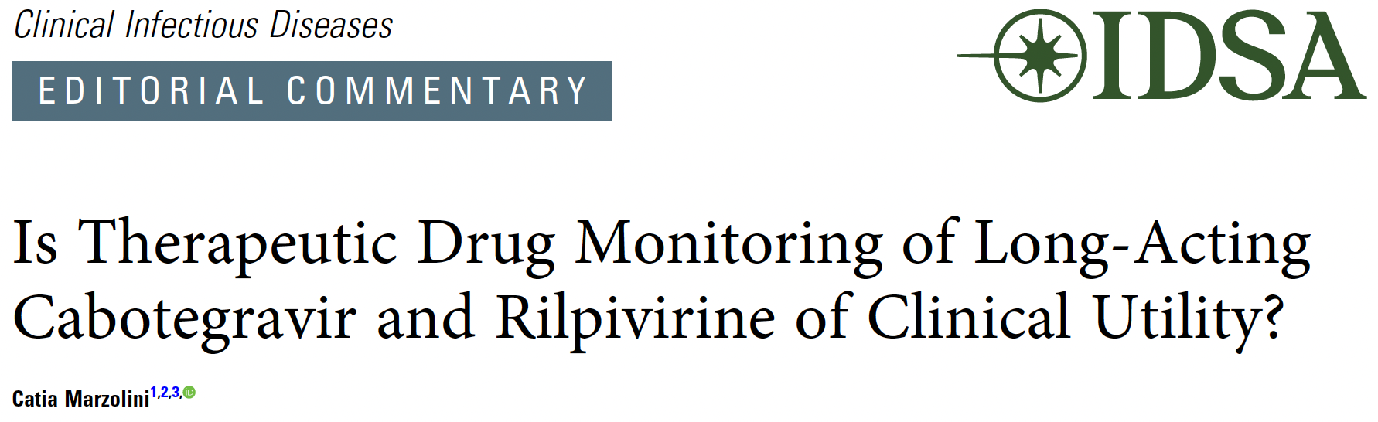
Lack of consensus on minimal effective target concentrations
No strict association between virologic failure and low plasma concentrations
TDM useful in
Obese or morbidly individuals (optimize timing of dosing) ?
Pregnancy (reduced RPV exposure): RPV QM ?
Cases of d-d-I : inducers or agents that can enhance the release of CAB/RPV from the depot (anabolic androgen steroids): risk of suboptimal drug exposure
Clin Infect Dis. 2025 Aug 18:ciaf386. doi: 10.1093/cid/ciaf386. Online ahead of print.

Slide 35
CAPELLA Study: lenacapavir in HTE patients
Key eligibility criteria:
HIV-1 RNA ≥400 c/mL
Resistance to ≥2 agents from 3 of 4 main ARV classes
≤ 2 fully active agents from 4 main ARV classes
Functional
monotherapy
(14d)
Optimisation
N=24
Oral LEN
SC LEN q6mo for 52 wk
Failing regimen
OBR
Randomised cohort (double blind)
Resistance class at Screening |  |  |  | Number (%) of participants
NRTI | NNRTI | PI | INSTI | Cohort 1 (N=36) | Cohort 2 (N=36)
✅ | ✅ | ✅ | ✅ | 17 (47%) | 16 (44%)
✅ | ✅ | ✅ |  | 9 (25%) | 13 (36%)
✅ | ✅ |  | ✅ | 8 (22%) | 5 (14%)
✅ |  | ✅ | ✅ | 2 (6%) | 0
 | ✅ | ✅ | ✅ | 0 | 1 (3%)
 | ✅ |  | ✅ | 0 | 1 (3%)
NO
Screening period
Prerandomisation repeat HIV-1 RNA
Decline ≥ 0.5 log₁₀ c/mL (vs screening) ; or <400 c/mL
Placebo
Oral LEN*
SC LEN q6mo for 52 wk
N=12
Failing regimen
OBR
YES
Non randomised cohort (open label)
N=36
Oral LEN
SC LEN q6mo for 52 wk
OBR
OBR
Segal-Maurer S, N Engl J Med 2022;386:1793-803 ; Ogbuagu O. Lancet HIV. 2023 Aug;10(8):e497-e505

Slide 36
CAPELLA Study: W156 outcomes (1)
CV < 50 c/mL (missing data excluded)
Mean change in CD4/mm³ at W156
%
100
85.1
84.6
82.9
81.5
250
80
200
60
150
40
100
+164 CD4/mm³
20
50
2.8
0
0
D0
W26
W52
W104
W156
-50
D1
D8
D1
4
10
16
22
26
52
78
104
130
156
Weeks
2/72
58/70
57/67
44/54
44/52
Oral
sc
N =
72
68
70
71
66
66
67
67
66
62
55
49
49
Ogbuagu O, IDWeek 2024, Abs.155

Slide 37
CAPELLA Study: W156 outcomes (2)
LEN resistance at W156
 | Total N = 72
Emergent LEN resistance (M66I; Q67H/K/N; K70H/N/R/S; N74D/H/K; A105S/T; T107A/C/N/S) No fully active agents in OBR Inadequate adherence to OBR | 14 4 10
Resuppressed after LEN resistance emergence whilst remaining on LEN With OBR change Without OBR change | 5 2 3
Did not resuppress after LEN resistance emergence Continued study drugs Discontinued study drug for reasons not related to efficacy | 9 6 3
Overall, 14 people developed resistance to LEN, 9 by W52 and 5 between W52 and W104
No new cases of LEN resistance emerged between W104 and W156
Two participants with resistance detected earlier developed additional mutations
All 14 participants with LEN resistance had no fully active drugs in OBR or inadequate OBR adherence
Median (interquartile range [IQR]) CD4 cell count change from baseline to W156: 82 (48-399) cells/µL
Ogbuagu O, IDWeek 2024, Abs.155

Slide 38
Lessons learned from sc LEN in salvage
In patients with heavily pretreated PWH with uncontrolled viremia and MDR HIV, sc LEN Q6M + oral OBR can
maintains virologic suppression in 85% for at least 3 years
leads to substantial and clinically relevant gain in CD4
20% of individuals develop LEN resistance, mainly because poor adherence to OBR
Challenge of counseling, reinforcement of adherence, closed monitoring
In some patients failing LEN-based therapy with emergence of LEN resistance, continuing LEN with or without OBR optimization can leads to viral load resuppression
Fitness effect ?
Residual antiviral effect, sufficient with «active » OBR ?

Slide 39
LA in development
Oral combos
ISL + LEN QW
ULO + ISL QW
bNAbs
N6LS
TAB +ZAB

Slide 40
ISL + LEN QW: Phase 2 (1)
Extension phase
HIV Adults
On B/F/TAF > 6 months
HIV-1 RNA < 50 c/mL ≥ 6 months
No prior virologic failure
CD4 ≥ 350/mm³
Lymphocytes ≥ 900/mm³
No HBV co-infection
QW oral ISL (2 mg) + LEN (300 mg) *
N = 106 1:1
QW oral ISL (2 mg) + LEN (300 mg)
QD oral B/F/TAF
D1
W12
W24
W48
Visits every 12 weeks
* loading dose of LEN 600 mg D1 + D2
Colson AE, HIV Drug Therapy Glasgow 2024, Abs. O21

Slide 41
ISL + LEN QW: Phase 2 (2)
W48 Results, ITT-snapshot
ISL + LEN (N = 52)
B/F/TAF (N = 52)
%
100
94.2
92.3
80
60
40
20
5.8
7.7
0
0
0
HIV-RNA > 50 c/ml
HIV-RNA < 50 c/ml
No data
n =
0
0
49
48
3
4
Colson AE, HIV Drug Therapy Glasgow 2024, Abs. O21

Slide 42
ISL + LEN QW: Phase 2 (3)
Mean (95% CI) change
in CD4+ T-cell count/mm³
Mean (95% CI) change
in Lymphocyte count/10³ cells
ISL + LEN (N = 52)
300
B/F/TAF (N = 52)
0.5
200
0.03
0.25
100
-12
0
p = 0.88
0
p = 0.23
-100
-0.07
-29
-0.25
-200
-300
-0.5
Mean values
BL
W12
W18
W24
W30
W36
W42
W48
Mean values
BL
W12
W18
W24
W30
W36
W42
W48
ISL + LEN
755
732
766
755
754
756
761
746
ISL + LEN
1.94
1.94
1.98
1.92
1.96
1.94
1.93
1.88
B/F/TAF
818
758
767
761
785
783
797
787
B/F/TAF
1.95
1.99
1.97
1.96
2.03
1.96
2.00
1.99
Colson AE, HIV Drug Therapy Glasgow 2024, Abs. O21

Slide 43
Phase 3: ISLEND-1 and -2
ISL/LEN (2 mg/300 mg): one tablet per week
(enrollment complete; results likely in 2026)
https://clinicaltrials.gov/study/NCT06630286

Slide 44
Ulonivirine (100 to 400 mg) + ISL 20 mg QW in virologically suppressed adults- Phase 2b
HIV-1 RNA < 50 c/mL (observed data)
Week 12
Week 24
100 -
100 -
80 -
100.0 %
(39/39)
80 -
100.0 %
(28/28)
100.0 %
(34/34)
97.4 %
(37/38)
97.3 %
(36/37)
100 %
(26/26)
100.0 %
(28/28)
91.7 %
(33/36)
60 -
60 -
40 -
40 -
20 -
20 -
0 -
0 -
ISL + ULO 100 mg ISL + ULO 200 mg
ISL + ULO 400 mg BIC/FTC/TAF
ISL + ULO 100 mg ISL + ULO 200 mg
ISL + ULO 400 mg BIC/FTC/TAF
Study discontinued at W24 due to lymphocytes and CD4 decrease (ISL 20 mg)
New phase 2b with ULO 200 mg + ISL 2 mg QW
Molina JM, IAS 2025, Abs. OAB0102

Slide 45
Weekly oral dosing GS-1720 (integrase inhibitor) plus GS-4182 (LEN pro-drug)
Phase 2 studies: oral weekly GS-1720 plus GS-4182 (WONDERS-1 and -2)
June 10, 2025: US FDA placed clinical hold on trials of GS-1720 and/or GS-4182. Decrease in CD4 and lymphocyte counts in a subset of participant receiving combination
1000
450 mg daily (N = 6)
100
900 mg daily (N = 6)
10
1
Mean plasma concentration (µg/mL)
0.1
C_{max}, µg/mL, GLSM |  |  | AUC_{tau}, hr*µg/mL, GLSM
Day 1 | Day 7 or 14 | Accumulation ratio | Day 1 | Day 7 or 14 | Accumulation ratio
15.4 | 64.0 | 4.16 | 258 | 1350 | 5,23
23.9 | 125 | 5.25 | 419 | 2730 | 6,52
0.01
0.001
0.0001
1
2
3
4
5
6
7
8
14
24
26
32
36
40
45
50
60
70
Day
Fichtenbaum CJ et al/ CROI 2024, abstr. 116; Shaik N et al, AIDS 2024 (Munich), abstr. WEPEB117;
Zhang H, ID week 2024, abstr. 154

Slide 46
CAB IM + 1 bNAb (N6LS) for maintenance: EMBRACE
18-70 years
HIV RNA < 50 c/mL ≥ 12 months
No prior VF
On stable oral cART ≥ 6 months
CD4 ≥ 350/mm³
No HBV infection
Susceptible to N6LS (IC₉₀ ≤ 2 µg/mL)
N6LS 60 mg/kg IV Q4M + CAB 400 mg IM QM (N = 50)
Randomization
2:2:1
N6LS 3 000 mg + rHuPH20 SC Q4M + CAB 400 mg IM QM (N = 49)
Primary endpoint: HIV RNA ≥ 50 c/mL ay M6
Oral SOC ART (N = 26)
Day 1
6 months
12 months
24 months
M6 outcome
%
Confirmed virologic failure (HIV RNA ≥ 200 c/mL x 2), N = 4
2 in N6LS IV group: both had emergence of phenotypic resistance to N6LS and no INSTI RAMs
2 in N6LS SC group: neither had diminished susceptibility to N6LS and 1 had an emergent INSTI RAM (Q148R)
Better tolerance of IV than SC administration: further development with IV
0
HIV-1 RNA > 50 c/mL
HIV-1 RNA < 50 c/mL
No virologic data
Leone P, CROI 2025, Abs. 203

Slide 47
LEN SC + 2 bNAbs IV (TAB + ZAB) for maintenance
18-65 years
HIV RNA < 50 c/mL ≥ 12 months
On stable oral cART ≥ 12 months
CD4 ≥ 200/mm³
No HBV infection
Highly susceptible to TAB AND ZAB (IC₉₀ ≤ 2 μg/mL)
LEN SC 927 mg + TAB IV 2550 mg + ZAB IV 2550 mg Q6M , N = 53
R 2:1
Oral baseline regimen, N = 27
N = 80
D0
W26
W52
W26 outcome (FDA Snapshot)
 | LEN + TAB + ZAB (N = 53) | Oral baseline regimen (N = 27)
HIV RNA > 50 c/mL | 1 (1.9) | 0
HIV RNA < 50 c/mL | 51 (96.2) | 26 (96.3)
No virological data | 1 (1.9) | 1 (3.7)
Ogbuagu O, CROI 2025, Abs. 151

Slide 48
LEN + TAB + ZAB as maintenance: 1 case of virological failure at W26
Susceptibility to bNAbs at screening
HIV-1 RNA
TAB concentration
LEN concentration
ZAB concentration
Mean (SD) [LEN]
Enrolled participants
Screening failures
10⁶
1 000
Oral ART restarted (B/F/TAF)
> 50
10⁵
100
10
10⁴
IQ4
10³
1
IQ2
Teropavimab IC90 (μg/mL)
10²
10
50 c/ml
10¹
0.1
IC₉₀ = 2 µg/ml
1
10⁰
TAB and ZAB susceptible
0
2
4
6
8
10
12
14
16
18
20
22
24
26
28
30
32
34
36
38
0.01
Study week
0.01
0.1
1
10
> 50
Resistance to LEN detected (Q67H) + loss of ZAB susceptibility + TAB susceptibility unchanged
Zinlirvimab IC₉₀ (μg/mL)
Ogbuagu O, CROI 2025, Abs. 151

Slide 49
LA ARV in prevention (PrEP)

Slide 50
CAB for PrEP
Initiation
D-35 to D1: oral lead-in CAB 30 mg 1 tablet/day (optional)
D1-M1, then every 2 months: IM LA CAB 600 mg (3 mL)
Protective levels of CAB are achieved 7 days following the 1st injection (condoms or 1 week oral CAB or TDF/FTC overlap)
HIV screening
Rapid diagnostic test (HIV antigen/antibody test) and HIV viral load before initiating CAB LA and every 2 months
Weight increase
If switch from TDF/FTC to CAB PrEP, risk of modest weight gain (1-2 kg) due to removal of a weight gain suppressive effect of TDF/FTC
Otherwise, weight trajectory similar to the general population
Pregnancy
No safety signal

Slide 51
HPTN083 - Cabotegravir for HIV prevention in cisgender men and transgender women
PK “tail” coverage for CAB group, ongoing access for TDF-FTC group
Blinded trial portion
Oral cabotegravir 30 mg daily plus oral TDF-FTC placebo daily | CAB-LA 600 mg intramuscularly at weeks 5, 9, and every 8 weeks thereafter plus daily oral placebo for TDF-FTC | Open-label daily oral TDF-FTC
Oral TDF-FTC daily Oral cabotegravir placebo daily | Daily oral TDF-FTC plus placebo for CAB-LA intramuscularly at weeks 5, 9, and every 8 weeks thereafter
Cabotegravir group
1:1
TDF-FTC group
oral phase
injection phase
tail phase
0
2
4
6
10
19
27
35
43
51
59
67
75
83
91
99
+2 wk
5
9
17
25
33
41
49
57
65
73
81
89
97
+8 wk
153 / Day 0
12
24
36
48
Weeks
Days
Incident HIV infection in prespecified subgroups :
Subgroup
Cabotegravir
TDF-FTC
HR (95% CI)
no. of events/PY (incidence per 100 PY)
Overall
13/3205 (0.41)
39/3187 (1.22)
0.34 (0.18-0.62
Landovitz RJ. N Engl J Med. 2021 Aug 12;385(7):595-608

Slide 52
HTPN 084 - Cabotegravir for the prevention of HIV-1 in women (1)
Oral cabotegravir 30 mg daily plus oral TDF-FTC placebo | Long-acting cabotegravir 600 mg intramuscular injection at weeks 5, 9, and every 8 weeks thereafter plus daily oral TDF-FTC placebo | Open-label daily oral TDF-FTC 300 mg-200 mg for 48 weeks
Oral TDF-FTC 300 mg-200 mg daily plus oral cabotegravir placebo | Daily oral TDF-FTC 300 mg-200 mg plus long-acting cabotegravir placebo intramuscular injection at weeks 5, 9, and every 8 weeks thereafter
Step 1 oral phase
Step 2 injection phase
Step 3 tail phase
0
2
4
6
13
21
42
5
9
17
25
33
41
49
57
65
73
81
185
12
24
36
48
Weeks
Days
Delany-Moretlwe S. Lancet 2022 May 7;399(10337):1779-1789

Slide 53
HTPN 084 - Cabotegravir for the prevention of HIV-1 in women (2)
0.08
TDF-FTC
0.06
Cabotegravir
Cumul ative incidence
0.04
0.02
0
0
9
17
25
33
41
49
57
65
73
81
89
97
105
113
121
129
137
145
153
N at risk
Time since enrolment (weeks)
1610
1614
1490
1488
1429
1441
1410
1429
1353
1371
1260
1279
1160
1181
984
988
800
801
656
647
485
482
306
304
201
204
115
116
70
67
63
58
52
50
22
23
3
3
0
2
Cumulative number of events
0
0
4
1
7
1
10
1
15
2
17
2
21
3
22
3
26
3
27
4
28
4
31
4
32
4
35
4
35
4
36
4
36
4
36
4
36
4
36
4
Figure3: Cumulative HIV incidence by study group
Kaplan-Meier estimates of HIV infection are shown. Four HIV infections were observed in the cabotegravir group (HIV incidence 0-20 per 100 person-years
[95% Cl 0-06-0-52]) and 36 in theTDF-FTC group (185 per 100 person-years [1-3-2-57]). Participants in the cabotegravir group had an 88% lower risk of HIV infection
than those in theTDF-FTC group (hazard ratio 0-12 [0-05-0-31]; p<0-0001).TDF-FTC=tenofovir disoproxil fumarate plus emtricitabine.
Delany-Moretlwe S. Lancet 2022 May 7;399(10337):1779-1789

Slide 54
HIV RNA screening on LA CAB for PrEP
HPTN084: CAB LA PrEP in women, Africa
2,462 participants - 24,178 visits
HIV RNA screening to detect HIV infection
8 confirmed HIV infection: 4/8 detected by positive isolated HIV RNA test (true positive)
In addition, 14 positive isolated HIV RNA adjudicated HIV negative (false positive)
Isolated RNA+ Test Results (log₁₀ copies/mL)
1000
CAB-LA < 6 months
CAB-LA > 6 months
Performance of HIV RNA screening
 | FPR (95% CI) | PPV (95% CI) | Sensitivity (95% CI)
Overall | 75% (47.6 – 92.7) | 25% (7.3 – 52.4) | 62.5% (24.5 – 91.5)
CAB-LA use < 6 m | 76.9% (46.2 - 95.0) | 23.1% (5.0 - 53.8) | 100.0% (29.2 - 100.0)
CAB-LA use > 6 m | 100% (15.8 - 100.0) | 0% (0 - 84.2) | 0%
100
BLQ
Conclusion: most positive isolated HIV RNA tests were false positive with the potential for negative clinical consequences in some cases. Need for testing algorithm guidelines
False positive
N=10
True positive
N=3
False positive
N=2 RNA Test Status
Delany-Moretlwe S, CROI 2025, Abs. 195

Slide 55
Q6M LEN SC for PrEP in Women: PURPOSE-1
Randomized blinded trial, South Africa & Uganda
> 5000 women 16-25 years, HIV negative, randomized 2:2:1
LEN SC Q26W (+ LEN po 600 mg D1 + D2) + oral F/TAF or F/TDF placebo (N = 2134)
F/TAF qd + SC LEN placebo (+ (placebo po D1 + D2) (N = 2136)
F/TDF qd + SC LEN placebo (+ (placebo po D1 + D2) (N = 1068)
Prespecified interim analysis when 50% of participants completed ≥ 52 weeks
IDMC June 18th 2024: efficacy criteria met, discontinuation of study, switch from oral F/TXF to SC LEN
HIV incidence (%)
4
2.41
3
2.02
1.69
2
1
0
0
Background HIV incidence *
LEN
F/TAF
F/TDF
0 infection 1393 PY
39 infections 1932 PY
16 infections 949 PY
* % in the screened population
(N = 8094)
Gail-Bekker L, et al AIDS2024 ; # SS0407LB &NEJM July 24th2024

Slide 56
Q6M LEN SC for PrEP in MSM and Transgender: PURPOSE-2
Randomized blinded trial, US, South Africa, Peru, Brazil, Mexico, Argentina and Thailand
3271 MSM or Transgender ≥ 16 years, not on PrEP, no HIV testing in past 3 months
Screening test HIV negative, randomized 2:1
LEN SC Q26W (+ LEN po 600 mg D1 + D2) + oral FTC/TDF placebo (N = 2179)
FTC/TDF qd + SC LEN placebo (+ placebo po D1 + D2) (N = 1086)
Prespecified interim analysis when 50% of participants completed ≥ 52 weeks
Primary analysis: IRR LEN vs background incidence (HIV positive at screening)
Secondary analysis IRR LEN vs FTC/TDF
Ogbuagu O, HIV Drug Therapy Glasgow 2024, Abs. O49

Slide 57
PURPOSE 2: Two HIV infections in participants receiving LEN
4
2.37
3
Median follow-up duration: 39.4 weeks
HIV incidence per 100 PY (95% CI)
2
0.93
1
0.10
0
Background HIV incidence
(in the screened population)
LEN 2 infections 1 938 PY
FTC/TDF 9 infections 967 PY
PURPOSE 2 Primary analysis:
LEN has 96 % efficacy for PrEP
PURPOSE 2 Secondary analysis:
LEN superior to FTC/TDF
p < 0.0001
Favors LEN
0.04
0.11
p = 0.0025
Favors F/TDF
LEN
Favors LEN
LEN
0.01
0.18
Does not favor LEN
0.02
0.51
0
HIV IRR (95% CI)
1
0
HIV IRR (95% CI)
1
Incidence lower than background hIV
Higher
Favors LEN
Favors F/TDF
Ogbuagu O, HIV Drug Therapy Glasgow 2024, Abs. O49

Slide 58

Initiation of LEN for PrEP Requires Oral LEN Loading Tablets and Injections ^{1,2}
LEN for PrEP Day
1
2
Initiation regimen
💉
💉
LEN SC 927 mg Day 1
LEN PO 600 mg Days 1 and 2
ªInjection sites are depicted as per the United States Prescribing Information. GI, gastrointestinal; LEN, lenacapavir; PO, orally; PrEP, pre-exposure prophylaxis; SC, subcutaneous(ly).
1. Gilead Sciences. https;//www.accessdata.fda.gov/drugsatfda_docs/label/2025/220020s000lbl.pdf (accessed June 26, 2025).
2. Jogiraju V, et al. Poster #PESUB22 presented at the 24th International AIDS Conference; July 29-August 2, 2022; Montreal, Canada, and virtually.

Slide 59

LEN initiation dosing with oral loading achieves LEN target concentrations by day 2 through week 26
LEN for PrEP initiation regimen
LEN SC
Day
1
Time to reach IQ4 with and without LEN oral loading
2
Week 26
100
10
IQ4
if an individual misses the Day 2 PO dose,
they should take it as soon as they remember, to achieve IQ4 quickly
LEN 927 mg sc + oral loading
0
LEN 927 mg sc
0
2
4
6
8
10
12
14
16
18
20
22
24
26
0
7
14
21
28
35
42
Weeks
Days post-dose
Omission of LEN oral loading significantly delays achievement of target concentrations
1. Gilead Sciences. https;//www.accessdata.fda.gov/drugsatfda_docs/label/2025/220020s000lbl.pdf (accessed June 26, 2025).
2. Jogiraju V, et al. Poster #PESUB22 presented at the 24th International AIDS Conference; July 29-August 2, 2022; Montreal, Canada.

Slide 60
CAB and LEN for PrEP: indirect comparison (1)
Leveraging methodology for indirect treatment comparison
Comparison of CAB vs LEN with no PrEP as comparator (approach 1) or with TDF/FTC as comparator (approach 2), adjusting for differences in adherence levels to TDF/FTC between PURPOSE and HPTN
Network approach 1
Network approach 2
Predicted efficacy (95% CrI) vs no PrEP
Predicted efficacy (95% Cri) vs TDF/FTC
Adjusted to PURPOSE trials TDF/FTC adherence levels
Cabotegravir
Lenacapavir
Cabotegravir
Lenacapavir
HPTN 083
96%
(89.78-98.37)
HPTN 083
85%
(64.96-93.22)
Men who have sex with
men and gender-diverse
individuals
PURPOSE 2
96%
(82.05-99.00)
PURPOSE 2
90%
(49.17-98.00)
HPTN 084
98%
(88.95-99.75)
HPTN 084
99%
(91.11-99.84)
Cisgender women
PURPOSE 1
100%
(95.91-100.00)
PURPOSE 1
100%
(89.74-100.00)
CrI: credible intervals
Hawkins N, IAS 2025, Abs. EPLB005

Slide 61


CAB and LEN for PrEP: indirect comparison (2)
LEN vs CAB HR (95% CrI) for HIV acquisition risk in the base case analysis
HR (95% CrI)
Risk of HIV acquisition (LEN vs CAB) using no PrEP as comparator
Network approach 1
Men who have sex with men and gender-diverse individuals
1.04 (0.19 ; 5.69)
Cisgender women
0.00 (0.00 ; 3.21)
Risk of HIV acquisition (LEN vs CAB) using oral TDF/FTC as comparator
Network approach 2
Men who have sex with men and gender-diverse individuals
0.65(0.11 ; 4.01)
Cisgender women
0.00 (0.00 ; 10.07)
Lower HIV acquisition risk
0
2
4
6
8
10
12
Higher HIV acquisition risk
HR (95% CrI)
Hawkins N, IAS 2025, Abs. EPLB005

Slide 62
LA for PrEP
HIV screening
Rapid diagnostic test (HIV 4th generation antigen/antibody test) and HIV viral load before initiating LA PrEP (ideally 1 week before)
4th generation HIV test at M1 and every 2-4 months (EACS guidelines), 2 months (BHIVA guidelines)
When PrEP with CAB is used, HIV RNA test can be performed before injections but is not mandatory (EACS guidelines), every 2 months (BHIVA guidelines)
WHO: rapid diagnostic test before each injection
Vaccinations
Against HAV, HBV, HPV and mpox virus and doxycycline post-exposure prophylaxis when indicated
Screening for STI
Syphilis, chlamydia, gonorrhoeae, HAV, HCV, when starting PrEP and regularly during use of PrEP

Slide 63
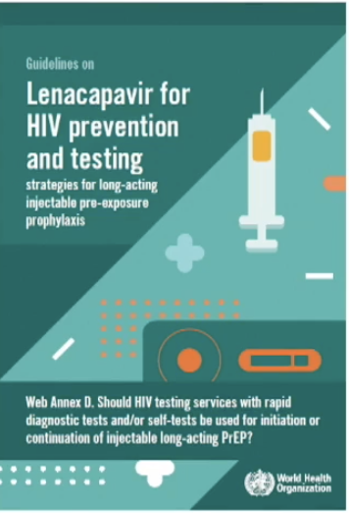
Evidence* on HIV RDTs for injectable LA-PrEP
HIV RDT supported injectable LA-PrEP compared to NAT and/or laboratory-based testing algorithms resulted in:
Faster turnaround time and more rapid ART initiation
Fewer delayed or missed injection visits
Similar negative predictive value and positive predictive value
No difference in absolute number of missed or delayed HIV infections detected or the detection of breakthrough infections
No difference in the prevention of INSTI resistance associated mutations
No difference in frequency of testing
No difference in clinical or social harm
High acceptability and feasibility
Substantial cost-savings
To detect 1 additional HIV case, missed by a rapid test, using NAT requires testing 5,305 people with estimated cost of $46,684 -
$451,456 per test*

Slide 64
CAB PrEP – breakthrough infections
In HPTN083, observation 34 HIV infections : 4 at study enrolment, 3 during the oral lead-in phase, 21 with delayed or no recent CAB administration, only 6 considered as probable « pharmacological failures »: on-time CAB injections
LEVI syndrome in some cases: Long-acting Early Viral Inhibition with HIV viral suppression and delayed/diminished antibody expression persisting for months, even after CAB-LA injections are discontinued
Testing with a sensitive VL assay (lower limit of detection of 30 c/mL) detected most infections before INSTI resistance emerged
Markinze MA. Antimicrob Agents Chemother 2023; 67: e0005323

Slide 65
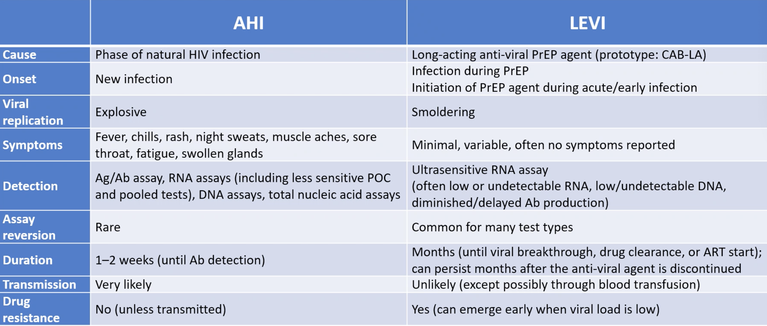
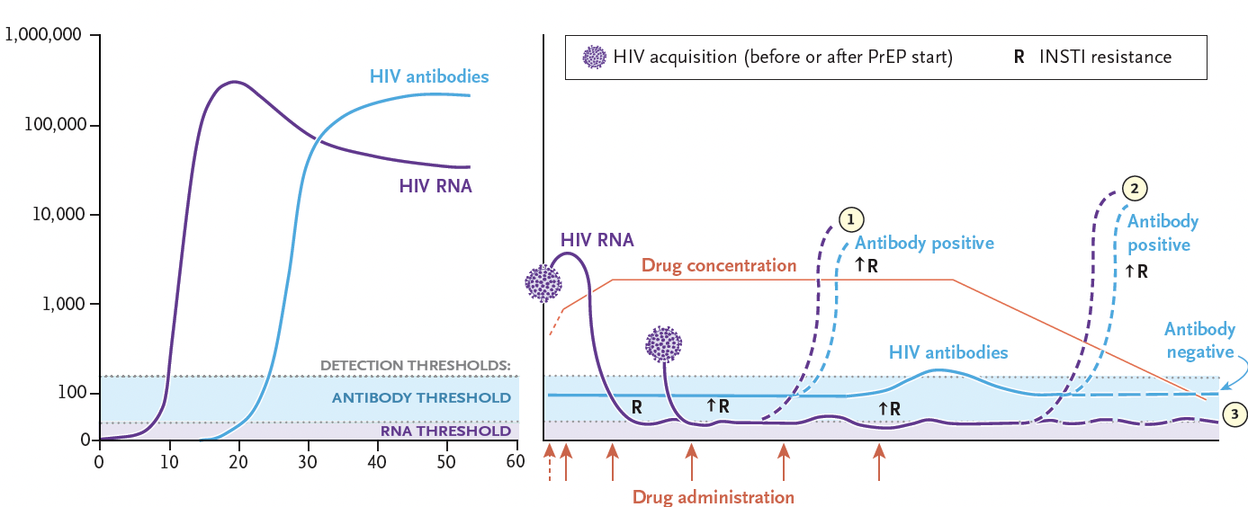
Classic Acute HIV Infection
LEVI
HIV RNA (c/mL)
Days
Months
Landovitz RJ. NEJM 2024; 391:1253-6

Slide 66
bNABs (CAP256V2LS + VRC07-523LS) to prevent breastmilk HIV transmission
CAP256V2LS = bNAb targeting the V1V2 Glycan Region of gp120
VRC07.523LS = bNAb targeting the CD4 binding site of gp120
Proof-of concept study of the 2 bNAbs administered sc in breastfeeding HIV exposed neonates, born without HIV and receiving standard of care HIV
Combined bNAbs at dose of 60 and 90 mg before 96 hours of birth (N = 8)
Combined bNAbs at birth and 120/120 mg at 3 months (to cover breastfeeding period) (N = 8)
Good local tolerability: 13/48 participants had reactogenicities, all of grade 1
PK: Cmax levels lower than in adults and half-life shorter
Potential protective concentration achieved 10-15 weeks post injection, Repeat doe at W12 to achieve the potential target of efficacy
No children became HIV infected
Advantages of the approach: small sc dose, easily integrated into routine child care
Potential rescue to protect infants of mothers with recent HIV acquisition
Many remaining challenges: How many bNAbs needed ? What is the target efficacy concentration for breastmilk transmission ? Cost ?
Scarlatti G, IAS 2025, Abs. OAB0306LB

Slide 67
New LA in PrEP
Oral MK-8527 qm
IM LEN once-yearly

Slide 68
MK-8527 oral QM for PrEP: phase 2
MK-8527: new oral nucleoside reverse transcriptase translocation inhibitor
Phase 2 RCT in adults with low risk of HIV exposure
Randomisation 2:2:2:1 oral QM MK-8527 (3 mg, 6 mg or 12 mg) or placebo for 6 months
MK-8527 plasma concentration (µmol/L)
MK-8527-TP in PBMCs (pmol/10⁶ cells)
MK-8527 3 mg QM (N = 101)
10
1.000
MK-8527 6 mg QM (N = 101)
MK-8527 12 mg QM (N = 99)
0.100
1
0.010
0.1
LLOQ = 0.00324 µmol
PK efficacy threshold = 0.03 pmol/10⁻⁶ cells
0.001
0.01
0
4
8
12
16
20
24
0
4
8
12
16
20
24
0
84
168
252
336
420
504
588
672
0
3.5
7
10.5
14
21
28
35
42
Hours after first dose (D1)
Hours after last dose (W20)
Hours after first dose (D1)
Days after last dose (W20)
Good tolerability, safety profile similar to placebo, No decrease in lymphocyte and/or CD4 counts
Mayer K, IAS 2025, Abs. OAS0106LB

Slide 69
Oral MK-8527 QM for PrEP
Phases 3: ongoing enrolment (EXPrESSIVE-10 et EXPrESSIVE-11)
EXPrESSIVE-10: randomized, active-controlled study enrolling 4580 sexually active women aged 16 to 30 in Kenya, South Africa, and Uganda: 11 mg QM oral MK-8527 vs QD TDF/FTC
EXPrESSIVE-11: randomized, active-controlled study enrolling 4390 sexually active people at greater likelihood of HIV-1 exposure in 16 countries: 11 mg QM oral MK-8527 vs QD TDF/FTC

Slide 70
LEN IM once-yearly
Phase 1, open-label study in participants aged 18–55 years without HIV
PK, safety, and tolerability of 2 LEN free acid formulations administered by 2 ventrogluteal IM injection as a single 5,000 mg dose (formulation 1 with 5% w/w ethanol, formulation 2 with 10% w/w ethanol)
Median (IQR) LEN plasma concentration (ng/mL)
1000
1000
100
100
10
10
In vitro paEC₉₅
In vitro paEC₉₅
1
Once-yearly intramuscular lenacapavir : formulation 1 (N = 20)
1
Once-yearly intramuscular lenacapavir : formulation 2 (N = 20)
Twice-yearly subcutaneous lenacapavir (historical-PURPOSE)
Twice-yearly subcutaneous lenacapavir ((historical-PURPOSE)
0
4
8
12
16
20
24
28
32
36
40
44
48
52
56
0
4
8
12
16
20
24
28
32
36
40
44
48
52
56
Time post-dose (weeks)
Time post-dose (weeks)
Injection-site pain: 16 (80%) participants given formulation 1, 15 (75%) given formulation 2, which was generally mild, resolved within 1 week, was substantially reduced by pretreatment with ice
Jogiraju V, CROI 2025, Abs. 154, and Lancet, published online 11 March 2025

Slide 71
im LEN Q12M for PrEP
Phase 3 study enrolling (NCT07047716)
300 subjects (3 sites in US) with an indication for PrEP
Single arm study to evaluate the pharmacokinetics, safety and tolerability of every 12 months 3000 mg IM LEN x 3 years

Slide 72
Innovation in PrEP products
Long-acting injectable (sc) CAB/MPA (medroxyprogestrone actate) Implant for prevention of HIV and Unintended Pregnancy: active plasma concentrations maintained for 180 days in mice with no PK tail at removal (King JL, Abs. 1236)
Injectable in-situ forming implant releasing CAB/MPA for prevention of HIV and contraception: complete suppression of ovulation in macaques + sustained plasma CAB levels for > 6 months, with short PK tail (Massud I, Abs.199)
Biodegradable implant in the arm releasing low-dose islatravir: 100% protection of macaques from rectal HIV infection – challenges done 7 weeks post implant (Kim JS, Abs. 1233)
Intravaginal rings of islatravir: active concentration > 90 days in macaques (Srinivasan P, Abs. 1238)

Slide 73
LA ARVs in the near future
The SOC for prevention: IM Q2M/Q4M (CAB), sc Q6M/ im Q12M (LEN), oral QM (MK-8527)
An alternative to QD STR
Meets patients’ expectations, improves QoL, satisfaction, etc.
Dual therapies will be the standard
Oral QW/QM
Injectable Q2M/Q4M/Q6M

Slide 74
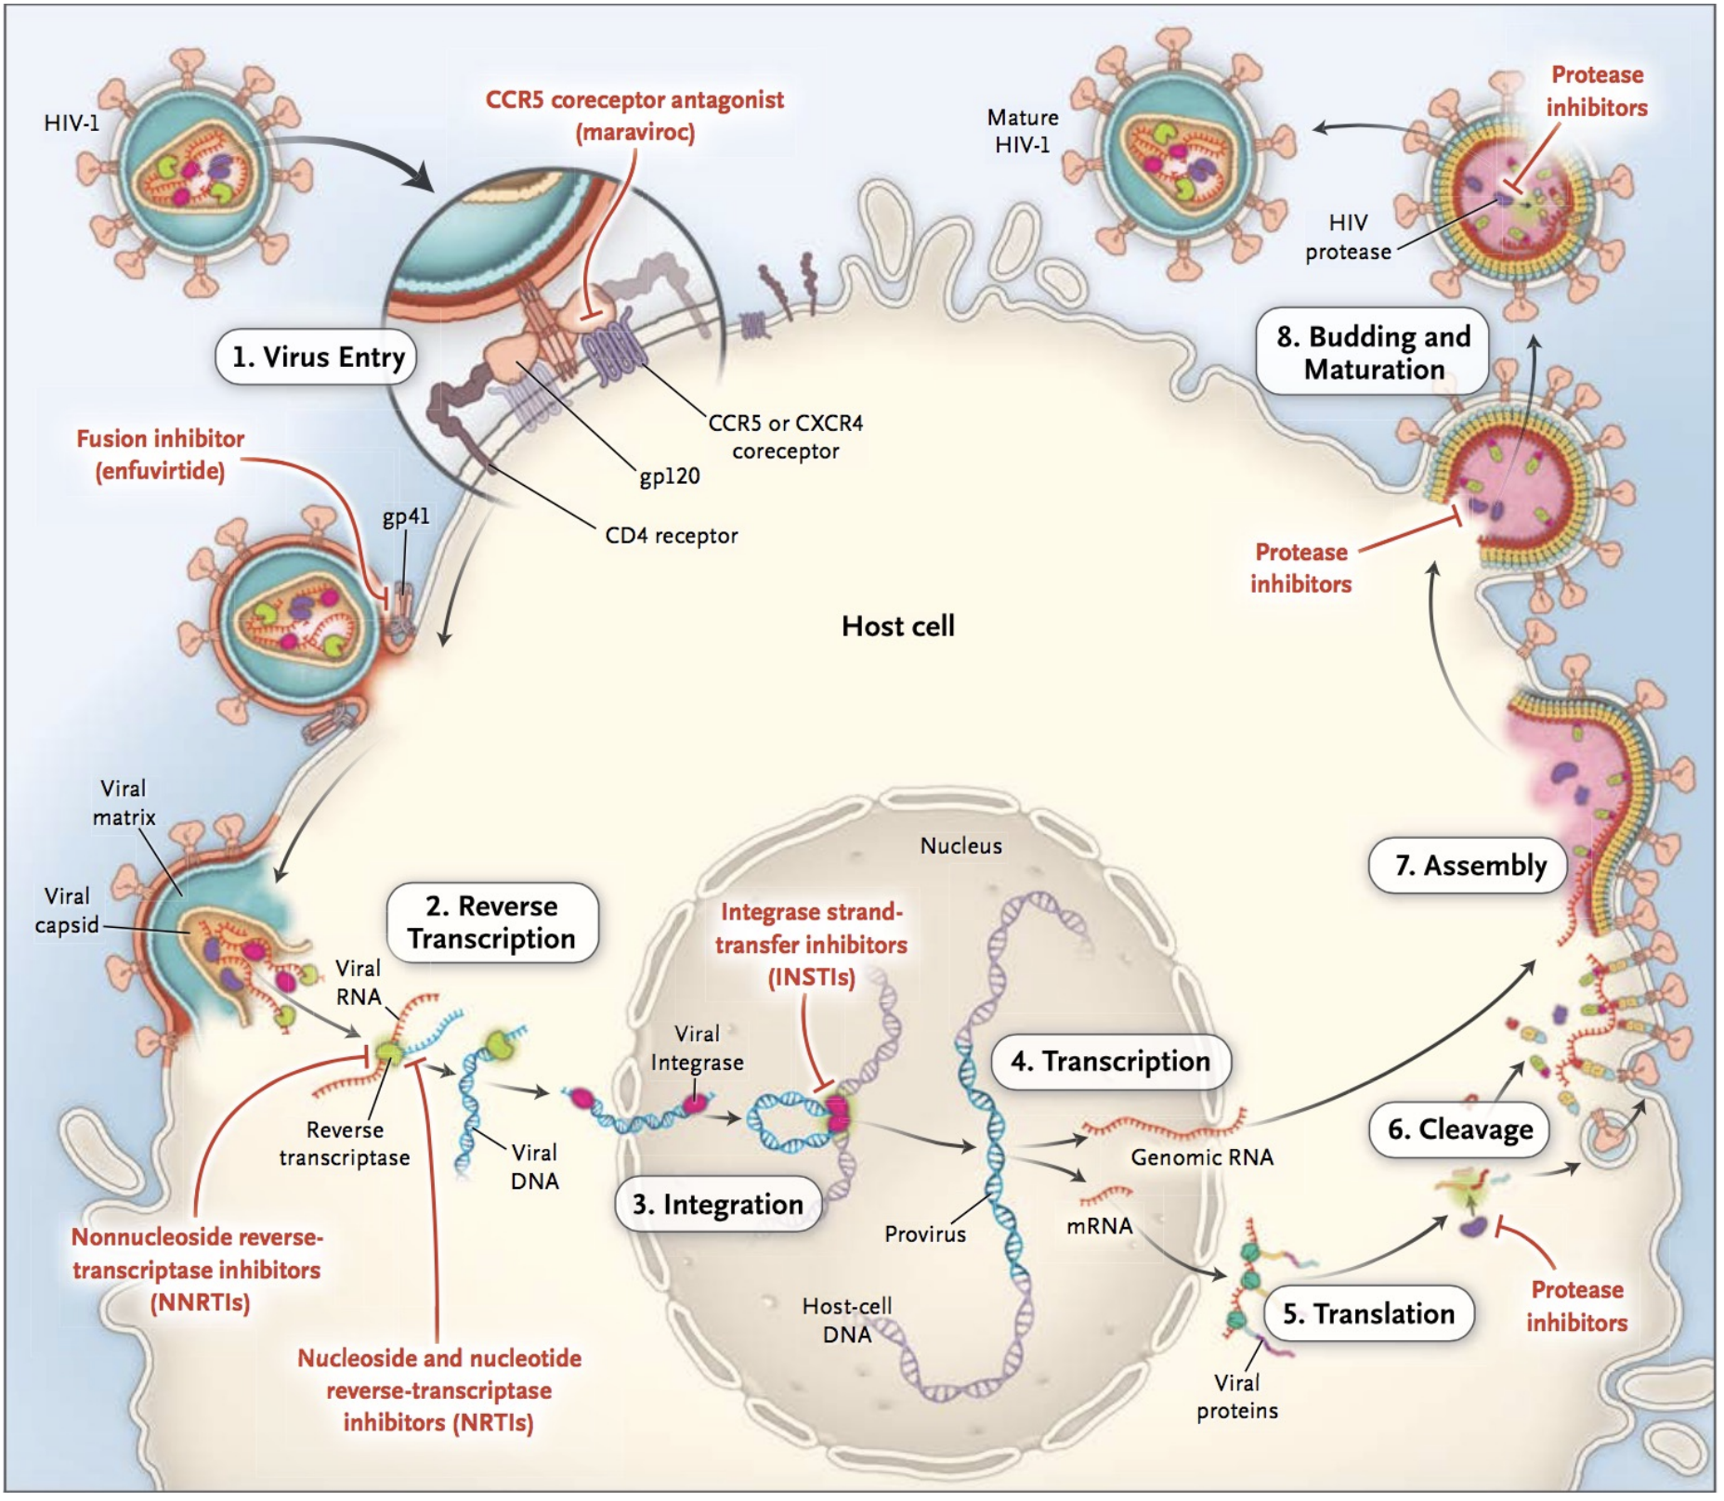
New Drugs and Formulations in Development (1)
Entry inhibitors
Ibalizumab – approved (only in US)
Fostemsavir -- approved
Broadly neutralizing Abs*
Maturation inhibitors
GSK3640254 —
discontinued
VH3739937
HRF-10071 - phase2
Capsid inhibitors
Lenacapavir -- approved
GS-4182 -- LEN prodrug (hold)
VH-499
Reverse Transcriptase Inh (RTI)
Nonnucleoside RTI (NNRTIs)
Ulonivirine (ULO ; MK-8507)*
Nucleoside RT translocation
Inhibitors (NRTTIs):
Islatravir (ISL)*, MK-8527*,
GS-1614 (ISL pro-drug)
Integrase strand transfer inhibitors (INSTI)
Ultra-long-acting CAB ;
VH-184 ; GS-1720 (hold)

Slide 75
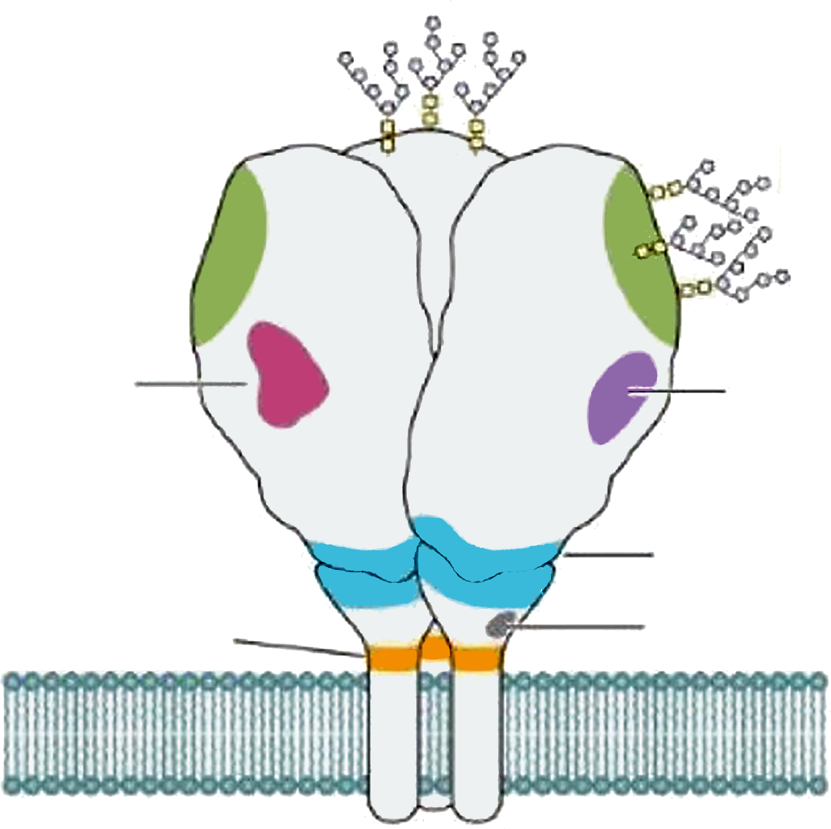
New Drugs and Formulations in Development (2)
Broadly neutralizing antibodies and binding sites on HIV gp120
CAP256V2LS
PGDM1400
PG9
CHO1
PG16
PGT145
V1/V2 glycan
PGT121
10-1074/10-1074LS
PGT125
PGT135
3BNC117/3BNC117LS
N6
VRC01 and VRC01LS
VRC07-523LS
CH235,12
N49P7
NIH45i
V3 glycan
CD4bS
gp120 silent face
SF12
VRC-PG05
gp120-40 interfaceface
8ANC195
PGT151
LN02
10E8
2F5
2G12
4E10
gp41 MPER
Fusion peptide
ACS202
VRC34.01
Adapted from Mahomed S. Clin Microbiol Rev 2024; 37:e0015222

Slide 76
Dose Interval of new ARVs in development
Q1W
Q1M
Q3M
Q4M
Q6M
Q12M
ISL + LEN
MK-8527*
GS1614
TAB/ZAB + LEN
VH-109 (N6LS) + CAB Q2M
LEN (IM) *
ISL + ULO
*PrEP
CAB/RPV ULA
*PrEP
GS1720 + GS4182 (hold)
Other LA investigational agents
VH-499: Capsid inhibitor
VH-184: 3rd generation INSTI
Other bNAbs
Implants
Ghandi R, IAS 2025, Abs. SY1605

